Slide 1
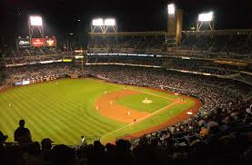
Baseball Nicknames
1950 All Star Game

Slide 2
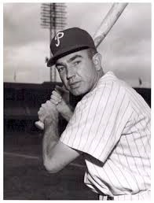
Willie Jones, 3B
Philadelphia Phillies

Slide 3
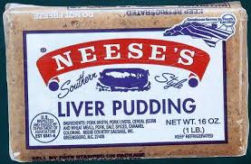
Willie Jones, 3B
Philadelphia Phillies
Puddin’ Head
Willie loved liver pudding and, reportedly, ate it before every game

Slide 4
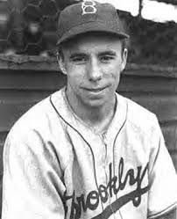
Harold Reese, SS
Brooklyn Dodgers

Slide 5
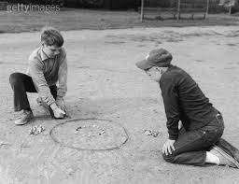
Pee Wee Reese, SS
Brooklyn Dodgers
Pee Wee
Even though he weighed only 120 lbs as senior in high school, his nickname was given because he was a champion marbles player

Slide 6
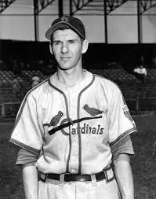
Marty Marion, SS
St. Louis Cardinals

Slide 7
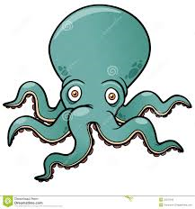
Marty Marion, SS
St. Louis Cardinals
The Octopus
Slats
He was very tall (6'2") and thin for a SS, with long arms that looked like "tentacles"

Slide 8
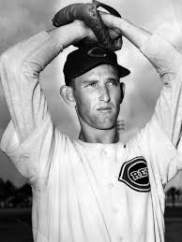
Ewell Blackwell, P
Cincinnati Reds

Slide 9
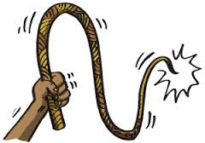
Ewell Blackwell, P
Cincinnati Reds
The Whip
He pitched with a sidearm, snap delivery

Slide 10
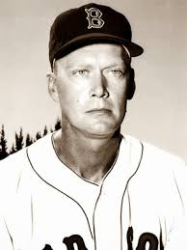
Walter Arthur Evers, 3B
Detroit Tigers

Slide 11
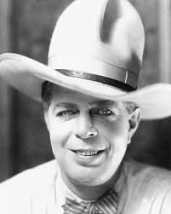
Hoot Evers, 3B
Detroit Tigers
Hoot
As a kid, he loved western movie star Hoot Gibson

Slide 12
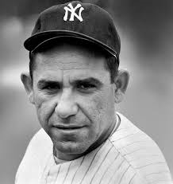
Lawrence Peter Berra, C
New York Yankees

Slide 13
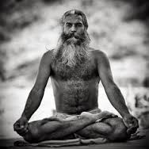
Yogi Berra, C
New York Yankees
Yogi
A childhood friend said he looked like a "Hindu yogi" as he sat waiting for his next at bat (with arms and legs crossed)

Slide 14
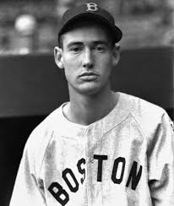
Ted Williams, LF
Boston Red Sox

Slide 15
Ted Williams, LF
Boston Red Sox
The Splendid Splinter
Teddy Ballgame
The Kid
Thumper

Slide 16
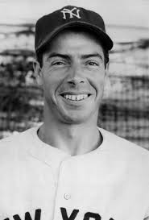
Joe DiMaggio, RF
New York Yankees

Slide 17
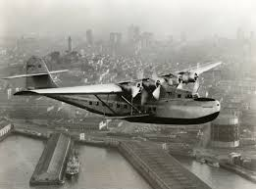
Joe DiMaggio, RF
New York Yankees
The Yankee Clipper
Joltin’ Joe
Yankee Stadium announcer, Arch McDonald, compared his range and speed to the new Pan American airliner

Slide 18
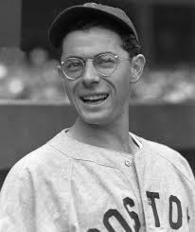
Dom DiMaggio, LF
Boston Red Sox

Slide 19
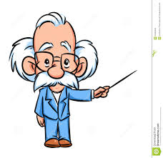
Dom DiMaggio, LF
Boston Red Sox
The Little Professor
He was small (5'9") and wore eyeglasses

Slide 20
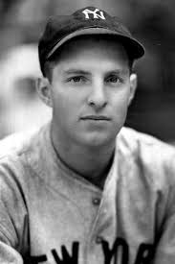
Tommy Henrich, PH
New York Yankees

Slide 21
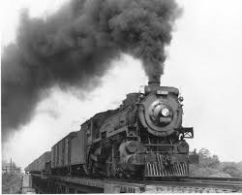
Tommy Henrich, PH
New York Yankees
Old Reliable
Yankee announcer, Mel Allen, nicknamed him after a train that ran from Ohio to Alabama because he was always "getting a hit just when it was needed"

Slide 22
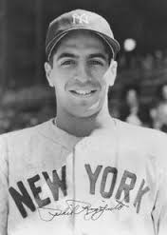
Phil Rizzuto, SS
New York Yankees

Slide 23
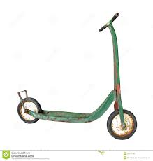
Phil Rizzuto, SS
New York Yankees
The Scooter
Quick footed, very smooth SS who would glide to catch ground balls

Slide 24
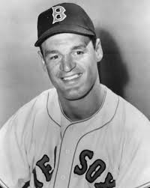
Walt Dropo, 1B
Boston Red Sox

Slide 25
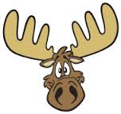
Walt Dropo, 1B
Boston Red Sox
Moose
He was from Moosup, CT - was 6’5” and weighed 220 lbs

Slide 26
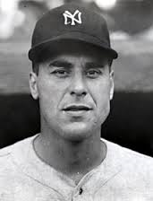
Vic Raschi, P
New York Yankees

Slide 27
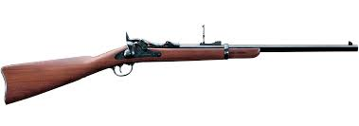
Vic Raschi, P
New York Yankees
The Springfield Rifle
He was from West Springfield, MA and threw the ball very hard

Slide 28
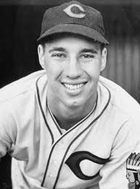
Bob Feller, P
Cleveland Indians

Slide 29
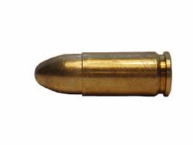
Bob Feller, P
Cleveland Indians
Bullet Bob
Rapid Robert
He reportedly threw his fastball 98.6 mph. Ted Williams called him the BEST and fastest pitcher he ever faced.

