Slide 1
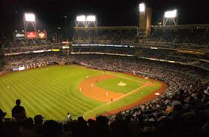
The Good Ole Days –
The 1950’s

Slide 2
Television

Slide 3
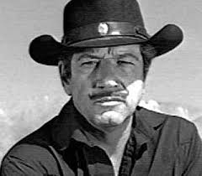
TV Show? Character’s Name?

Slide 4
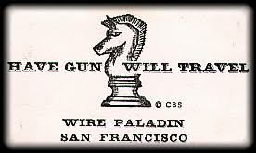
Richard Boone played a gunfighter named Paladin

Slide 5
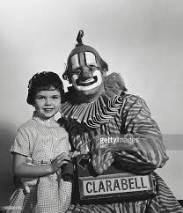
TV Show?

Slide 6
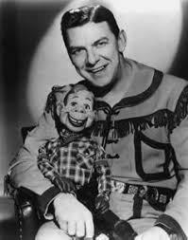
Howdy Doody Show! Who Played Clarabell?

Slide 7
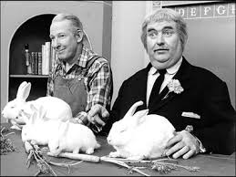
Bob Keeshan – Captain Kangaroo
Notes:
Who is the guy on the left?

Slide 8
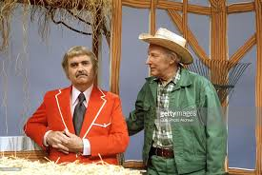
Mr. Green Jeans

Slide 9
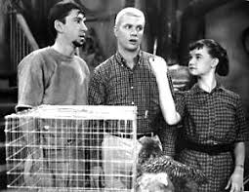
TV Show? Character’s Name (guy on the left)?

Slide 10
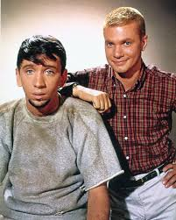
Maynard G. Krebs – Dobie Gillis Show
Actor’s name and what was his most famous role on TV?

Slide 11
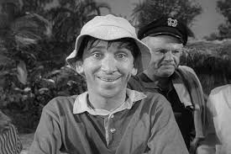
Bob Denver - Gilligan

Slide 12
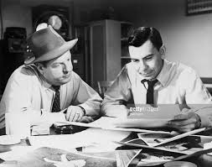
TV Show?

Slide 13
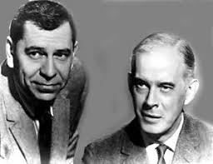
Dragnet - Character’s Name (guy on the right)?

Slide 14
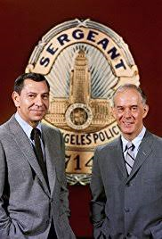
Sgt. Frank Smith– Dragnet
Actor’s name and what was his other famous role on TV?

Slide 15
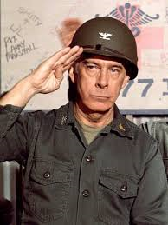
Harry Morgan/Colonel Potter – M*A*S*H

Slide 16
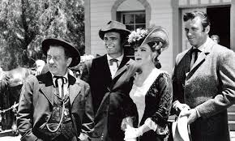
TV Show? Character’s Name (guy second from left)?

Slide 17
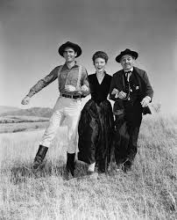
Chester – Gunsmoke
Actor’s name and what was his other famous role on TV?

Slide 18
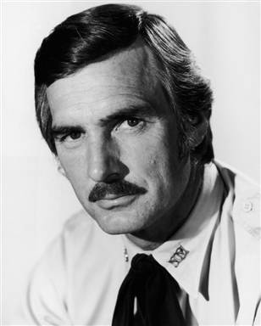
Dennis Weaver – McCloud

Slide 19
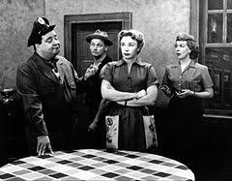
TV Show? Characters’ Names?

Slide 20
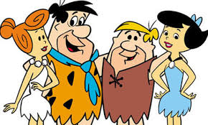
TV Show? Characters’ Names?

Slide 21
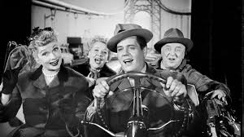
TV Show? Characters’ Names?

Slide 22
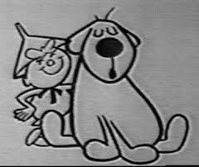
TV Show/Characters’ Names?

Slide 23
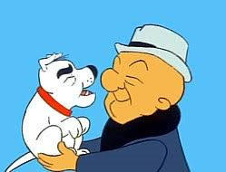
TV Show?

Slide 24
Toys

Slide 25
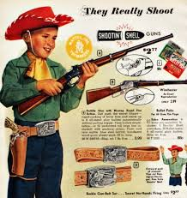
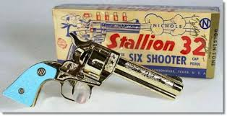
BB Guns and Cap Guns

Slide 26
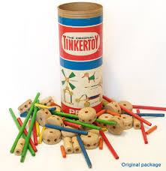
Tinker Toys

Slide 27
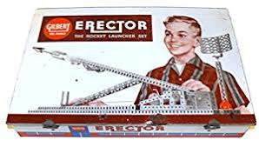
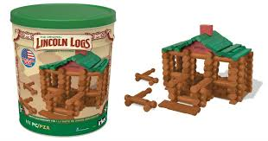
Erector Sets and Lincoln Logs

Slide 28
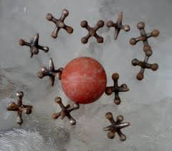
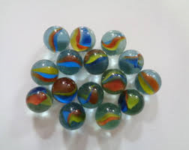
Jacks and Marbles

Slide 29
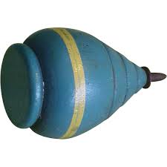
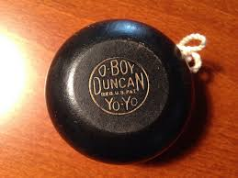
Tops and YoYo’s

Slide 30
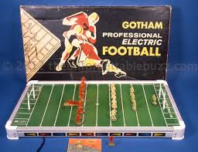
Electric Football Game

Slide 31
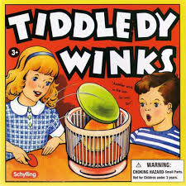
Tiddledy Winks

Slide 32
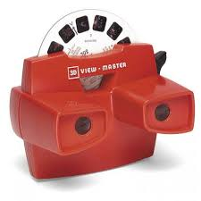
View Master

