Slide 1
Ballparks in Austin
A Brief History

Slide 2
Austin Senators at Riverside Park
Formed in 1888 - charter members of Texas league
Played games at Riverside Park
Final season was 1914

Slide 3
Clark Field 1928-1974

Slide 4
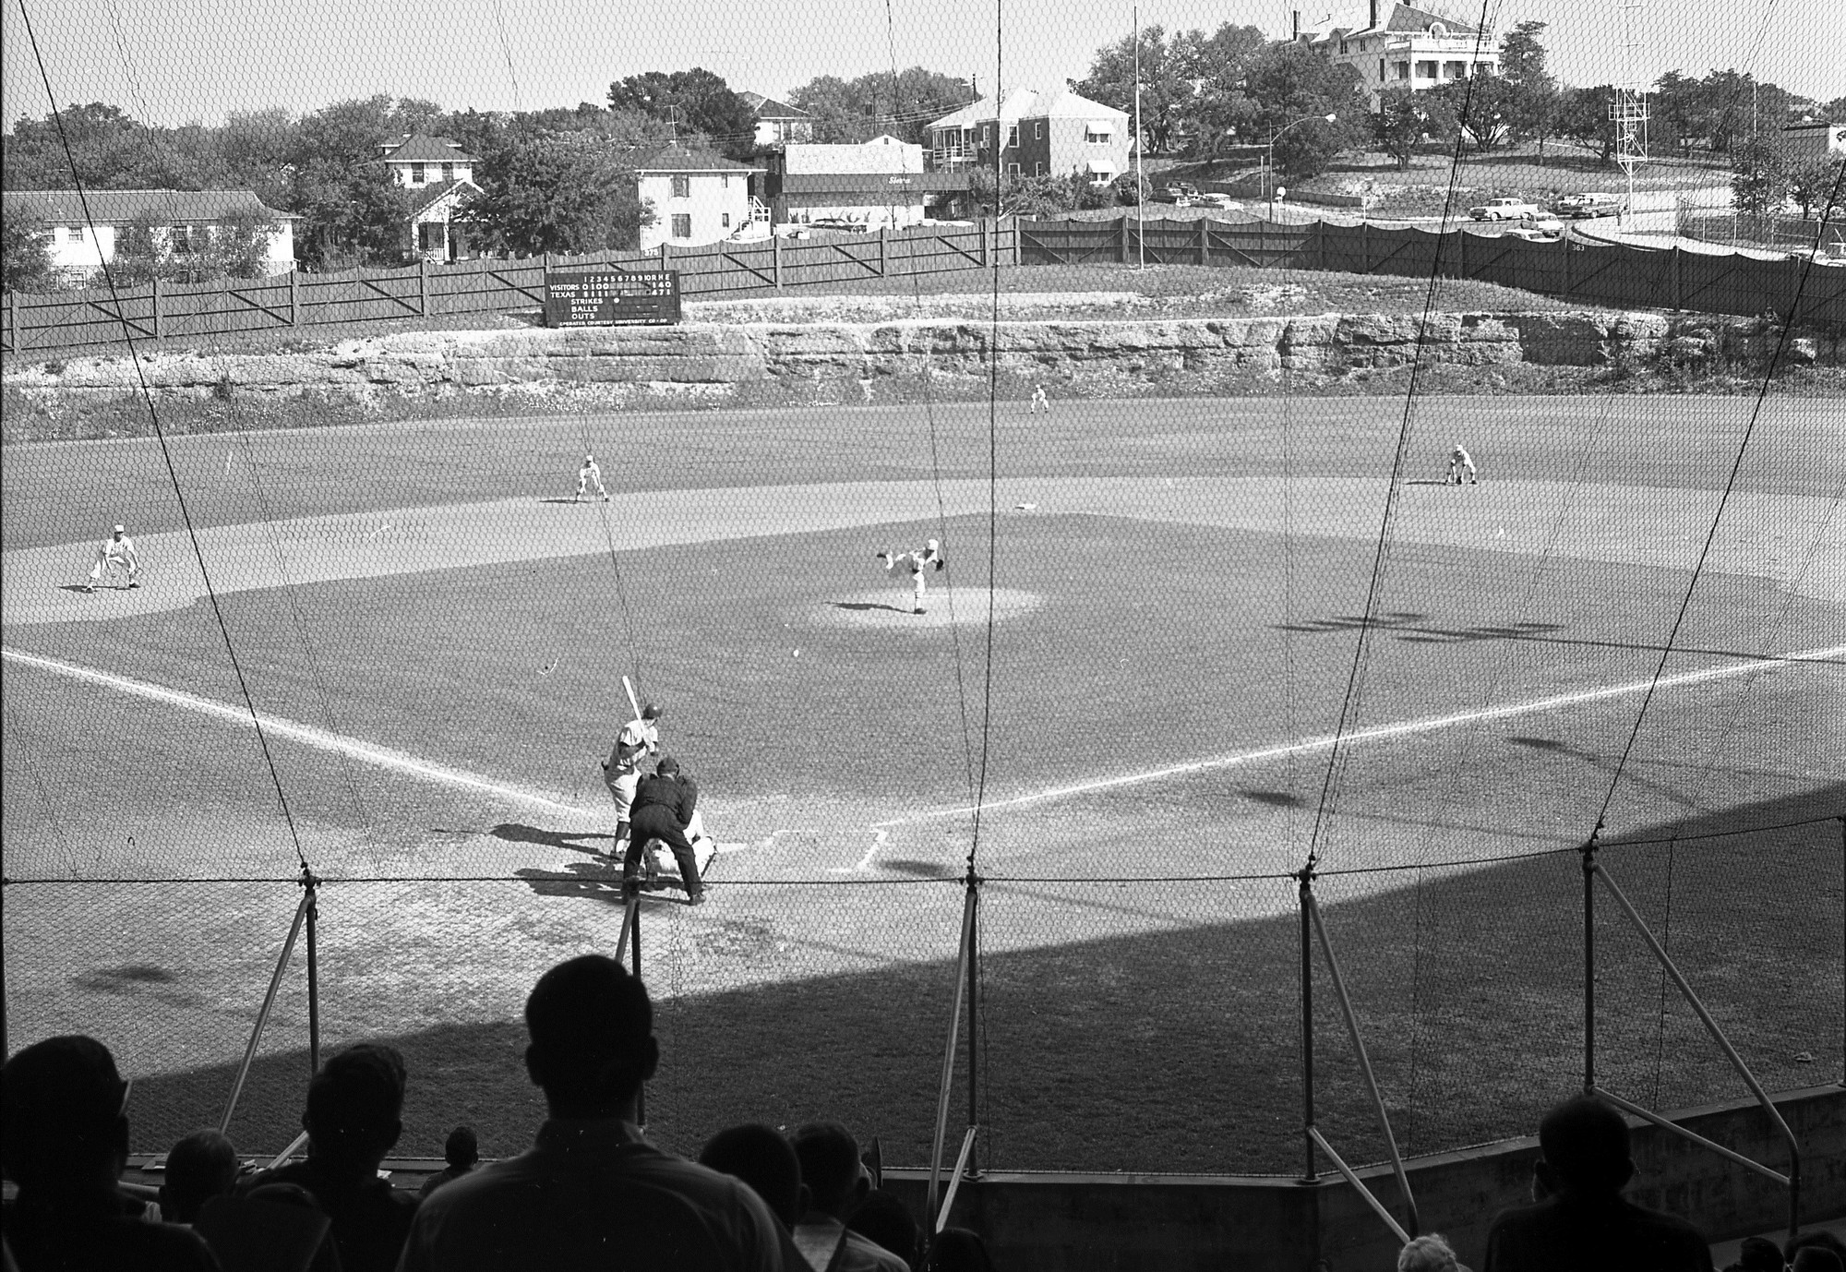

Slide 5
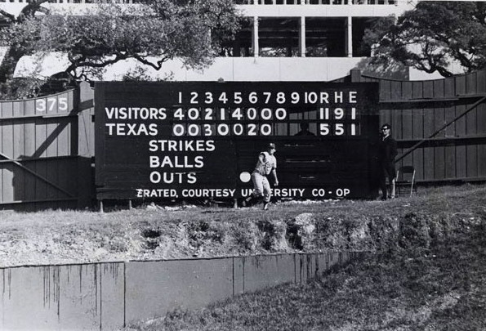

Slide 6
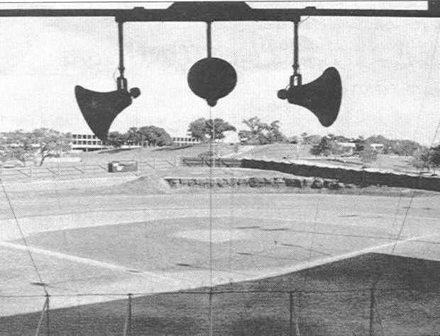

Slide 7
Disch Field 1947-1975
http://www.digitalballparks.com/Texas/AustinDisch.html

Slide 8
Disch-Falk Field 1975-present
Home of Univ. of Texas Longhorns
Won 4 National Championships at Disch Falk
1975, 1983, 2002, 2005

Slide 9
Longhorn Stars

Slide 10
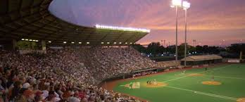
Disch-Falk Field

Slide 11
Dell Diamond Round Rock 2000-present
Home of the Round Rock Express

Slide 12
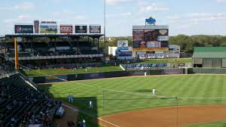

Slide 13
St. Edwards University Hilltoppers 43-10
2016 Heartland Conference Champions
2013 NCAA II – World Series, 3rd place

