Slide 1
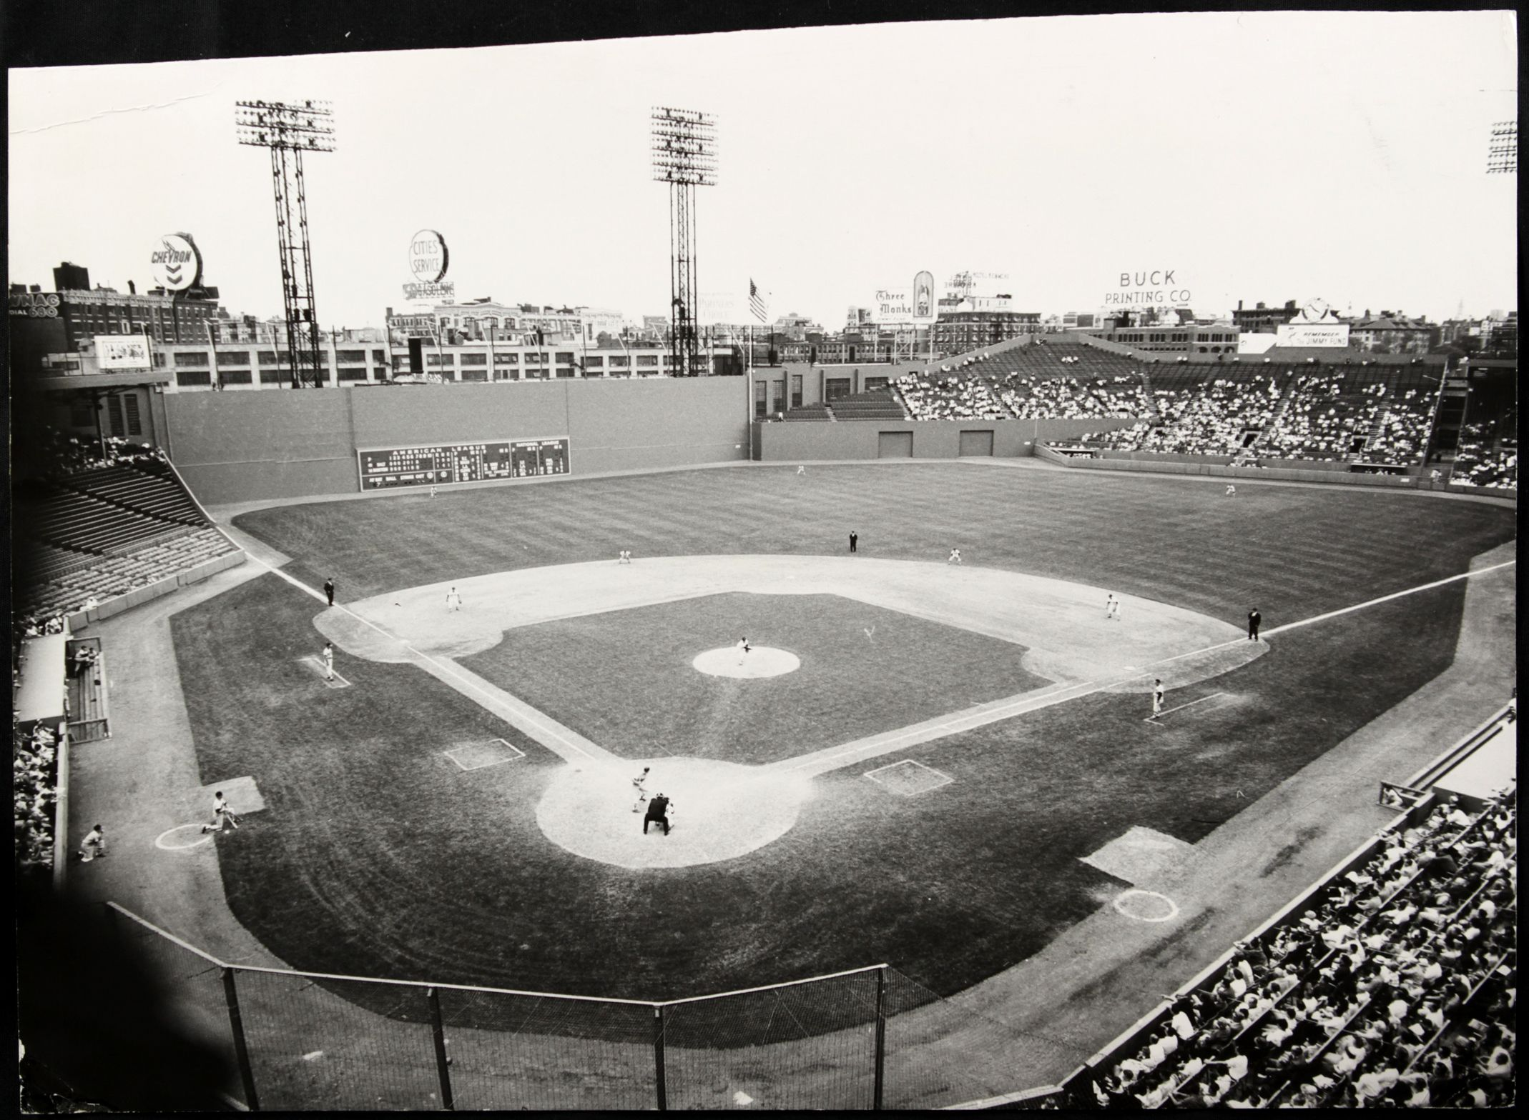
A Day at the Ballpark –
Food and Drink

Slide 2
“A Day at the Ballpark” Topics
Session 1-- Getting Ready for a Game (Mike)
Session 2-- Memorable Ballparks in Austin (Dan)
Session 3- Pregame Activities (Ira)
Session 4- Sights and Sounds at the Ballpark (Monte & Linda)
Session 5-- Food and Drink at the Ballpark (Bob and Jim)
Session 6– Keeping Score (Dan) … or …
Promotions, Contests & Give-aways

Slide 3
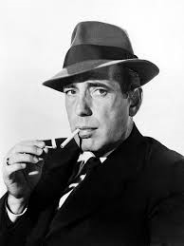
Ballpark Concessions
“A hotdog at the ballpark is better than a steak at the Ritz.”
- Humphrey Bogart

Slide 4
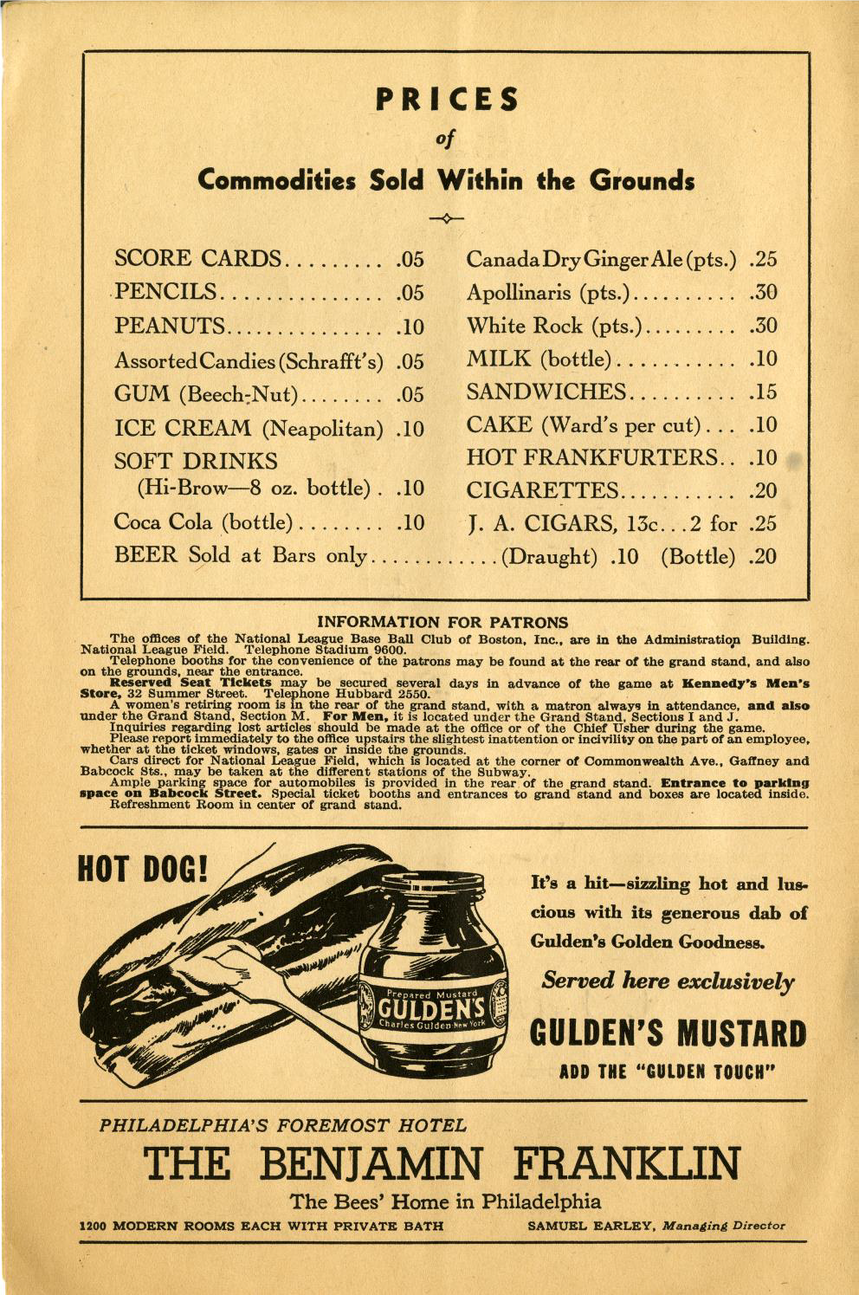
Boston Bees (Braves)
Braves Field
1938
1938 Beer - $0.10
2016 Beer (Fenway Park) - $7.75
Notes:
To try to boost fan interest in the team, the Boston Braves held a fan poll in 1936 and changed their name to the Boston Bees. They remained the Bess until 1941 when they went back to their original name and team colors. Apollinaria is a mineral water, now owned by Coca Cola.

Slide 5
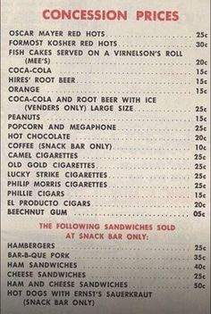
Philaldephia Athletics
Shibe Park
1950
1950 Hot Dog - $0.25
2016 Hot Dog (Fenway Park) - $5.25
Notes:
Prizes put in boxes in 1912. Since then, an estimate 23 billion prizes distributed. Cracker Jack helped make K-Rations during WWII and put them in the same wax boxes. In 1893, popcorn makers Frederick and Louis Rueckheim were determined to give the puffed kernels a new twist. The two brothers threw molasses and peanuts into the mix, and unveiled the sweet and salty treat at the 1893 World’s Fair in Chicago. A few years later, they developed a special formula to keep the ingredients from sticking together that remains a secret to this day.

Slide 6
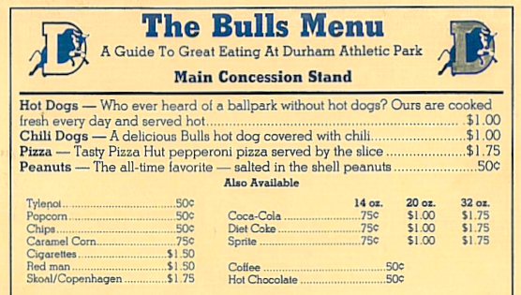
Durham Bulls
Durham Park
1951
A 2008 study asked “Which ballpark food can you not live without”:
63% said hot dogs
18% said peanuts
19% said either pizza, cotton candy and/or Cracker Jack
Notes:
Prices seem way too high for 1951. 1961? 1971? What ballpark food could you not live without?

Slide 7
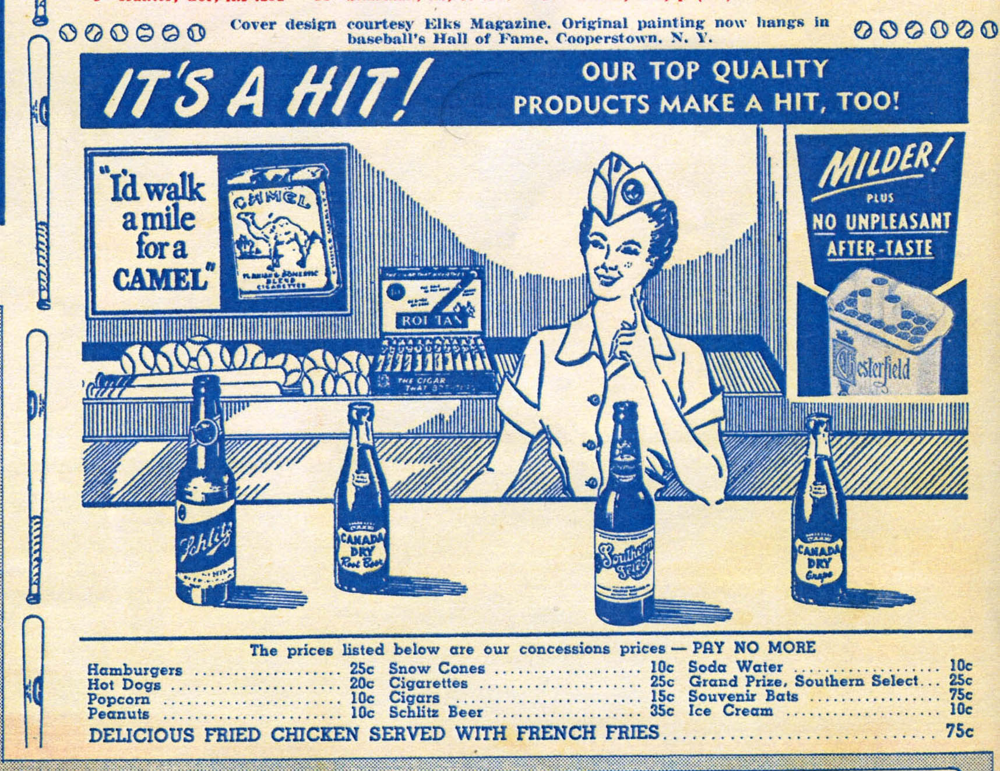
Houston Buffs
Buff Stadium
1951
An estimated 20,421,361 hot dogs were consumed at Major League ballparks in 2013
An average hot dog vendor walks 4-5 miles per game (up and down stairs) carrying his bin of hot dogs

Slide 8
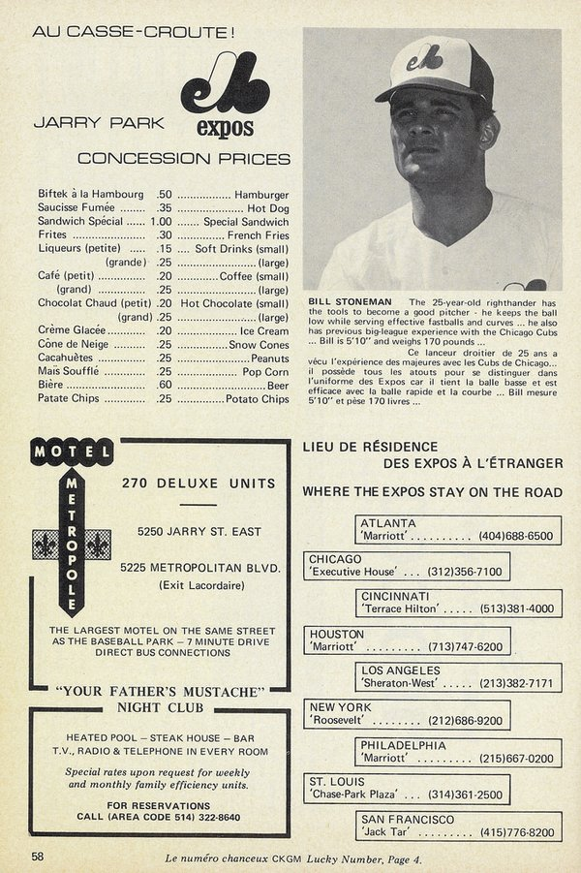
Montreal Expos
Jarry Park
1969
Sample Profit Margins on Ballpark food:
Nachos 47-64%
Hot dogs 62-81%
Pizza 69 – 75%
Large Pop Corn 88 – 92%
Snow Cones 92-97%
Soft drinks >90%

Slide 9
Times, and prices, have certainly changed!

Slide 10
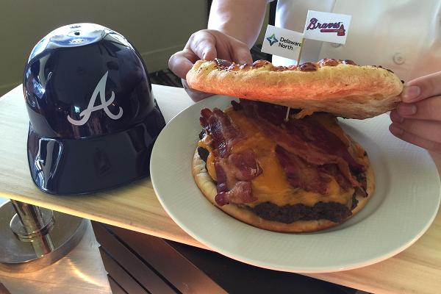
Atlanta Braves
Turner Field
2015
Burgerizza
A 20-ounce patty, five slices of cheddar with bacon, served between two 8-inch pepperoni pizzas
Cost $26 (cost of angioplasty not included)

Slide 11
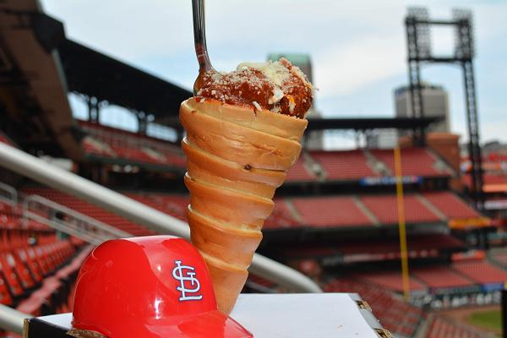
St. Louis Cardinals
Busch Stadium
2015
The Hill Meatball Cone
Four meatballs and marinara sauce, made custom in St. Louis' Italian neighborhood known as The Hill, served in an Italian bread cone and topped with shredded mozzarella and Parmesan cheese.
Cost $15

Slide 12
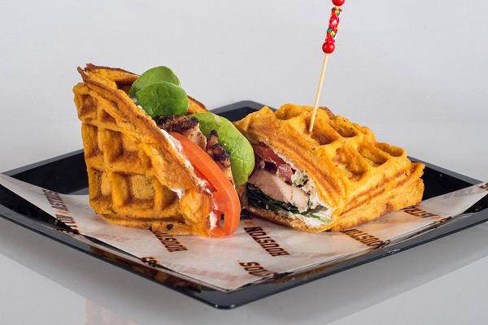
Houston Astros
Minute Maid Stadium
2015
Sweet Potato Waffle Chicken Sandwich
Homemade sweet potato waffle with grilled chicken breast, Greek yogurt, baby spinach and sliced tomatoes.
Cost $10
Korean Fried Pork Belly Sandwich also available

Slide 13
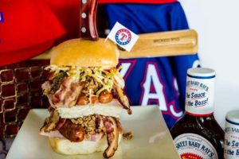
Texas Rangers
Globe Life Park
2016
Wicked Pig Sandwich
A combination of pulled pork, bacon, sausage, prosciutto, ham and pork rinds all stacked on a Hawaiian bun and doused in barbecue sauce and topped with coleslaw and pork rinds.
Cost $27

Slide 14
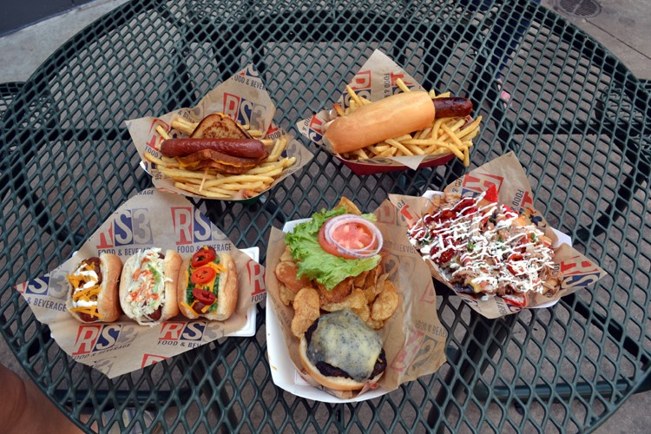
Round Rock Express
Dell Diamond
2015 (June 27th ?)
Hot dog wrapped in a grilled cheese sandwich
Kahuna Kolache (jumbo hot dog with sweet mango sauce)
Texas carnitas nachos
Black and Bleu burger
The Marilyn (a hot dog with neon nuclear relish, red jalapenos and shredded cheese)

