Slide 1
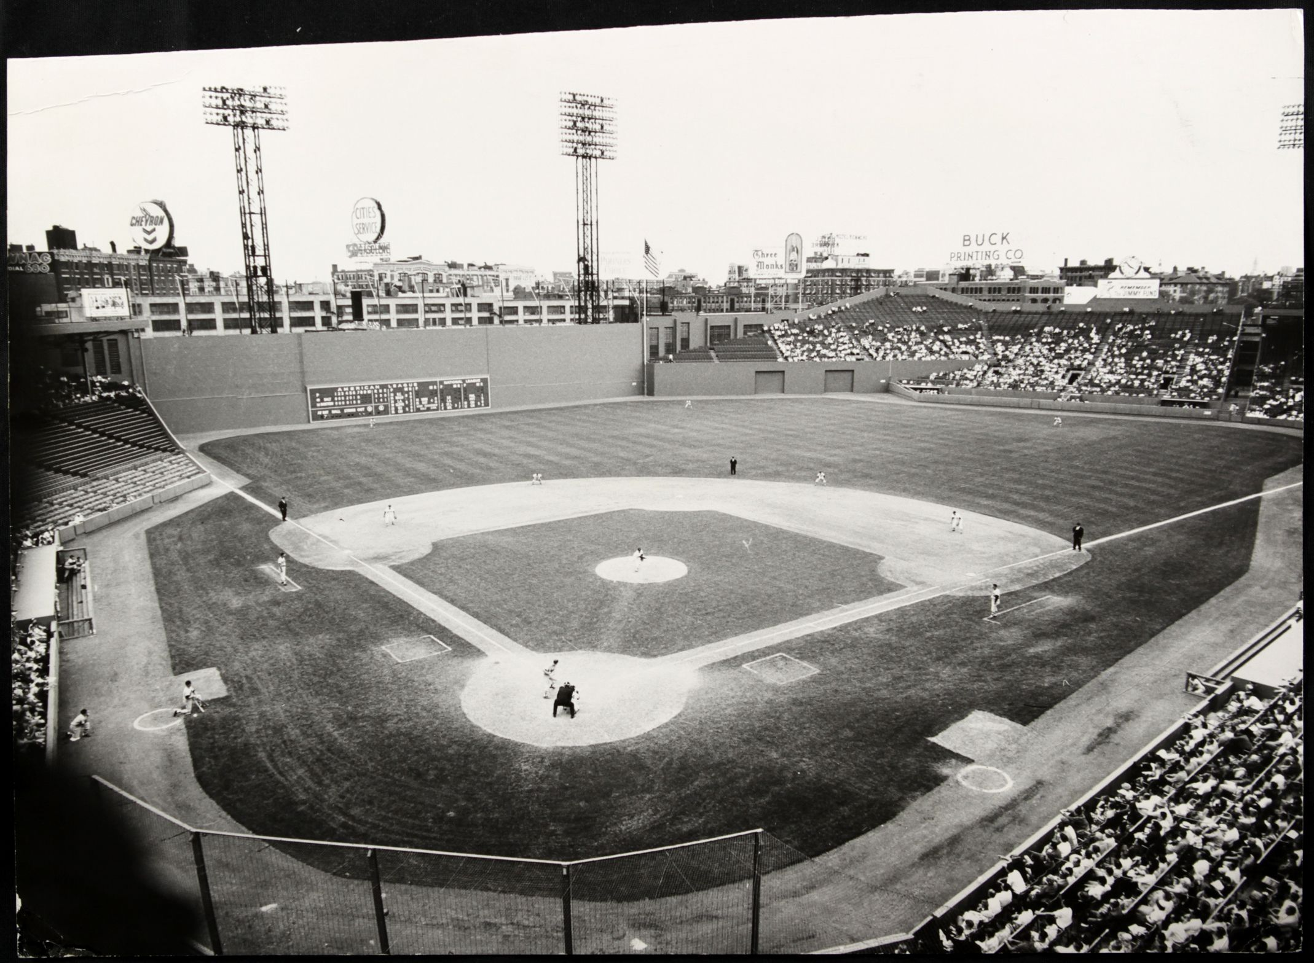
A Day at the Ballpark

Slide 2
“A Day at the Ballpark” Topics
Session 1-- Getting Ready for a Game (Mike)
Session 2-- Memorable Ballparks in Austin (Dan)
Session 3- Pregame Activities (Ira)
Session 4- Sights and Sounds in the Ballpark (Monte & Linda)
Session 5-- Food and Drink at the Ballpark (Bob and Jim)
Session 6– Promotions, Contests & Give-aways (Jim and Dan)

Slide 3
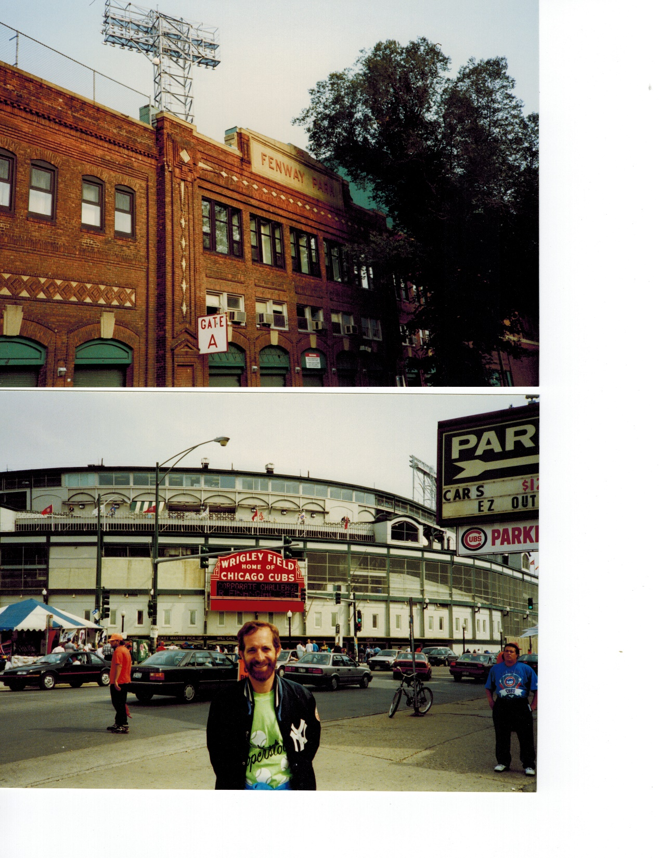
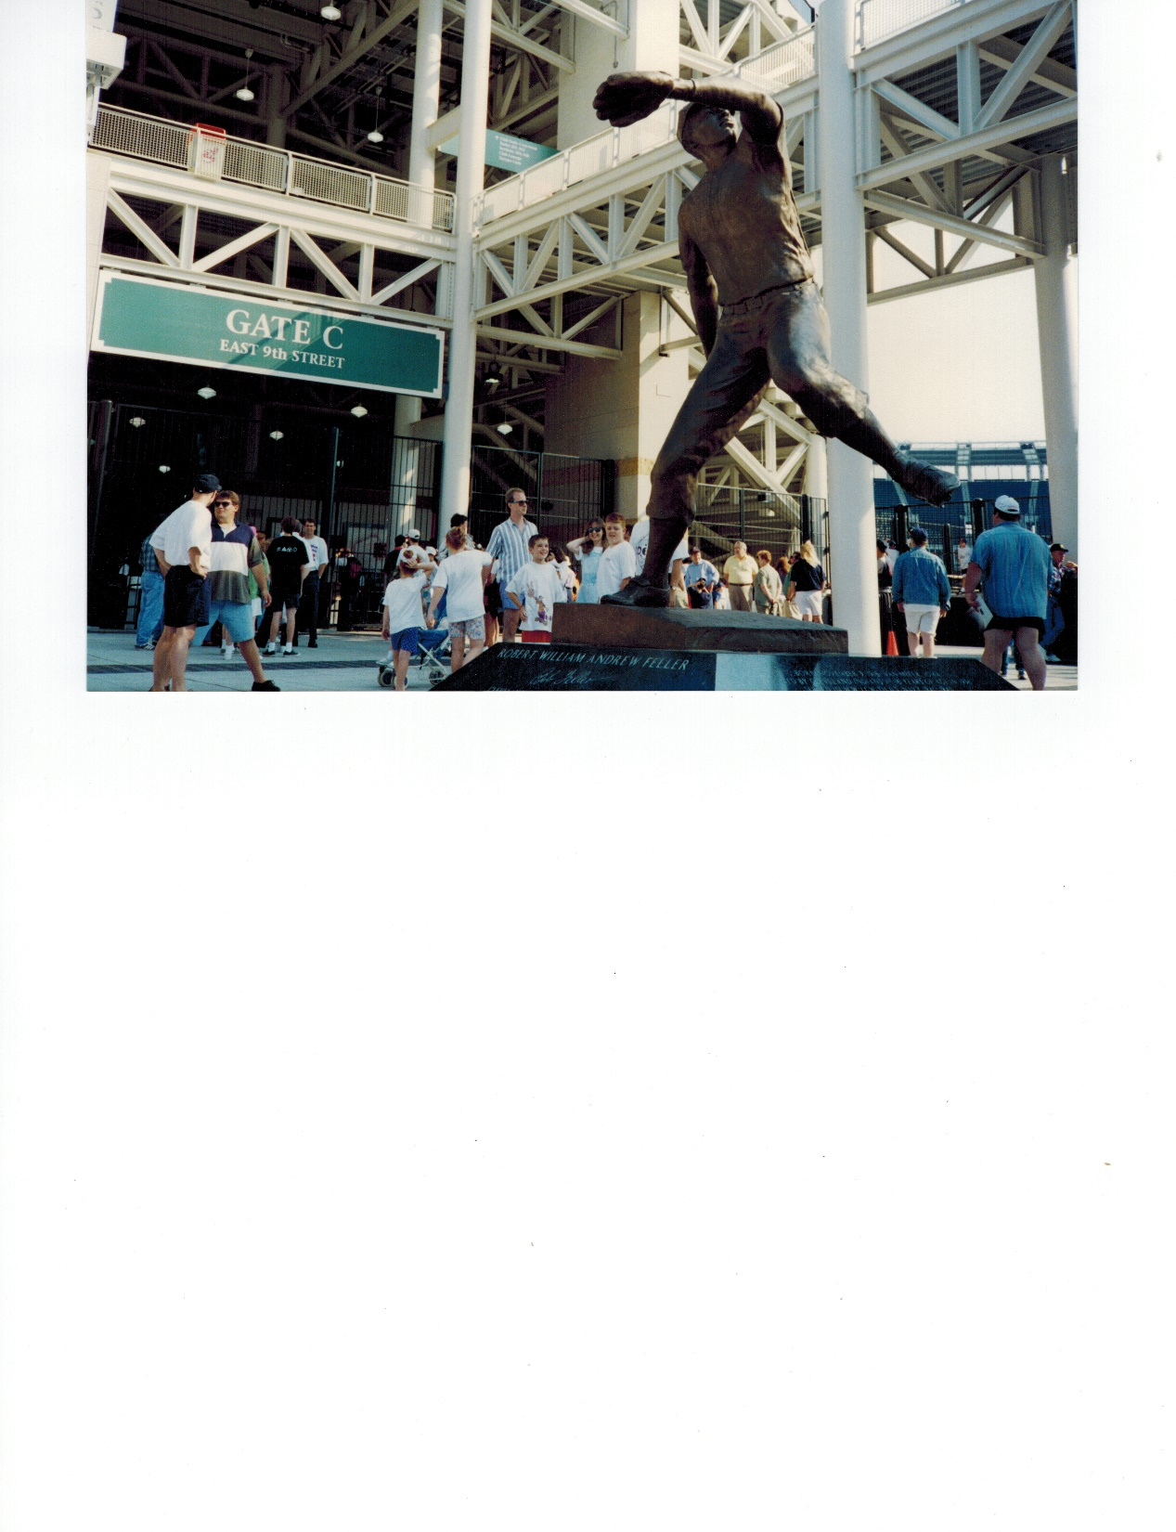
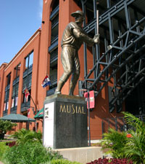
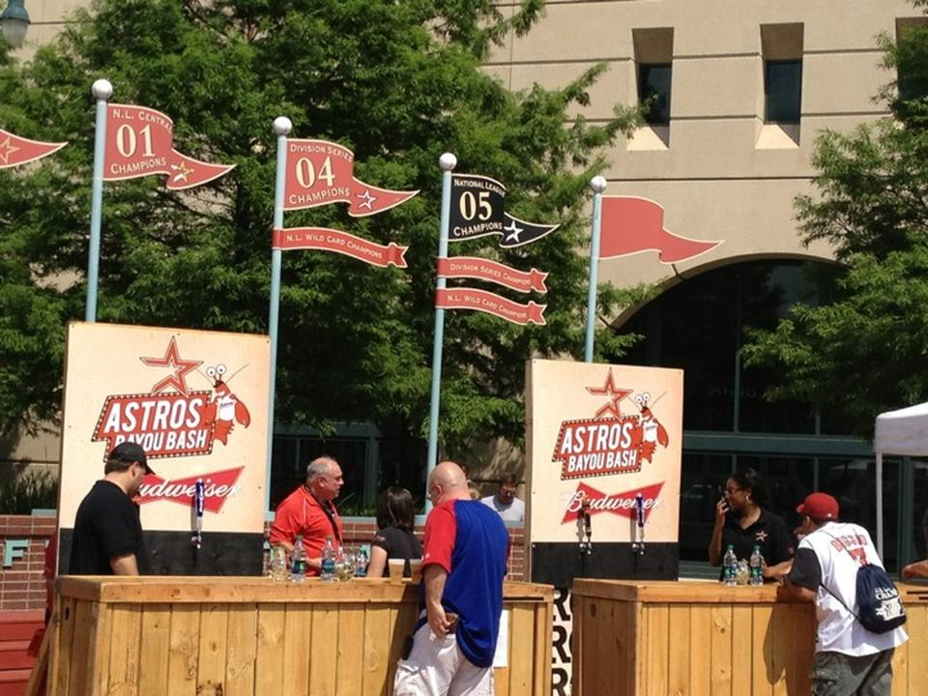
Pre-game
Activities
Get to the stadium early
Walk around the neighborhood
and outside the ballpark

Slide 4
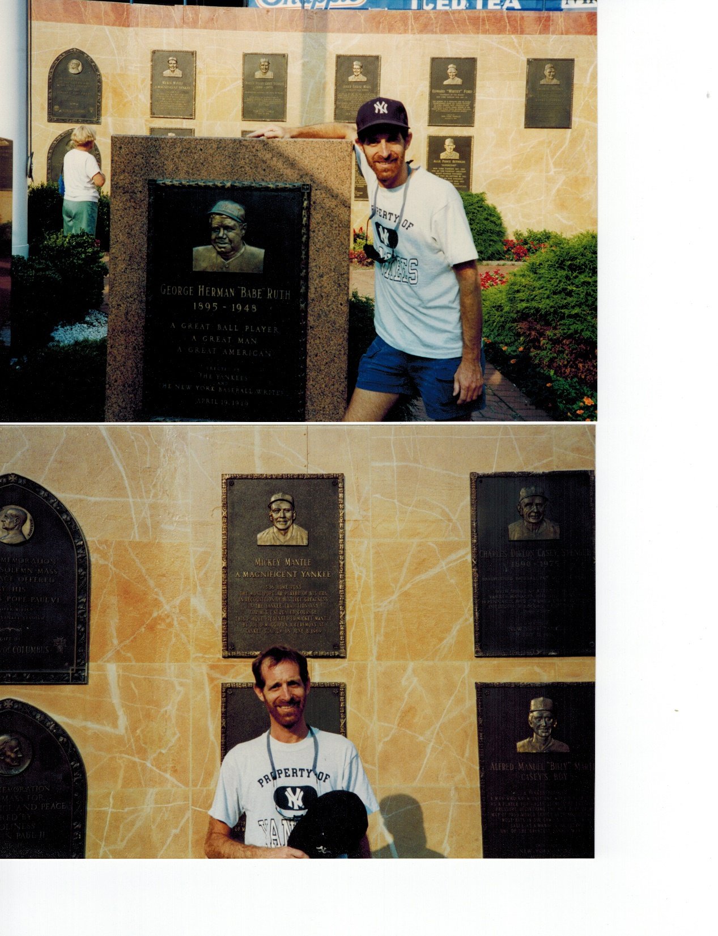
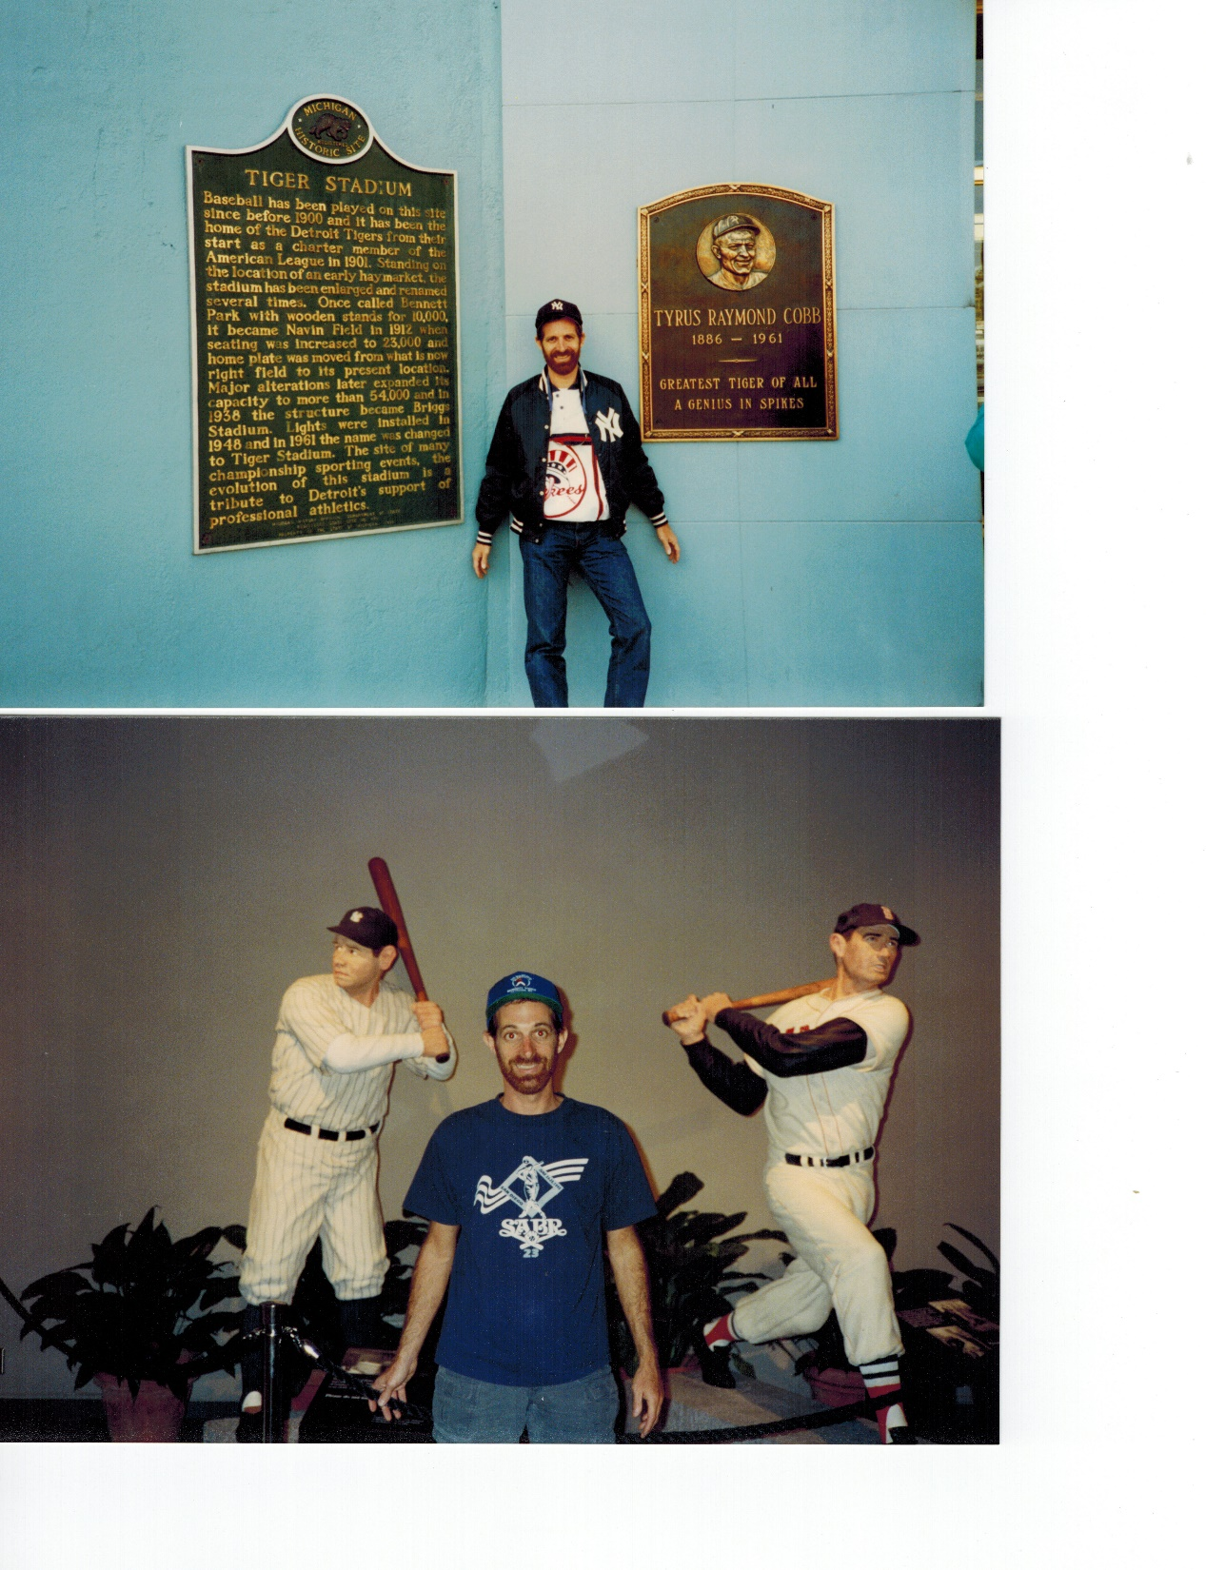
Pre-game
Activities
Enter early
Check out the sights inside
the stadium

Slide 5
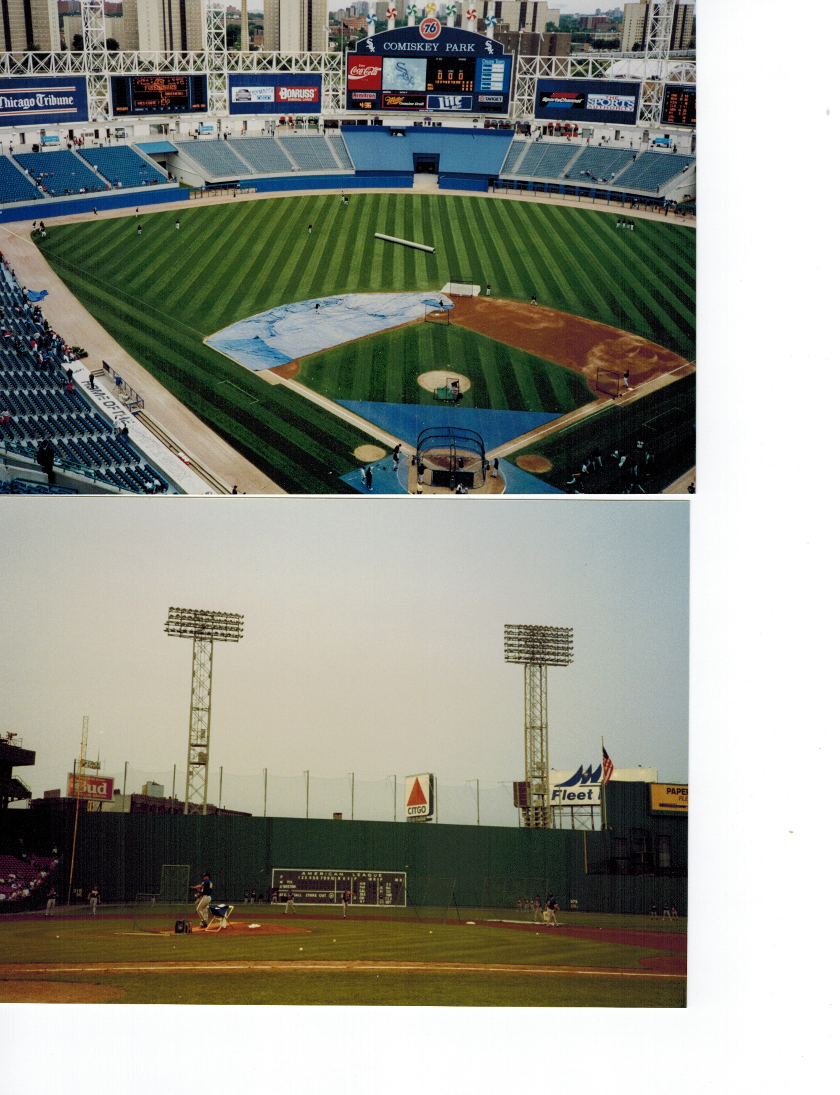
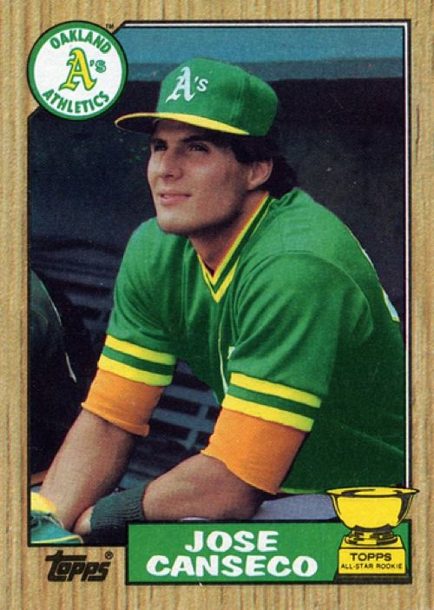
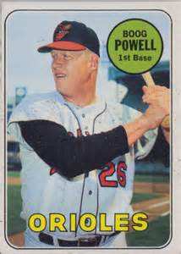
Pre-game
Activities
Batting Practice
Getting a Ball ?
Hit one to netting over
Monument Park
Hit one to my short RF porch seat

Slide 6
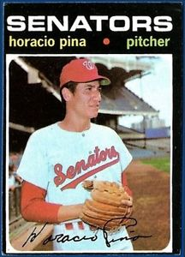
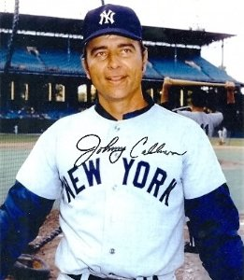
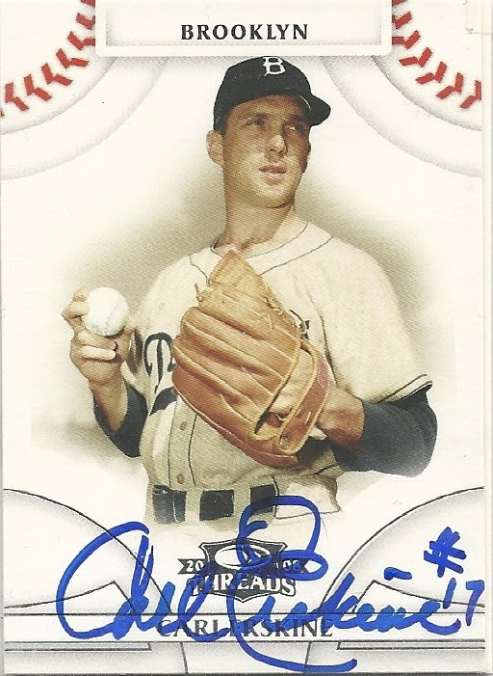
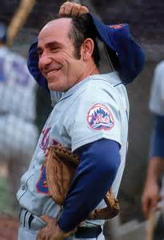
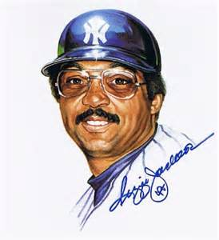
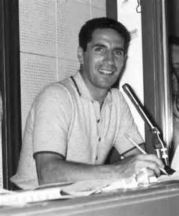
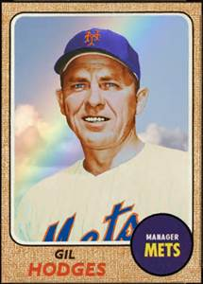
Pre-game
Activities
Get some autographs
On scorecard page
Sat near his
broadcast
booth
Both guys
on same piece
of paper
Running through Anaheim parking lot

Slide 7
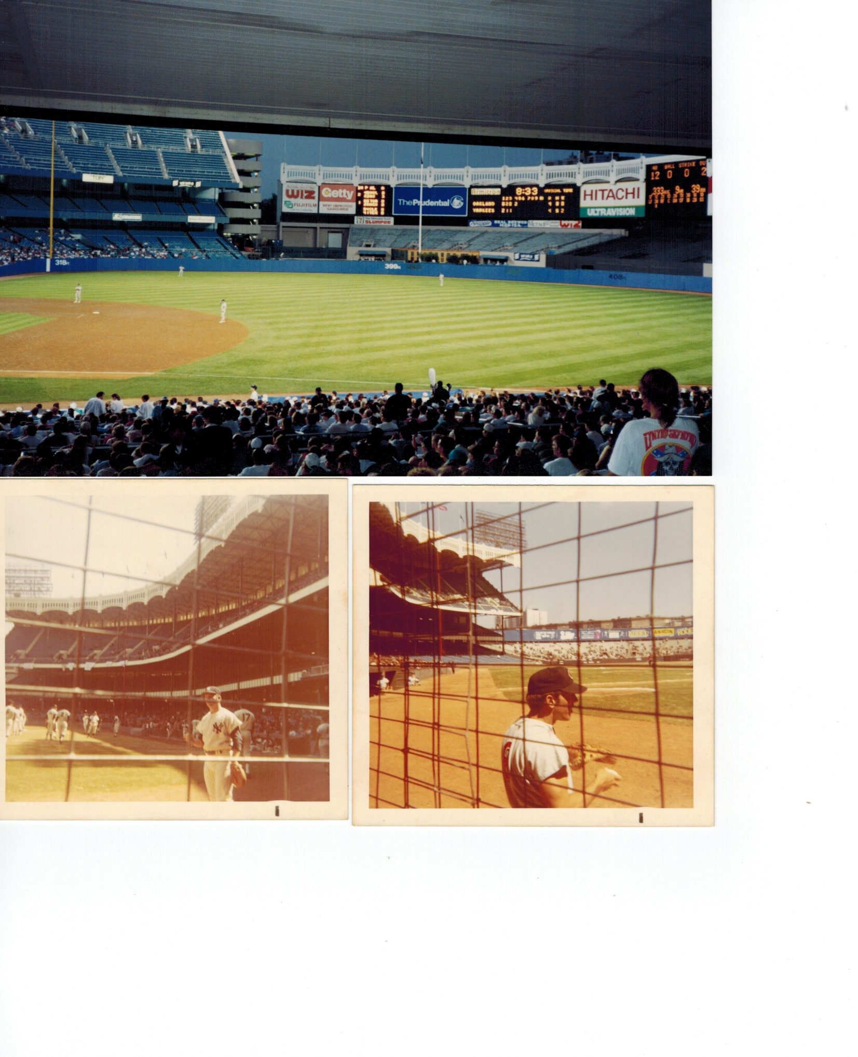
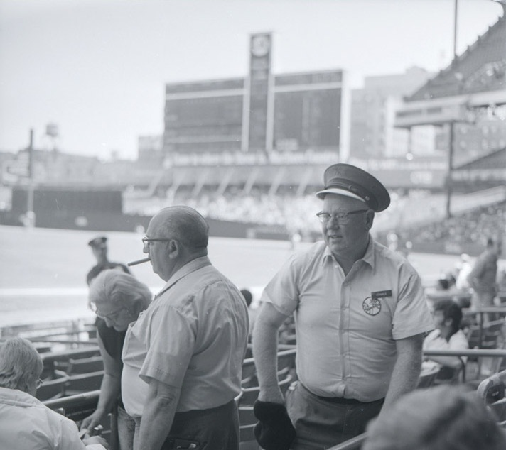
Grab some ‘dogs
and
get to our seats
Pre-game Activities
Negotiate with an usher
for better seats

