Slide 1
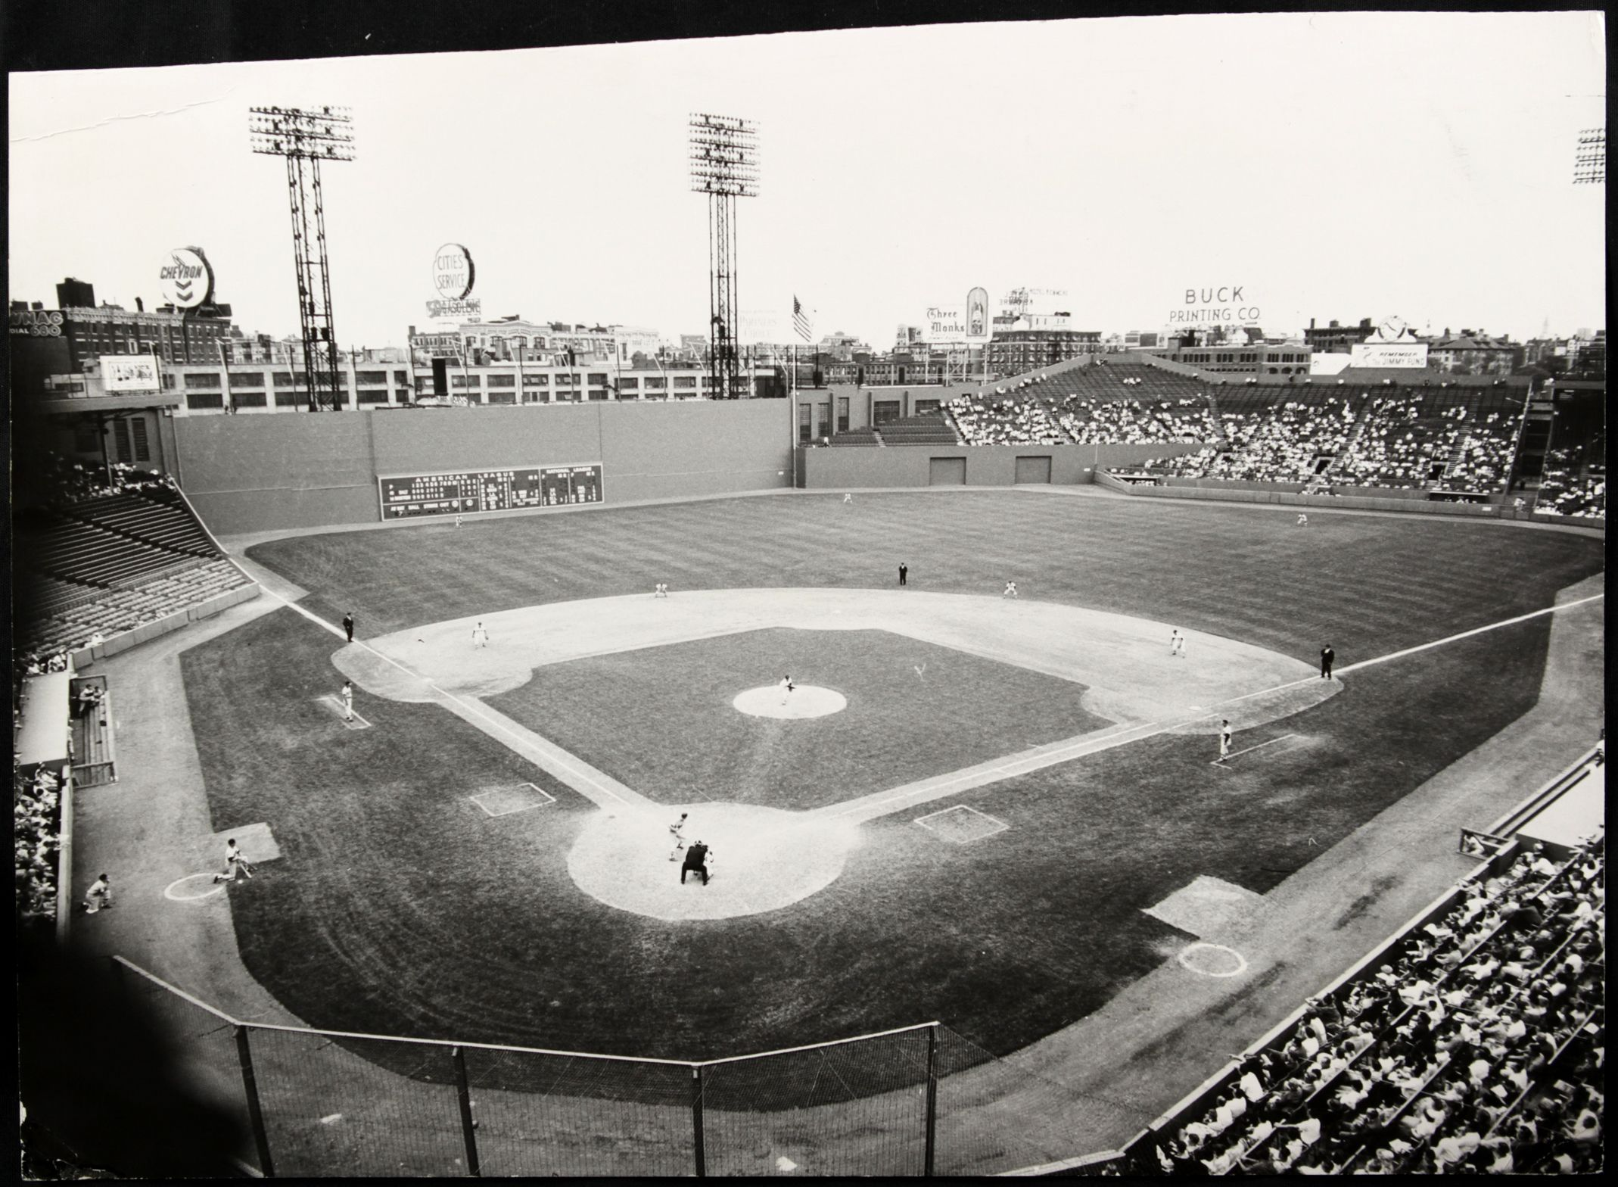
A Day at the Ballpark –
Promotions

Slide 2
“A Day at the Ballpark” Topics
Session 1-- Getting Ready for a Game (Mike)
Session 2-- Memorable Ballparks in Austin (Dan)
Session 3- Pregame Activities (Ira)
Session 4- Sights and Sounds at the Ballpark (Monte & Linda)
Session 5-- Food and Drink at the Ballpark (Bob and Jim)
Session 6– Promotions, Contests & Give-aways

Slide 3
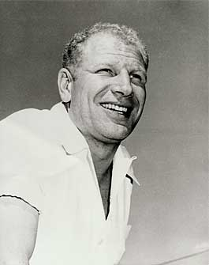
Ballpark Promotions
“I try not to break the rules but merely to test their elasticity.”
- Bill Veeck
A marketing genius
Owner of the Cleveland Indians, St. Louis Browns and Chicago White Sox

Slide 4
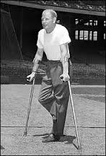
Veeck lost his right leg in the Pacific in WWII. In true Veeck fashion, he had an ashtray carved into his wooden leg.
The wooden leg came in handy on Opening Day, 1976

Slide 5
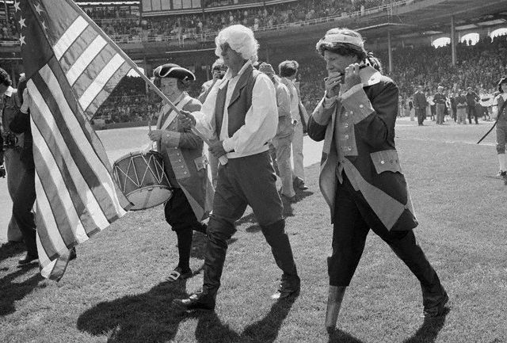
Spirit of ‘76 Day
Veeck staged Spirit of ‘76 Day on Opening Day of the 1976 season at Comiskey Park
That’s Veeck as the peg legged fifer (far right)
White Sox Manager Paul Richards is holding the American flag (center)

Slide 6
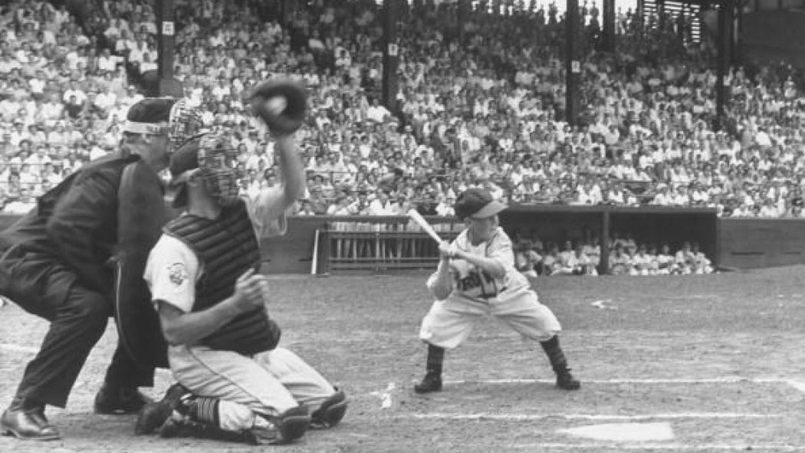
Eddie Gaedel
Veeck’s most famous stunt was batting 3’7” Eddie Gaedel on August 19, 1951
Five days later, he held his most elaborate stunt

Slide 7
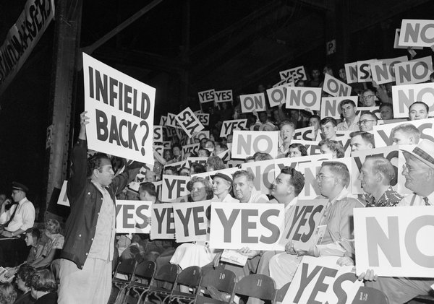
Grandstand Manager’s Day
Publicity director Bob Fischel held up cards with proposed moves - steal, bunt, change pitchers
Thousands of fans had placards that said “Yes” on one side and “No” on the other
The fans voted on the best strategy and the vote was relayed to the dugout

Slide 8
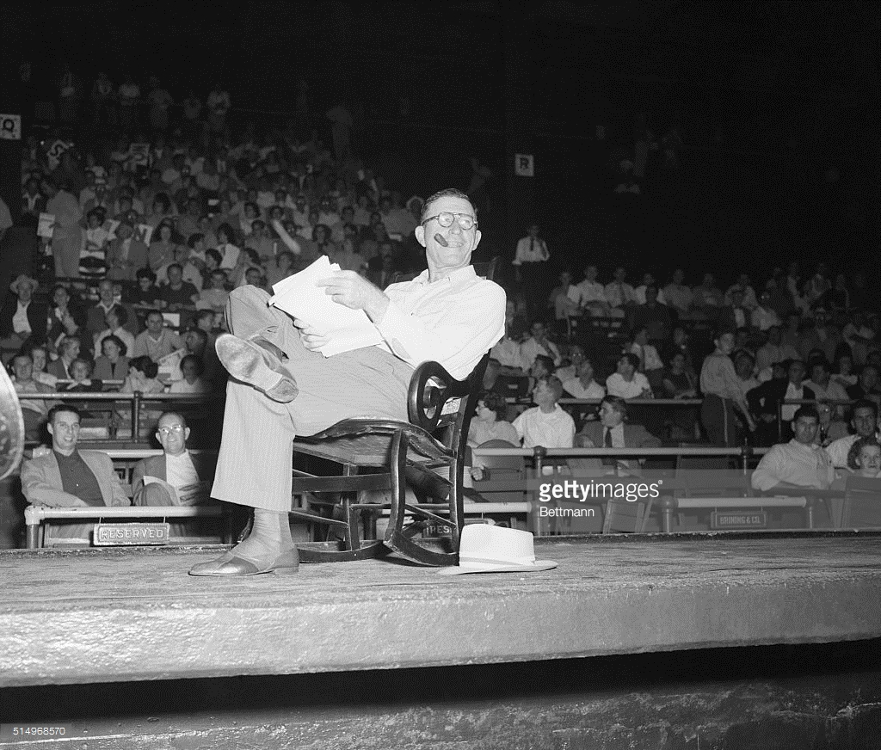
Grandstand Manager’s Day
Browns’ Manager Zach Taylor sat in a rocking chair puffing on a pipe
The Browns won the game, 5-3, ending a four game losing streak
“I have discovered in 20 years of moving around a ballpark, that the knowledge of the game is in inverse proportion to the price of the seats” – Bill Veeck

Slide 9
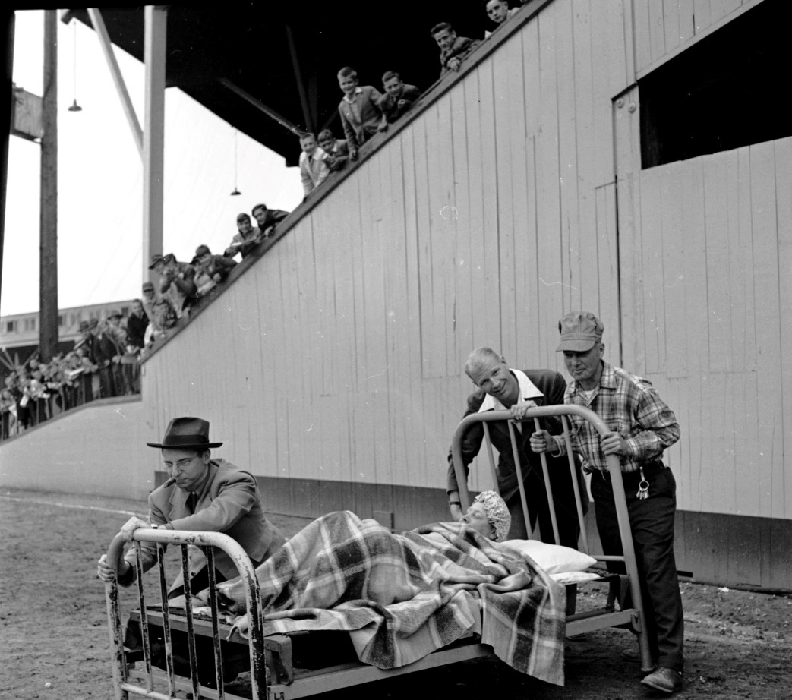
Early Morning Game
Veeck bought the AAA Milwaukee Brewers in 1941
During WWII, Veeck scheduled an early morning game to benefit defense workers who worked the night shift
That is the Brewers’ manager sleeping in the bed

Slide 10
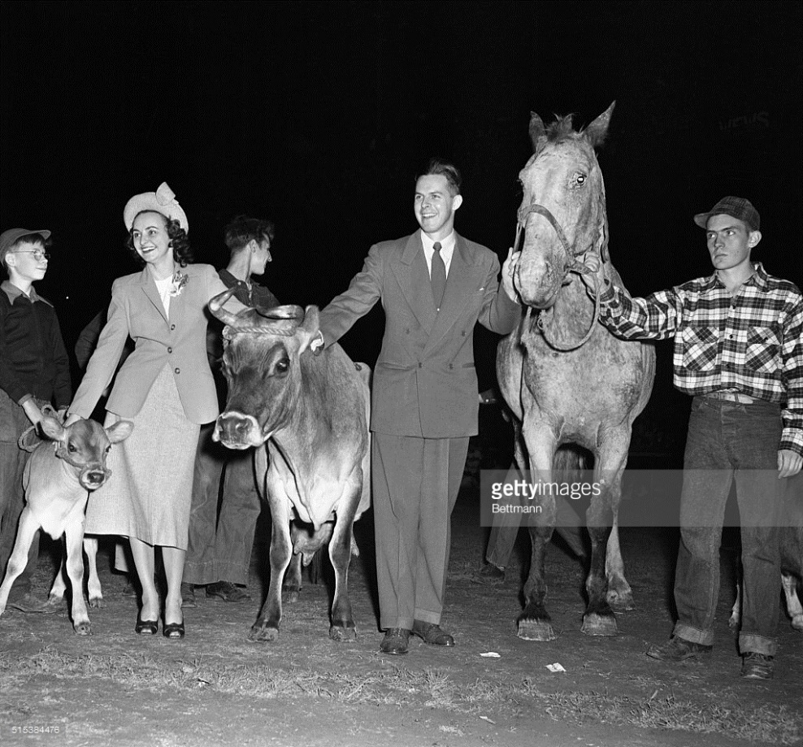
Good Old Joe Earley Day
In 1948, a Cleveland Indians fan complained to Veeck that he was having nights honoring everyone but the “good old Joe”
On September 29, 1948 - Veeck held “Good Old Joe Earley Night”. Earley and his wife are shown with some of their gifts

Slide 11
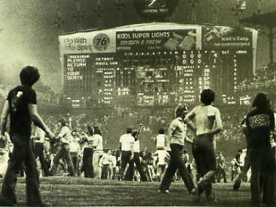
Disco Demolition Night
In 1979, Veeck scheduled his most disastrous promotion
Click picture for video of news broadcast from Disco Demolition Night

Slide 12
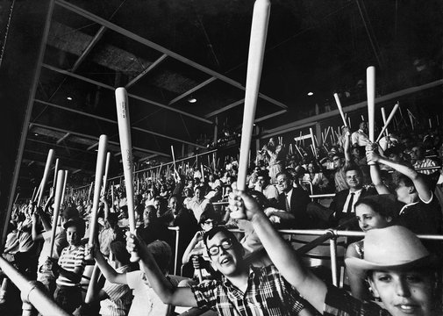
Bat Day
In 1951, as owner of the St. Louis Browns, Veeck was offered 6,000 bats by a company going bankrupt
Veeck held the first ever Bat Day and soon followed up with Ball Day and Jacket Day
These promotions live on in almost every MLB ballpark

Slide 13
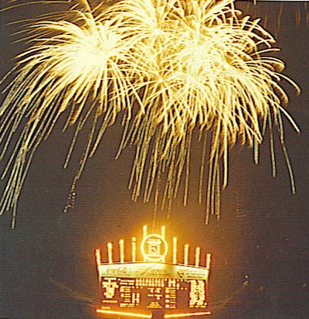
Exploding Scoreboard
In 1960, as owner of the Chicago White Sox, Veeck installed the first exploding scoreboard in the major leagues
The ostentatious 130-foot scoreboard produced fireworks, sound effects and 10 electric pinwheels after each White Sox home run
Video link

Slide 14
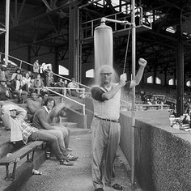
Other Comiskey Park Improvements
Veeck had showers installed in the center field bleachers to help fans cool off during hot summer games
He also added a "picnic area", created by replacing portions of the left field walls with screens and setting up picnic tables under the seating areas

Slide 15
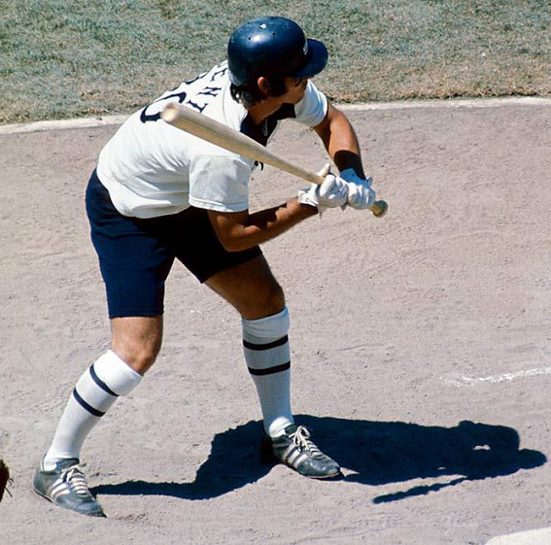
Short Pants
In 1976, Veeck’s Chicago White Sox were the only team in major league history to play games in short pants
They were also the first team to have players’ names on the back of the jerseys

Slide 16
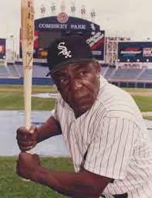
Minnie Minoso
Minoso was born in 1923
In 1976, Veeck reactivated 53-year-old Minnie Minoso so that Minoso could say he had played in four decades. Minoso had 1 hit in 8 at bats (his rookie season was 1949)
In 1980, he again reactivated Minoso, who went 0-for-2 but could say he had played in five decades (picture at right from 1980)

Slide 17
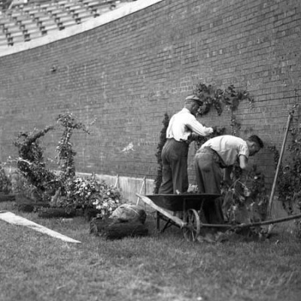
Ivy at Wrigley Field
Veeck’s father, William Veeck, was President of the Chicago Cubs until his death in 1932
Bill Veeck is credited with planting the ivy at Wrigley Field in 1937
That said, the ivy, while planted by Veeck, was the brainchild of P. K. Wrigley, then owner of the club

Slide 18
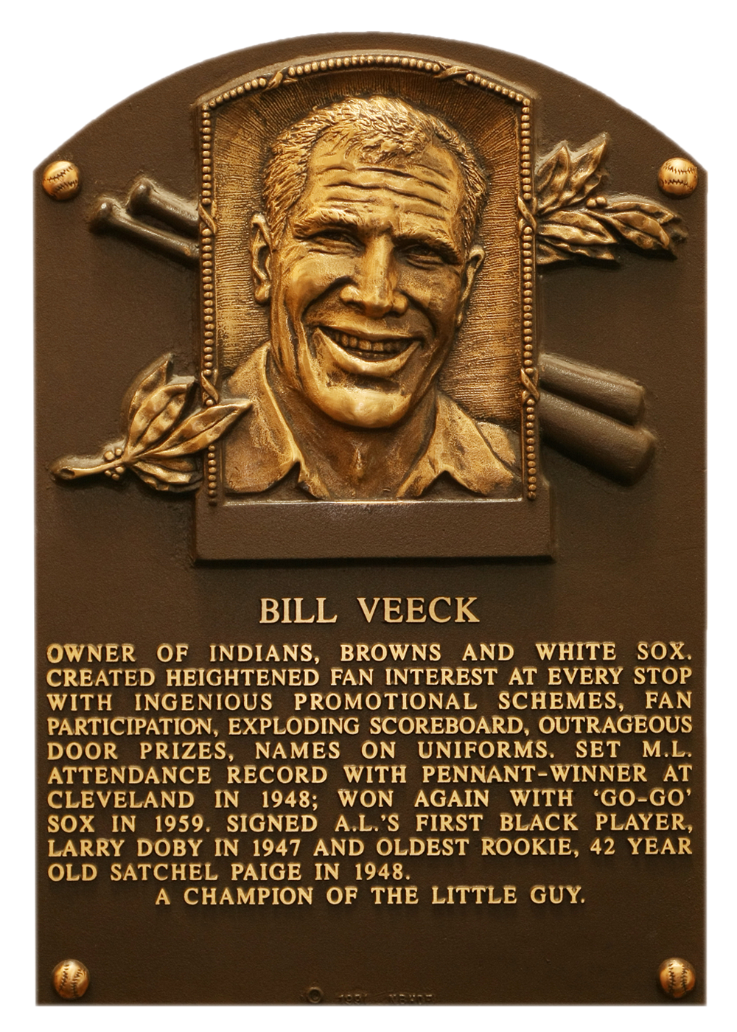
Hall of Fame
Veeck was inducted to the Baseball Hall of Fame in 1991
The following slides highlight some unique Promotions put on by Minor League baseball teams. The spirit of Bill Veeck is alive and well in the minors!

Slide 19
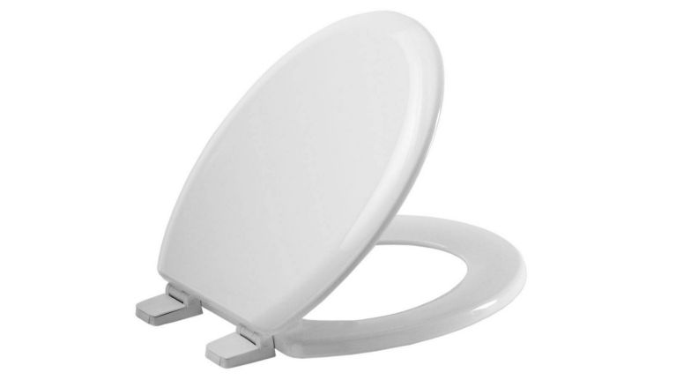
Hudson Valley Renegades
Tampa Bay Minor League A
2014
Toilet Seat Cushion Day
Free toilet seat cushions were given to the first 3,000 fans through the gates
Cushions doubled as a stadium seat
The year before, the Renegades gave away toilet plungers

Slide 20
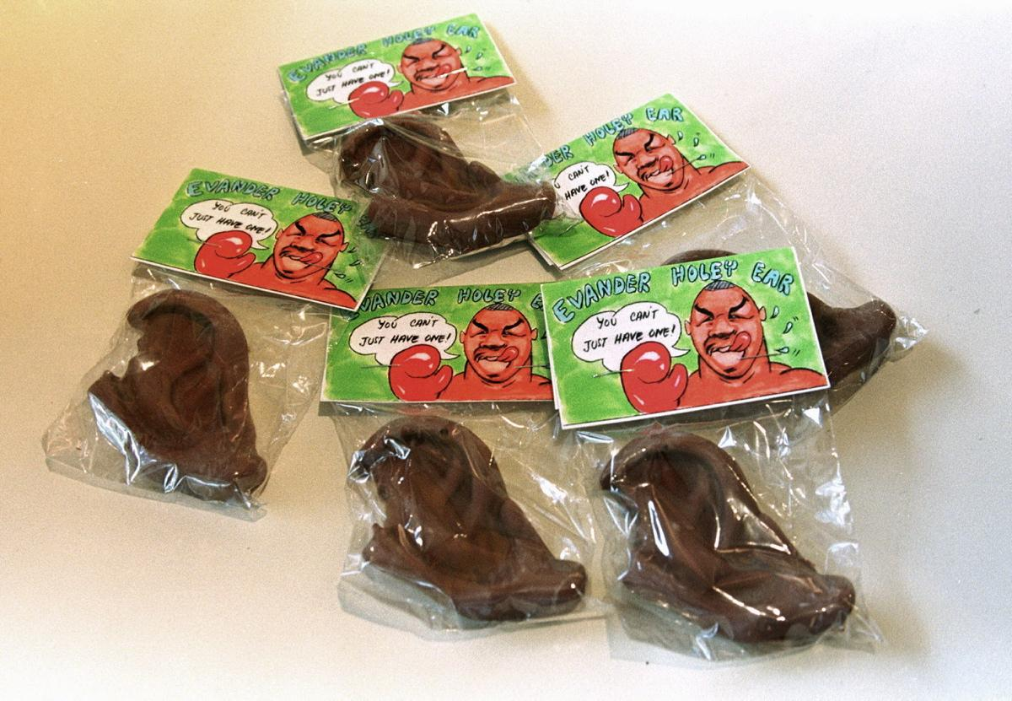
Fort Myers Miracles
Minnesota Minor League A
2014
Mike Tyson Ear Night
Plastic ears were given out at the front gate to honor of the famous boxer’s most infamous move of biting off part of Evander Holyfield’s ear during a fight

Slide 21
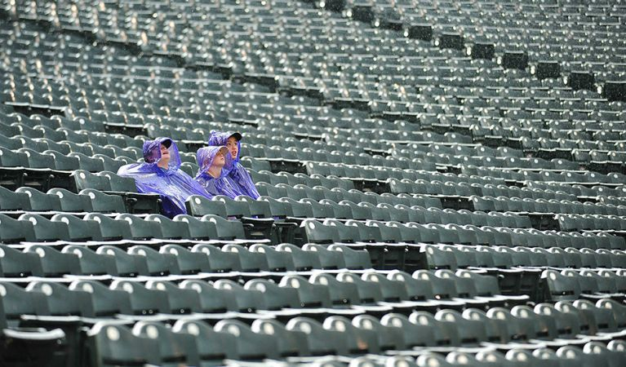
Charleston River Dogs
New York Yankees Minor League A
2002
Nobody Night
Fans were purposefully locked out of the stadium until the fifth inning so that the official attendance could be reported as zero (a record no one could break)
Fans were directed to a party tent with discounted beer and food
Notes:
Wanted to set a record that nobody could break

