Slide 1
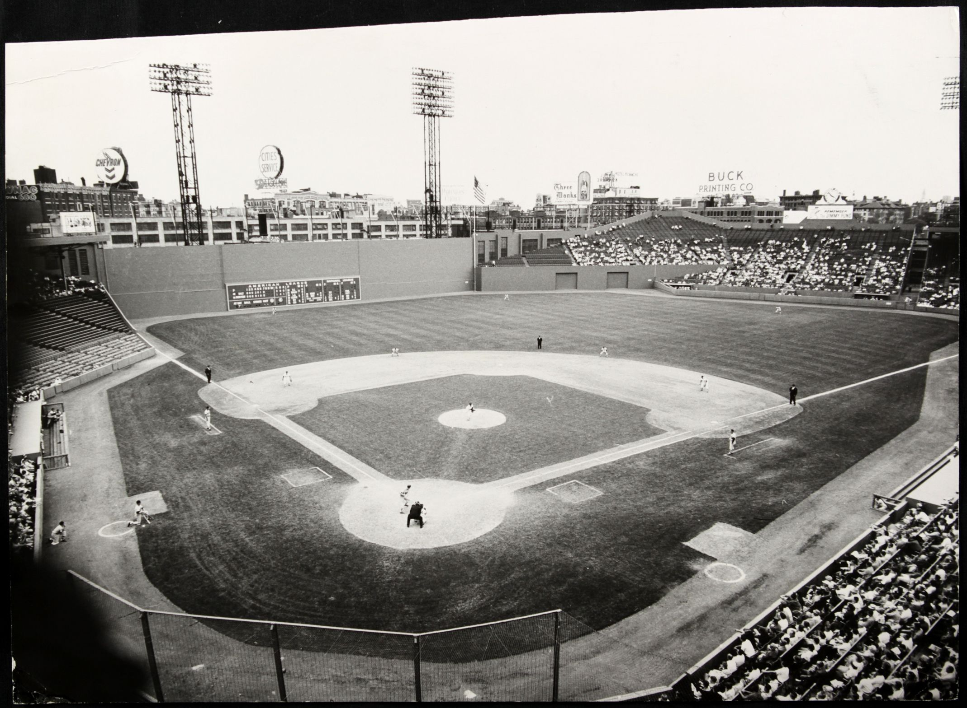
A Day at the Ballpark

Slide 2
“A Day at the Ballpark” Topics
Session 1-- Getting Ready for a Game (Mike)
Session 2-- Memorable Ballparks in Austin (Dan)
Session 3- Pregame Activities (Ira)
Session 4- Sights and Sounds in the Ballpark (Monte & Linda)
Session 5-- Food and Drink at the Ballpark (Bob and Jim)
Session 6– Promotions, Contests & Give-aways (Jim and Dan)

Slide 3
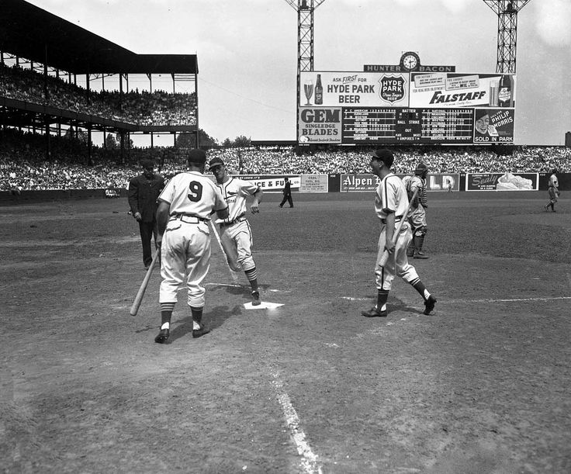
Sights and Sounds in the Ballpark

Slide 4
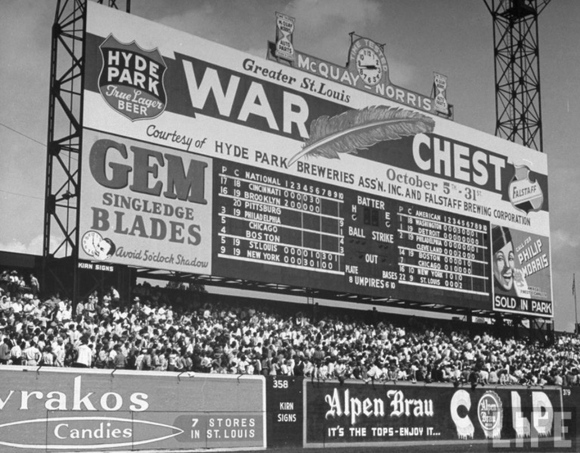
Sportman’s Park
St. Louis
Scoreboard
And
Advertising
Notes:
Scoreboard at Sportsman’s Park – Sunday October 1, 1944 – last game of regular season. Yankees visiting Browns. Battery for Browns was Sig Jakucki (#22) and Red Hayworth (#9) – Browns went on to win this game 5-2 and clinch their first and only AL pennant.

Slide 5
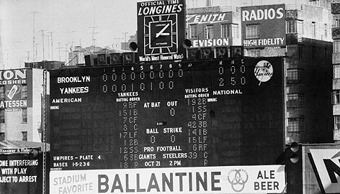
Yankee Stadium Scoreboard and Advertising – mid 1950s
Notes:
Look at the linescore on the scoreboard … Brooklyn visiting, so this must be a World Series game … and no hits !! It’s Don Larsen’s perfect game in Game 5 of the 1956 World Series – October 8 at Yankee Stadium.

Slide 6
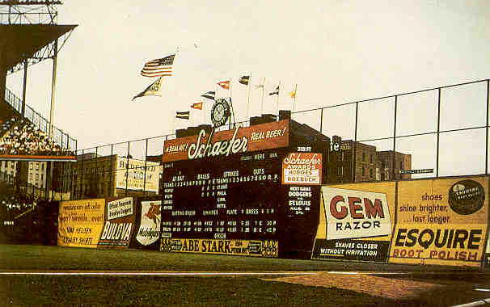
Ebbets Field Brooklyn mid-1950s

Slide 7
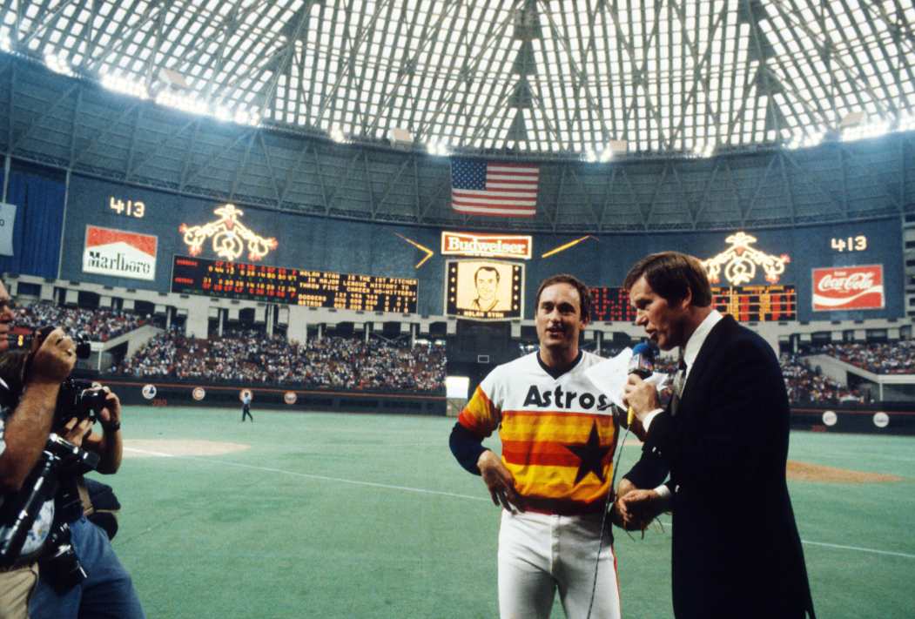
exploding scoreboard
https://www.youtube.com/watch?v=v9SodoCNiIE
Astrodome
with some ball park music:
https://www.youtube.com/watch?v=RcVJVUfXWgU
Notes:
Astrodome on the occasion of a Nolan Ryan no-hitter in 1981

Slide 8
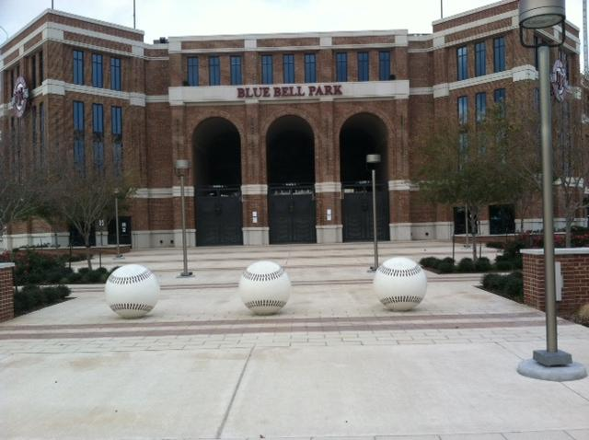
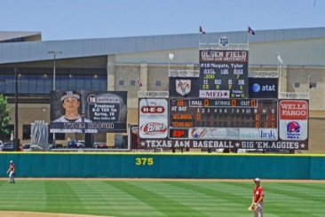
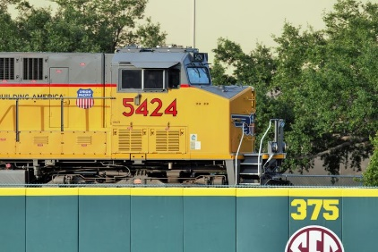

Slide 9
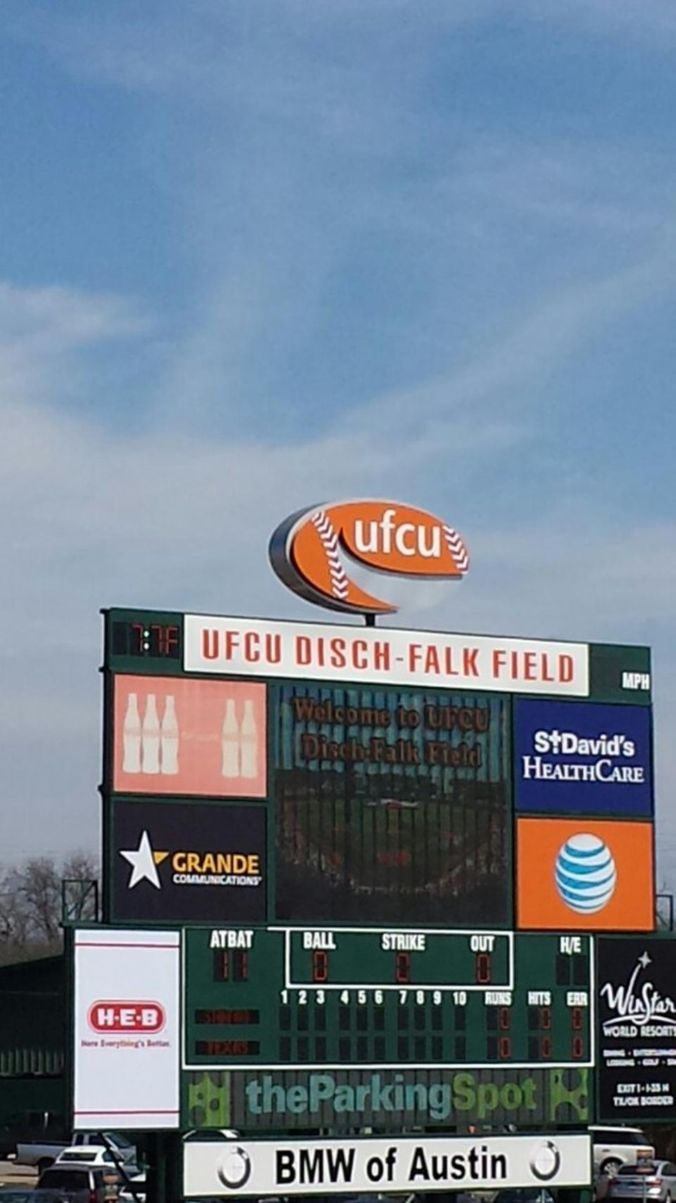

Slide 10
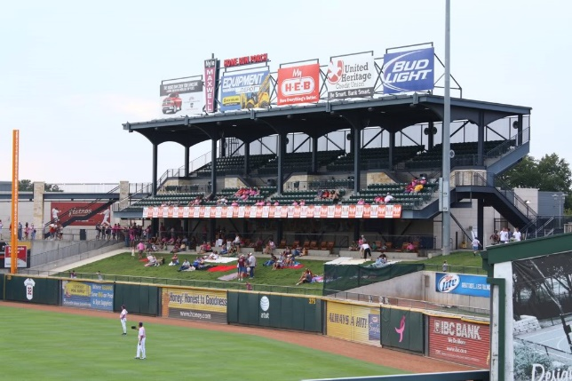

Slide 11
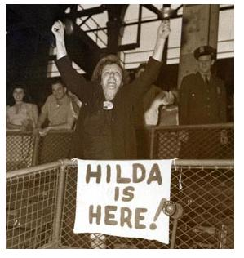
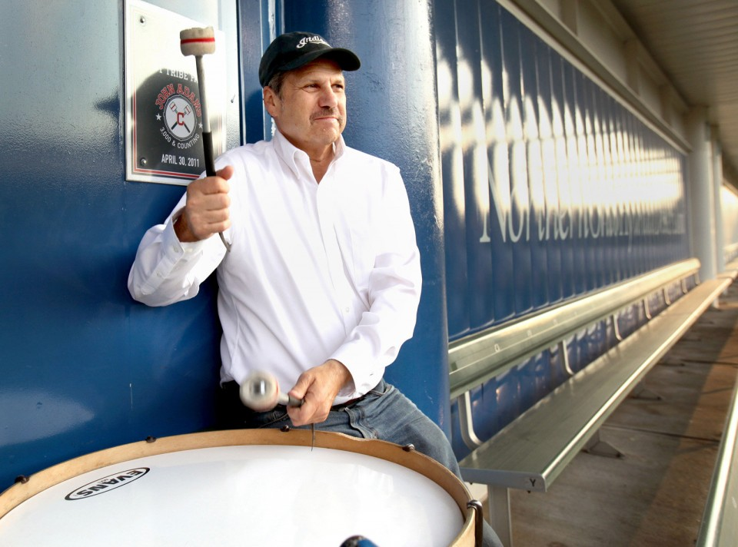
Some Notable Fans at the Ballpark
The Drum Guy at Cleveland Indians Games
She rang her cow bells in Brooklyn
Notes:
The Drum Guy at Indians games is John Adams. He has been pounding his bass drum for 40 years at Tribe games. “Howling Hilda” Chester was a Brooklyn Dodgers fan that sat in the bleachers during the 20s thru the 50s. After she had a heart attack, the team gave her the famous cow bells so she would not have to scream so loud.

