Slide 1
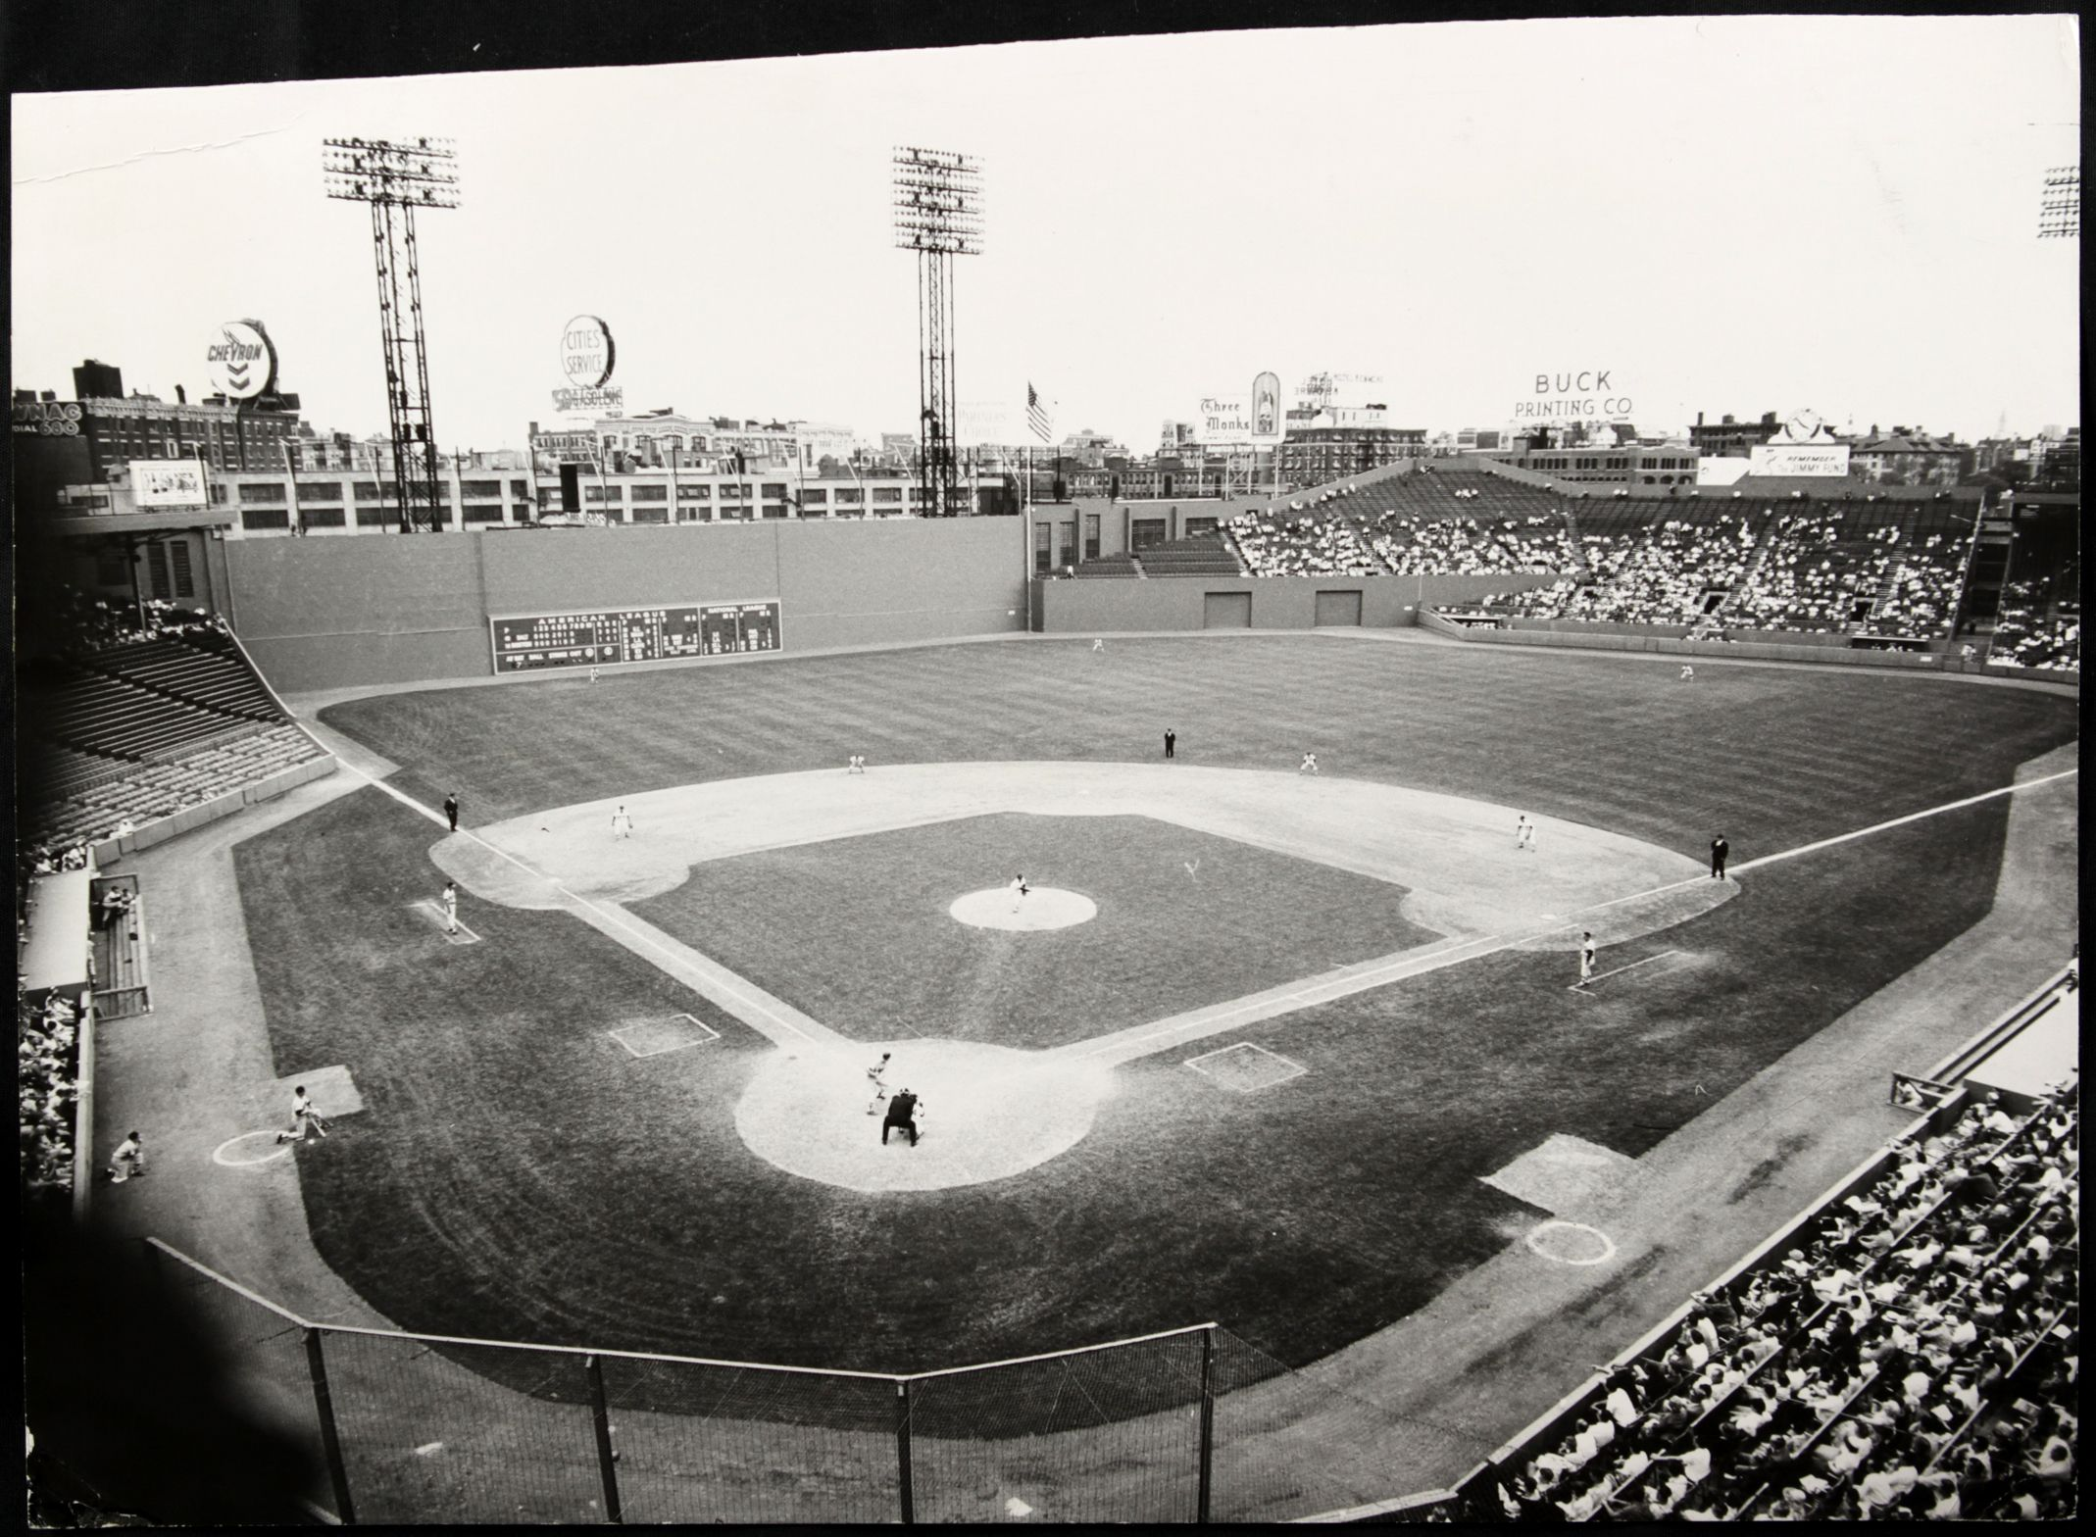
A Day at the Ballpark

Slide 2
“A Day at the Ballpark” Topics
Session 1-- Getting Ready for a Game (Mike)
Session 2-- Memorable Ballparks in Austin (Dan)
Session 3- Pregame Activities (Ira)
Session 4- Sights and Sounds in the Ballpark (Monte & Linda)
Session 5-- Food and Drink at the Ballpark (Bob and Jim)
Session 6– Promotions, Contests & Give-aways (Jim and Dan)

Slide 3
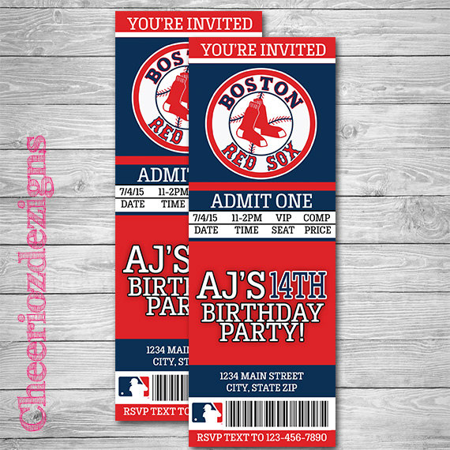

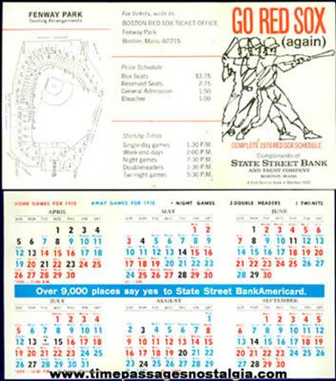
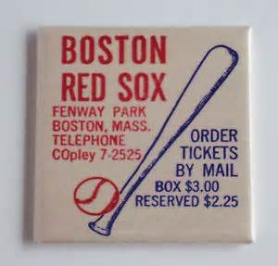
Getting Ready for a Game
Get a schedule at the gas station or bank the first day they came out. Circle which game(s) you wanted to go to and where you wanted to sit. Double-headers or special attraction games (Cub Scout Day, State of Maine Day, etc.) were the best deals.
Write to the team with cash or a check for those games.
What special attractions do you remember ?

Slide 4
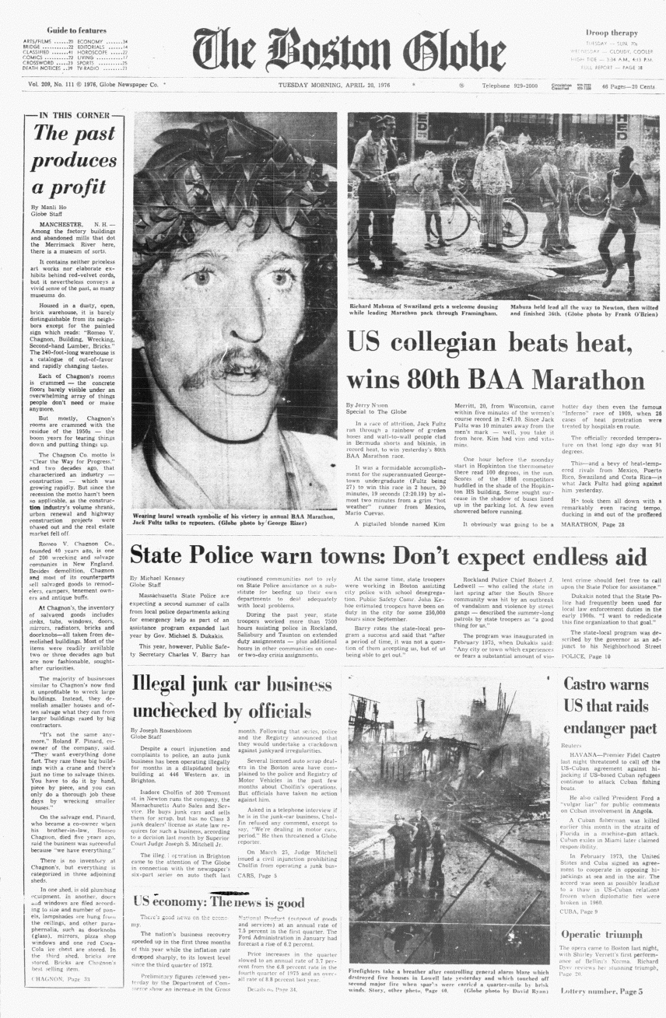
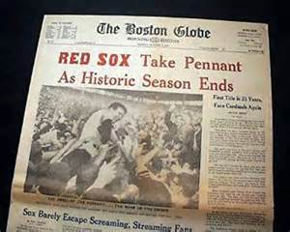
Getting Ready for a Game
A few days in advance, check the paper for who would be pitching your game.

Slide 5

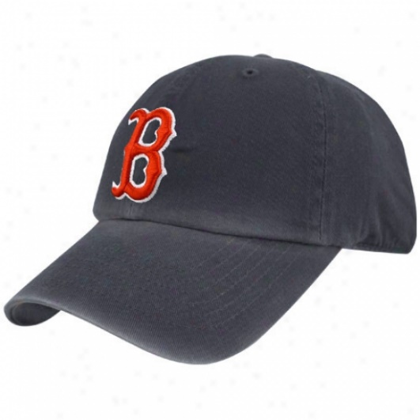
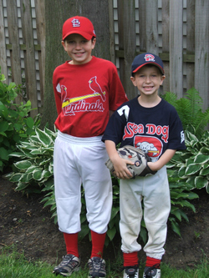
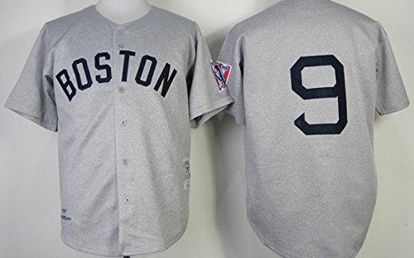
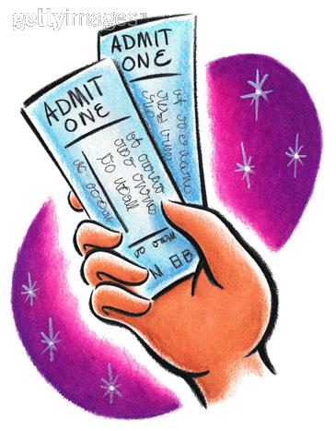
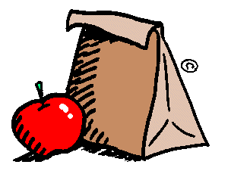
Getting Ready for a Game
The night before: Lay out your cap, jersey, and glove. REMEMBER TICKETS! Make a sack lunch. Barely sleep.
Game Day: Get up early and put on your outfit.

Slide 6
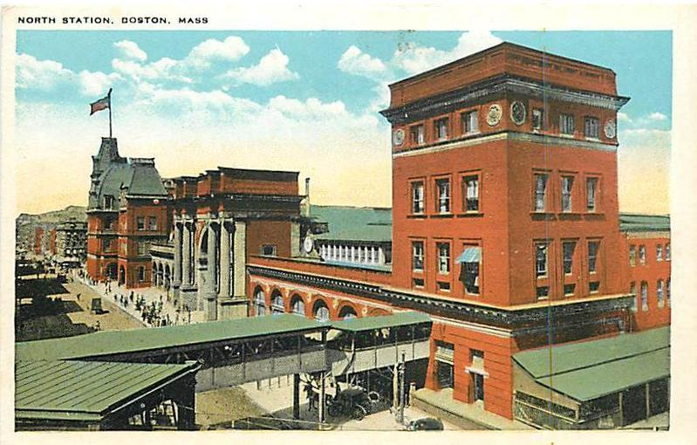
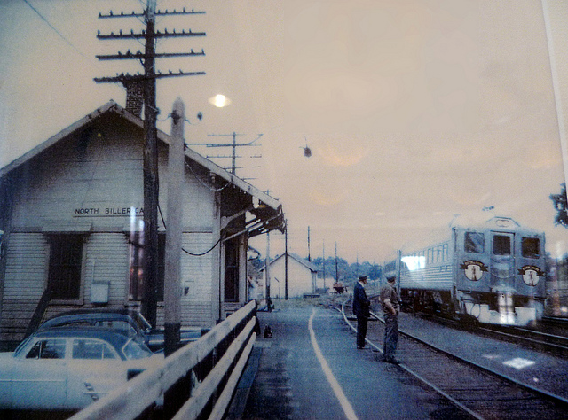
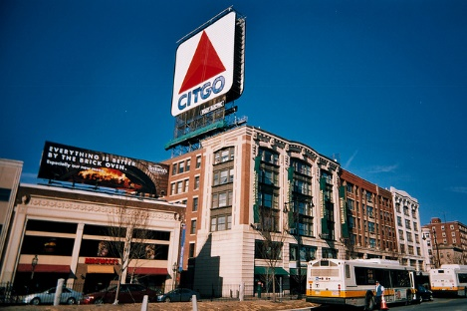
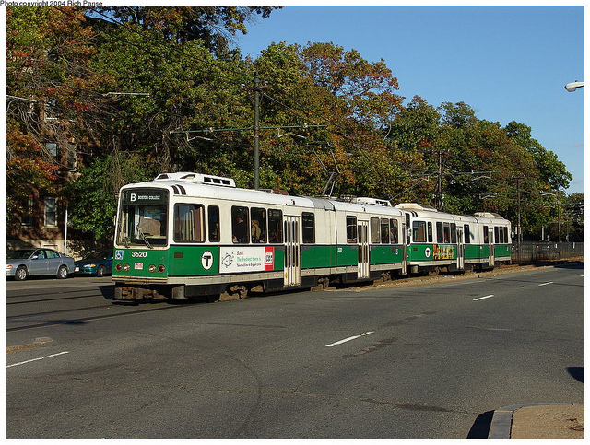
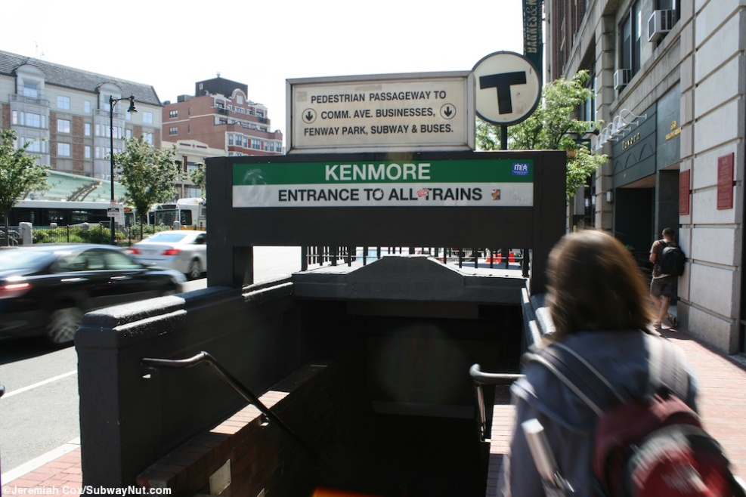
Getting Ready for a Game
Game day – travel to the
ball park !!

Slide 7
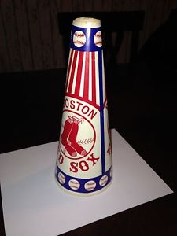
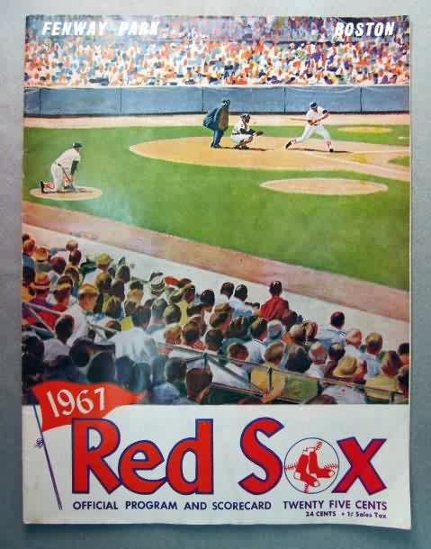
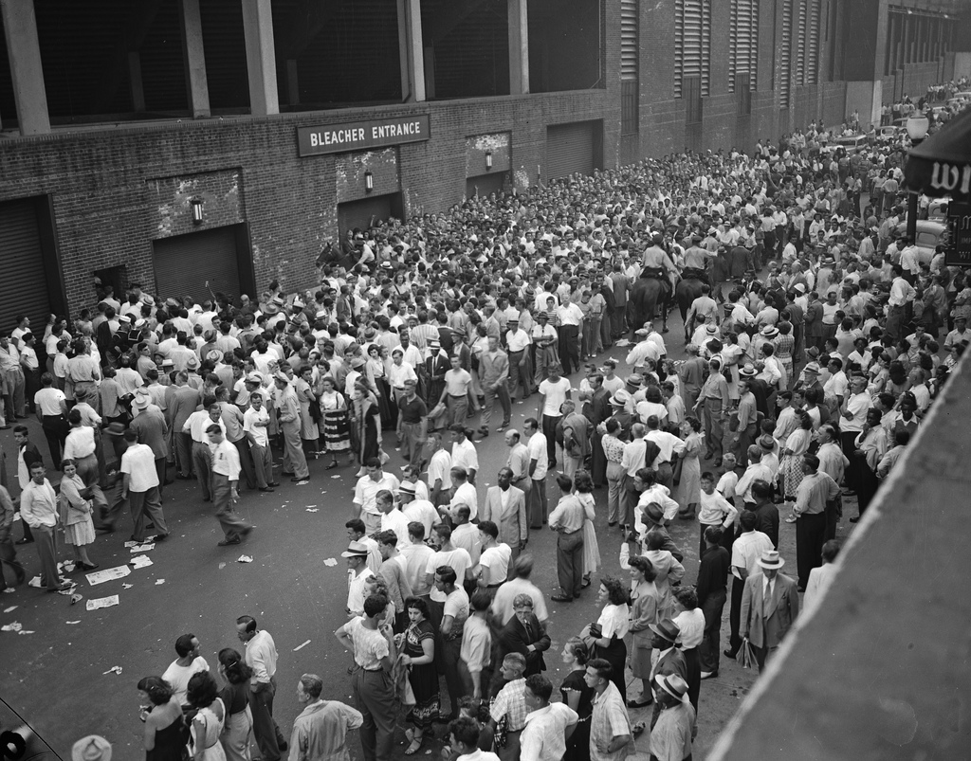
Getting Ready for a Game
Get there as soon as they opened the gates for batting practice.
Buy a popcorn whose container turned into a megaphone.
Buy a program, check all the stats (including the updated ones on the slip-in sheet), and sometimes keep score.

