Slide 1
A Summer Day in the
Life of a Little Leaguer

Slide 2
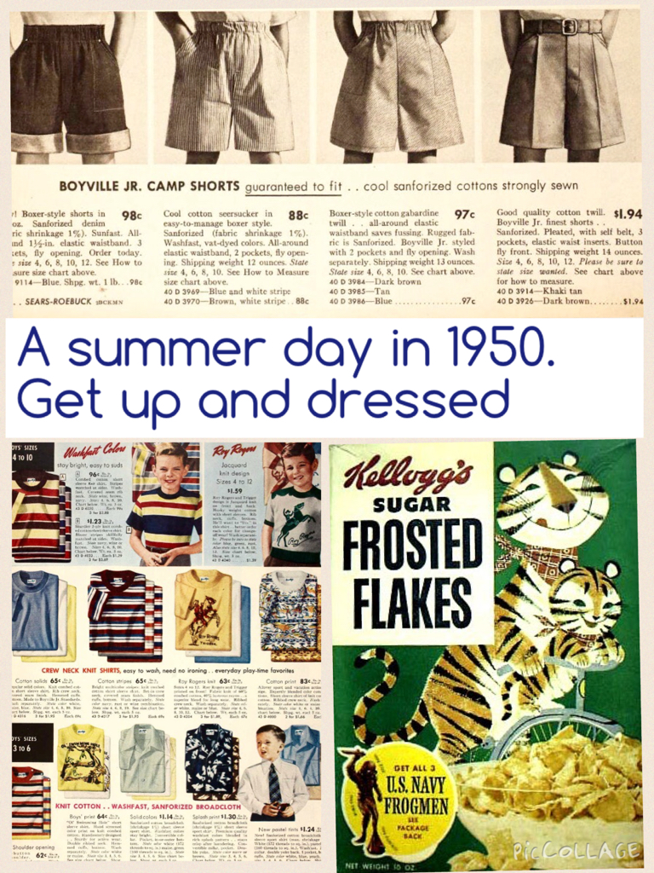

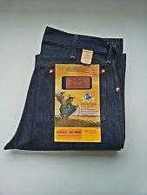
A Summer Day … sometime in the 1950s
Get up and get dressed !

Slide 3
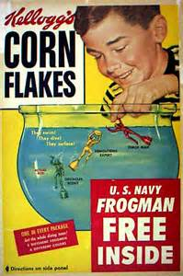

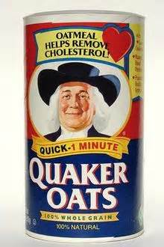
Breakfast Favorites

Slide 4
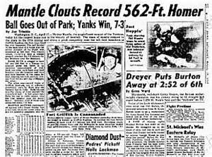
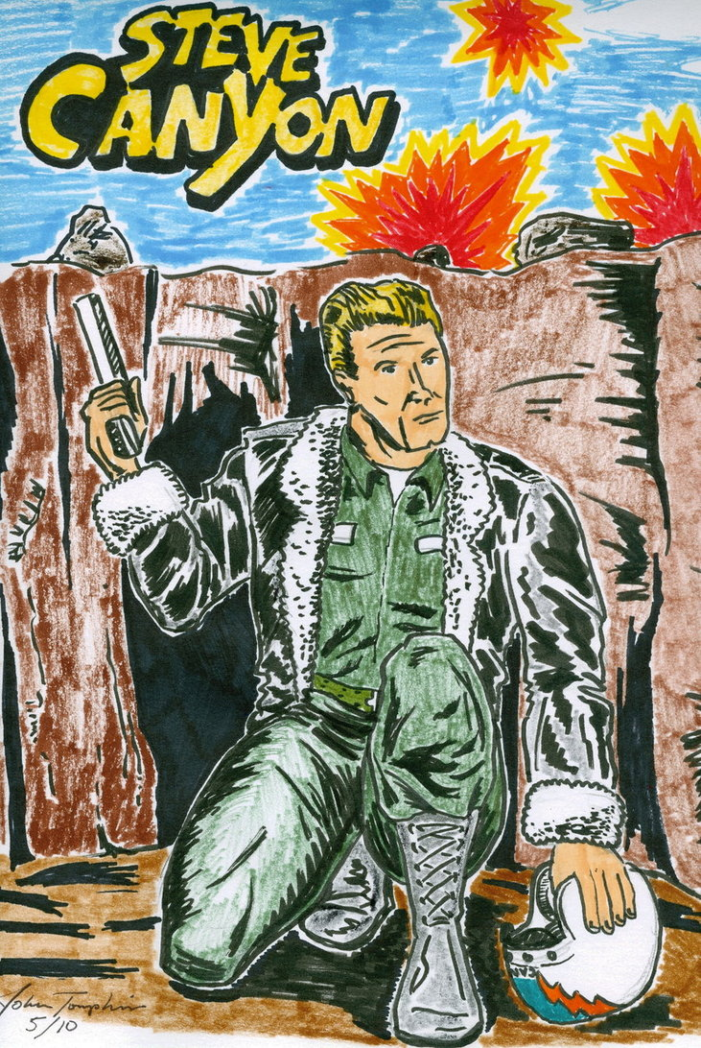
Check Out the Morning Paper

Slide 5
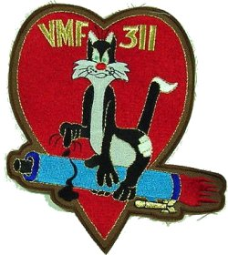

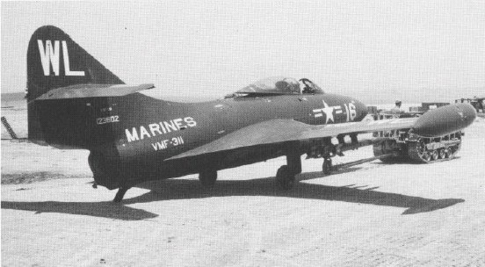
Capt. Theodore “Ted” Williams, USMC
Grumman
F9F
“Panther”
Major John Glenn, USMC
Ted Williams’ wing-mate
In Korea
You Might be Following the Exploits
of Jet Fighter Pilots
in Korea

Slide 6
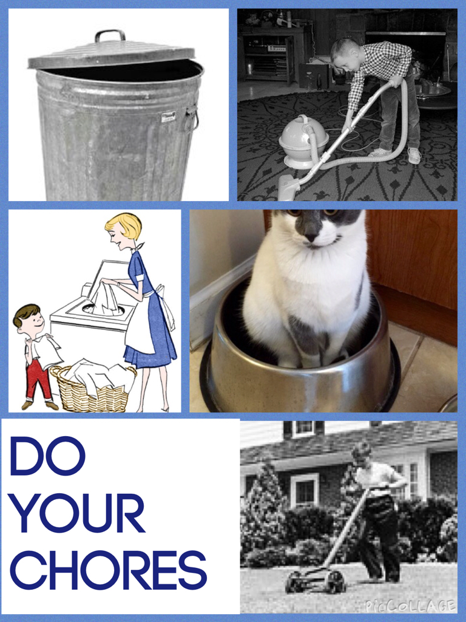

Slide 7
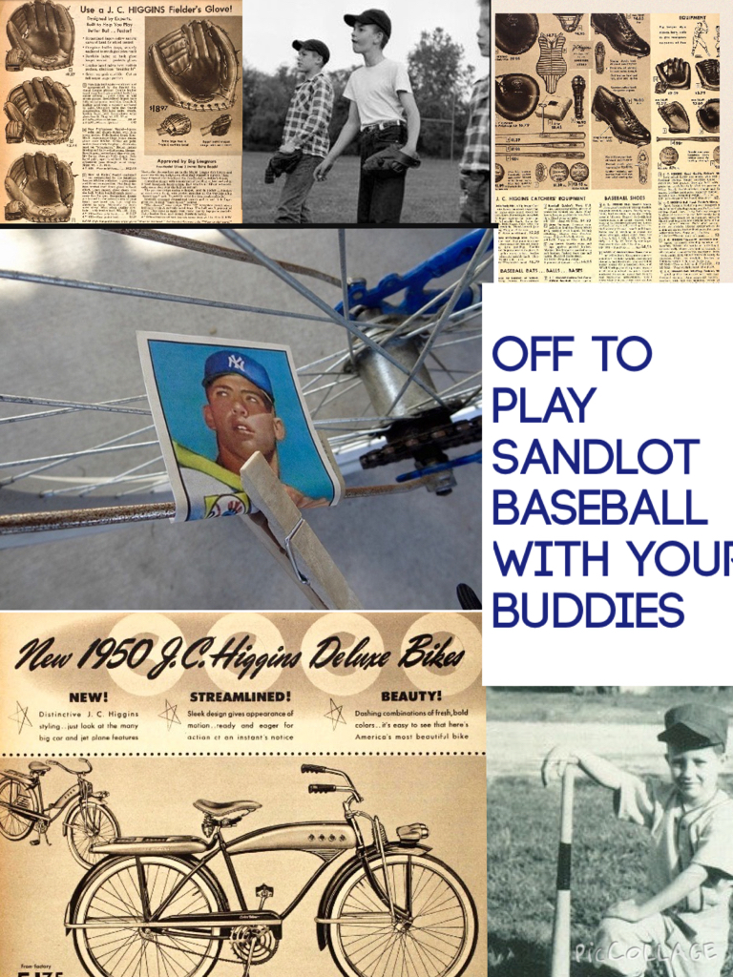
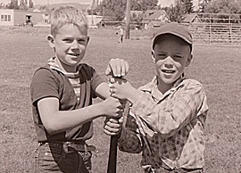

Slide 8
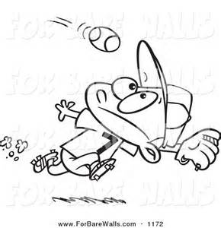
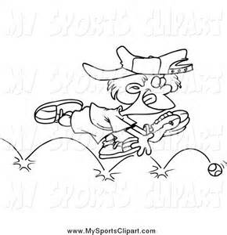
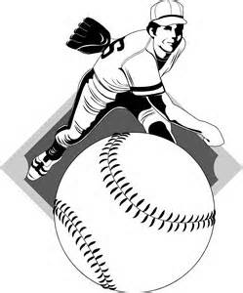

Sandlot Baseball – types of games
Less than 9 on a side
Over-the-Line
Indian Ball
One or two outfielders
grounder line
One infielder
Pitcher – could be from the batting team
Batter

Slide 9
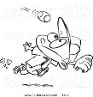
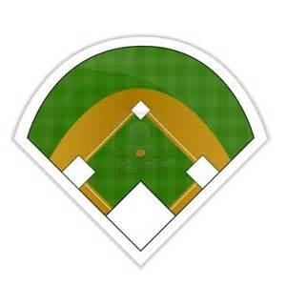
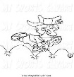

Sandlot Baseball – types of games
Less than 9 on a side
Right Field Out
Pitcher’s Mound
Out

Slide 10

Sandlot Baseball – types of games
Less than 9 on a side
Right Field Out
1st Base Out

Slide 11

Sandlot Baseball – types of games
More than 9 on a side
Extra Outfielders

Slide 12
Sandlot Baseball – types of games
More than 9 on a side
If the field
did not
have a
backstop
What is this position called?

Slide 13


Slide 14
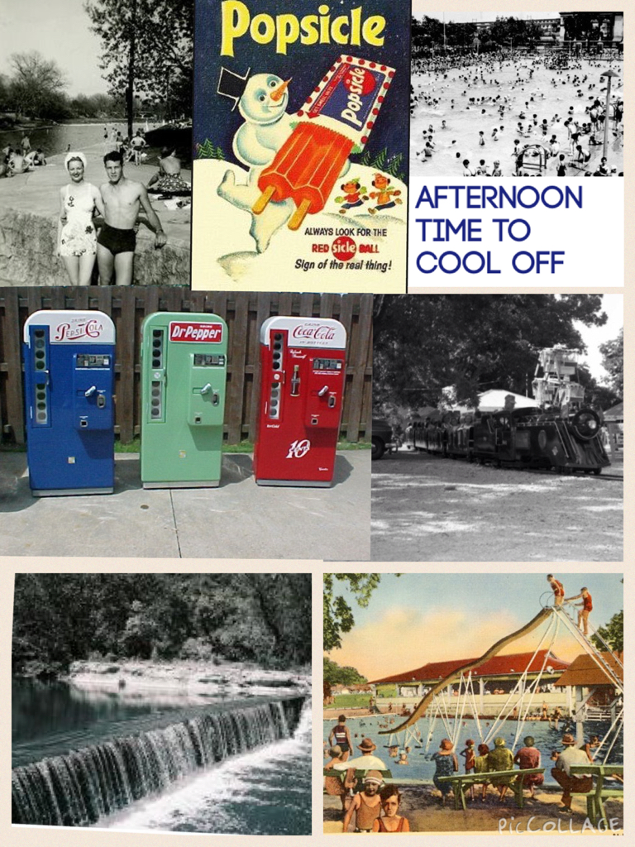

Slide 15


Slide 16
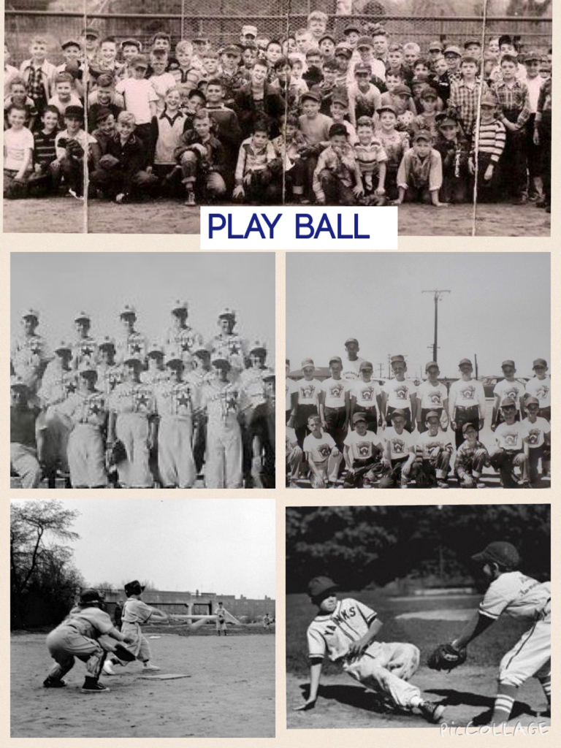

Slide 17


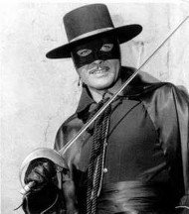
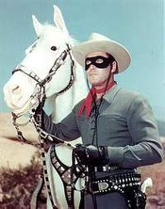
Some family TV favorites
Maybe Dad and Mom were planning a
Summer vacation:
https://www.youtube.com/watch?v=qhR8GZ_WWMM

Slide 18
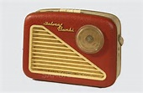
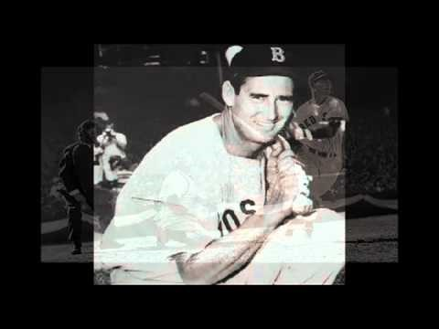
BED TIME
BUT YOU MIGHT SNEAK YOUR RADIO
UP TO BED TO LISTEN TO THE GAME …
in the major leagues.
Notes:
Curt Gowdy

Slide 19
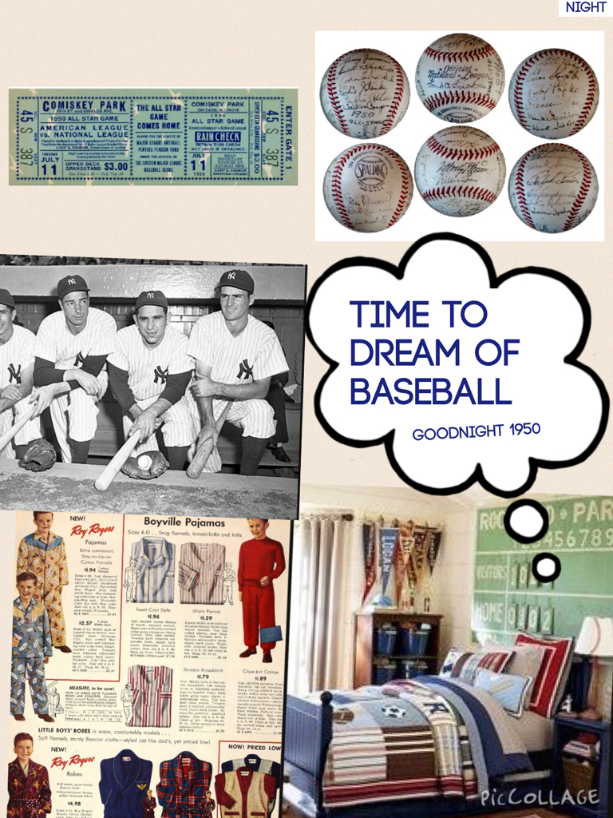
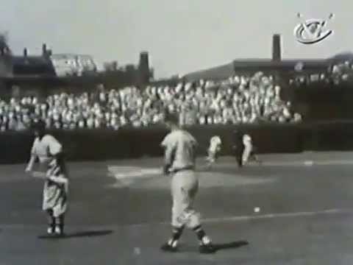
BED TIME
HOPEFULLY YOUR BATTERY DOESN’T
RUN OUT BEFORE THE GAME IS OVER
BUT EVENTUALLY, IT’S …
Notes:
Harry Caray

