Slide 1

ALL STARS of the 60’s
Vote for your favorite players from 1960-1969
Notes:
You will have an opportunity to vote on the best players from the 1960’s. We have selected three players at each position; and of the 27 players we will discuss, 18 of them are National Leaguers. That should not be surprising – from 1960 through 1982, the NL dominated the All Star games, winning 23 of the 26 games. It was generally considered that the NL had the best players during the 60’s. A note about the statistics – the batting averages, Hrs and other stats I’ll show here are based only on what the palyer did during the 1960’s. For example, we know that Hank Aaron hit more than 700 homers in his career, so when I mention that he hit 350 HR, I’m referring only to his performance during the 10 year period 1960-69.

Slide 2
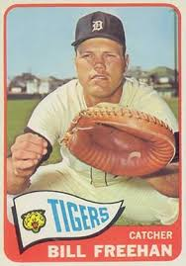
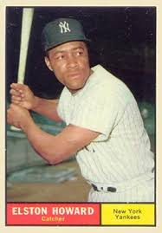
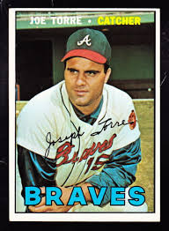
CATCHERS
Bill Freehan, Tigers Elston Howard, Yankees Joe Torre, Brave
.293 w/ 160 HR
6x All Star/ 5 Gold Gloves 6x All Star/ 1963 MVP 5 x All Star
Notes:
Freehan batted .262 w/ 110 HR during the 60’s; he was the premier defensive catcher in the AL, winning 5 Gold Gloves. Yankee catcher Elston Howard hit .272 w/ 115 HR in the 60’s; the AL MVP in 1963 when he led the Yankees w/ 28 HR. Like Freehan, Howard was also a 6x All-Star. Joe Torre was the Braves catcher during the 60’s, and he led all catchers in the major leagues in batting average, HR, RBI, hits, doubles and runs scored. He was named to the All-star tweam 5 times, and won 1 GG.

Slide 3
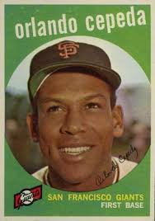
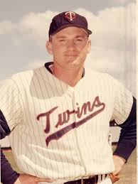
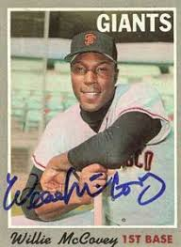
FIRST BASE
Orlando Cepeda, Giants Harmon Killebrew, Twins Willie McCovey, Giants
& Cardinals .393 HR, 1013 RBI .279 – 300 HR
6x All Star / 1967 MVP 8x All Star/ 1969 MVP 4x All Star/ 1969 MVP
Notes:
Orlando Cepeda spent most of the 60’s with the Giants, but had his best season w/ Cardinals in ‘67 when he won the MVP. During 60’s batted .295 w/ 253 HR. Harmon Killebrew hit more HR’s than any other player from 1960 to 69 – 393 HR, leading the AL 5x in HR and his 1,013 RBI were the most in AL. Killer was a 8x All star and the MVP in 1969. Willie McCovey was the reason the Giants could afford trading Cepeda to the Cardinals. Known as “Stretch” – record books say he was 6’4 – he hit 300 HR, and led NL in HRs 3 x during 1960’s. He won the NL MVP in 1969. Mc Covey holds the NL record for grand slam HR’s with 18.

Slide 4
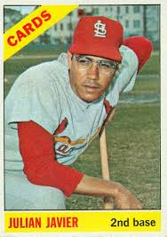
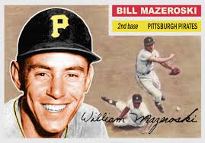
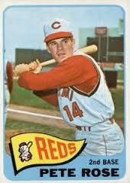
SECOND BASE
Julian Javier, Cards Bill Mazeroski, Pirates Pete Rose, Reds
.258 – 71 HR/ 123 SB .262 – 93 HR, 600 RBI .309 / 2 batting titles
2x All Star 5x All Star/ 7 gold Gloves 4 x All Star/ ROY ‘63
Notes:
Javier was starting 2B for Cardinals throughout the 60’s, named to two all star teams. Although a light hitting infielder, he stepped up big in both the 1967 and 1968 World Series, and had a .346 batting av. In WS play for Cards. Mazeroski, who is best known for the most dramatic HR in baseball- his game winner in 1960 vs, Yankees, was the premier defensive 2B during the 60’s, winning 7 gold gloves. He led all 2B in major leagues in games played, hits, HR and RBI during 60’s. Pete Rose – known as Charlie Hustle- was the sparkplug for the Cincinnati Reds during 60’s. Rose was Rookie of the year in ‘63, and won batting titles in 1968 and 69. During 60’s he had a overall avg. o .309.

Slide 5
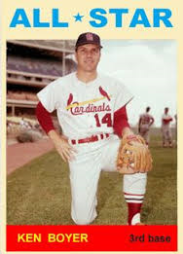
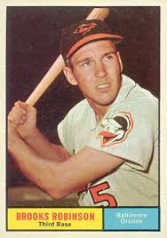
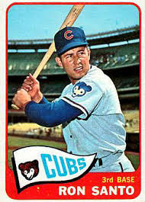
THIRD BASE
Ken Boyer, Cardinals Brooks Robinson, Orioles Ron Santo, Cubs
253 HR / 937 RBI
5x All Star/ 1964 MVP 10x All Star & 10 GG 6x All star & 5 GG
3 Gold Gloves 1964 AL MVP
Notes:
Boyer was a power hitting 3b for Cardinals; batted .285 w/68 HR during 60’s. His was named to 5 all star teams, and was MVP in NL in 1964. Brooks Robinson’s nickname was the “Human Vacuum Cleaner” – he caught everything that came his way and was the AL gold glove winner every year. Brooks led all 3B in games played and hits during the 60’s. Cubs’ Ron Santo was a 6x All Star, and led all 3B during 60’s in HR, runs scored, and RBI. Also won five gold gloves.

Slide 6
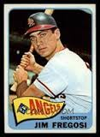
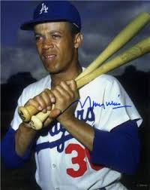
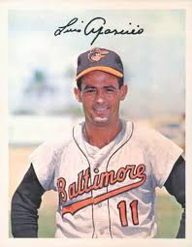
SHORTSTOP
Luis Aparicio, White Sox Jim Fregosi, Angels Maury Wills, Dodgers
and Orioles
5x All Star/ 6 gold gloves 5x All Star 5x All Star / 1962 MVP
Notes:
Luis Aparicio was a slick fielding SS for W.Sox and Orioles; he won 6 gold gloves. Also led AL in stolen bases five straight years from 1960-64, stealing 342 bases during 60’s. Jim Fregosi was Angels starting SS throughout the 60’s; to show how highly regarded he was, the Mets traded 4 players (including Nolan Ryan) for only Fregosi in 1971. Maury Wills broke Ty Cobb’s single season base stealing record in 1962 with 104 steals – and he was the NL MVP that year. Like Aparicio, Wills led his league in SB every year from ‘60 to ’64. Maury was a 5x all star, and played in more games than any other SS during 60’s. Only 3 other players had more hits than Wills during the 60’s; and, he led all players in SB with 535.

Slide 7
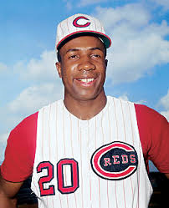
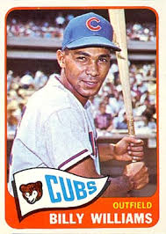
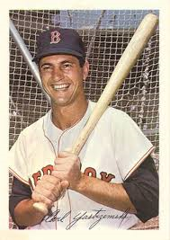
LEFT FIELD
Frank Robinson, Reds Billy Williams, Cubs Carl Yastrzemski, Red Sox
& Orioles
6x All Star/NL MVP-1961 4x All Star 6x All Star /5 Gold gloves
AL MVP- 1966 Rookie of Year, 1961 3 Batting titles/ 1967 MVP
Notes:
Robinson is only player to be named MVP in both the NL and Al; won it ‘61 when Reds were NL champs, then in AL in 1966 with Orioles. Why the Reds ever traded him is beyond me. Not only di Robinson lead the Orioles to their first WS title in ‘66, he was the leagues MVP, hit .316/49/122 – a Triple Crown year. During 60’s, Robby hit .304, w/ 316 HR and 1011 RBI.
Billy Williams hit 25 HR as a rookie, and didn’t let up hitting .292 w/ 249 HR during 60’s. Williams was on 4 all star teams. Yaz won three AL batting titles – in 1963, 67 and 68. He followed Frank Robinson’s Triple crown year with his own triple crown in 1967 - .326/44/121, and the AL MVP that year. Yaz was named to 6 all star teams, and won 5 gold gloves with Boston.

Slide 8
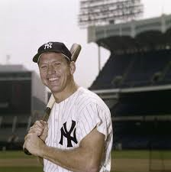
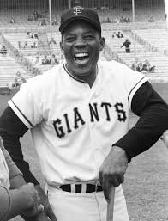
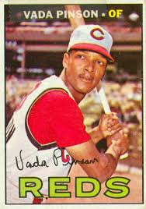
CENTER FIELD
Mickey Mantle, Yankees Willie Mays, Giants Vada Pinson, Reds
8x All Star / 1962 MVP 10x All Star/ 1965 MVP 2x All Star/.292, 175 HR
9 Gold Gloves
Notes:
“The Mick” played with injuries through most seasons in the 60’s; in fact he was in CF on just over 50% of the time when he was healthy. Nonetheless, he was the AL MVP in 1962, and 2nd in MVP voting in three other years. He made the all star team 8x during 60’s. Willie Mays – the Say Hey Kid – the most complete ballplayer to live – power, speed, great defense – he won 3 HR titles and 9 gold gloves in 60’s- batted .300 w/ 350 HR. One the most under appreciated players – Vada Pinson played the most games in CF during 60’s; He had 1776 hits, inc. 310 doubles during 60’s. Only two players had more hits during the decade than Pinson (Aaron& Clemente), and only player(Yaz) had more doubles. By the way, Pinson was a product of McClymonds HS in Oakland, CA – which also produced Frank Robinson, Curt Flood, and Basketball great Curt Flood.

Slide 9
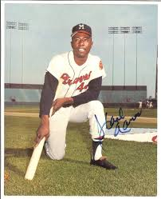
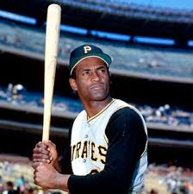
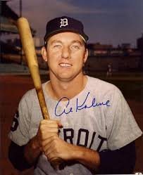
RIGHT FIELD
Hank Aaron, Braves Roberto Clemente, Pirates Al Kaline, Tigers
10x All Star 9x All Star / 9 Gold gloves 8x All Star
3 HR titles 1966 MVP 7 Gold gloves
Notes:
Hammerin’ Hank Aaron hit 350 HR, second only to Killebrew, during 1960’s; and he led all baseball with most RBI 1107 and 1091 runs scored. Aaron batted .308, with the second most hits. Clemente was, arguably, the best pure hitter in baseball during the 1960’s. He won batting titles in 1961, 64, 65 and 67- his overall average for the 10 year period was .328. He was considered one of the finest defensive players – winning 9 gold gloves in RF. He led all player with most hits and most triples during the 60’s. Al Kaline was considered the best RF in the AL during the 60’s; a steady presence in Detroit’s lineup, he batted .296 w/ 247 HR and won 7 gold gloves.

Slide 10
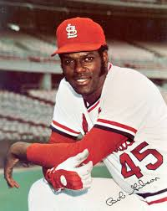
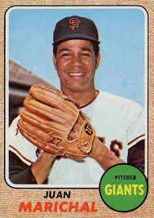
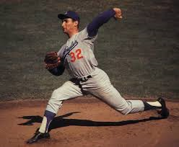
STARTING PITCHER
Bob Gibson, Cards Sandy Koufax, Dodgers Juan Marichal, Giants
5x All Star & 5 Gold g 3 Cy Young Awards 8x All Star/No hitter ‘63
Cy Young & MVP 1968 4 No Hit games 191 Wins & 45 SHO
Notes:
Bob Gibson won 164 games (2nd most during 60’s decade) and his 2070 K’s were the most for any pitcher. In ‘68 he had an ERA of 1.12 in 304 IP – that’s the lowest ERA recorded by a pitcher in one season. That year he won both the CY and NL MVP awards. In ‘68 World Series, Gibby struckout 17 batters in game 1 – the most in a WS game.
One sportswriter said that Sandy Koufax had the “Left Arm of God”. During the 5 year period of 1962-66, he won 111 games with an overall ERA of 1.95, threw 4 no hitters, and won 3 CY awards – all three times he was a unanimous choice. He had the lowest ERA for a starting pitcher during the decade and the highest strikeout rate – he averaged 9.5 K’s per game. He set a major league record w/ 382 K’s in a season (later broken by Nolan Ryan). He retired prematurely at the age of 30 due to an arthritic elbow.
Juan Marichal had the misfortune of pitching at the same time as Sandy Koufax and Bob Gibson. Three times during the 60’s Marichal won 25 games; however, he never earned one vote for the Cy Young award. Nonetheless, a strong argument could be made that he was the best pitcher during the decade: He won the most games (191), Pitched the most complete games (197) and the most shutouts (45). He was 3rd in IP, 3rd in lowest ERA, and had the second lowest walk rate. Plus, he threw a no-hitter in ‘63.

Slide 11
ALL STARS of the 60’s
Vote for your favorite players from 1960-1969
Notes:
Now it’s time to cast your vote for your favorite players.

