Slide 1
Baseball Broadcasters
Favorite Calls

Slide 2
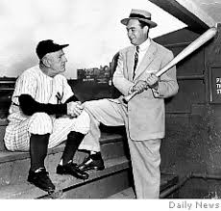
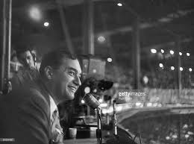
“How about that?”
“Go-ing, go-ing, gone!”
Mel Allen
NY Yankees

Slide 3
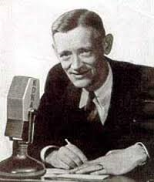
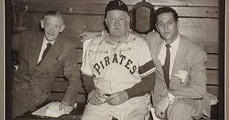
“Open the window Aunt Minnie, here it comes?
Rosey Rowswell
Pittsburgh Pirates 1936 - 1954

Slide 4
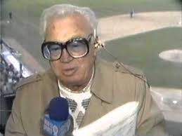
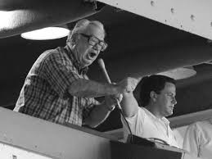
“It could be, it might be…….It is, a home run! Holy Cow!”
Harry Caray
Cardinals, Athletics, White Sox, Cubs

Slide 5
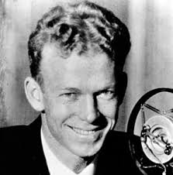
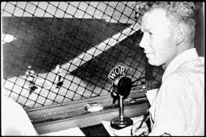
“He’s sitting in the catbird seat”
“The bases are FOB (full of Brooklyns)”
Red Barber
Reds, Dodgers, Yankees

Slide 6
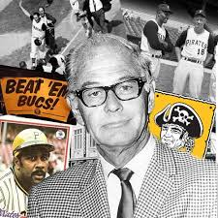
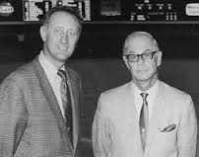
“You can kiss it goodbye!”
Bob Prince
Pittsburgh Pirates, Houston Astros

Slide 7
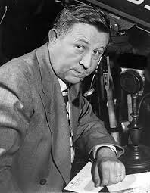
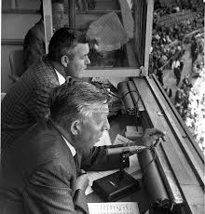
“Branca throws. There’s a long drive! The Giants win the pennant……..”
Russ Hodges
NY Giants, SF Giants……….

Slide 8
What others do you remember?
“Thuuuuuuuuuu Yankees wiiiinnnnnn”
John Sterling, NY Yankees (not rarely enough for me)
“That ball is history”
Eric Nadel, Texas Rangers
“I don’t believe what I just saw”
Jack Buck (after Kirk Gibson homered in Game 1, 1988 WS
“She is gone!”
Vin Scully, Brooklyn and LA Dodgers

