Slide 1
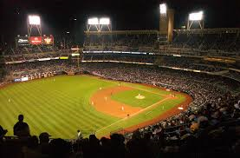
Cubs Win, Cubs Win
Baseball Curses:
The End of the Billy Goat Curse

Slide 2
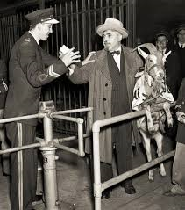
The Curse of the Billy Goat
On 10/06/45, bar owner Billy Sianis brought “Murphy”, the mascot for the Billy Goat Tavern, to Game 4 of the 1945 World Series
Sianis had a ticket for “Murphy”
The goat was refused admission because he smelled so bad
1945 World Series – Detroit Tigers vs. Chicago Cubs

Slide 3
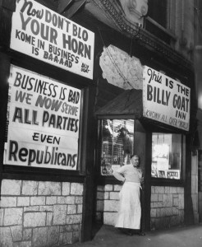
The Curse of the Billy Goat
“You are never going to win the World Series because you insulted my goat!”

Slide 4
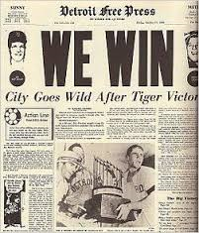
The Curse of the Billy Goat
The Cubs lost Game 4 and two of the next three games
After the World Series, Sianis sent a message to Cubs owner P.K. Wrigley that said:
Who stinks now?

Slide 5
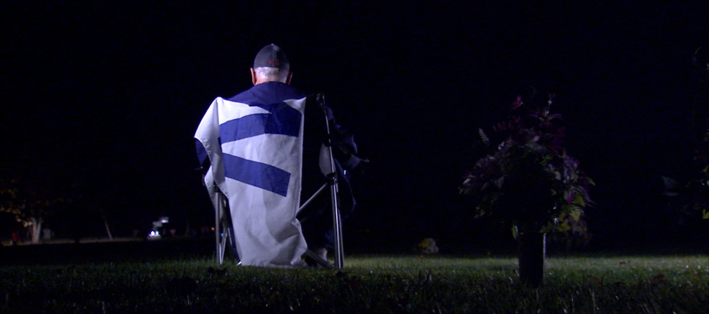
The Curse of the Billy Goat ended in 2016
Notes:
Link to article http://www.wthr.com/article/cubs-fan-shares-world-series-with-late-father-at-greenwood-cemetery

Slide 6
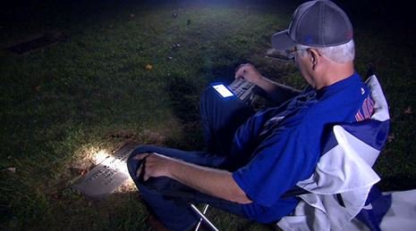
The Curse of the Billy Goat ended in 2016
Notes:
Link to article http://www.wthr.com/article/cubs-fan-shares-world-series-with-late-father-at-greenwood-cemetery

Slide 7
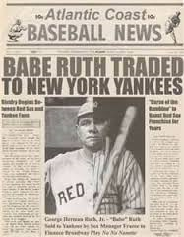
The Curse of the Bambino
In 1920, the Boston Red Sox were baseball’s most successful team; the Yankees had never won a championship
In 1920, Red Sox owner, Harry Frazee, sold Babe Ruth to the New York Yankees for $100,000 and a $300,000 loan (secured by Fenway Park). Reasons:
Help pay for girl friend’s Broadway play
Pay off debts to previous Red Sox owner, Joe Lanin
In the next three years, Frazee sold more of his best players to the Yankees

Slide 8
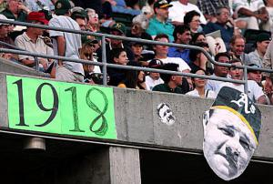
The Curse of the Bambino
The Yankees won their first World Series in 1923
Four of their eight positional players were former Red Sox
Four of their five starting pitchers were former Red Sox
Since 1920, the Yankee have won 26 World Series
The Red Sox did not win their first World Series (since 1918) until 2004

Slide 9
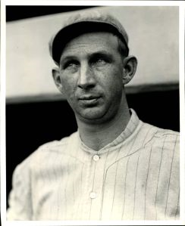
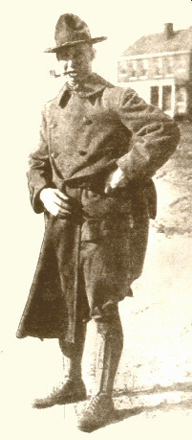
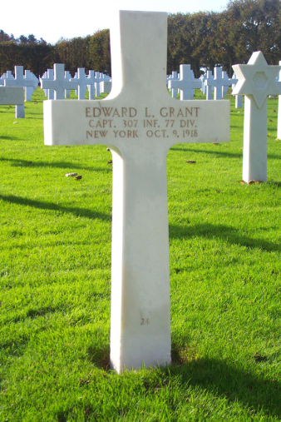
The Curse of Captain Eddie
NY Giants OF and Army Captain, Eddie Grant, was killed in WWI

Slide 10
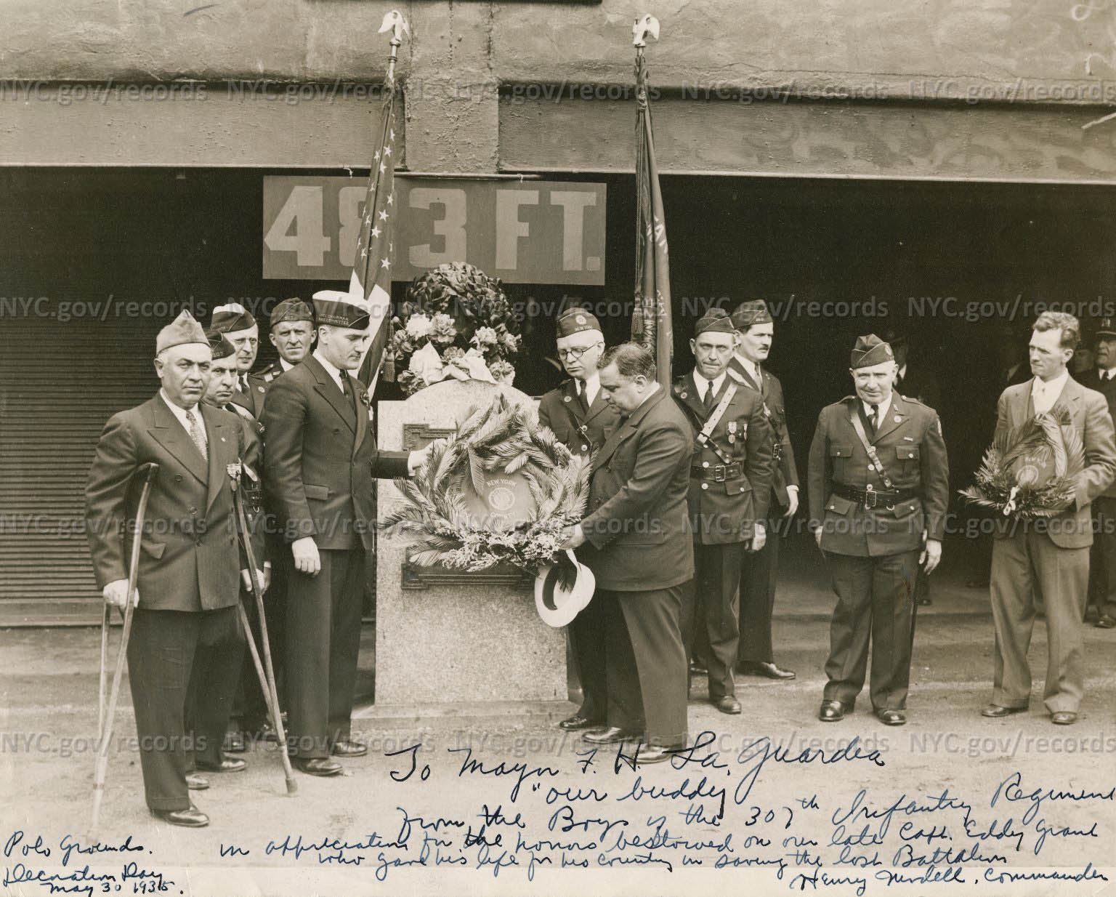
The Curse of Captain Eddie
The Giants installed a plaque in the Polo Grounds honoring Captain Grant
When the Giants moved to San Francisco in 1958, they took the plaque to be displayed Candlestick Park

Slide 11
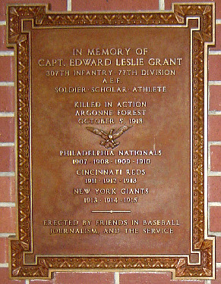
The Curse of Captain Eddie
The plaque was lost
Despite mounting a new plaque, the curse continued for 52 years - until 2010

Slide 12
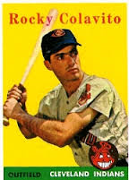
The Curse of Rocky Colavito
On April 17, 1960 – the Indians traded popular outfielder, Rocky Colavito, to the Detroit Tigers for Harvey Kuenn
The year before, Colavito led the AL in home runs
The year before, Kuenn led the AL in highest batting average
The trade was made to blunt Colavito’s popularity and salary demands

Slide 13
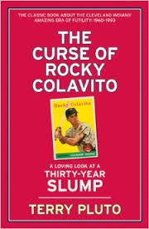
The Curse of Rocky Colavito
The Indians have not won a World Series since the trade

Slide 14
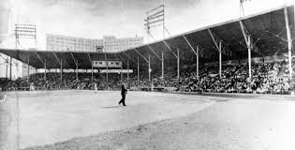
The Curse of Rocky Colavito (more proof)
On the day of the trade, the Indians were playing an exhibition game with the White Sox at Russwood Park in Memphis, Tennessee

Slide 15
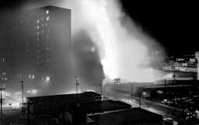
The Curse of Rocky Colavito (more proof)
Five hours after the game ended, the park burned down!

