Slide 1
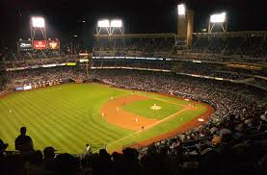
Baseball Favorites

Slide 2
What was your favorite
Baseball Team

Slide 3
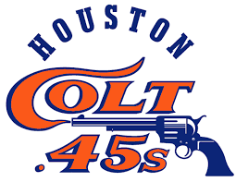
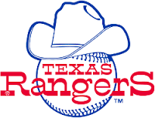
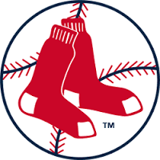
What was your favorite Baseball Team?

Slide 4
My favorite Baseball Teams

Slide 5
Who was your favorite
Baseball Player

Slide 6
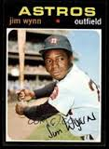
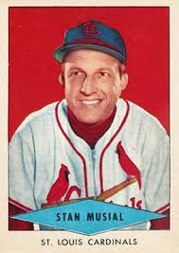
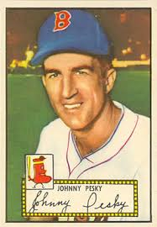
Who was your favorite Baseball Player?
Jimmy Wynn
Houston Astros
Stan Musial
St. Louis Cardinals
Johnny Pesky
Boston Red Sox

Slide 7
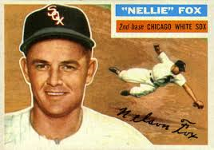
My favorite Baseball Player
Nellie Fox
Chicago White Sox

Slide 8
What was your favorite
Baseball Food

Slide 9
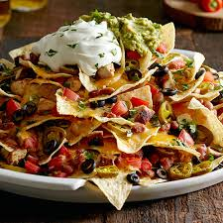
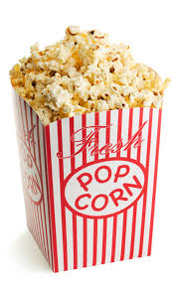
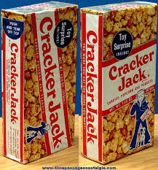
What was your favorite Baseball Food?
Nachos
Popcorn
Cracker Jack

Slide 10
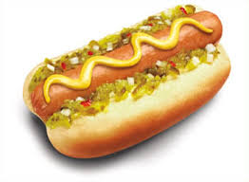
My favorite Baseball Food
Hot Dog

Slide 11
Who was your favorite
Baseball Broadcaster

Slide 12
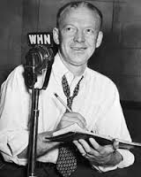
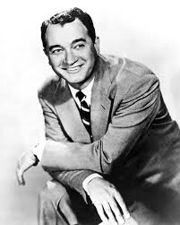
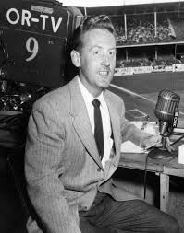
Who was your favorite Baseball Broadcaster?
Red Barber
Mel Allen
Vin Scully

Slide 13
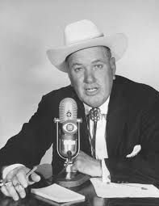
My favorite Baseball Broadcaster
Dizzy Dean

Slide 14
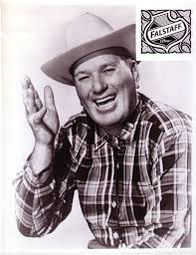
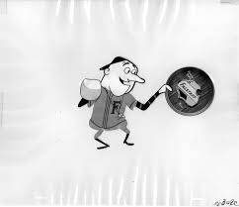
Dizzy Dean, Falstaff Beer and the Ol’ Perfessor

Slide 15
What was your favorite
Baseball Stadium

Slide 16
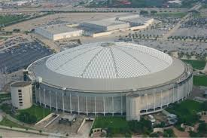
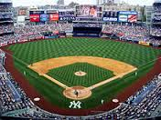
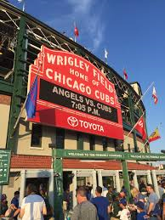
What was your favorite Baseball Stadium?
Astrodome
Yankee Stadium
Wrigley Field

Slide 17
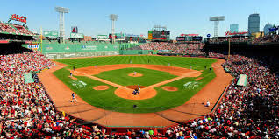
My favorite Baseball Stadium
Fenway Park

Slide 18
What was your favorite
Baseball Nickname

Slide 19
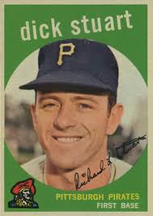
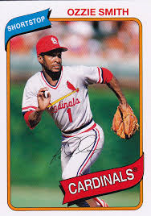
What was your favorite Baseball Nickname?
Jimmy Wynn
“The Toy Cannon”
Dick Stuart
“Dr. Strangeglove”
Ozzie Smith
“The Wizard of Oz”

Slide 20
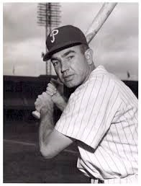
Willie Jones, 3B
Philadelphia Phillies

Slide 21
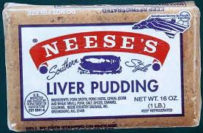
Willie Jones, 3B
Philadelphia Phillies
Puddin’ Head
Willie loved liver pudding and, reportedly, ate it before every game

Slide 22
What was your favorite
Old TV Western

Slide 23
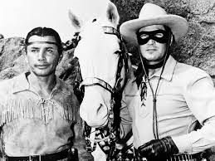
What was your favorite Old TV Western?
The Lone Ranger

Slide 24
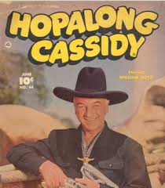
What was your favorite Old TV Western?
Hopalong Cassidy

Slide 25
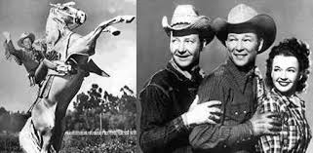
What was your favorite Old TV Western?
The Roy Rogers Show

Slide 26
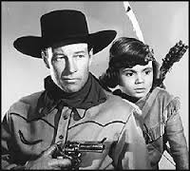
What was your favorite Old TV Western?
Red Ryder (who is the kid?)

Slide 27
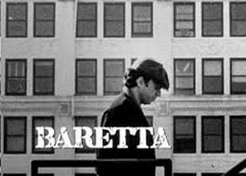
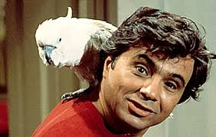
Little Beaver was played by Robert Blake
Blake also appeared in “The Little Rascals” and in the movie “In Cold Blood”

Slide 28
What was your LEAST favorite
Gag Gift for Christmas

Slide 29
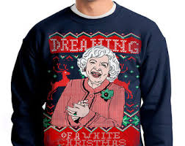
What was your LEAST favorite Christmas Gag Gift?
Ugly Sweater

Slide 30
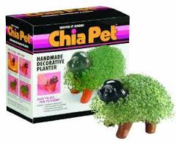
What was your LEAST favorite Christmas Gag Gift?
Chia Pet

Slide 31
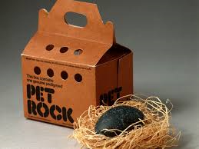
What was your LEAST favorite Christmas Gag Gift?
Pet Rock

Slide 32
What was your favorite
Christmas Song

Slide 33
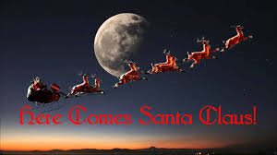
What was your favorite Christmas Song?
Here Comes Santa Claus

Slide 34
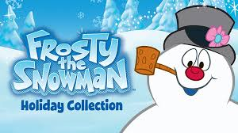
What was your favorite Christmas Song?
Frosty the Snowman

Slide 35
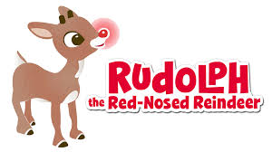
What was your favorite Christmas Song?
Rudolph the Red-Nosed Reindeer

Slide 36

Each of these songs was first released by the same person
Who was it?

Slide 37
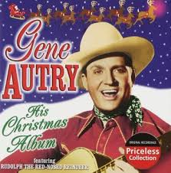
Each of these songs was first released by the same person
Gene Autry – “The Singing Cowboy”

