Slide 1
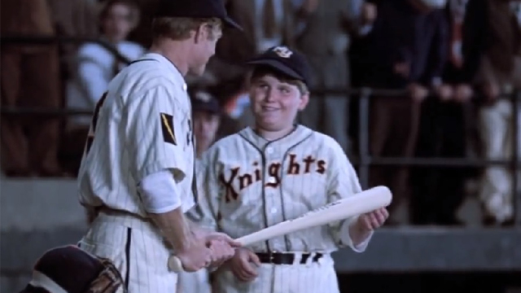
Baseball Mascots
“Pick me out a winner, Bobby.”

Slide 2
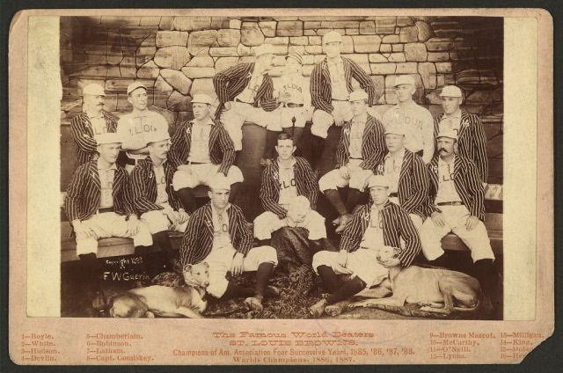
Early Baseball Mascots
Boys, often orphans,
were early mascots
and also
served as batboys
This is “Little Nick”,
the mascot of the
1880’s
St. Louis Browns

Slide 3
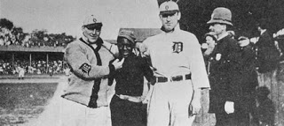
Early Baseball Mascots
Ty Cobb adopted
this homeless boy
as the Tigers’ mascot
in the early 1900s
His name was
Ulysses Harrison, but
he went by the
nickname
“Lucky Rastus”

Slide 4
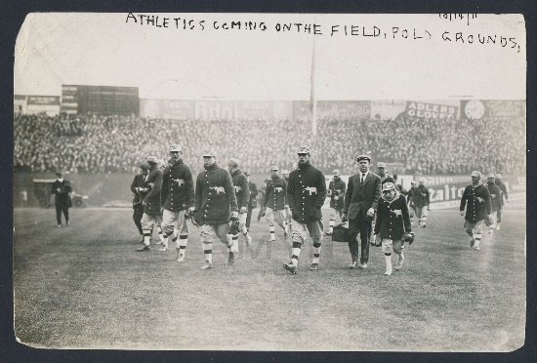
Early Baseball Mascots
In the early 1900s it was considered lucky to associate with a “hunchback”. They were considered to have good insights, thus the term
“having a hunch”.
Louis Van Zelst was
the mascot for the
1910’s Athletics

Slide 5
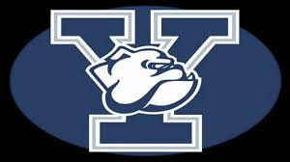
Animal Mascots
Having an animal mascot began in college football in the late 1880s.
Yale University had one of the first …

Slide 6
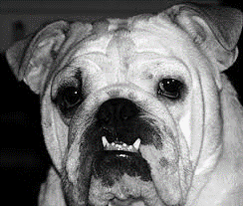
Animal Mascots
“Handsome Dan”
Today, Yale’s bulldog mascot is Handsome Dan XVIII.
There is a hot dog at
Shake Shack named for him.

Slide 7
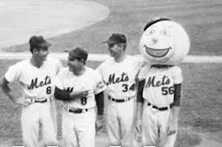
Celebrity Mascots
In the 1960s, we see the advent of the “celebrity” mascot. This trend has continued to the current day, with 27 of 30 MLB teams now having a “celebrity” mascot.
“Mr. Met” was the first of these in 1964 during the inaugural season at
Shea Stadium.
Mr. Met

Slide 8
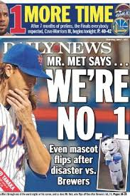
Mr. Met got some
bad press recently
https://www.youtube.com/watch?v=fUchlDzSADs

Slide 9
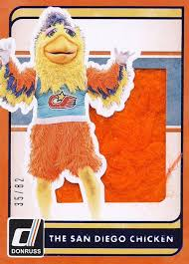
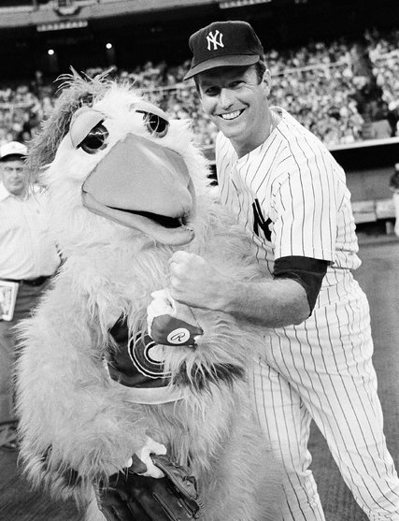
Celebrity Mascots
Probably the most famous of the “Celebrity” Mascots.
The Chicken got its start in 1974 as a promotional character for a San Diego radio station.
He eventually became
“The Famous Chicken” as he expanded beyond baseball and the San Diego area.
https://www.youtube.com/watch?v=9KdjhWTMZII
The San Diego Chicken

Slide 10
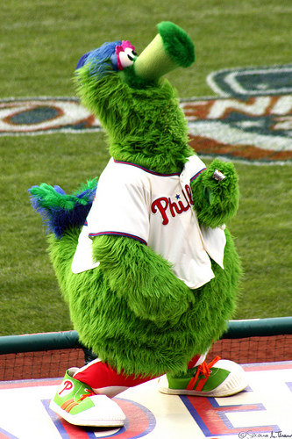
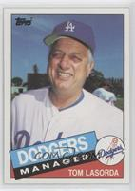
Celebrity Mascots
Created by the Philadelphia Phillies promotions department in 1977 to compete with the San Diego Chicken
Now considered to be one of the most recognizable baseball mascots.
The Phanatic did not get along with Dodgers manager
Tommie Lasorda:
https://www.youtube.com/watch?v=vX4L2LHGs98
The Phillie Phanatic

Slide 11
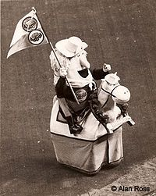
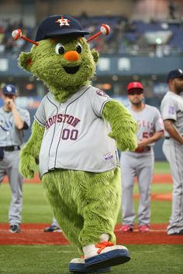
Astros Mascots
“Chester Charge” was the Houston Astros’ mascot beginning in 1977 at the Astrodome.
“Orbit” became the Astros’ mascot in 1990.
Orbit was actually ejected from a game in 1988 by home plate umpire Gary Darling for arguing balls and strikes.
Chester Charge & Orbit

Slide 12
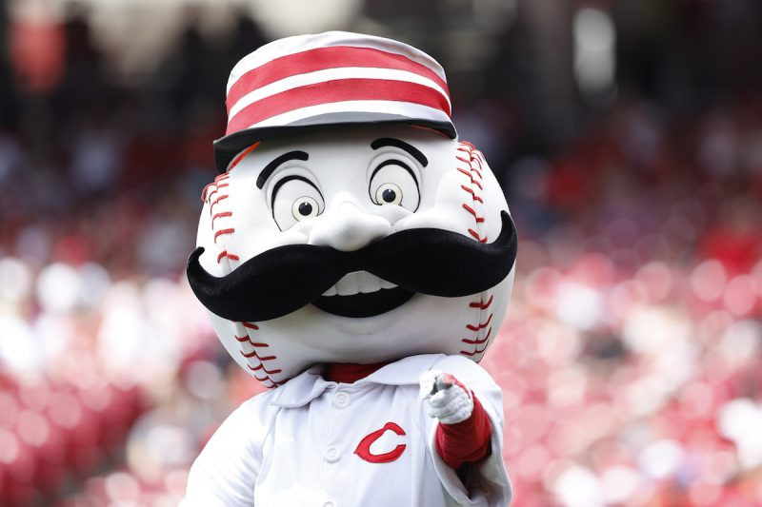
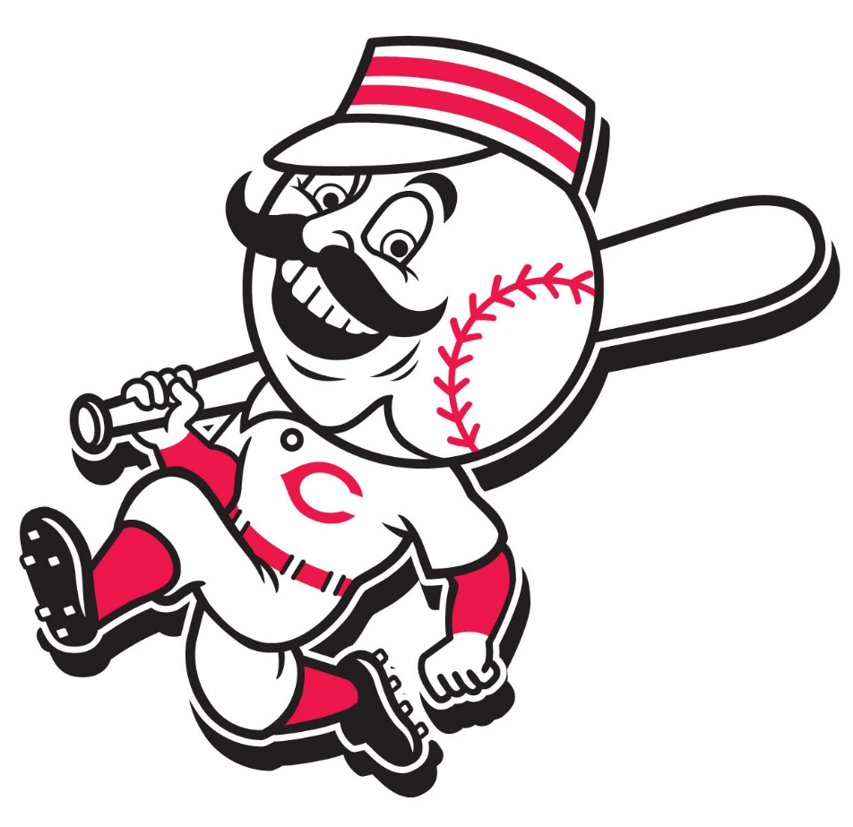
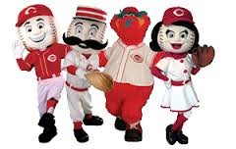
Reds Mascot
“Mr. Red” first appeared as a sleeve patch on the Reds uniforms in 1955. He is also called “The Running Man” for his action pose.
The human version of the mascot appeared in the 1975 World Series.
Today there are four mascots: Mr. Red, Rosie Red, Mr. Redlegs, and Gapper.
Mr. Red

Slide 13
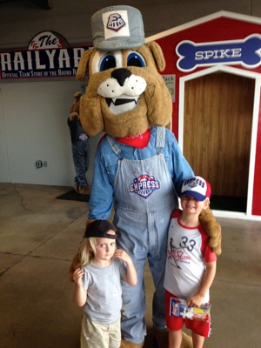
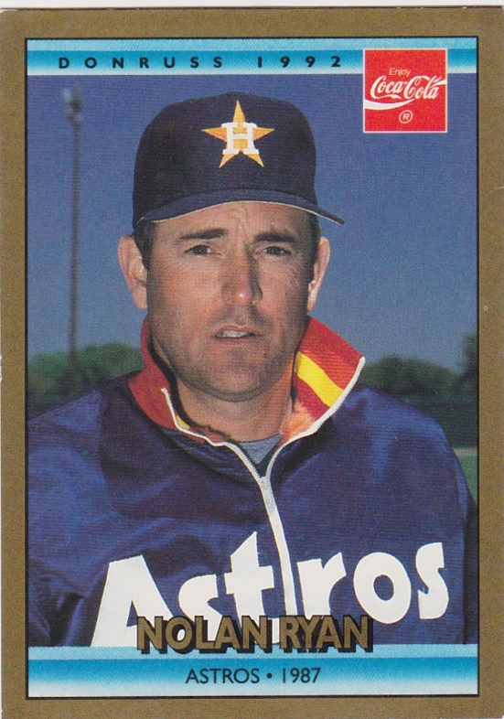
Round Rock Express Mascot
“Spike” has been the mascot of the Round Rock Express since the franchise moved to Texas in 2000.
His name comes from a railroad tie spike, in keeping with the “Express” theme named after the team’s famous owner.
Spike
The Ryan “Express”

Slide 14
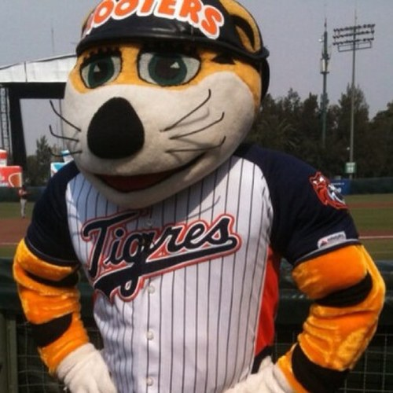
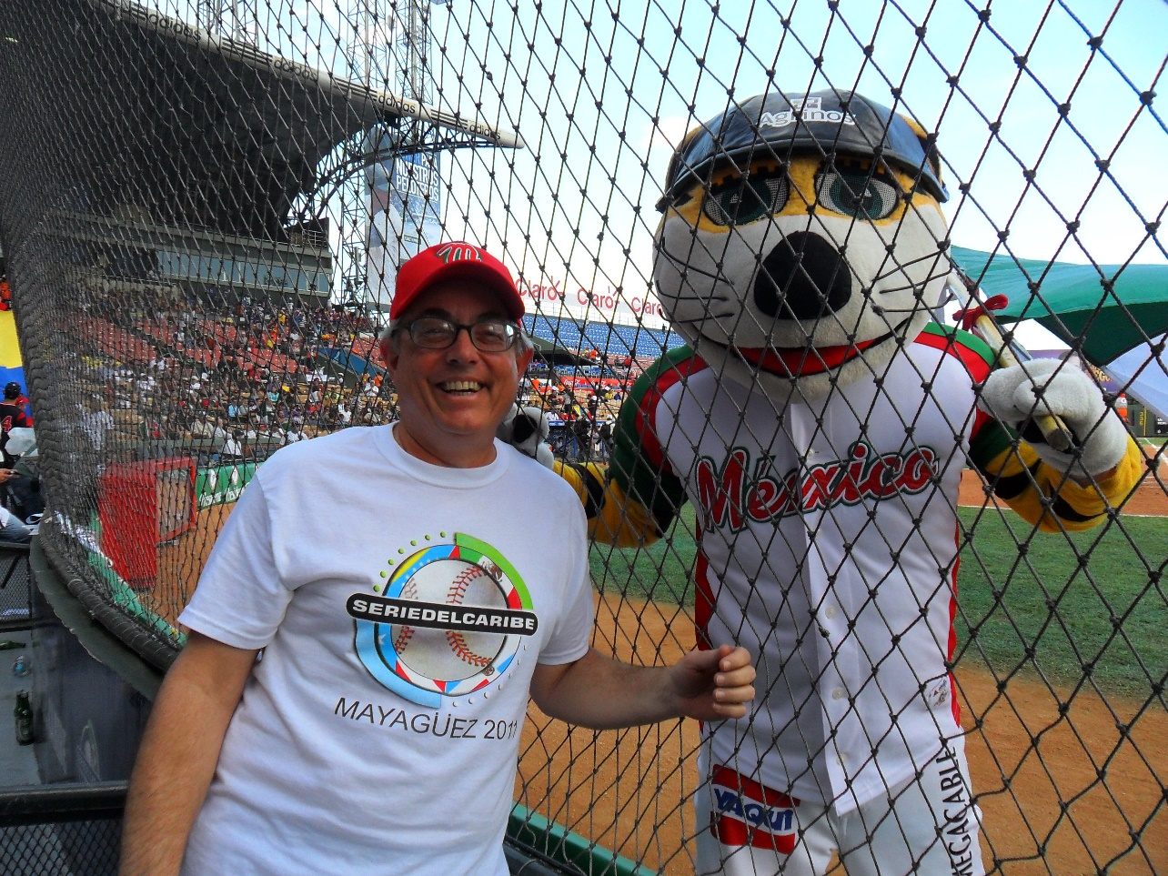
Mascots South of the Border
Chacho the Tiger is the most popular mascota de beisbol in Mexico.
He is so popular he works both summer and winter ball for different teams.
His routines are a little more risqué than his American counterparts:
https://www.youtube.com/watch?v=YmZnuqCJ5-w
el Tigre “Chacho”

Slide 15
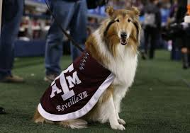
More Animal Mascots
Reveille
The Texas A&M Aggies’ mascot since 1931.
The current mascot is
Reveille IX.

Slide 16
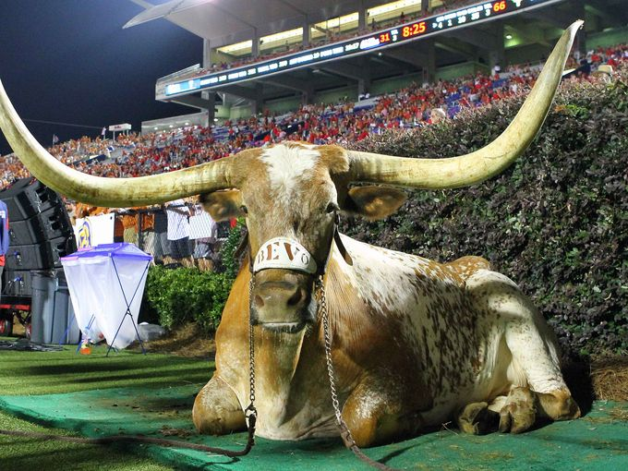
More Animal Mascots
Bevo
Made his first appearance as
University of Texas’ mascot at the Thanksgiving Day game in 1916.
Bevo I was originally named “Bo”, but he was soon renamed “Bevo” after a popular amber-colored non-alcoholic drink that also debuted in ’16.
The current mascot is
Bevo XV
Notes:
Bevo II once charged an SMU cheerleader, who had to defend himself with his megaphone.^{[4]}
Bevo III escaped from his enclosure and ran amok across campus for 2 days.^{[4]}
Bevo IV once attacked a parked car
Bevo V broke loose and scattered the Baylor band.^{[4]}
More recent Bevos have had a more peaceful tenure.

Slide 17
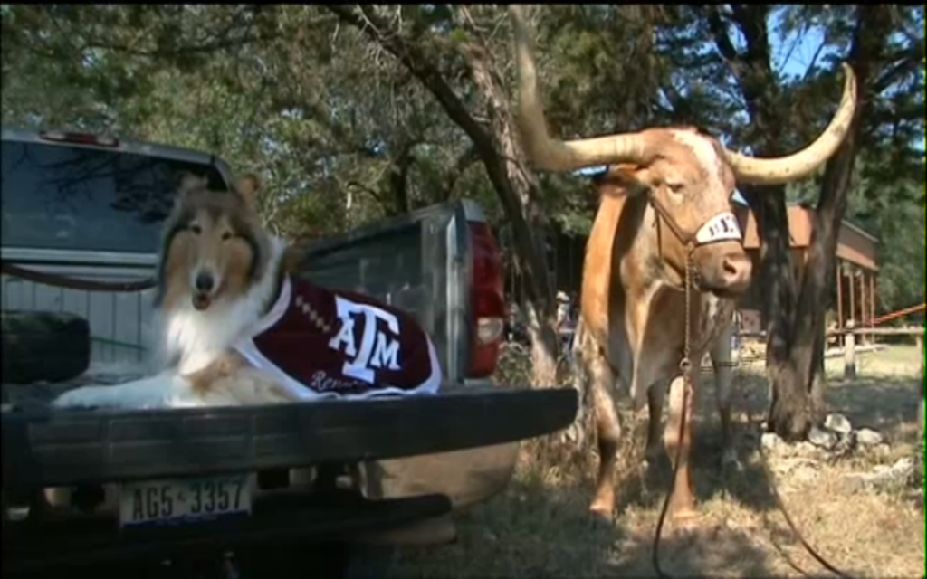
Reveille visits Bevo at his ranch
Notes:
Bevo II once charged an SMU cheerleader, who had to defend himself with his megaphone.^{[4]}
Bevo III escaped from his enclosure and ran amok across campus for 2 days.^{[4]}
Bevo IV once attacked a parked car
Bevo V broke loose and scattered the Baylor band.^{[4]}
More recent Bevos have had a more peaceful tenure.

Slide 18
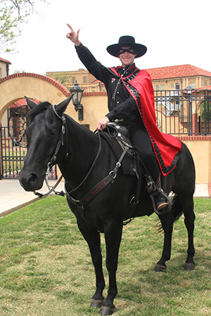
Masked Rider
Has been the Texas Tech
mascot since the 1954 Gator Bowl.
Was the first mounted mascot in
college football, and soon
copied by USC, Florida State, and
T. Boone Pickens U. (…otherwise known
as Oklahoma State)
Notes:
Bevo II once charged an SMU cheerleader, who had to defend himself with his megaphone.^{[4]}
Bevo III escaped from his enclosure and ran amok across campus for 2 days.^{[4]}
Bevo IV once attacked a parked car
Bevo V broke loose and scattered the Baylor band.^{[4]}
More recent Bevos have had a more peaceful tenure.

Slide 19
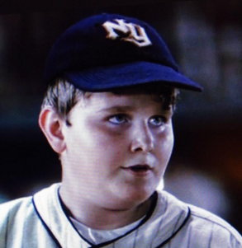
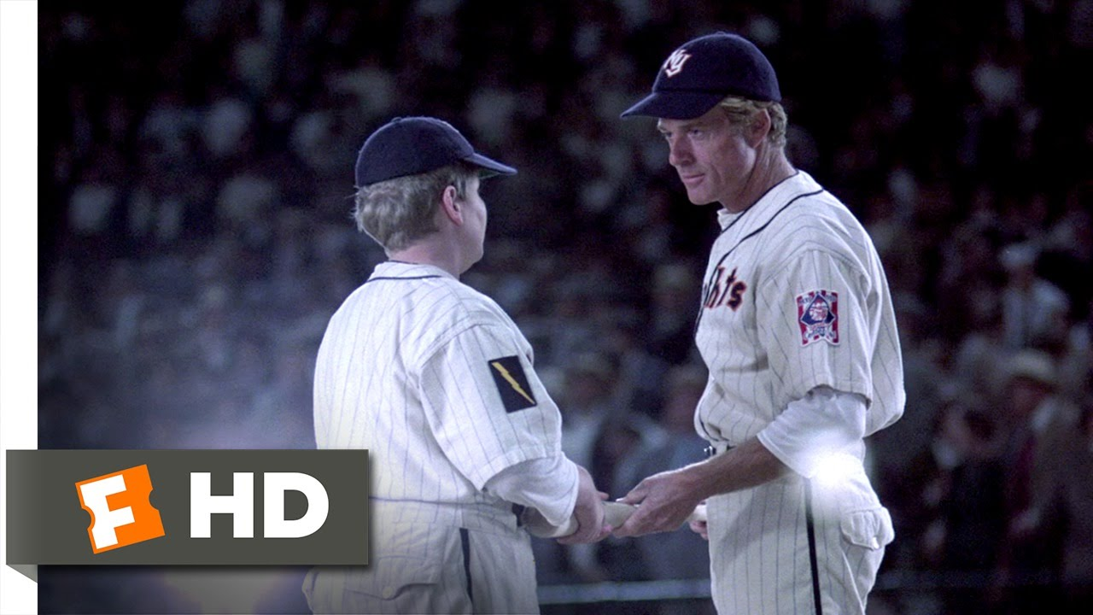
Baseball Mascots in the Movies
Bobby Savoy
New York Knights
“The Natural”
https://www.youtube.com/watch?v=2QGYIM-8y38

Slide 20
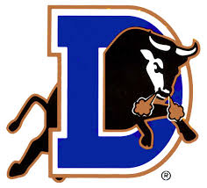
Baseball Mascots in the Movies
the Durham Bull
in
“Bull Durham”
https://www.youtube.com/watch?v=euHfP6X_axY
https://www.youtube.com/watch?v=85RZMIAL7vM

Slide 21
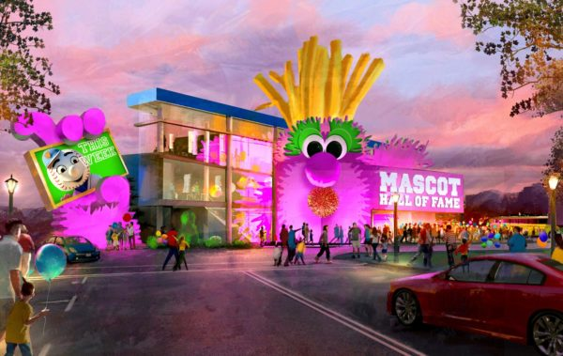
Mascot Hall of Fame
Current inductees
include – from MLB
Mr. Met
Philly Phanatic
The Chicken
Collegiate include
Brutus Buckeye
Bucky Badger
Scheduled to open in 2018 in Whiting, Indiana (Chicago metro area)

Slide 22
The next time you’re at Dell Diamond
Have some fun with a mascot !!

