Slide 1
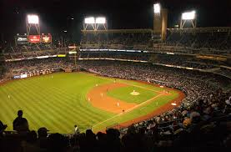
Baseball Movies

Slide 2
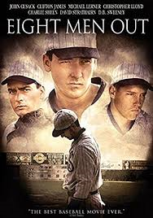
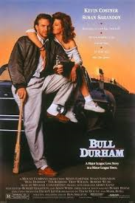
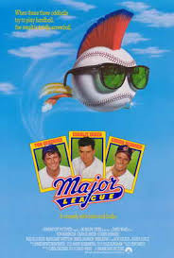
Paul’s favorite Baseball Movies
Eight Men Out
Bull Durham
Major League

Slide 3
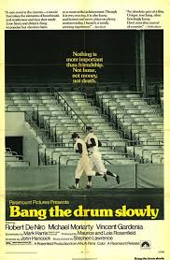
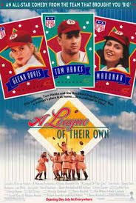
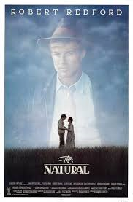
Mike’s favorite Baseball Movies
Bang the Drum Slowly
A League of Their Own
The Natural

Slide 4
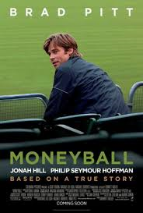
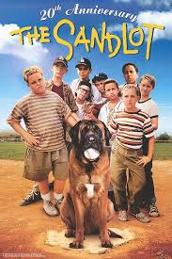
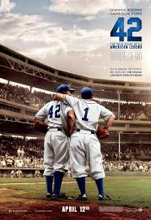
What was your favorite Baseball Movie?
Moneyball
The Sandlot
42

Slide 5
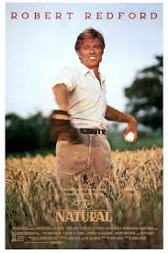
The Natural

Slide 6
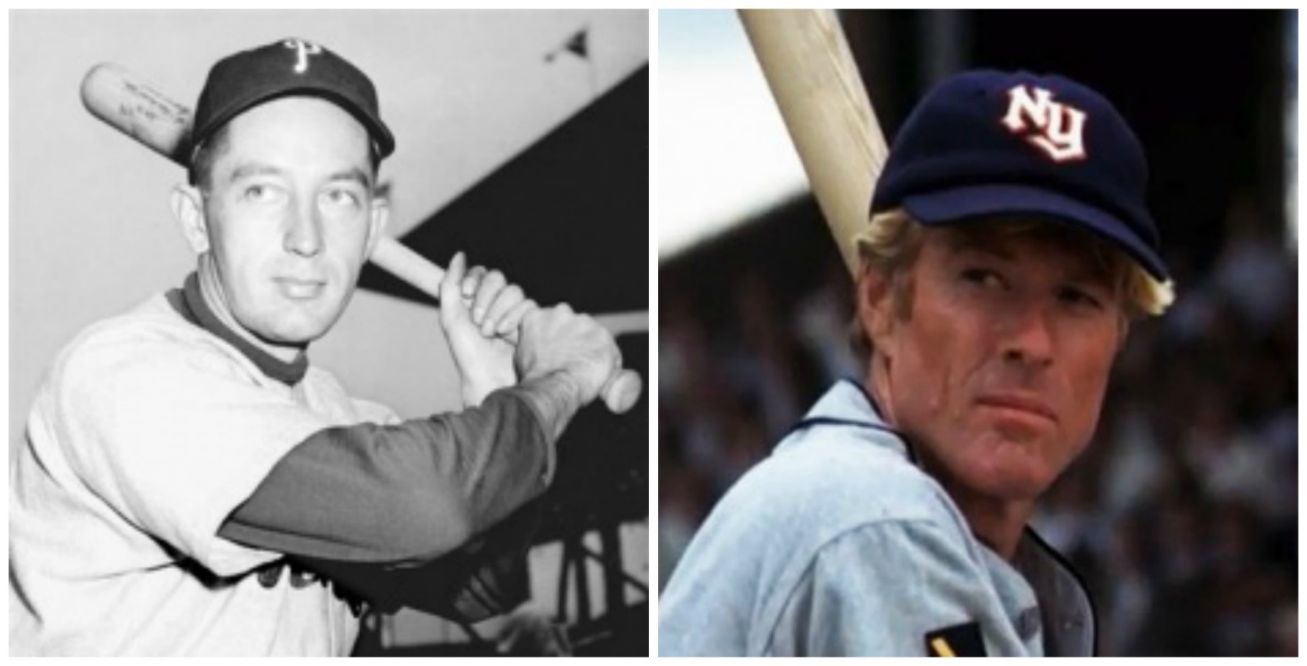
The Natural
Robert Redford played a character loosely based on Eddie Waitkus of the Philadelphia Phillies. Waitkus was shot by a deranged fan in 1949.

Slide 7
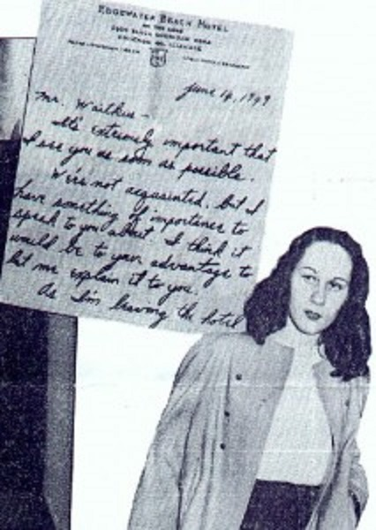
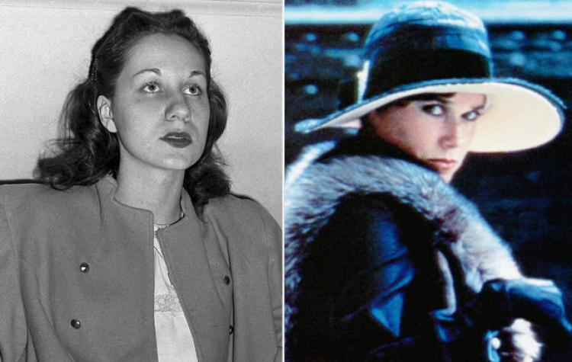
The Natural
On the night of June 14, 1949, Ruth Ann Steinhagen gave $5 tip to a bellhop at the Edgewater Beach Hotel in Chicago to deliver a note to another guest, Eddie Waitkus, first baseman for the visiting Phillies.
Notes:
Barbara Hershey played Harriet Bird – the “would be” shooter

Slide 8
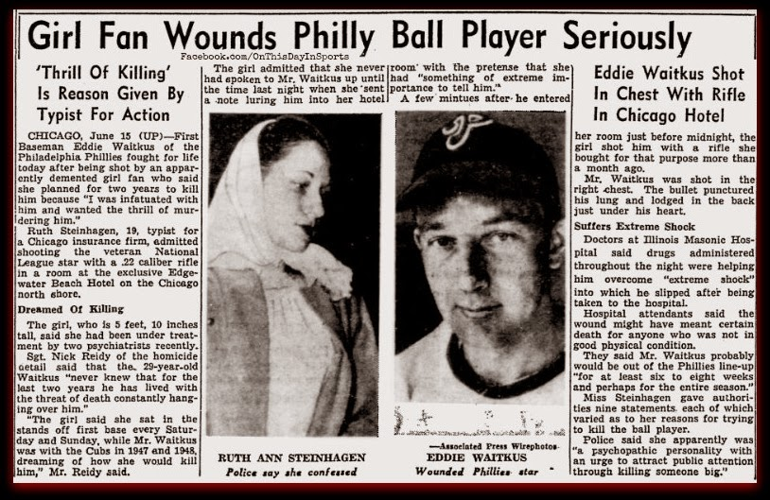
The Natural

Slide 9
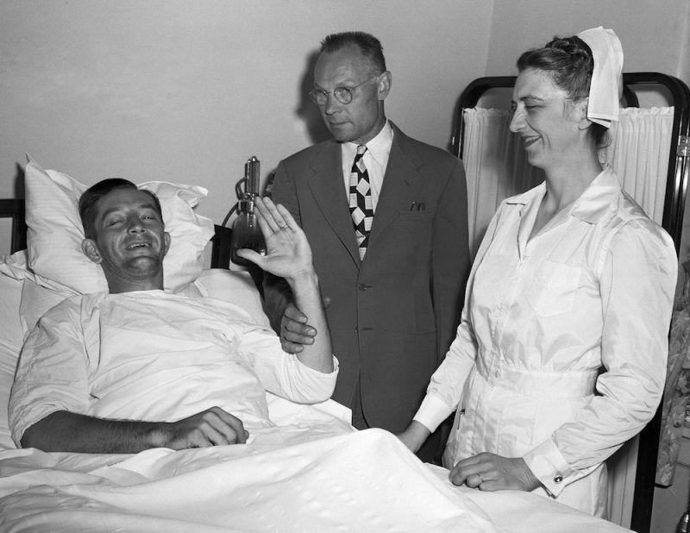
The Natural
Waitkus survived the attack and resumed his career the next season. He was the starting 1B for the Phillies in the 1950 World Series.

Slide 10
The Natural
Steinhagen was jailed but later declared insane and spent three years in a mental hospital

Slide 11
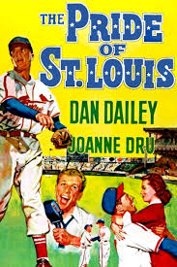
The Pride of St. Louis

Slide 12
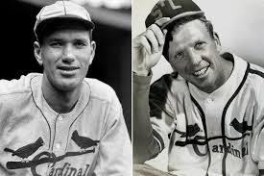
The Pride of St. Louis
Dan Dailey played Dizzy Dean

Slide 13
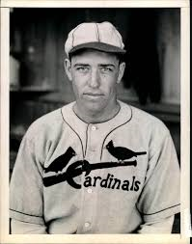
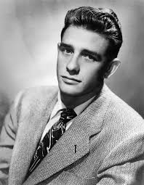
The Pride of St. Louis
Richard Crenna played Paul Dean

Slide 14
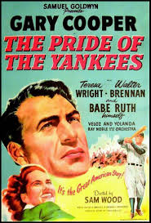
The Pride of the Yankees

Slide 15
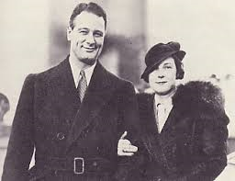
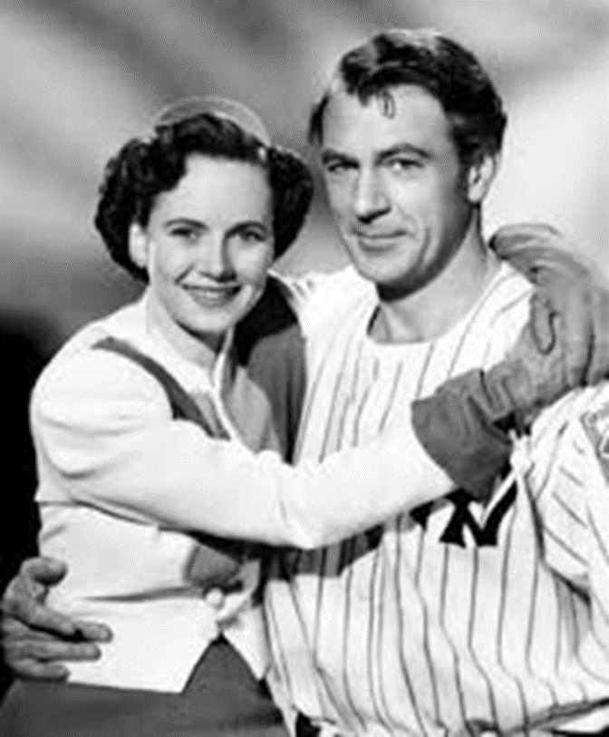
The Pride of the Yankees
Gary Cooper played Lou Gehrig; Teresa Wright played Eleanor Gehrig

Slide 16
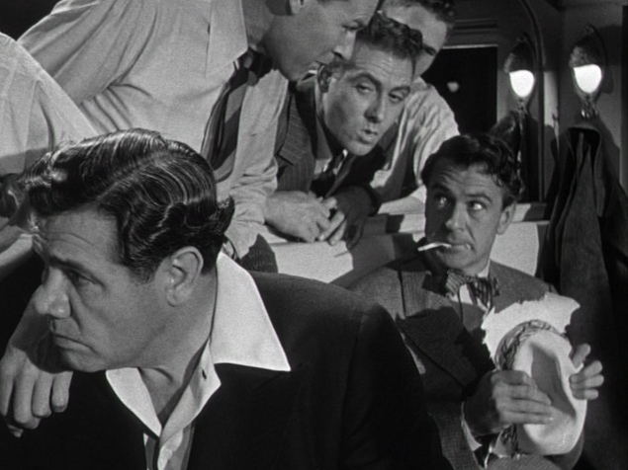
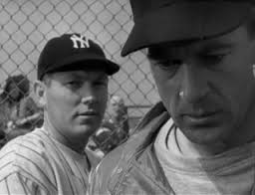
The Pride of the Yankees
Hall of Famers Babe Ruth and Bill Dickey played themselves

Slide 17
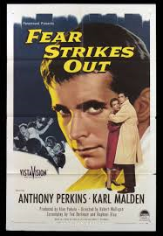
Fear Strikes Out

Slide 18
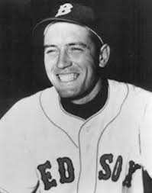
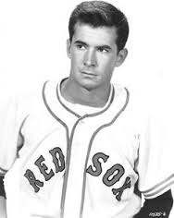
Fear Strikes Out
Anthony Perkins played Jimmy Piersall

Slide 19
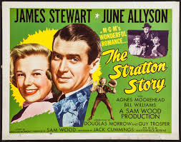
The Monty Stratton Story

Slide 20
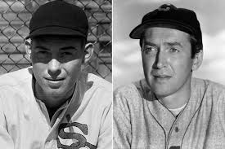
The Monty Stratton Story
Jimmy Stewart played Monty Stratton

Slide 21
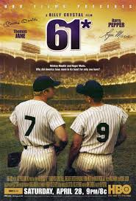
61*

Slide 22
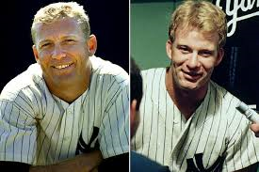
61*
Thomas Jane played Mickey Mantle

Slide 23
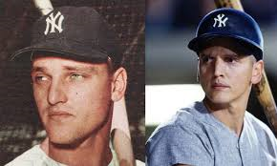
61*
Barry Pepper played Roger Maris

Slide 24
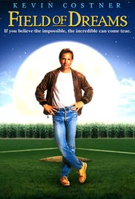
Field of Dreams

Slide 25
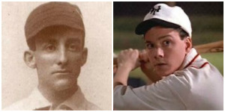
Field of Dreams
Frank Whaley played Archibald “Moonlight” Graham

Slide 26
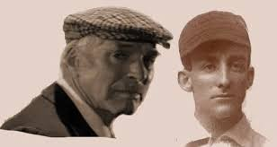
Field of Dreams
Burt Lancaster played an older “Moonlight” Graham
Notes:
Jimmy Stewart was the first choice for the role but he turned it down.

Slide 27
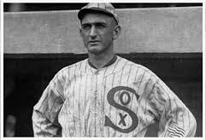
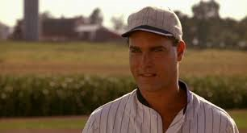
Field of Dreams
Ray Liotta played “Shoeless” Joe Jackson

Slide 28
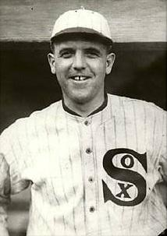
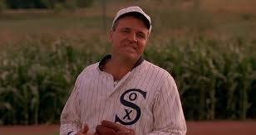
Field of Dreams
Steve Eastin played Eddie Cicotte

Slide 29
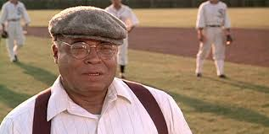
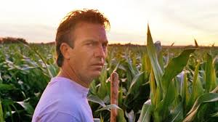
Field of Dreams
James Earl Jones as Terence Mann
Kevin Costner as Ray Kinsella
Notes:
In the book “Shoeless Joe”, author J.D. Salinger was the author that Costner was going to “kidnap” and take to Iowa. Salinger threatened to sue to name changed to fictional character Terence Mann. Ray Kinsella was a character in an obscure Salinger novel “A Young Girl in 1941 With No Waist at All”

Slide 30
Bull Durham

Slide 31
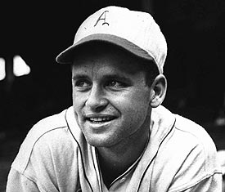
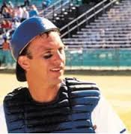
Bull Durham
Kevin Costner played Crash Davis

Slide 32
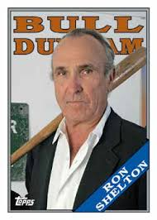
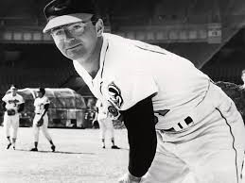
Nuke LaLoosh
Film Director, Ron Shelton, played minor league baseball with pitcher Steve Dalkowski. Dalkowski was the inspiration for Nuke LaLoosh.
Dalkowski averaged 12.63 strikeouts per 9 innings, but…………………….

Slide 33
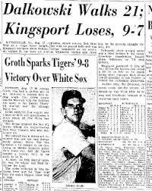
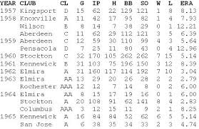
He also averaged 12.25 walks per 9 innings

