Slide 1
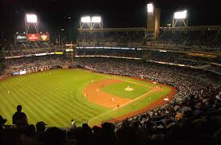
Baseball Nicknames

Slide 2
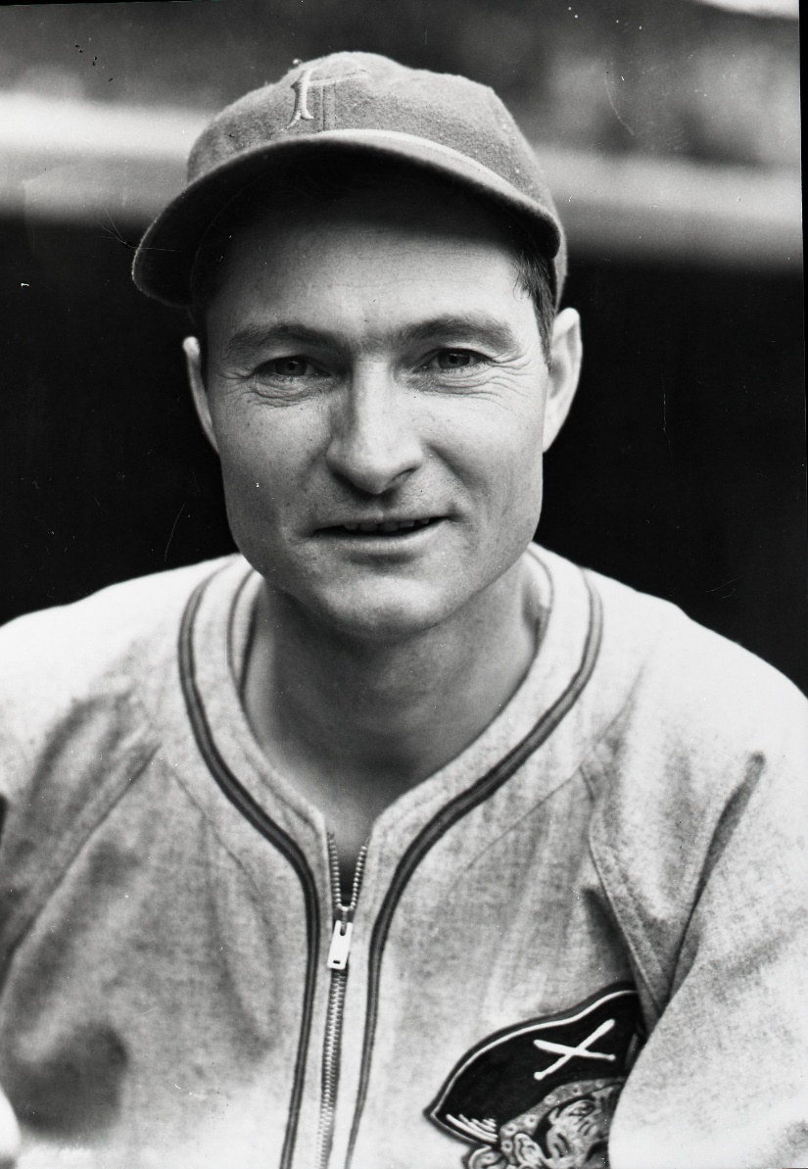
Lloyd Waner

Slide 3
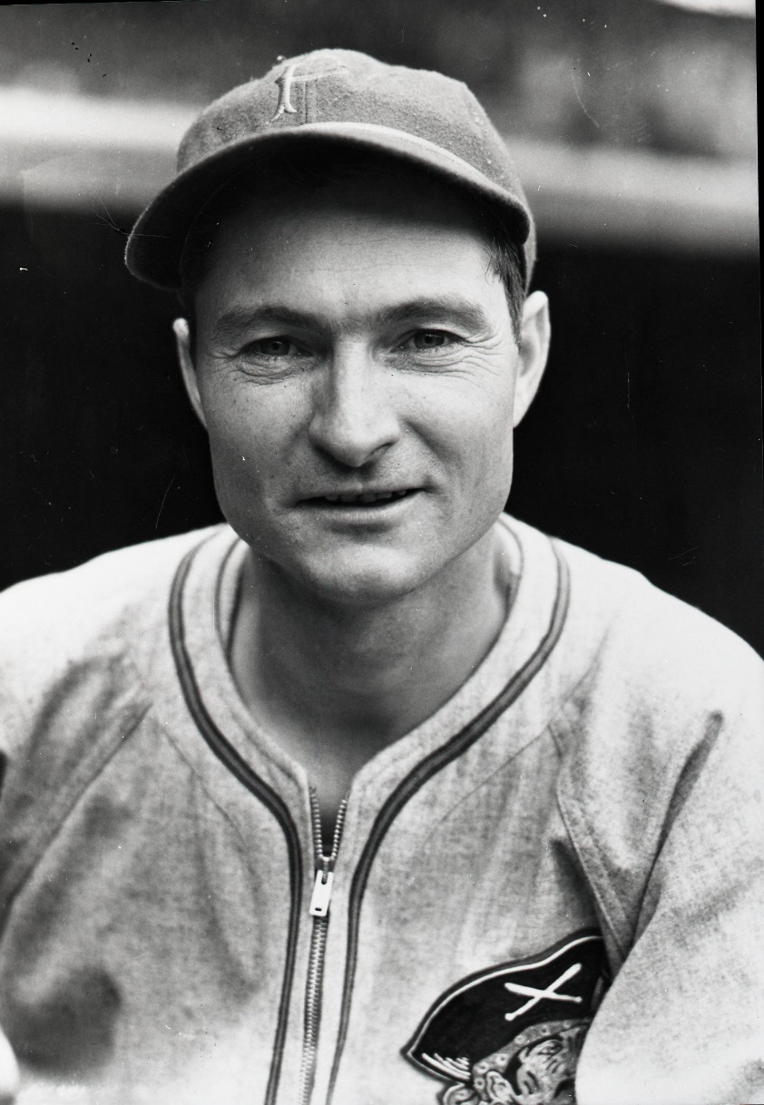

Lloyd Waner
Little Poison

Slide 4
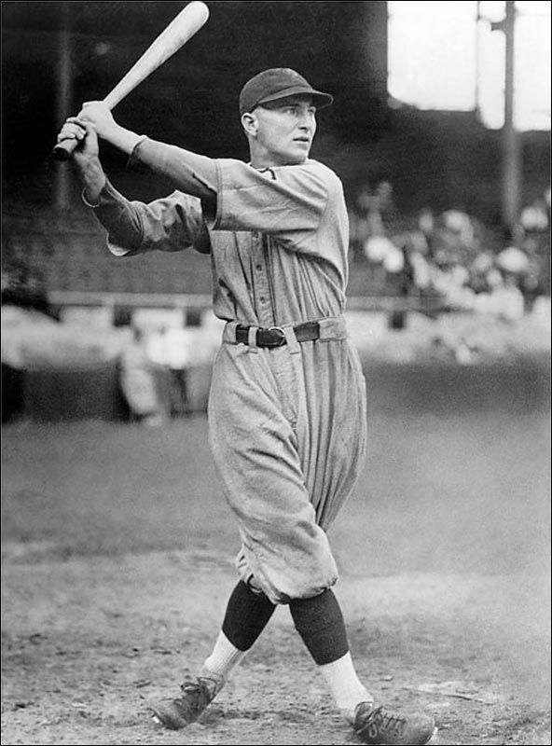
Paul Waner

Slide 5
Paul Waner
Big Poison
Lloyd and Paul Waner are the only brothers in the Hall of Fame.

Slide 6
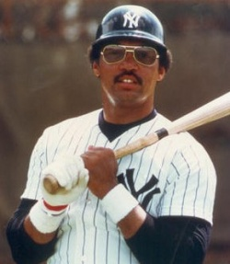
Reggie Jackson

Slide 7
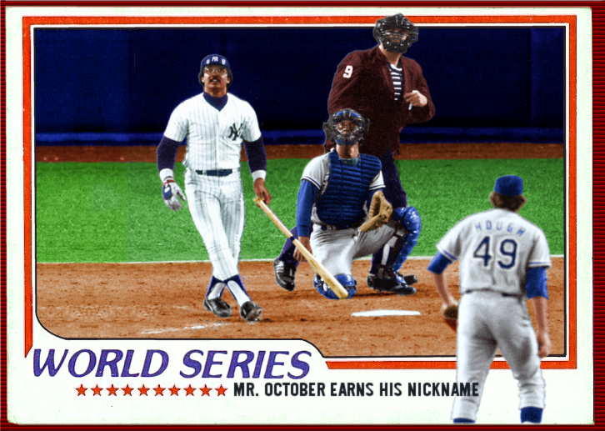
Reggie Jackson
Mr. October
Seemed to shine brightest in playoff and World Series games.

Slide 8
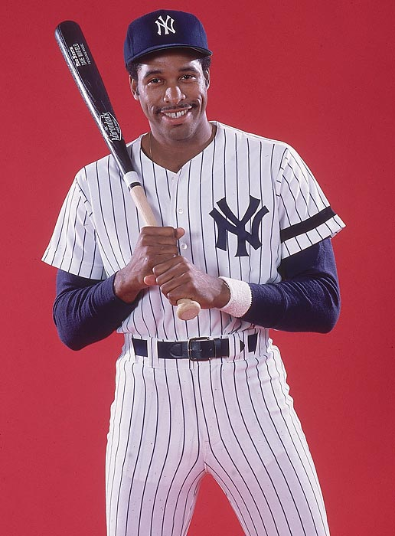
Dave Winfield

Slide 9
Dave Winfield
Mr. May
1981 post-season with Yankees:
.182, 0 HR, 3 RBI in 14 games.
.045, 0 HR, 1 RBI in World Series.
Notes:
George Steinbrenner gave him this nickname after paying him so much as a free agent and getting very little in the playoffs/WS.

Slide 10
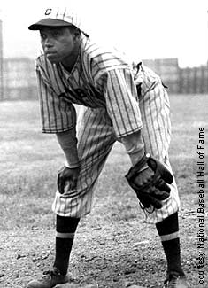
William Johnson

Slide 11

William Johnson
Judy
Judy Gans
Two different stories about his nickname.
Notes:
Resembled Judy Gans. ALSO hotel mistress story.

Slide 12
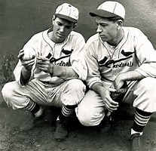
Jay and Paul Dean

Slide 13
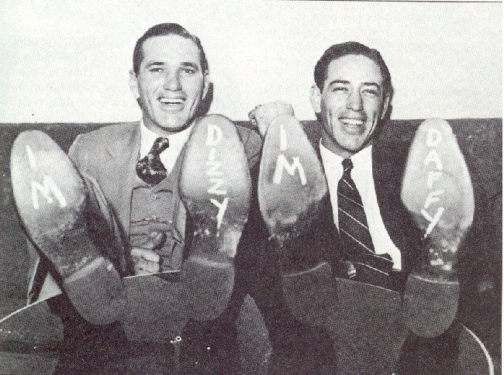
Jay and Paul Dean
Dizzy and Daffy

Slide 14
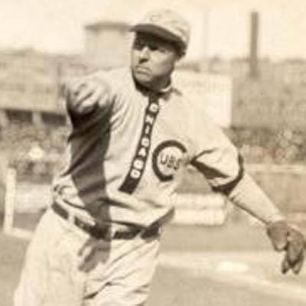
Mordecai Centennial Brown

Slide 15
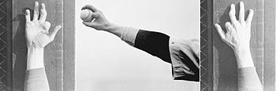
Mordecai Centennial Brown
Three-Fingered Brown
Farm accident at age 12.
Notes:
Middle name “Centennial” because he was born in 1876.

Slide 16
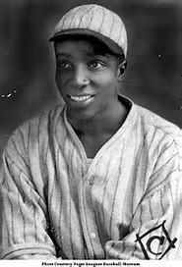
James Bell

Slide 17
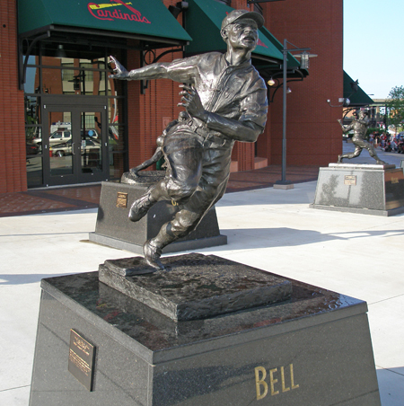
James Bell
Cool Papa Bell
Maybe fastest player ever. Scored on a sacrifice bunt from 1st base.
Notes:
Chopper up the middle that hit him sliding into second. Satchel Paige said, “He was so fast he could turn off the lights and be in bed before the room got dark.”

Slide 18
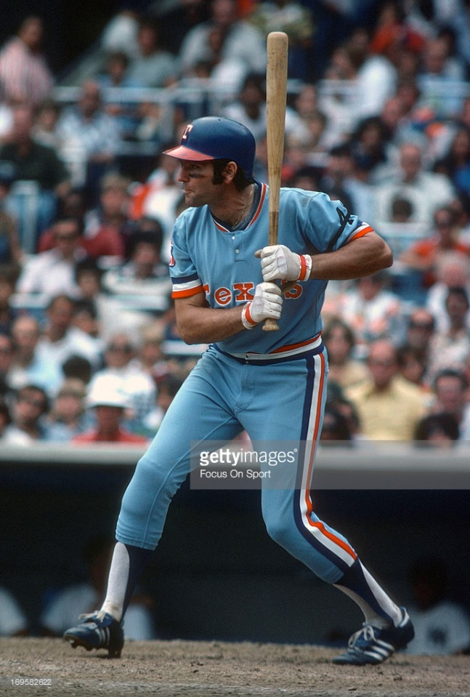
Mike Hargrove

Slide 19
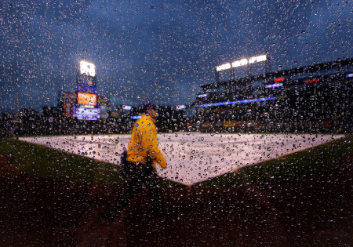
Mike Hargrove
The Human Rain Delay

Slide 20
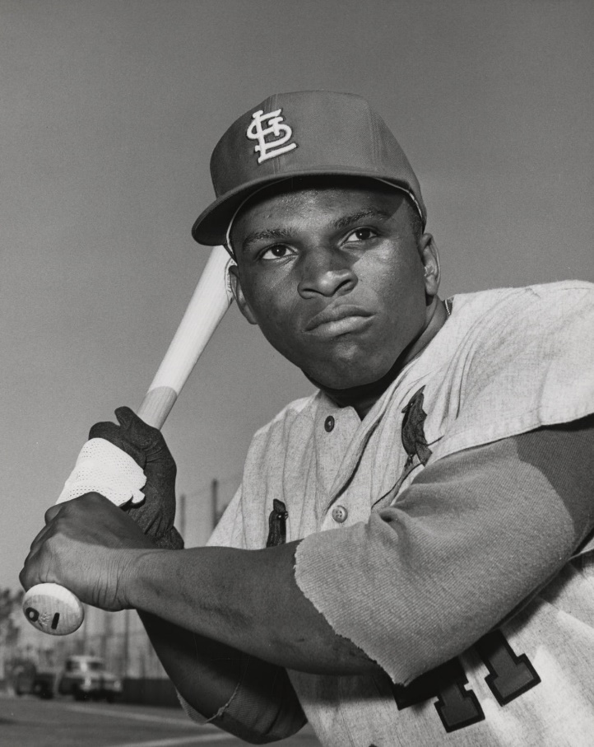
Walt Williams

Slide 21
Walt Williams
No Neck
Got a typhus shot in his neck as a baby, which stiffened and shrank his neck.

Slide 22
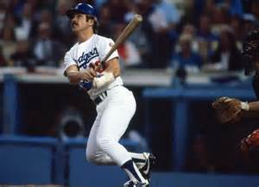
Ron Cey

Slide 23
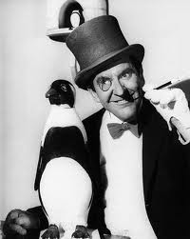
Ron Cey
The Penguin
Notes:
Short and stocky and waddled around the bases like a penguin.

Slide 24
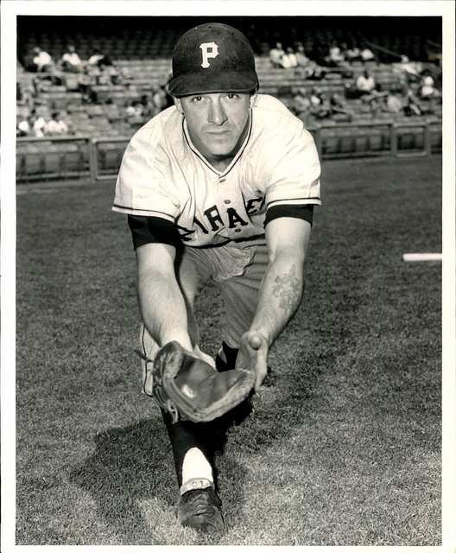
Dick Stuart

Slide 25
Dick Stuart
Dr. Strangeglove
Stonefinger
The Man With The Iron Glove
The Ancient Mariner
Notes:
Opening line in the Samuel Taylor Coleridge poem The Rime of the Ancient Mariner. "It is an ancient mariner, And he stoppeth one of three”.

Slide 26
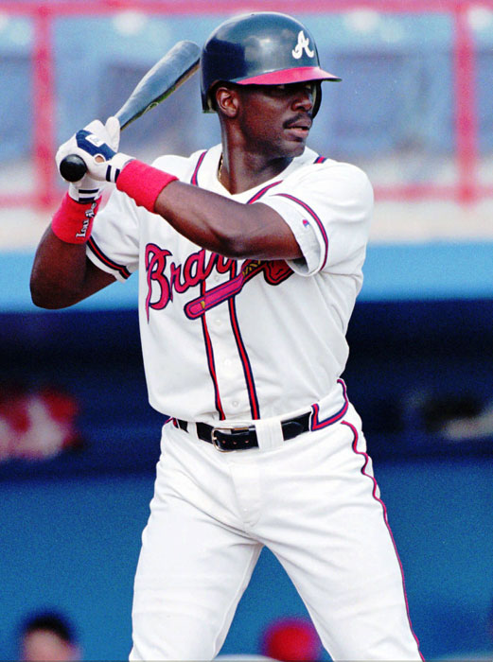
Wonder Monds
His full birth name?

Slide 27
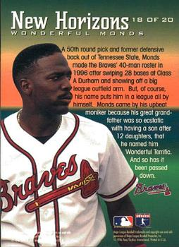
Wonder Monds
Wonderful Terrific Monds III

Slide 28
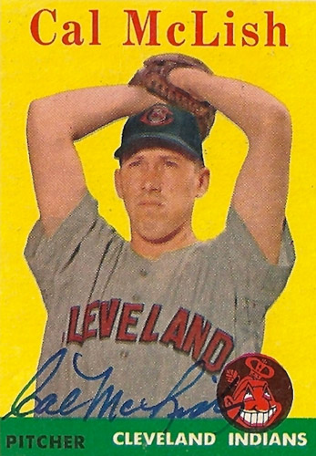
Cal McLish

Slide 29
Cal McLish
Nicknamed “Bus” because he travelled between so many teams.
His full birth name?
Notes:
Played for 12 major league and minor league teams.

Slide 30
Cal McLish
Calvin Coolidge Julius Caesar Tuskahoma McLish
Notes:
His father wasn’t allowed to name Cal’s 6 older siblings. After their 6 child, his mother said she was done having kids. But she jokingly told his Dad that if there were any more, he could name it.

