Slide 1
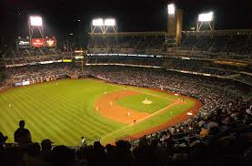
Baseball Oddities

Slide 2
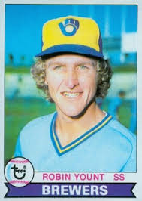
Robin Yount
Played 20 seasons (1974 – 1993). Elected to Hall of Fame in 1999
Notes:
Yount played 20 seasons in the major leagues and was elected to the HOF. How many All Star teams did he make?

Slide 3
Robin Yount
Played 20 seasons (1974 – 1993). 3 X All Star – 1980, 1982, 1983
Notes:
The fewest number of All Star games for any HOFer who played the majority of career after 1933 (when the All Star game was started): Bert Blyleven -2, Ferguson Jenkins - 3

Slide 4
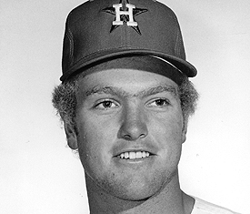
Robin Yount’s brother, Larry Yount
“Pitched” for Houston Astros in 1971

Slide 5
Larry Yount’s Career Stats
Year | Age | Team | W | L | ERA | G | GS | GF | Save | IP | Hits | K | BB
1971 | 21 | Hou | 0 | 0 |  | 1 | 0 | 0 | 0 | 0 | 0 | 0 | 0
Notes:
Yount hurt his arm warming up. Because he was announced, he is credited with playing in one game even though he never threw a pitch.

Slide 6
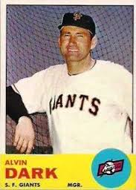
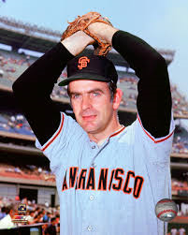
Alvin Dark and Gaylord Perry
Notes:
When manager of the Giants in the early 1960’s, Alvin Dark said of Gaylord Perry – “They’ll put a man on the moon before Gaylord hits a home run!”

Slide 7
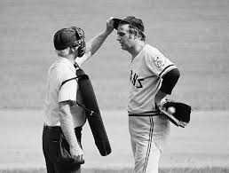
Gaylord Perry hit his first home run on July 20, 1969

Slide 8
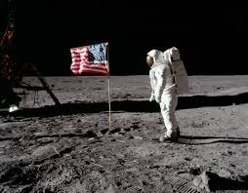
Gaylord Perry hit his first home run twenty minutes after
Notes:
20 minutes after the lunar landing (not the walk)

Slide 9
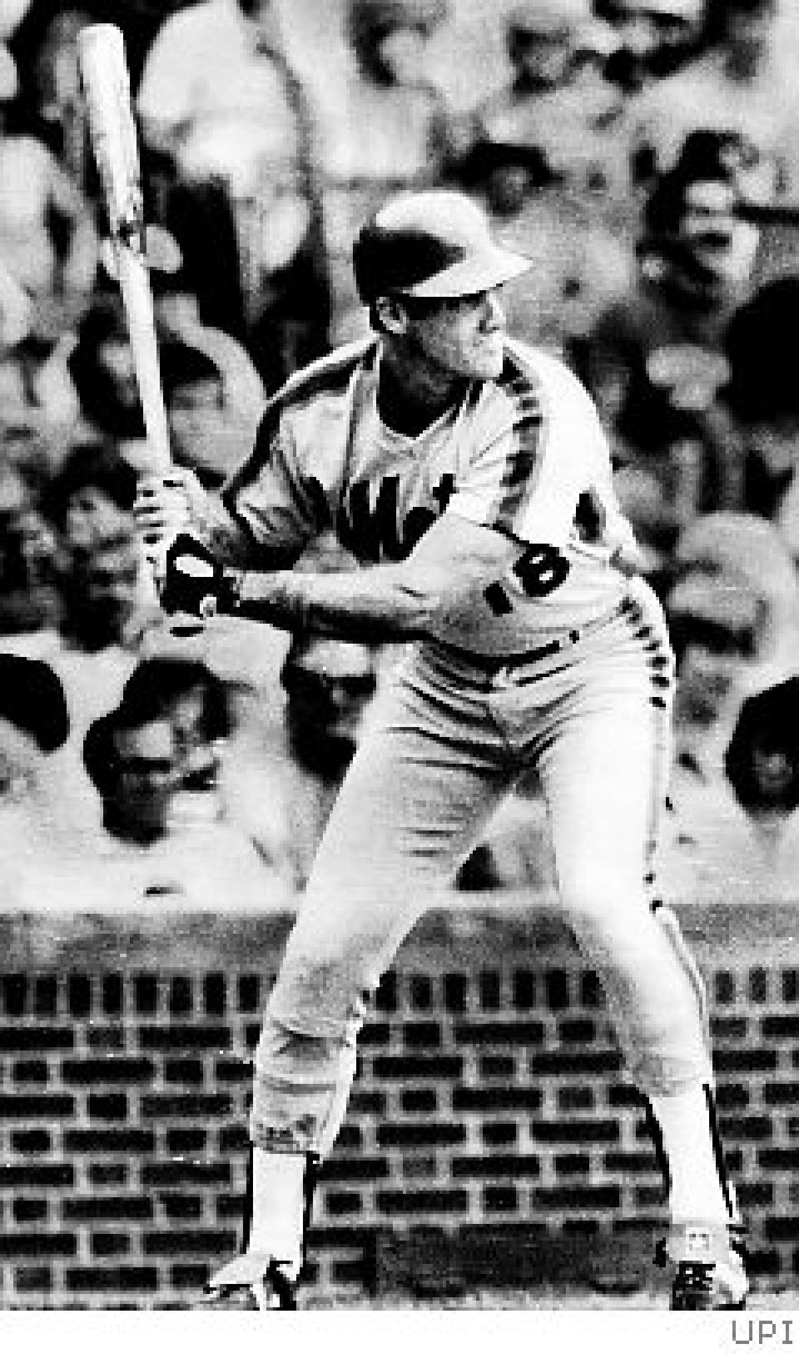
Joel Youngblood (NY Mets) August 4, 1982
Notes:
In day game at Wrigley Field, Youngblood hits two run single off of HOF pitcher, Ferguson Jenkins. Youngblood pulled and told he was just traded to Montreal.

Slide 10
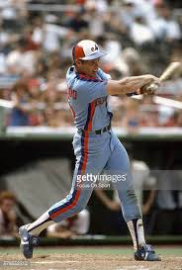
Joel Youngblood (Montreal Expos) August 4, 1982
Notes:
In night game in Philadelphia, Youngblood inserted as defensive replacement in 6th inning. In the 7th, he gets a single off of HOF pitcher, Steve Carloton. Two hits, in two cities, against two HOF pitchers on the same day.

Slide 11
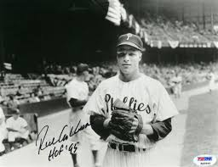
Richie Ashburn – August 17, 1957
Notes:
Foul ball broke nose of Alice Roth. As she was carried out on a stretcher, Ashburn hit her again with another foul ball.

Slide 12
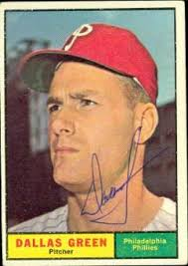
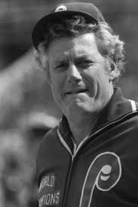
Dallas Green

Slide 13
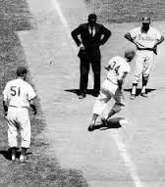
Dallas Green – June 23, 1963
Notes:
Green gave up Jimmy Piersall’s 100th home run. Piersall, to celebrate, ran the bases backwards (he backpedaled).

Slide 14
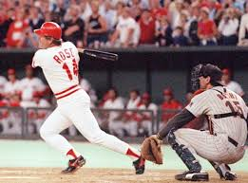
Dallas Green – June 18, 1964
Notes:
One year later, Dallas Green gave up Pete Rose’s ONLY career grand slam (in 14,053 at bats)

Slide 15
Who holds the record for most career home runs by players with the same name?

Slide 16
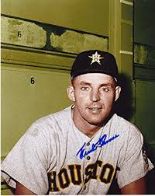
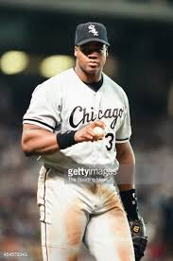
Frank Thomas
Notes:
Frank Thomas (1951-1966) hit 286. “The Big Hurt” (1990-2008) hit 521. Totaled 807 home runs!

Slide 17
Who is the only person to play for the Boston Braves, Milwaukee Braves and Atlanta Braves?

Slide 18
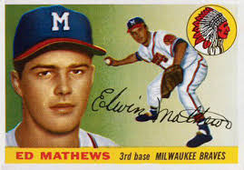
Eddie Mathews HOF

Slide 19
Who is the only person to hit his 500th home run while playing for the Houston Astros?

Slide 20
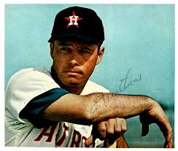
Eddie Mathews HOF
Notes:
July 14, 1967 at Candlestick Park off of HOF Juan Marichal

Slide 21
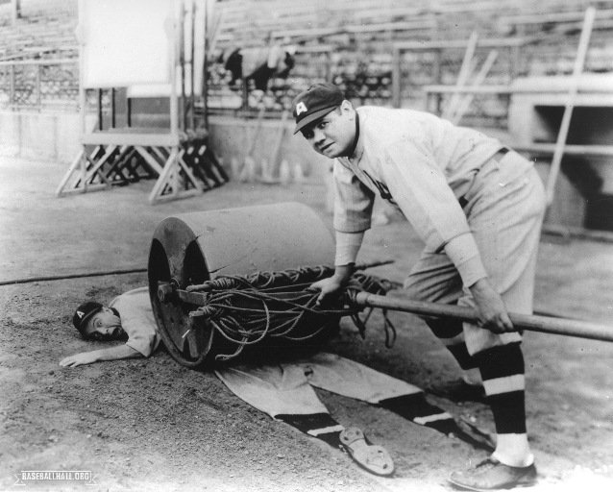
April Fool’s Day – Babe Ruth

