Slide 1
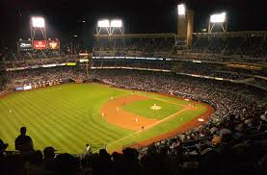
Baseball Pranks & Stunts
It’s a Loooooong Season!

Slide 2
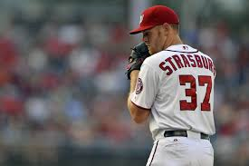
Stephen Strasburg
Notes:
Click picture to get video of NFL HOF Mike Singletary describing similar prank (no video of Strasburg incident)

Slide 3
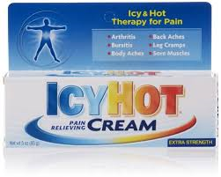
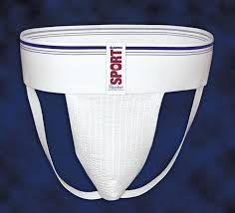
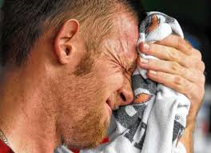
The Moral of the Story…..
+
=

Slide 4
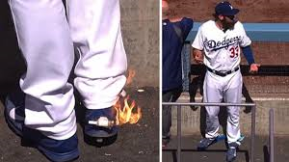
Hot Foot
Notes:
Click picture to get video Don Kelly – Detroit Tigers 2014

Slide 5

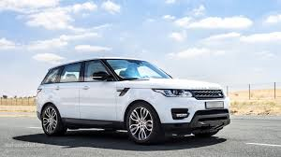
Astros Rookie, Tyler White, and his New Car

Slide 6
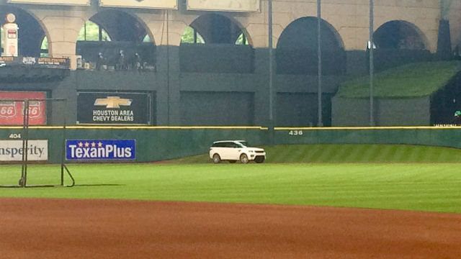
Tyler White’s New Car
Notes:
Click picture to get video of Tyler White’s new SUV in centerfield during batting practice

Slide 7
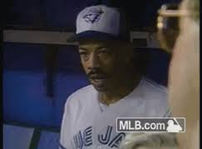
Derek Bell
Notes:
Click picture to get video of Derek Bell’s car being auctioned off by Joe Carter

Slide 8
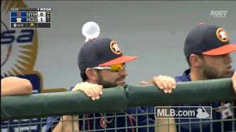
Bubble gum Hat Trick
Notes:
Click picture to get video of various players being pranked

Slide 9
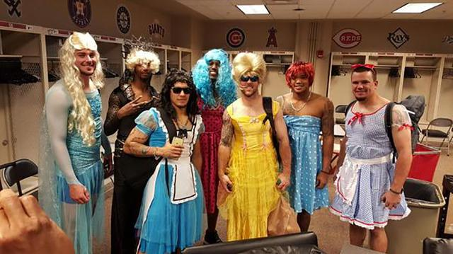
Rookie Dress Up Day - Cubs

Slide 10
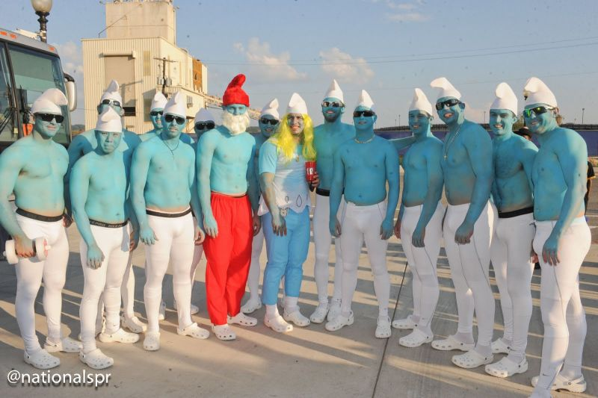
Rookie Dress Up Day - Nationals
Notes:
Smurfs

Slide 11
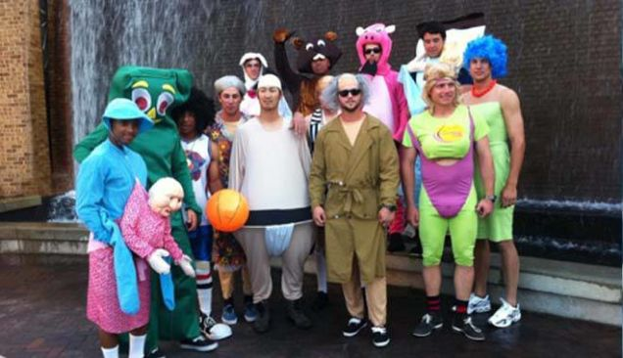
Rookie Dress Up Day - Twins

Slide 12
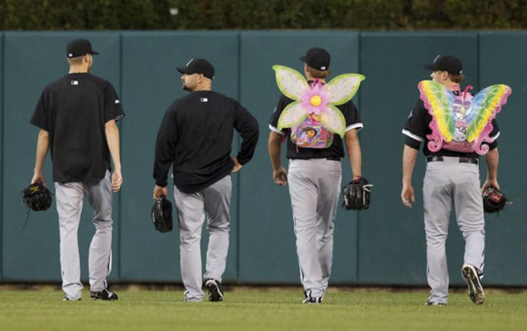
Rookies take Backpacks to Bullpen

Slide 13
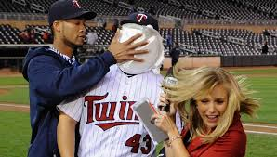
TV Interview – Pie in the Face

Slide 14
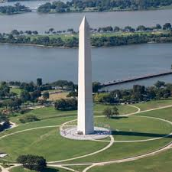
Washington Monument – Ball Drop

Slide 15
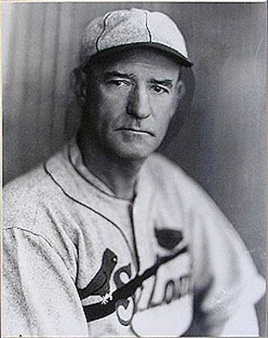
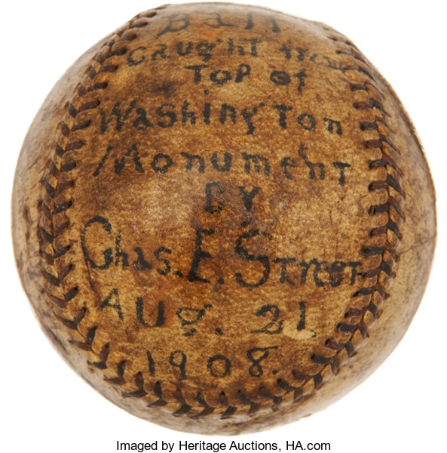
Gabby Street – August 21, 1908

Slide 16
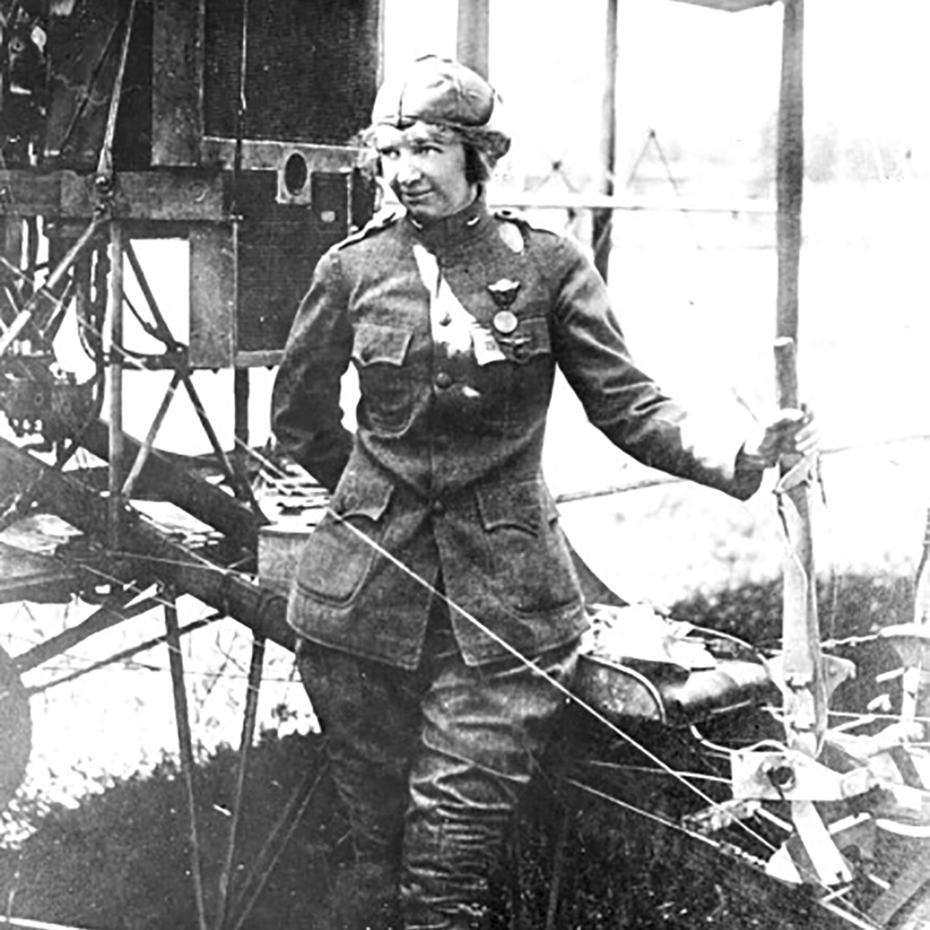
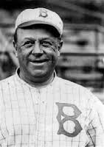
Wilbert Robinson – March 13, 1915
Notes:
Female aviator, Ruth Law and Dodger Manager, Wilbert Robinson (dropped grapefruit from just over 500’

Slide 17
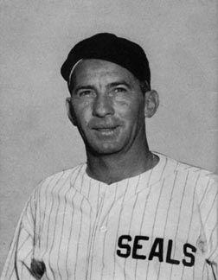
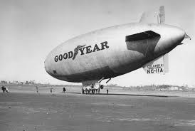
Joe Sprinz – August 3, 1939
Notes:
Joe Sprinz, attempted to catch a baseball dropped from approximately 800’s from blimp

Slide 18
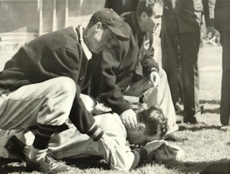
Joe Sprinz – August 3, 1939
Notes:
Missed the first 4; 5th one hit his glove going estimated 154 mph. Drove glove into his face with such force that it…………………………………..

Slide 19
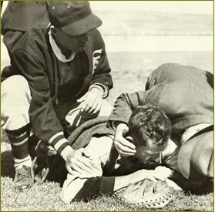
Joe Sprinz – August 3, 1939
Notes:
Broke his upper jaw in 12 places, fractured 5 teeth, broke his nose and knocked him unconscious

