Slide 1
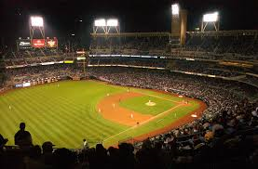
Baseball Stars – 1950 - 1960’s TV

Slide 2
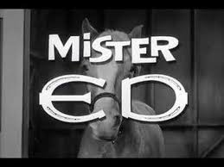
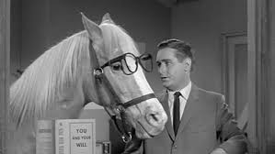
Mr. Ed

Slide 3
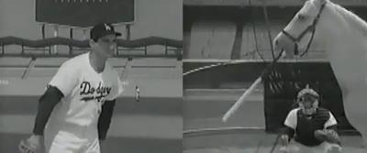
Mr. Ed – Sandy Koufax
Notes:
Click on picture to play short video of Mr. Ed home run

Slide 4
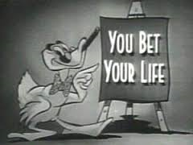
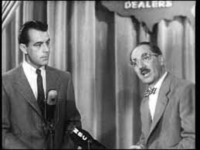
You Bet Your Life

Slide 5
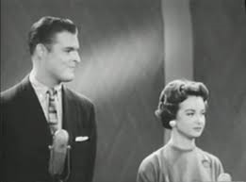
You Bet Your Life – Don Drysdale
Notes:
Click on picture to play short video of Drysdale and Groucho Marx

Slide 6
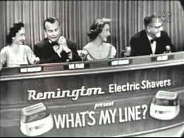
What’s My Line

Slide 7
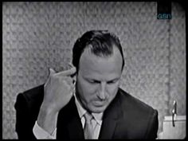
What’s My Line – Stan Musial
Notes:
Click on picture to play short video of Stan Musial on What’s My Line

Slide 8
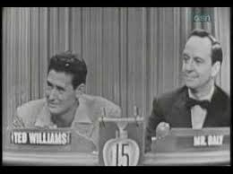
What’s My Line – Ted Williams
Notes:
Click for video of Ted Williams on What’s My Line

Slide 9
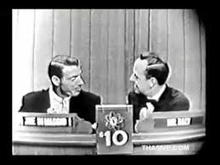
What’s My Line – Joe DiMaggio

Slide 10
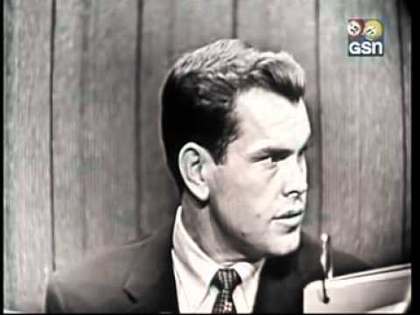
What’s My Line – Robin Roberts
Notes:
Roberts “line” was a frozen shrimp dealer

Slide 11
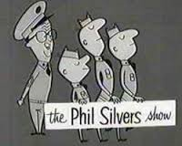
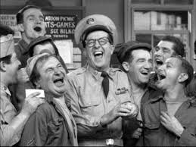
The Phil Silvers Show

Slide 12
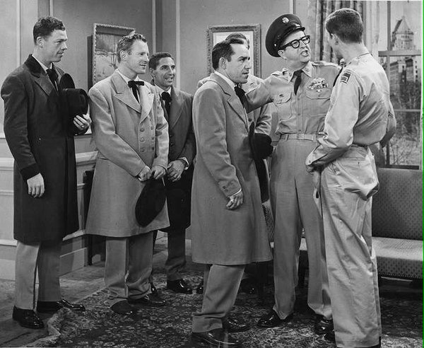
The Phil Silvers Show – Yogi Berra
Notes:
L-R: Gil McDougald, Whitey Ford, Phil Rizzuto, Berra and Phil Silvers/Sgt. Bilko

Slide 13
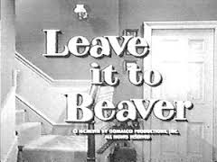
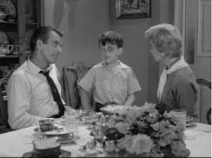
Leave It To Beaver

Slide 14
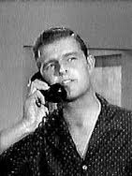
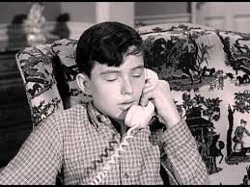
Leave It to Beaver – Don Drysdale

Slide 15
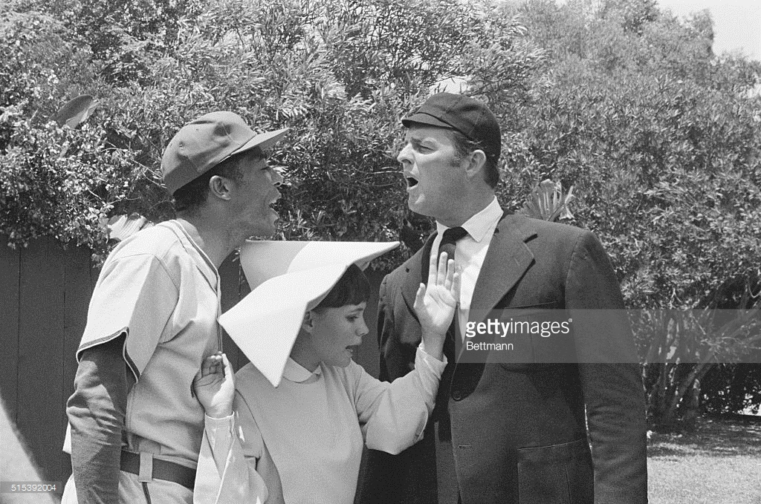
Don Drysdale on The Flying Nun

Slide 16
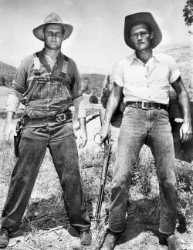
Don Drysdale on The Rifleman

Slide 17
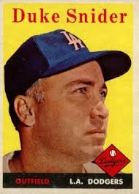
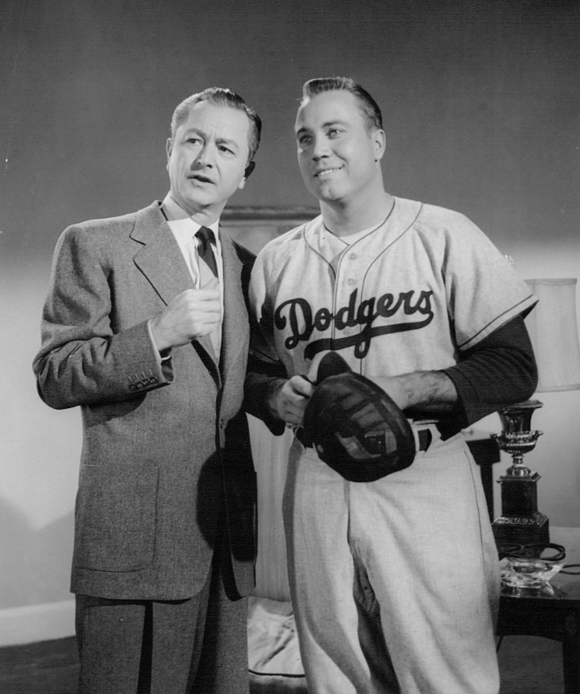
Duke Snider on Father Knows Best

Slide 18
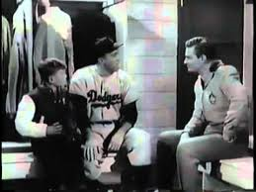
Duke Snider in Captain Midnight
Notes:
Click on picture to play short video of Duke Snider, Captain Midnight and Ovaltine

Slide 19
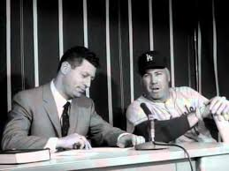
Duke Snider on Home Run Derby

Slide 20
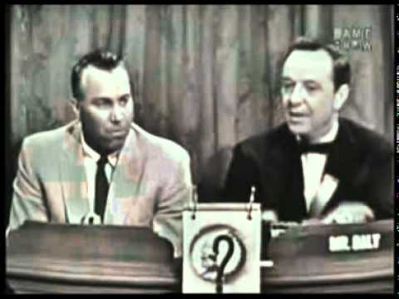
Duke Snider on What’s My Line

Slide 21
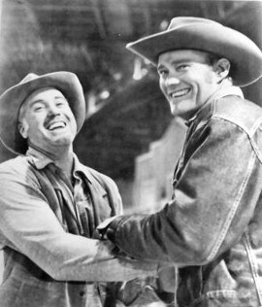
Duke Snider on The Rifleman

Slide 22
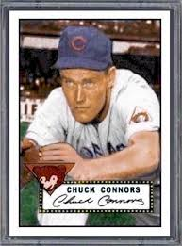
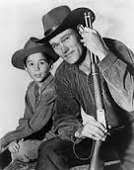
Chuck Connors – The Rifleman

Slide 23
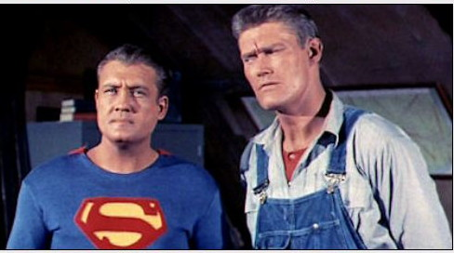
Chuck Connors on Superman

Slide 24
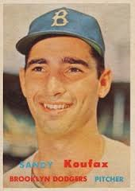
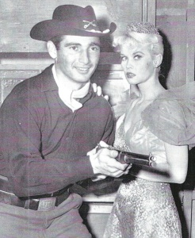
Sandy Koufax on Colt 45

Slide 25
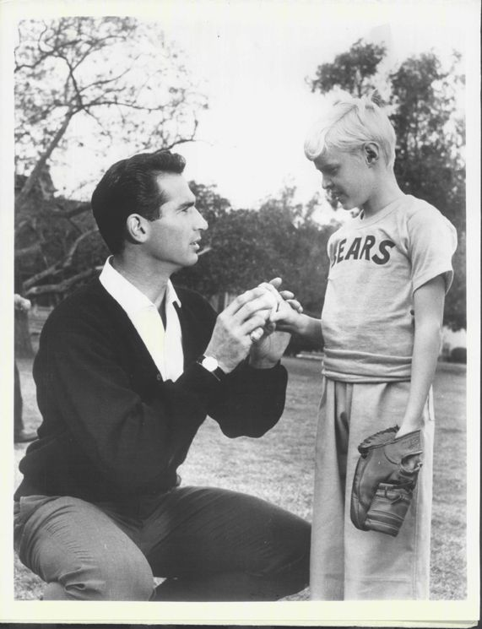
Sandy Koufax on Dennis the Menace

Slide 26
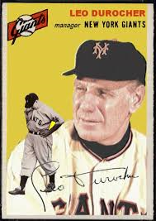
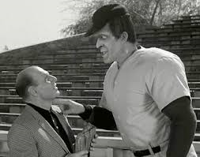
Leo Durocher on The Munsters
Notes:
Click on Herman Munster picture to see video

Slide 27
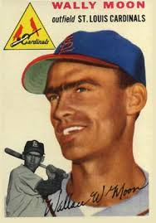
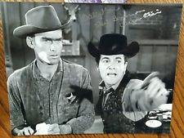
Wally Moon on Wagon Train

Slide 28
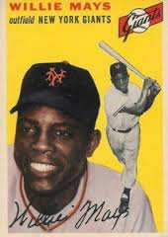
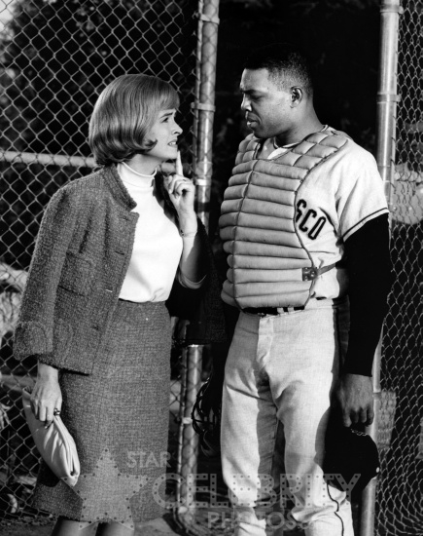
Willie Mays on The Donna Reed Show

Slide 29
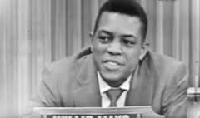
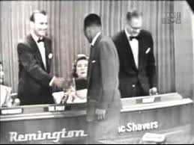
Willie Mays on What’s My Line

