Slide 1
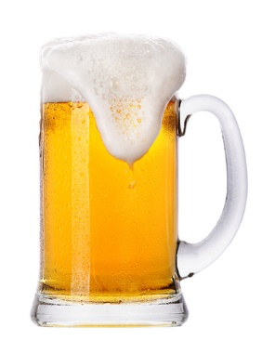
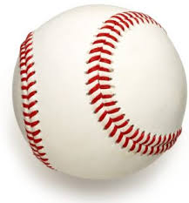
Beer and Baseball
In Heaven there is no beer, that’s why we drink it here …
verse from a popular polka

Slide 2
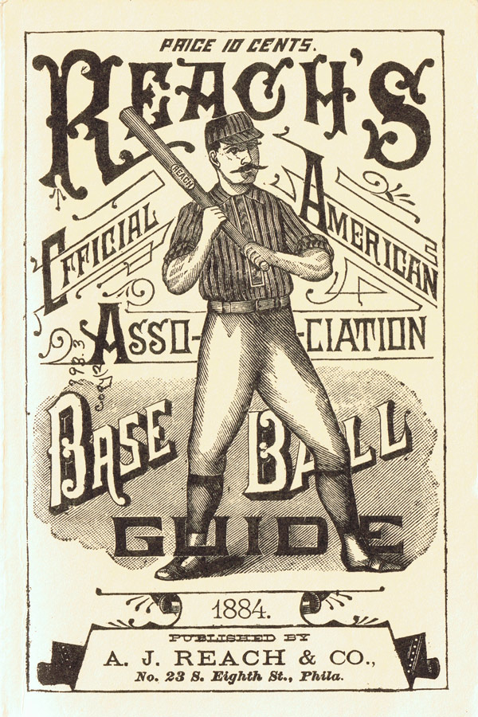
“Beer & Whiskey League”
Beer was not always welcomed at the ball park.
In 1878, baseball’s only “major league”, the National
League, voted to expel any club that played baseball on
Sunday or sold beer or whiskey at its ballpark.
The Cincinnati Red Stockings were expelled from the National
League in 1880, thus setting the stage for the creation of a
second major league.
Representatives from major cities, including Cincinnati, St. Louis, Pittsburgh and Louisville met in 1881 to establish the
American Association. Part of their organizing agreement was that the member clubs could set their own business rules and decide locally about ticket prices, Sunday baseball, and selling liquor at the ball park.
Many of baseball’s “old guard” of that era referred to the American Association as “The Beer and Whiskey League.”

Slide 3
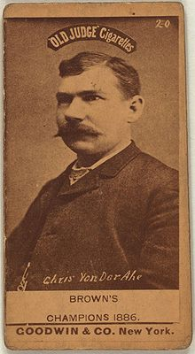
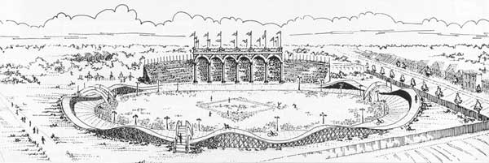
Chris von der Ahe
He was a German immigrant and owned a grocery store and saloon in St. Louis.
He noticed that business at the saloon always picked up before and after the nearby baseball game. So, in 1882, he decided to purchase the St. Louis Brown Stockings baseball team in the AA.
He opened a beer garden to serve patrons at Sportsman’s Park.
Was known as a showman and for malapropisms in his heavy German accent. He referred to himself as “Der Poss Bresident”

Slide 4
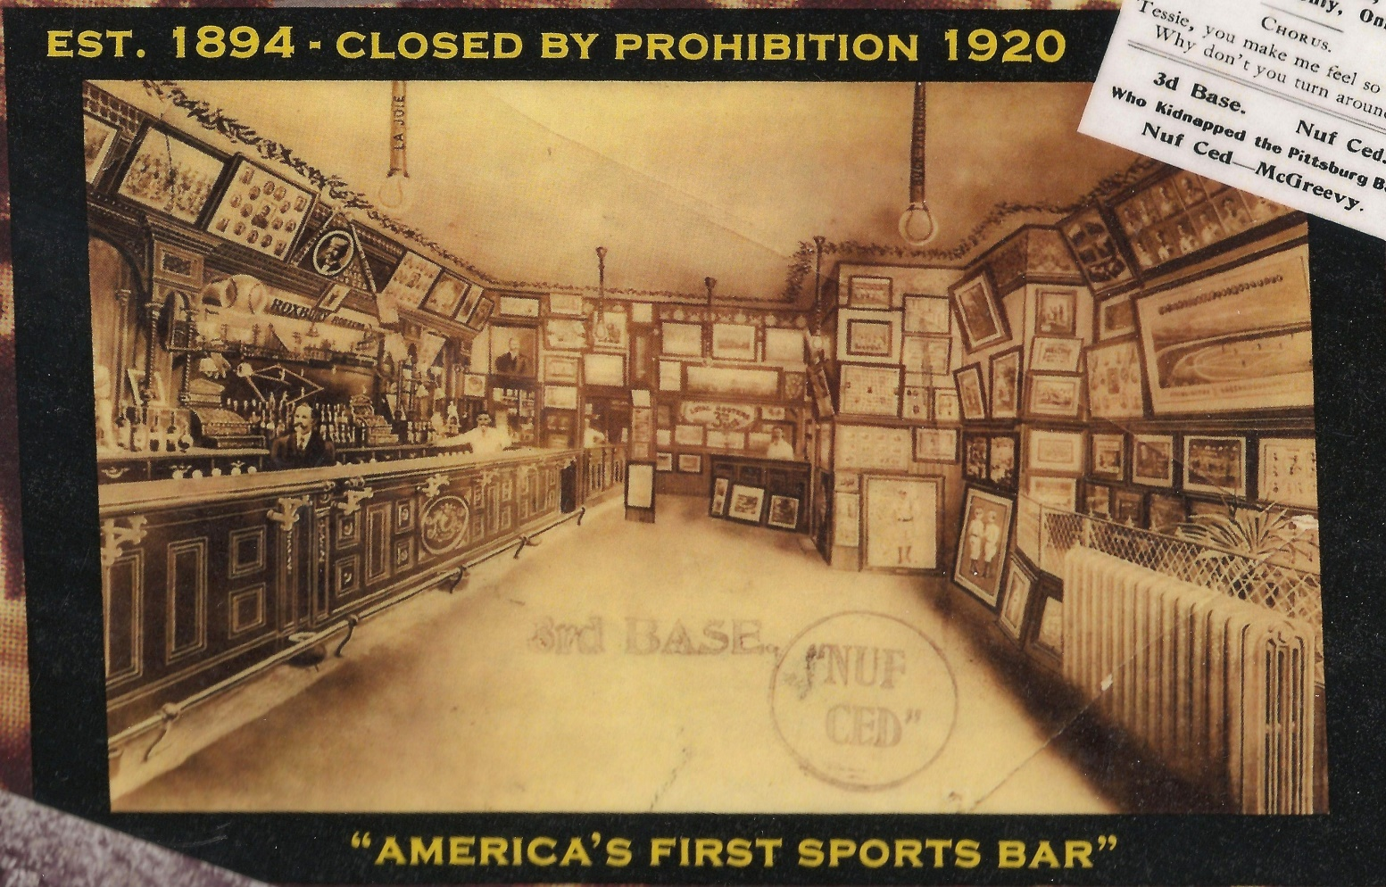
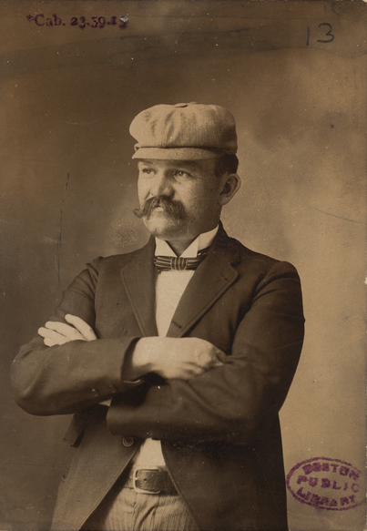
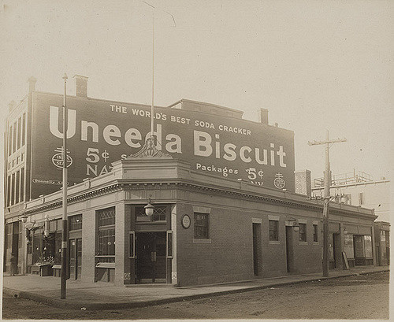
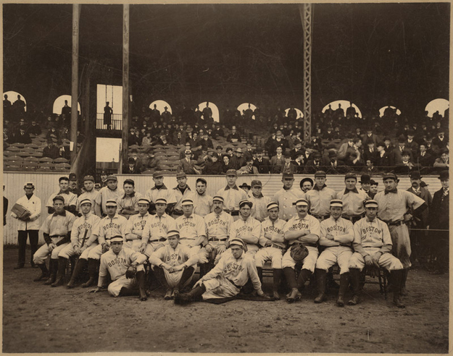
Third Base Saloon
Boston
Meeting place for the Boston Royal Rooters
Michael McGreevy was the proprietor
Michael “Nuf Ced” McGreevy
Third Base Saloon was the
HQ for the Boston Royal Rooters

Slide 5
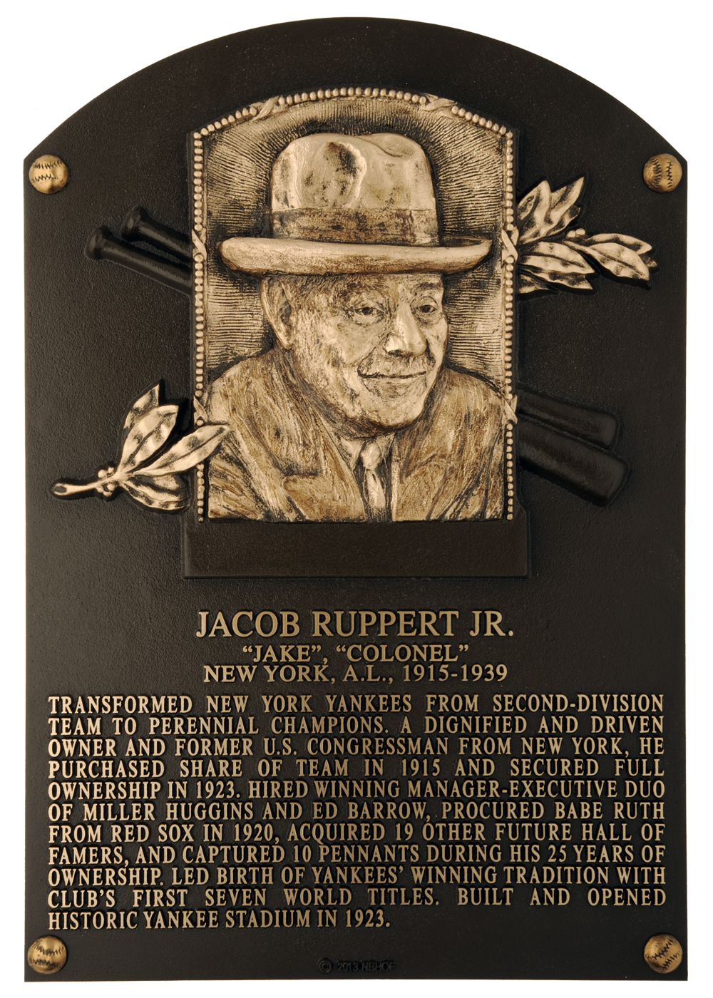
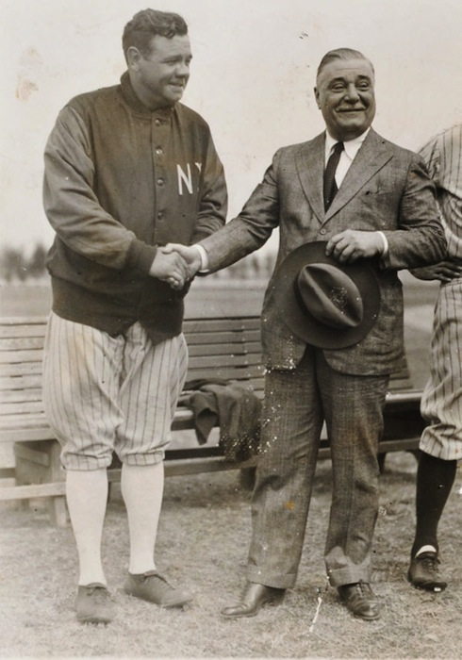
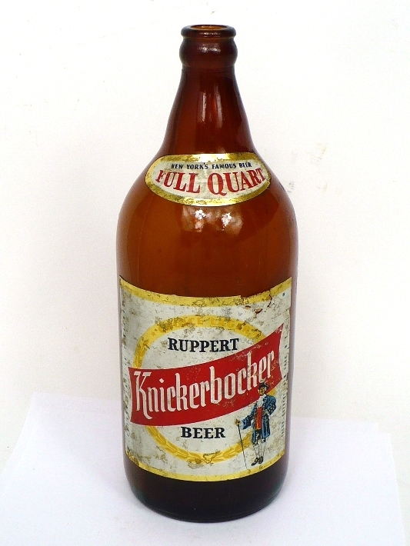
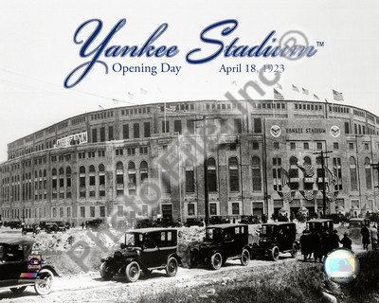
Jacob Ruppert
New York brewery owner who purchased the New York AL franchise in 1915.
Obtained Babe Ruth from Boston in 1920.
Built “The House that Ruth Built” in 1923

Slide 6
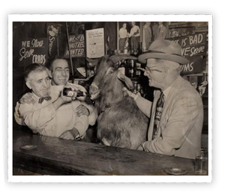
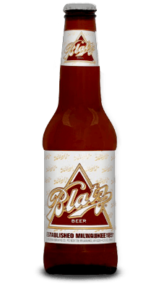
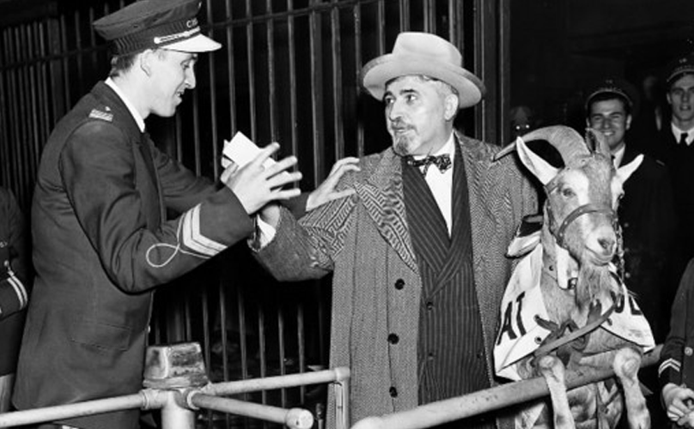
The Billy Goat Tavern
Chicago
William Sianis owned the Billy Goat
Tavern across the street from the Chicago Stadium (where the Blackhawks played).
The Saloon’s mascot, Murphy the Goat, supposedly escaped from a passing freight train, wandered into the saloon, and was adopted by Sianis. Murphy’s favorite beer was Blatz !
Sianis and his mascot goat were denied admission to Game 4 of the 1945 World
Series at Wrigley Field. The goat had a paid ticket.
Upon being denied entry, Sianis reportedly told ushers, “You are never going to win a
World Series again.”
The “Curse of the Billy Goat” held for 71 years !!

Slide 7
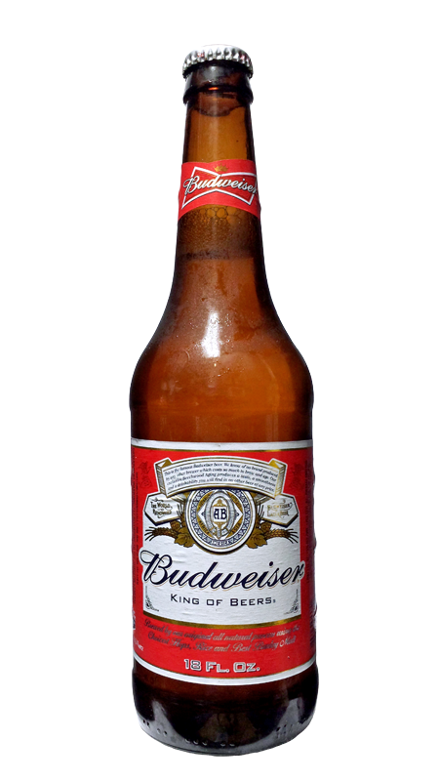
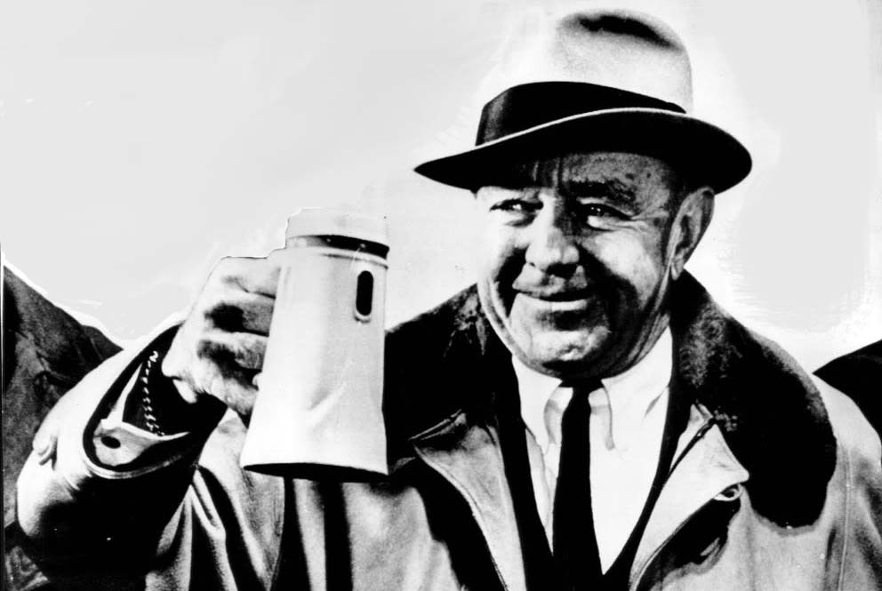
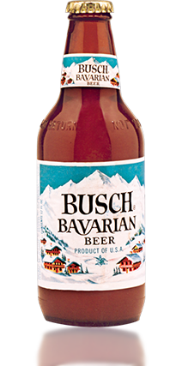
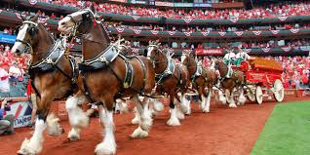
Gussie Busch
St. Louis
August A. Busch, Jr. was head of a brewing family in St. Louis and purchased the Cardinals NL franchise in early 1953.
At the same time, he also bought Sportsman’s Park in St. Louis from Browns’ owner Bill Veeck. Busch planned to rename the park “Budweiser Stadium”, but this was nixed by baseball commissioner Ford Frick. Busch then named the park “Busch Stadium”, supposedly to honor his father and grandfather. But he then created a new brand of beer – “Busch Bavarian” – which went on sale in 1955.
Here are two of Gussie’s favorite employees in a TV spot for Busch Beer:
https://m.youtube.com/watch?v=nfv1Bu06OHE

Slide 8
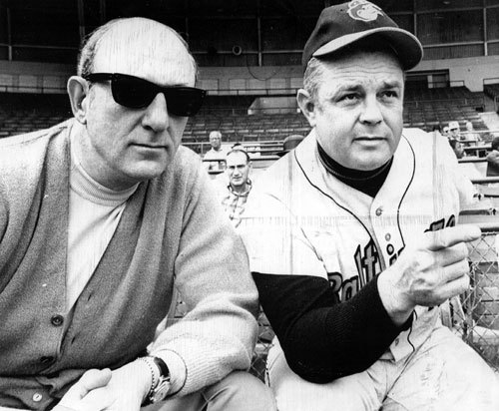
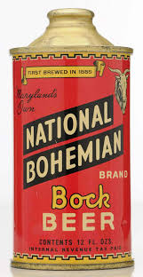
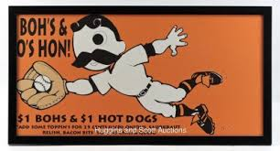
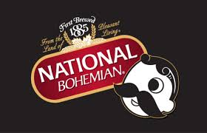
Jerold Hoffberger
Baltimore
Hoffberger was president of National Brewing Company in Baltimore and was part of the ownership group that purchased the St. Louis Browns and moved them to Baltimore for the 1954 AL season.
His main beer label was National Bohemian, which went by the nickname of “Natty Boh”.
The move of the Browns, now renamed the Baltimore Orioles, was opposed by Washington Senators owner Clark Griffith who claimed that Baltimore was part of the Senators’ territory. Hoffberger resolved this challenge by agreeing that his brewing company would become a major sponsor for the cash-strapped Senators.

Slide 9
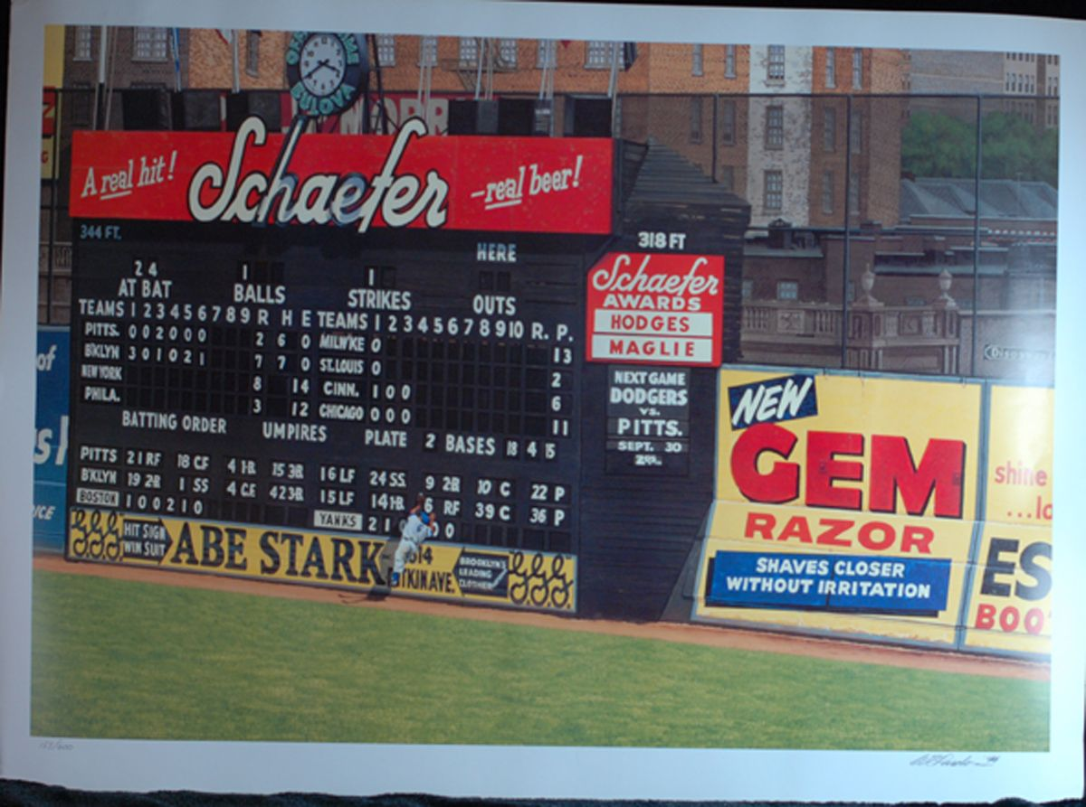
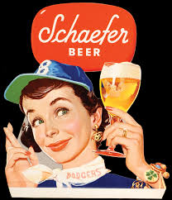
Baseball & Beer Promotions
Ebbets Field, Brooklyn
Schaefer Beer
The “h” or “e” in the “Schaefer” ad in right field at Ebbets Field would light up to signify “hit” or “error”.
Schaefer held the naming rights to the New England Patriots’ Foxboro stadium 1971-2001.

Slide 10
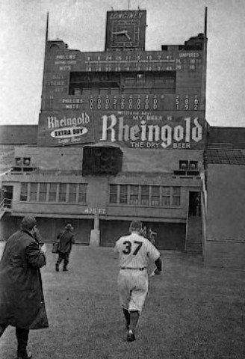
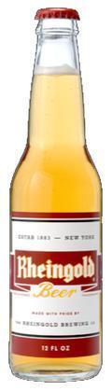
Baseball & Beer Promotions
Polo Grounds, New York
Rheingold Beer
Likewise, the “h” or “e” in the “Rheingold” ad in deepest center field at the Polo Grounds would light up to signify “hit” or “error”.
Rheingold sponsored the N.Y. Giants after the company acquired Ruppert Brewery; after the Giants left and expansion came, they sponsored the New York Mets.

Slide 11
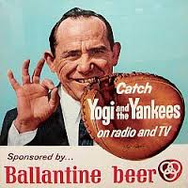
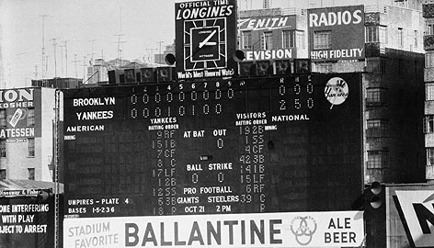
Baseball & Beer Promotions
Yankee Stadium
Ballantine Beer
“There’s a Ballantine
Blast!”
Mel Allen

Slide 12
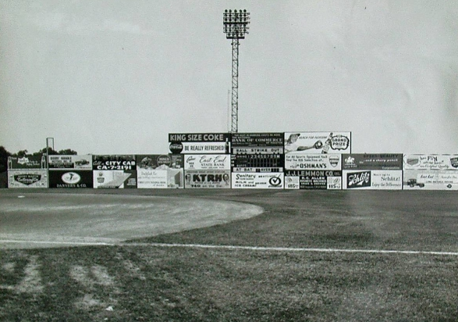
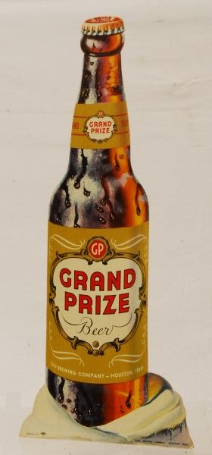
Baseball & Beer Promotions
Grand Prize Beer
Buffalo Stadium was home to the Texas League
Houston Buffaloes
from 1928-61.
Grand Prize Beer
was a product of
Gulf Brewing Co.
in Houston.
Gulf Brewing was
founded in 1933
by a prominent
Houston-born
businessman.
Buffs Stadium, Houston

Slide 13
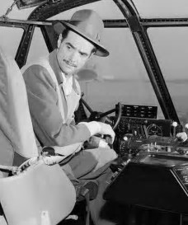
Gulf Brewing Co.
Baseball & Beer Promotions
was founded by
Howard Hughes

Slide 14
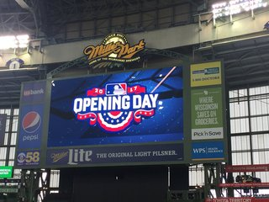
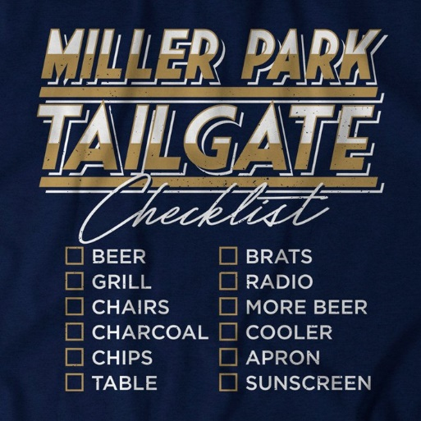
Baseball & Beer Promotions
Miller Park , Milwaukee
Miller Lite
Now days, it’s OK for a ball park to be
named for a beer brand.
Although usually a football ritual, baseball
tailgating is popular in Milwaukee:
POLKA

Slide 15
Baseball & Beer Promotions
Miller Park , Milwaukee
Beer Polkas
Beer-related polkas are a staple of tail-gating
in Milwaukee:
Ready to sing?
In Heaven There is No Beer:
https://www.youtube.com/watch?v=WzC_koWckdY
The Beer Barrel Polka:
https://www.youtube.com/watch?v=XsS_CXk2z_Q

Slide 16
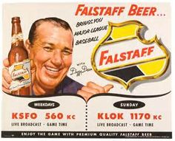
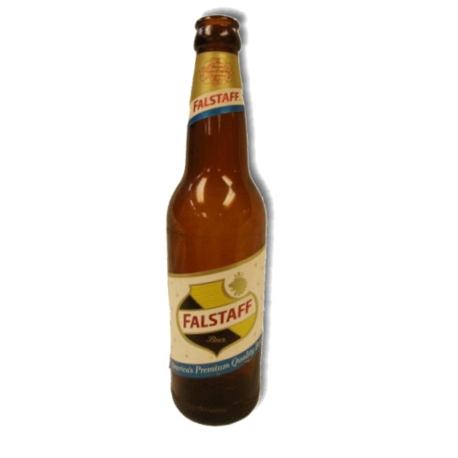
Baseball & Beer Pitchmen
Dizzy Dean
the ‘Ol Pardner’ on the
Game of the Week
pitching Falstaff

Slide 17
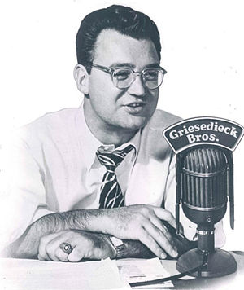
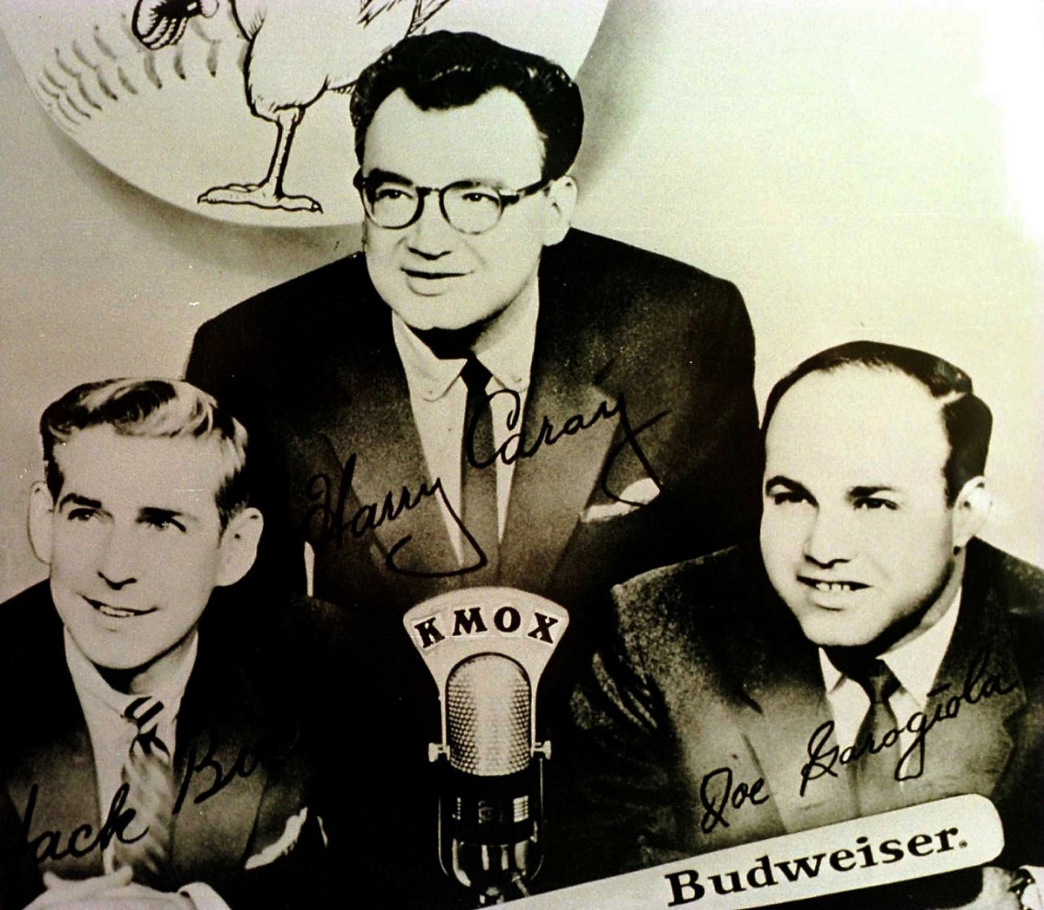
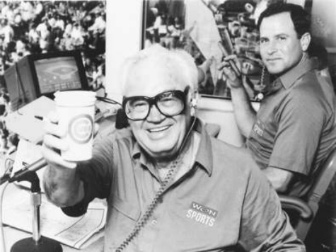
Baseball & Beer Pitchmen
Harry Caray
https://www.youtube.com/watch?v=s6NXkH9Wcp8

Slide 18
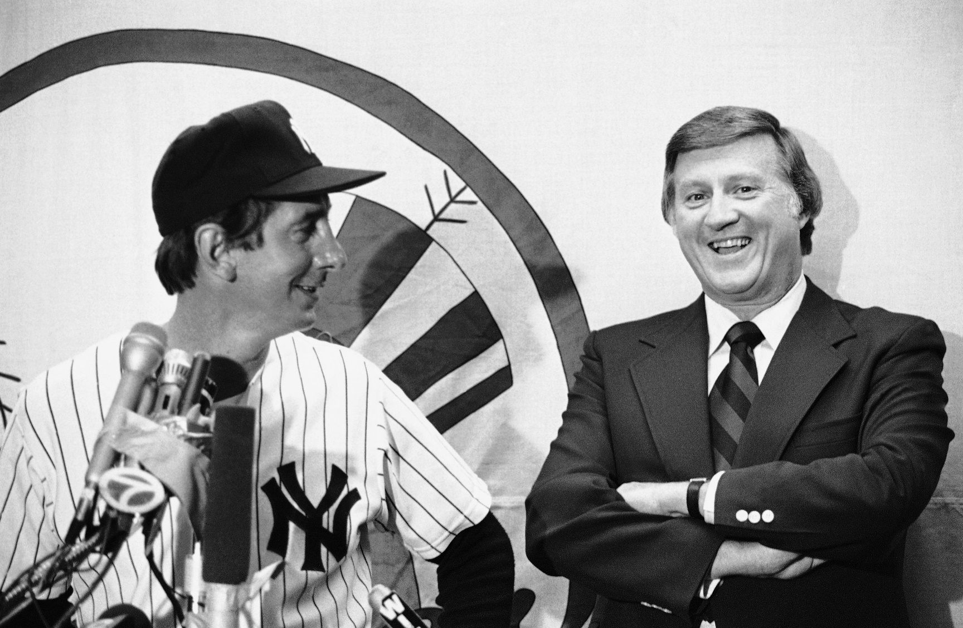
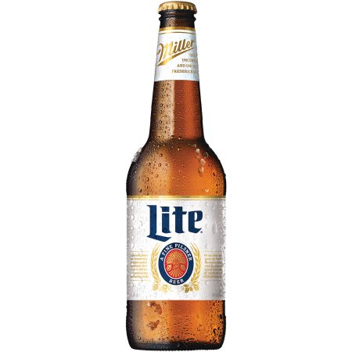
Baseball & Beer Pitchmen
Miller Lite
George Steinbrenner
and
Billy Martin
https://www.youtube.com/watch?v=0agZEMEpiVI

Slide 19
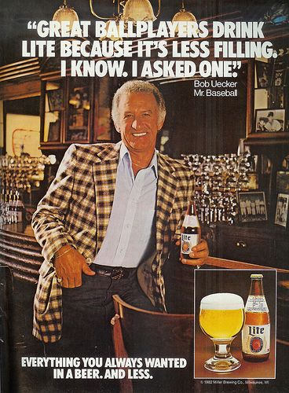
Baseball & Beer Pitchmen
Miller Lite
with “Mr. Baseball” – Bob Uecker
https://www.youtube.com/watch?v=DPh4iF76LbU

Slide 20
Thirsty ??

