Slide 1
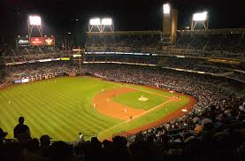
Catchers
The Tools of Ignorance

Slide 2
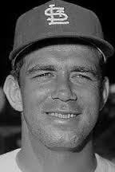
“I remember one time going out to the mound to talk to Bob Gibson. He told me to shut up – that the only thing I knew about pitching was that it was hard to hit.”*
- Tim McCarver, Catcher
* There are only 17 Catchers in the Hall of Fame

Slide 3
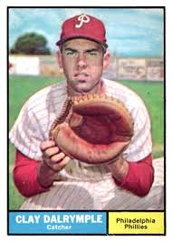
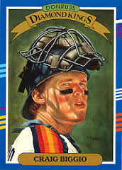
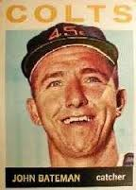
Who was your favorite Catcher?
Clay Dalrymple
Philadelphia Phillies
Craig Biggio
Houston Astros
John Bateman
Houston Colt 45s
Notes:
Vicki liked Dalrymple; Paul liked John Bateman; do you remember that Biggio broke in as a catcher

Slide 4
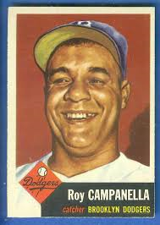
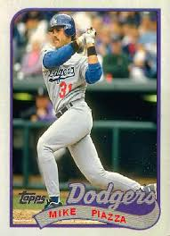
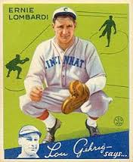
Bill’s favorite Catchers
Roy Campanella
Brooklyn Dodgers
Ernie Lombardi
Cincinnati Reds
Mike Piazza
Los Angeles Dodgers
Notes:
Three Hall of Fame catchers. Ernie “Schnozz” Lombardi was still playing when Bill started following baseball

Slide 5
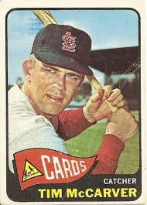
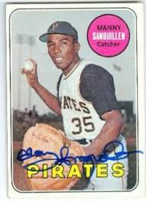
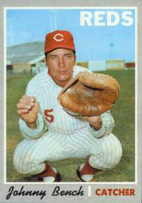
Bob’s favorite Catchers
Tim McCarver
St. Louis Cardinals
Manny Sanguillen
Pittsburgh Pirates
Johnny Bench
Cincinnati Reds

Slide 6
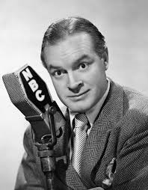
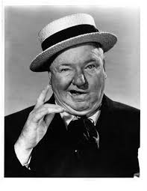
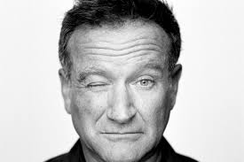
Jim’s favorite Comedians
Bob Hope
W.C. Fields
Robin Williams

Slide 7
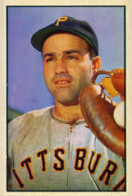
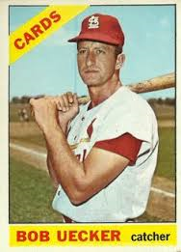
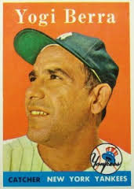
Baseball’s favorite Comedians
(all were Catchers)
Joe Garagiola
Pittsburgh Pirates
Bob Uecker
St. Louis Cardinals
Yogi Berra
New York Yankees

Slide 8
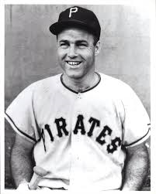
“I know a baseball star who wouldn't report the theft of his wife's credit cards because the thief spends less than she does.”
* Garagiola is in the Hall of Fame – he won the prestigious Ford C. Frick Award in 1991

Slide 9
“Not only was I not the best catcher in the Major Leagues, I wasn't even the best catcher on my street!.”
* Garagiola grew up in St. Louis on Elizabeth Avenue – just across the street from childhood friend Yogi Berra.

Slide 10
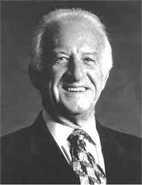
“The way to catch a knuckleball is to wait until it stops rolling and then pick it up.”
* In 1967, Uecker led the league in passed balls. He only caught 59 games that season!

Slide 11
“People don't know this but I helped the Cardinals win the pennant. I came down with hepatitis. The trainer injected me with it."
* Uecker is in the Hall of Fame – he won the prestigious Ford C. Frick Award in 2003

Slide 12
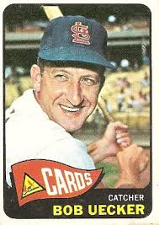
“I knew when my career was over. In 1965 my baseball card came out with no picture.”
* Bob Uecker batted right handed

Slide 13
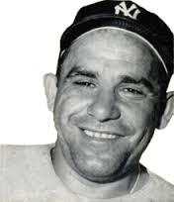
"He hits from both sides of the plate. He's amphibious."
* Yogi’s real name was Lorenzo Pietro Berra. His parents’ desire to assimilate in their new homeland led them to the English translation of Lawrence Peter.

Slide 14
"You should always go to other people's funerals, otherwise, they won't come to yours."
* Berra was voted to the AL All Star team 18 times. He played on 10 World Series championship teams.

Slide 15
"Nobody goes there anymore because it's too crowded."
* Berra was inducted into the Hall of Fame in 1972

Slide 16
" When you come to a fork in the road, take it.”
* Berra’s #8 was retired by the Yankees. Yankee catcher Bill Dickey also had his number 8 retired by New York.

Slide 17
"Baseball is ninety percent mental. The other half is physical."
* In WWII, Berra became a machine gunner and saw action on D-Day aboard a rocket boat deployed just off the Normandy coast helping as the soldiers assaulted the beach.

Slide 18
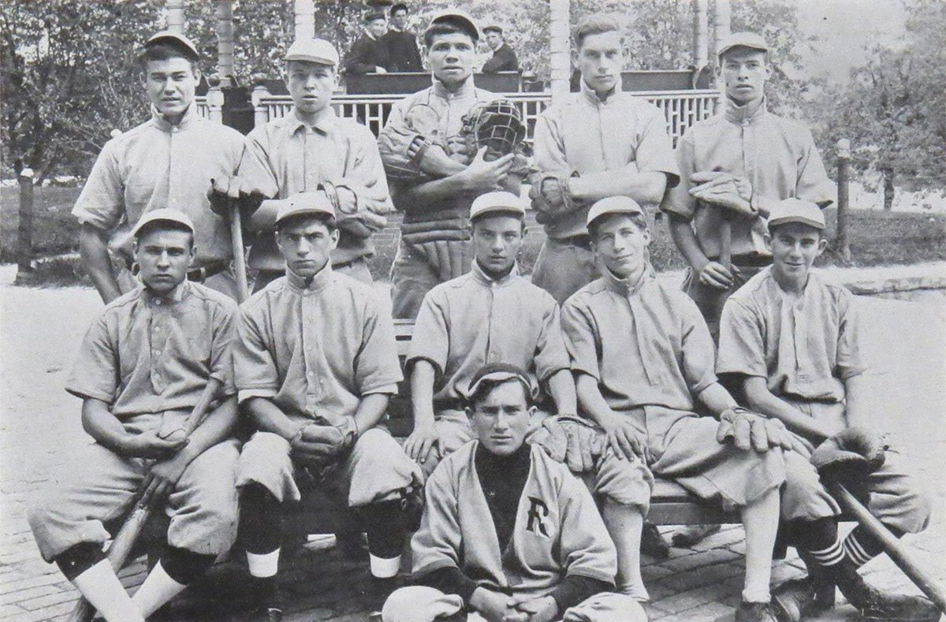
Who is the left handed catcher in the middle?
Notes:
1913 St Mary’s Industrial School (for wayward boys) in Baltimore. Babe Ruth in the middle.

Slide 19
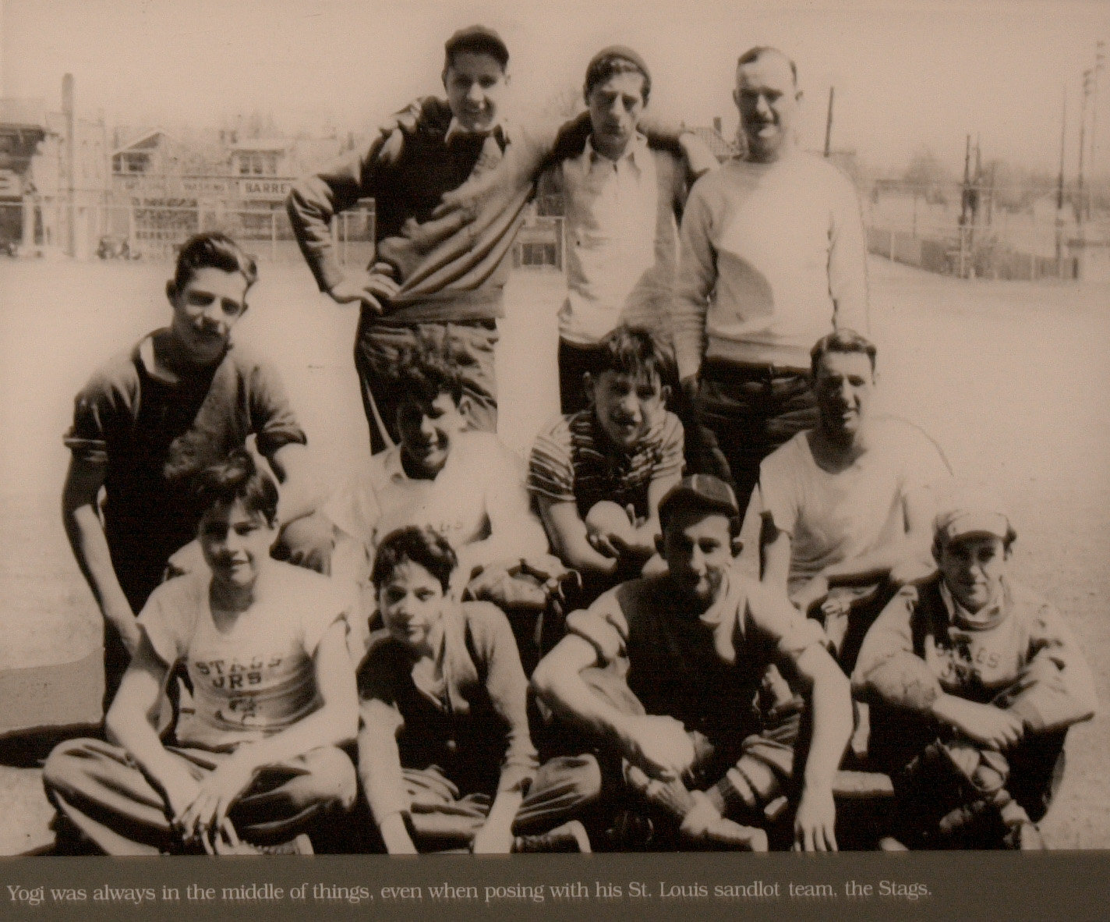
Who are two of these kids?
Notes:
Joe Garagiola far left on front row. Yogi Berra second row, third from left.

