Slide 1
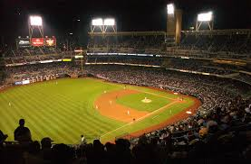
Celebrities that played Baseball

Slide 2
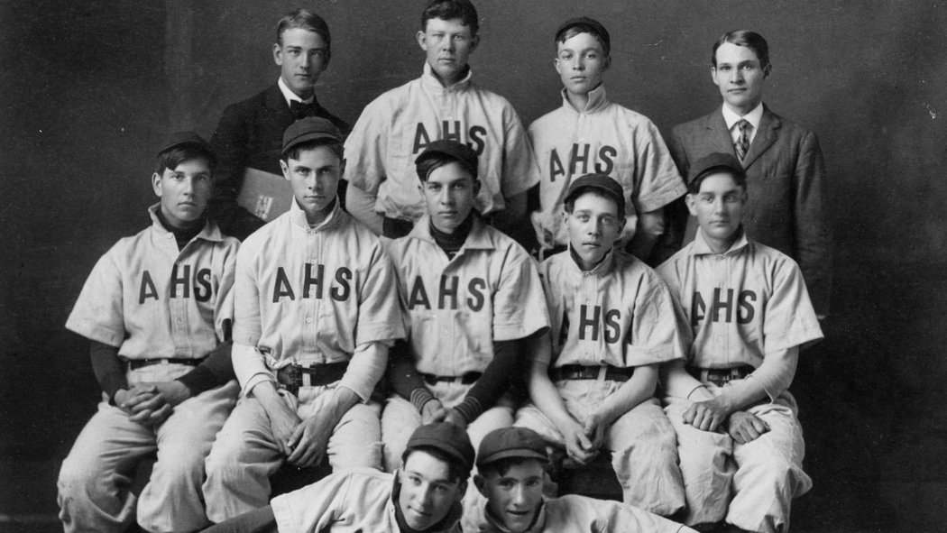
Politics

Slide 3
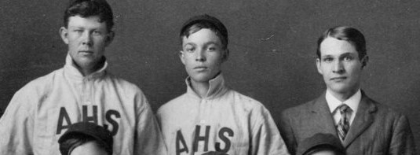
Politics

Slide 4
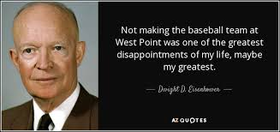
Politics
President Dwight D. Eisenhower

Slide 5
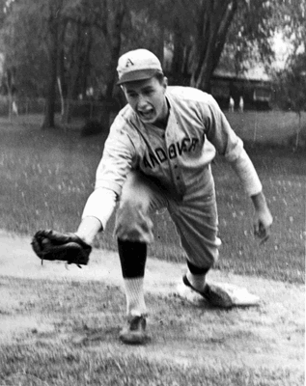
Politics

Slide 6
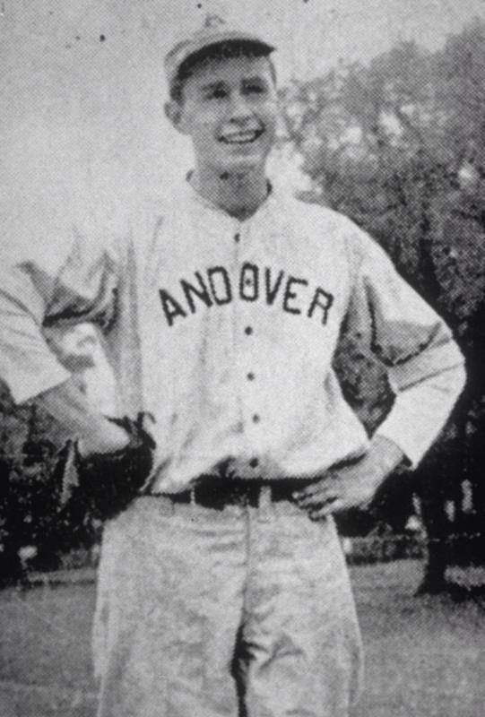
Politics

Slide 7
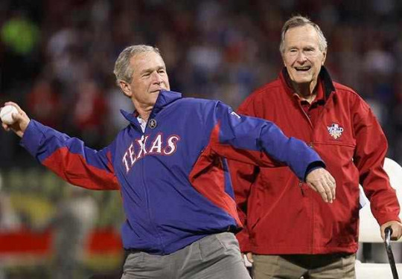
Politics
President George HW (and George W) Bush

Slide 8
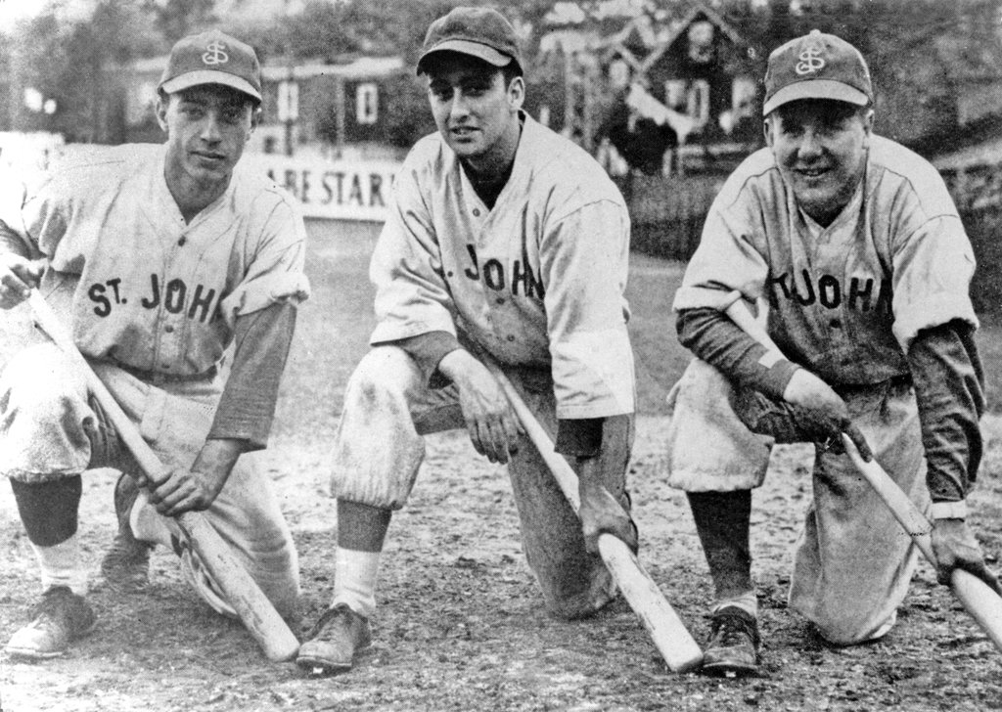
Politics
Notes:
Player on the left?

Slide 9
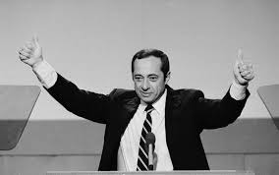
Politics
Mario Cuomo

Slide 10
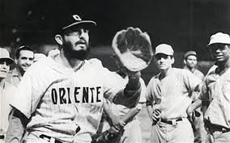
Politics

Slide 11
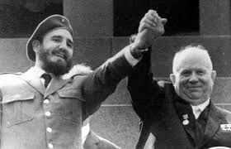
Politics
Fidel Castro

Slide 12
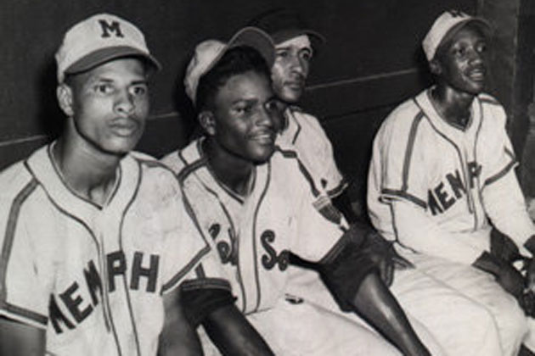
Music
Notes:
The guy in the middle

Slide 13
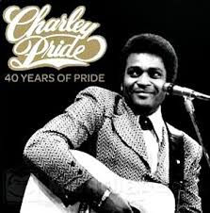
Music
Charley Pride

Slide 14
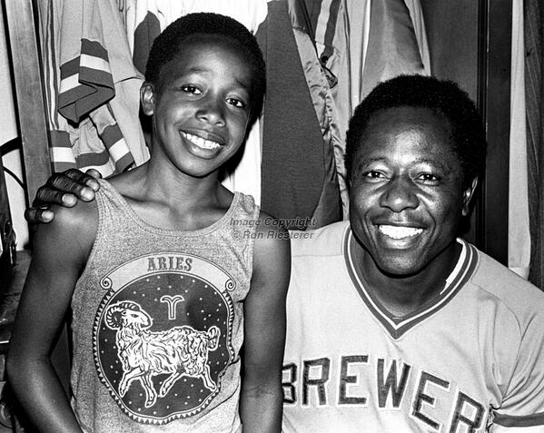
Music
Notes:
The guy on the left with Hank Aaron – they look alike? What was Aaron’s nickname? There’s the clue!

Slide 15
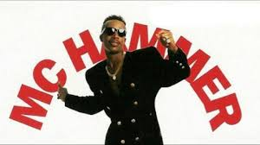
Music
MC Hammer

Slide 16
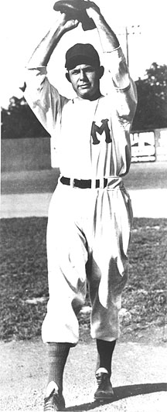
Music
Notes:
This one’s hard

Slide 17
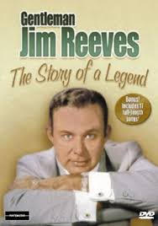
Music
Jim Reeves

Slide 18
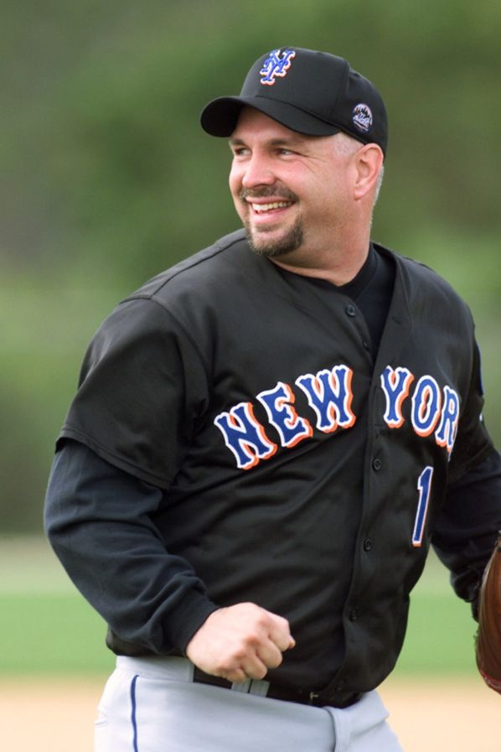
Music
Notes:
Played as a kid – this photo was from Mets’ spring training (he was invited to participate)

Slide 19
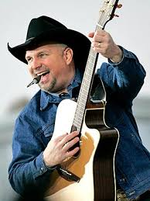
Music
Garth Brooks

Slide 20
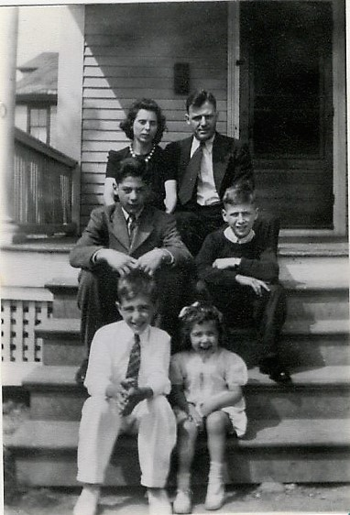
Industry
Notes:
The guy on the left in the middle row

Slide 21
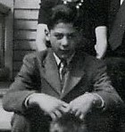
Industry
Notes:
This guy!

Slide 22
Industry
Tom Viola, IBM

Slide 23
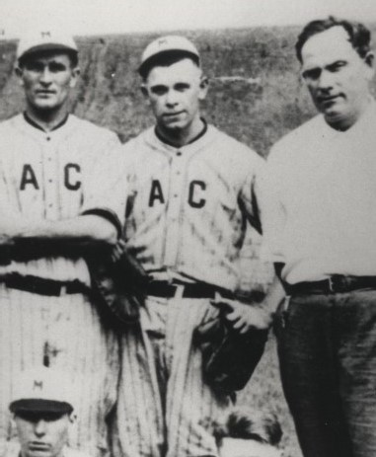
“Industry”
Notes:
The guy in the middle

Slide 24
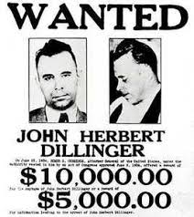
“Industry”
John Dillinger

Slide 25
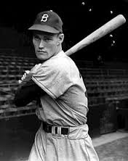
Entertainment

Slide 26
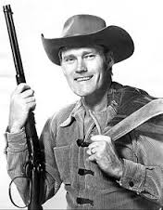
Entertainment
Chuck Connors, “The Rifleman”

Slide 27
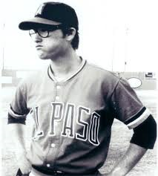
Entertainment

Slide 28
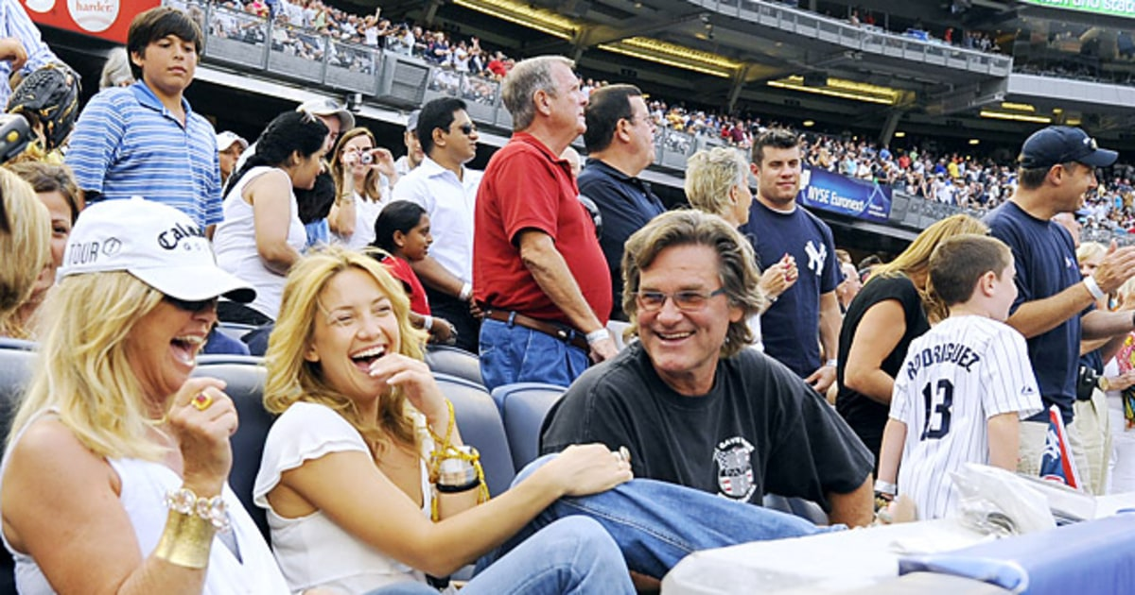
Entertainment
Kurt Russell

Slide 29
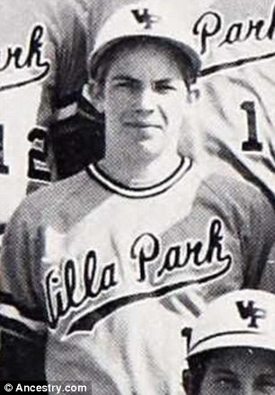
Entertainment

Slide 30
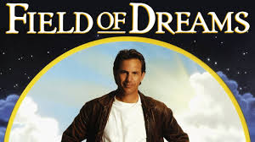
Entertainment
Kevin Costner

Slide 31
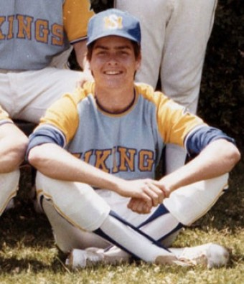
Entertainment

Slide 32
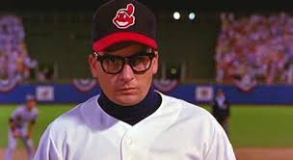
Entertainment
Charlie Sheen

Slide 33
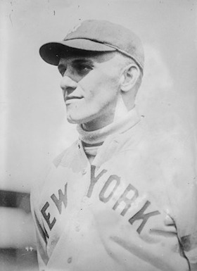
Other Sports

Slide 34
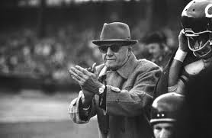
Other Sports
George Halas

Slide 35
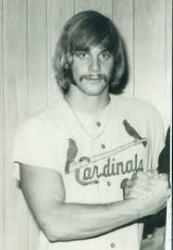
Other Sports

Slide 36
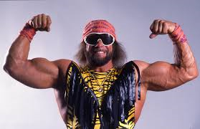
Other Sports
Randy “Macho Man” Savage

Slide 37
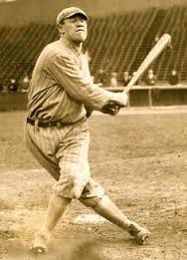
Other Sports

Slide 38
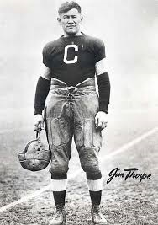
Other Sports
Jim Thorpe

Slide 39
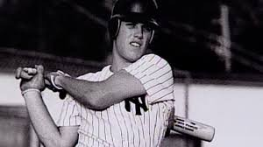
Other Sports

Slide 40
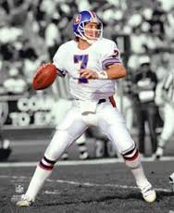
Other Sports
John Elway

