Slide 1
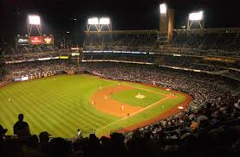
Cheating in Baseball

Slide 2
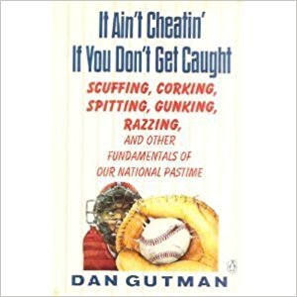
Notes:
Cheating is as old as baseball (book written by Dan Gutman in 1990)

Slide 3
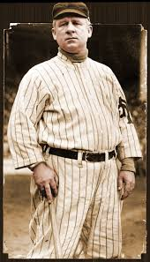
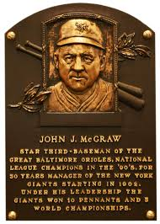
John McGraw, HOF Manager
Notes:
Hid balls in tall grass in outfield, grab belts of baserunners as 3B, tried to get pitchers to hold ball like 3 Finger Brown (“It’s luck for you fellows that it didn’t work. If I thought it did, I’d have a surgeon out here tomorrow”

Slide 4
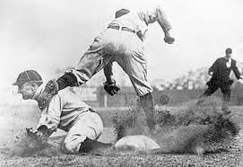
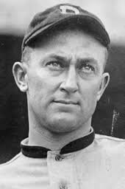
Ty Cobb, HOF Outfielder
Notes:
Ty Cobb would sharpen spikes in full view of opposing infielders to intimidate and give him extra advantage.

Slide 5
Stealing Signs

Slide 6
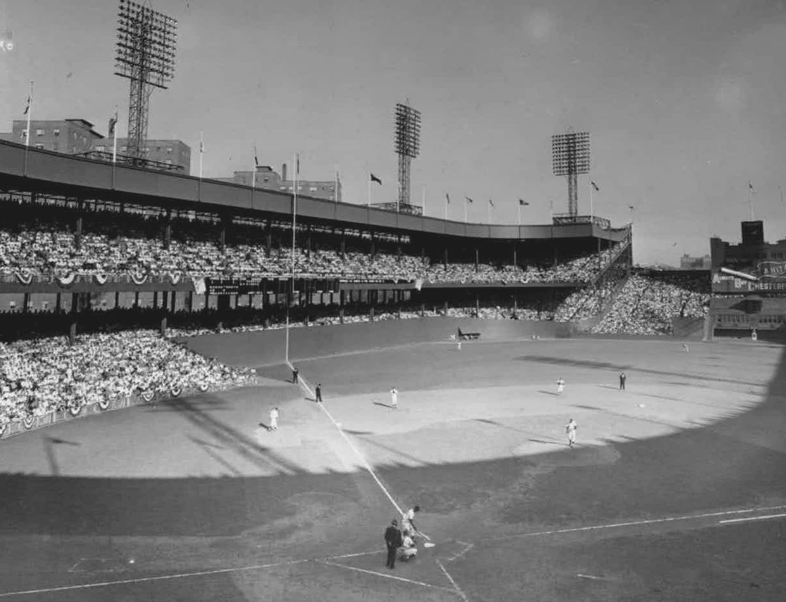
“Shot Heard ‘Round the World”
Notes:
Bobby Thomson off of Ralph Branca at 3:58 PM on October 3, 1951

Slide 7
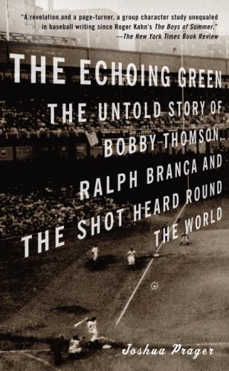
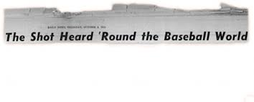
Thomson Knew?

Slide 8
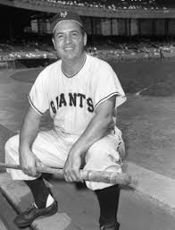
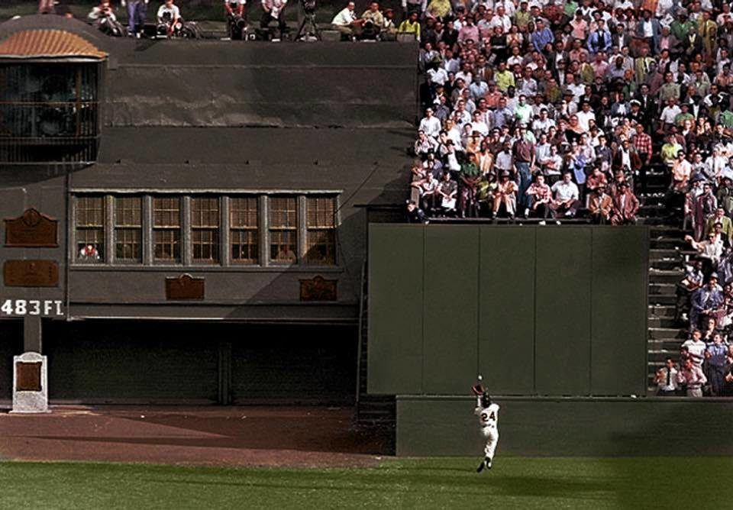
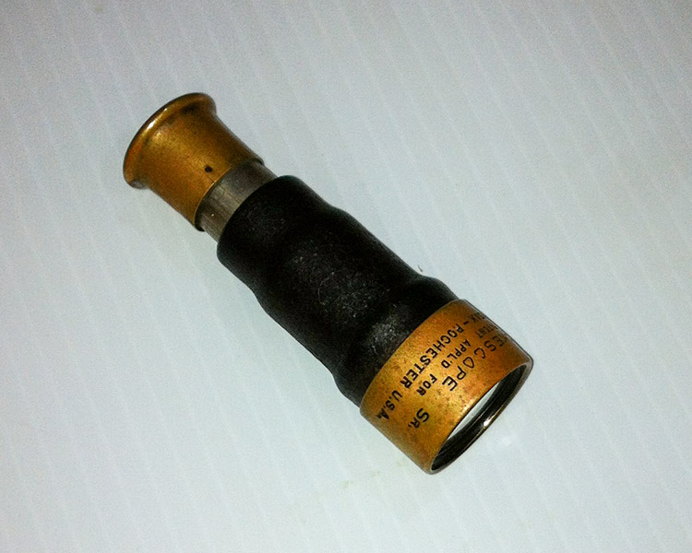
Herman Franks, NY Giants Coach

Slide 9
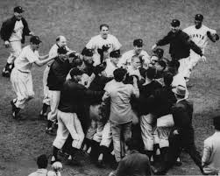
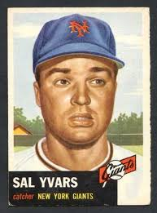
Sal Yvars, NY Giants Catcher
Notes:
Franks would buzz the pitch signal to bullpen catcher, Sal Yvars. Yvars would hold a baseball in the air to tell batter a fastball was coming; throw ball in air to indicate off speed pitch. The rest is history.

Slide 10
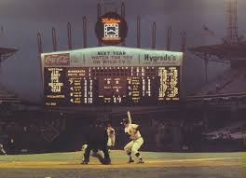
Comiskey Park Scoreboard
Notes:
Would use Sherm Lollar’s #10 as indicator on scoreboard. If fastball, would wiggle #1. If breaking ball, would wiggle #0.

Slide 11
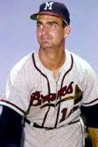
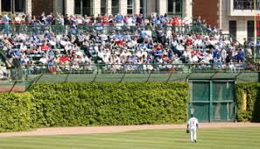
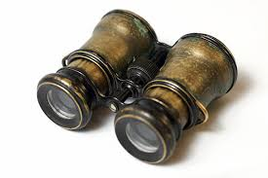
Bob Buhl, Milwaukee Braves Pitcher
Notes:
In the 1950’s, the Braves would put pitchers Joey Jay and Bob Buhl in the Wrigley bleachers – shirts off, dressed like fans.

Slide 12
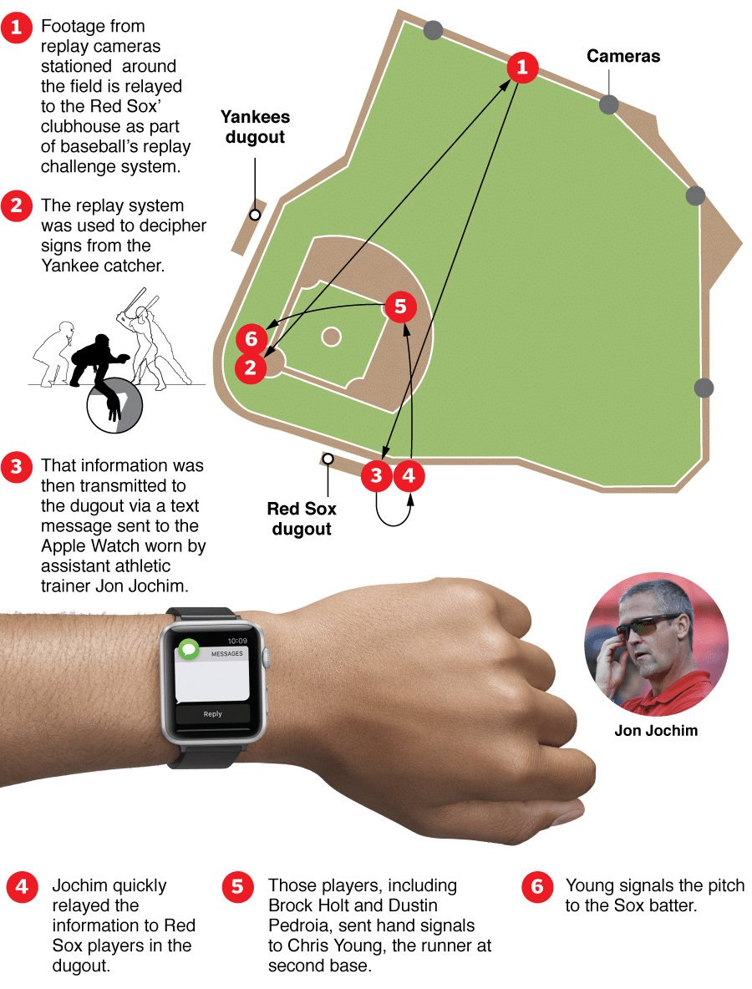
High Tech
Boston Red Sox
2017

Slide 13
Loading Up the Baseball

Slide 14
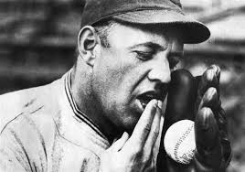
Spitball
Notes:
Burleigh Grimes, HOF Pitcher – spitball artist

Slide 15
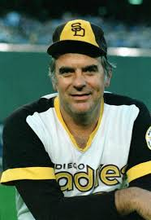
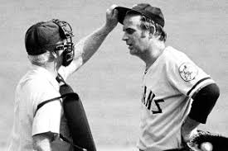
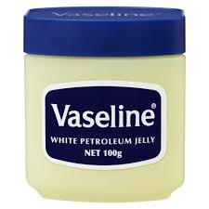
Gaylord Perry

Slide 16
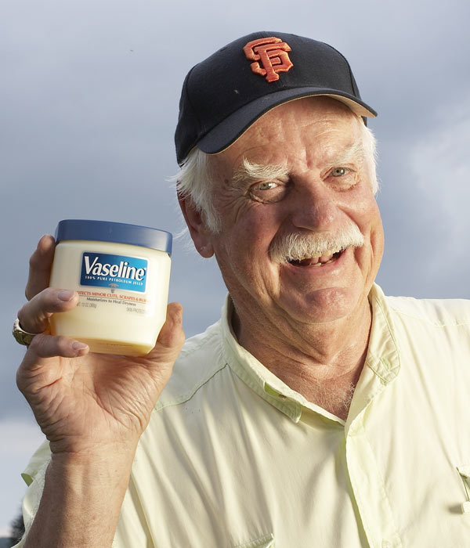
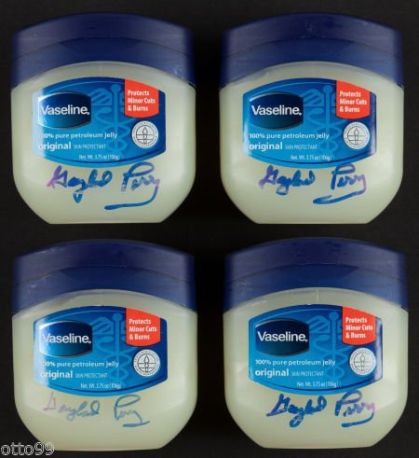
Gaylord Perry
Notes:
Autographed Vaseline jars on Amazon for $69.99……………plus shipping!

Slide 17
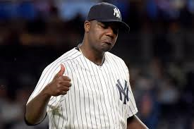
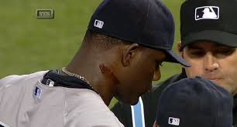
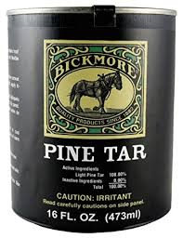
Michael Pineda, NY Yankees Pitcher

Slide 18
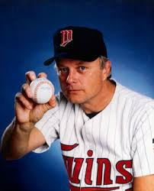
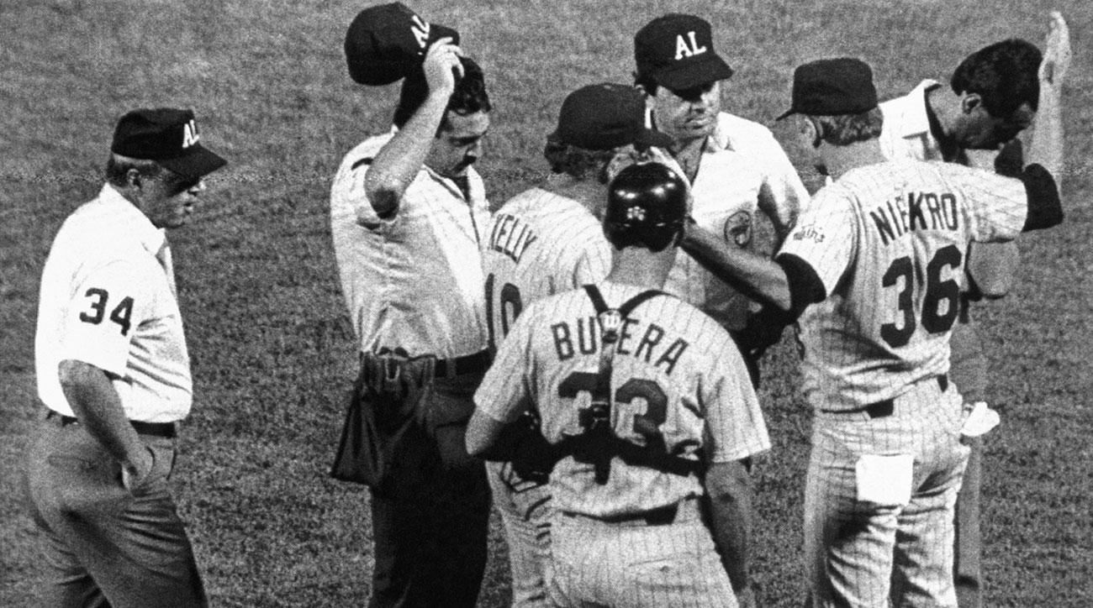
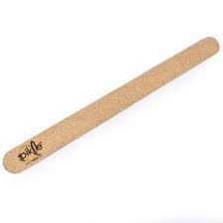
Joe Niekro, Minnesota Twins Pitcher
Notes:
Video link on big picture

Slide 19
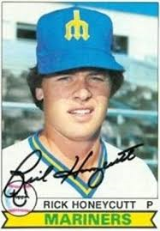
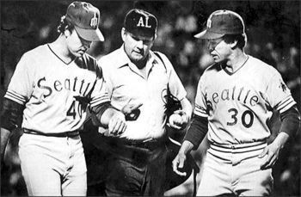
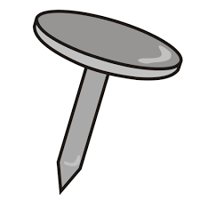
Rick Honeycutt, Seattle Mariners Pitcher
Notes:
Taped to inside of glove

Slide 20
Groundskeeping

Slide 21
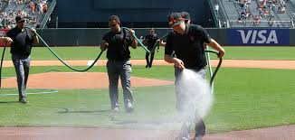
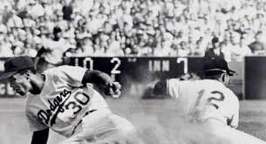
1962 SF Giants
“Speed Trap”
Notes:
SF Giants “speed trap” to try to slow down Maury Wills

Slide 22
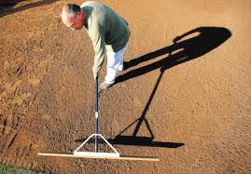
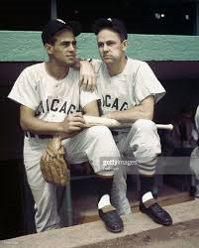
Chicago White Sox 1950’s
Notes:
Also, Crosley Field pitchers mound (concave to force higher pitches), LA Dodgers rolling outfield

Slide 23
Corked Bats

Slide 24
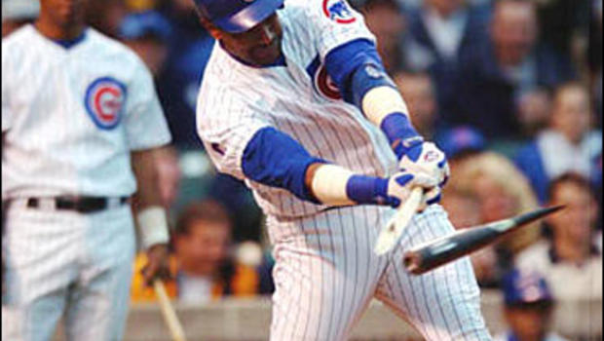
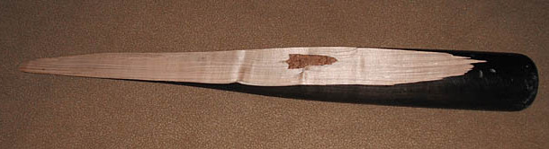
Sammy Sosa Corked Bat
Notes:
Teammate Mike Remlinger sold bat to Harry Caray’s Restaurant Group for $14,407

Slide 25
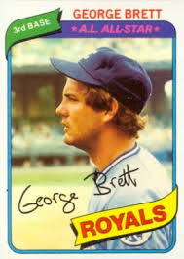
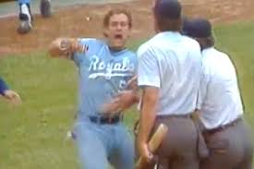
George Brett “Pine Tar Incident”

Slide 26
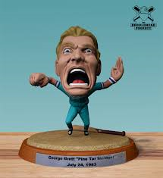
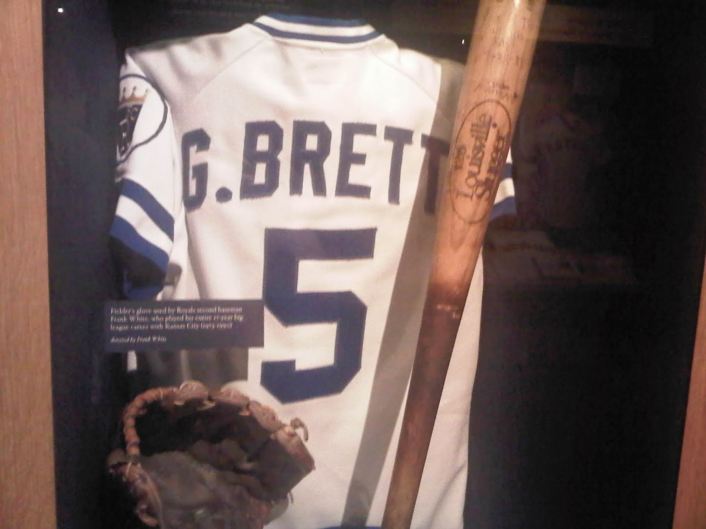
George Brett “Pine Tar Incident”
Notes:
Bobblehead and HOF Exhibit

Slide 27
Gambling

Slide 28
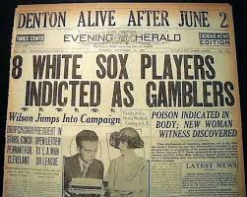
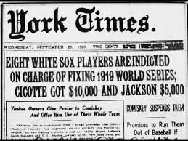
Black Sox Scandal 1919

Slide 29
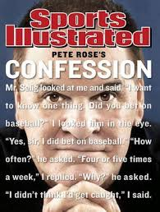
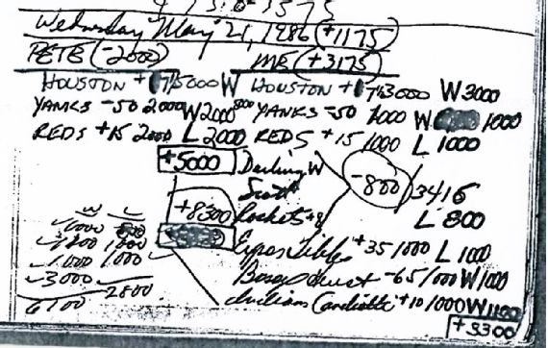
Pete Rose
Notes:
Given all the cheating that goes on in baseball, should Pete Rose be in the HOF?

Slide 30
Wrestling

Slide 31
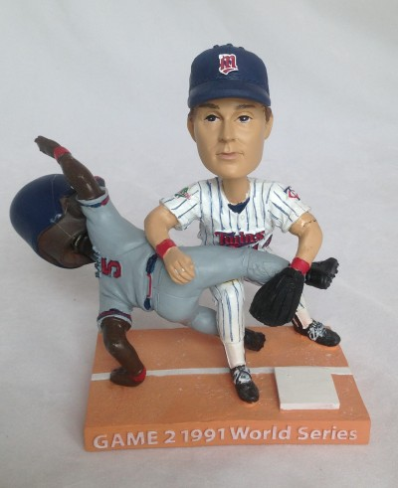
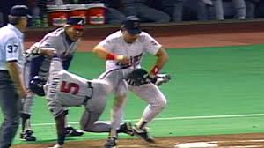
Kent Hrbek, 1991 World Series
Notes:
Video link on bigger picture – remember, no instant replay in 1991. Hrbek weighed 250; Gant 175

Slide 32

Performance Enhancing Drugs?

