Slide 1
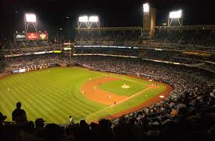
Famous Ballparks
Unusual Features

Slide 2
Landsdowne Street
Notes:
The architecture of old ballparks was many times determined by the surrounding streets and neighborhoods. Guess the stadium by the name of an adjacent street.

Slide 3
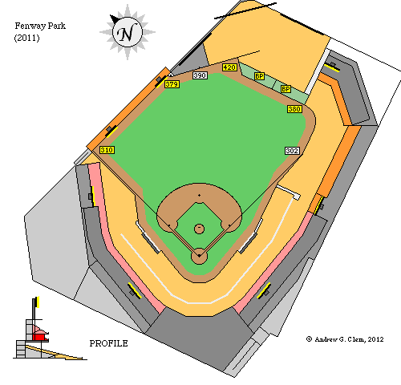
Fenway Park

Slide 4
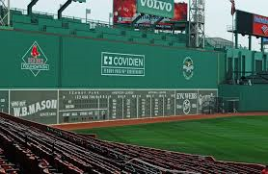
Fenway Park

Slide 5
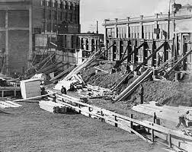
Fenway Park
Notes:
Building the Green Monster

Slide 6
Broad Street
Notes:
The architecture of old ballparks was many times determined by the surrounding streets and neighborhoods. Guess the stadium by the name of an adjacent street.

Slide 7
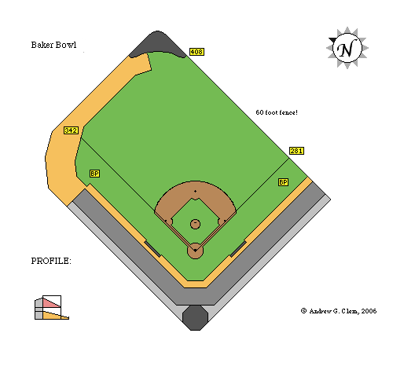
Baker Bowl

Slide 8
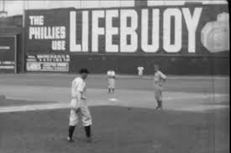
Baker Bowl
Notes:
60’ right field wall along Broad Street. Sign says “The Phillies Use Lifebuoy” and the fans would say “and they still stink!”

Slide 9
Bedford Avenue
Notes:
The architecture of old ballparks was many times determined by the surrounding streets and neighborhoods. Guess the stadium by the name of an adjacent street.

Slide 10
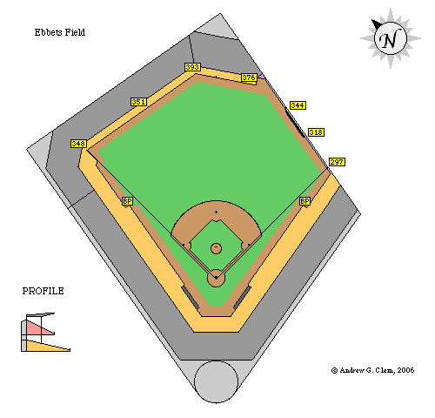
Ebbets Field

Slide 11
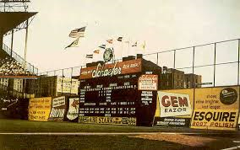
Ebbets Field
Notes:
Right field wall along Bedford Avenue. Notice convex shape and signage.

Slide 12
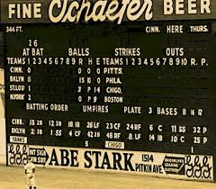
Ebbets Field
Notes:
“Hit sign – win a suit”.

Slide 13
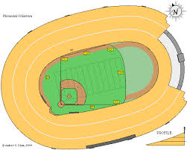
Notes:
Some ballparks used facilities built for other sports

Slide 14
LA Coliseum

Slide 15
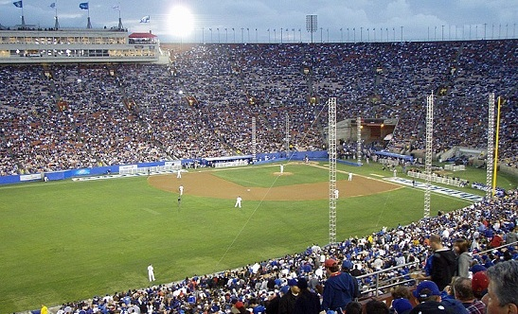
LA Coliseum

Slide 16
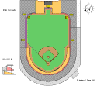
Notes:
Some ballparks used facilities built for other sports

Slide 17
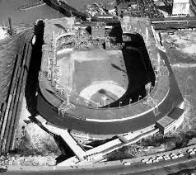
Polo Grounds

Slide 18
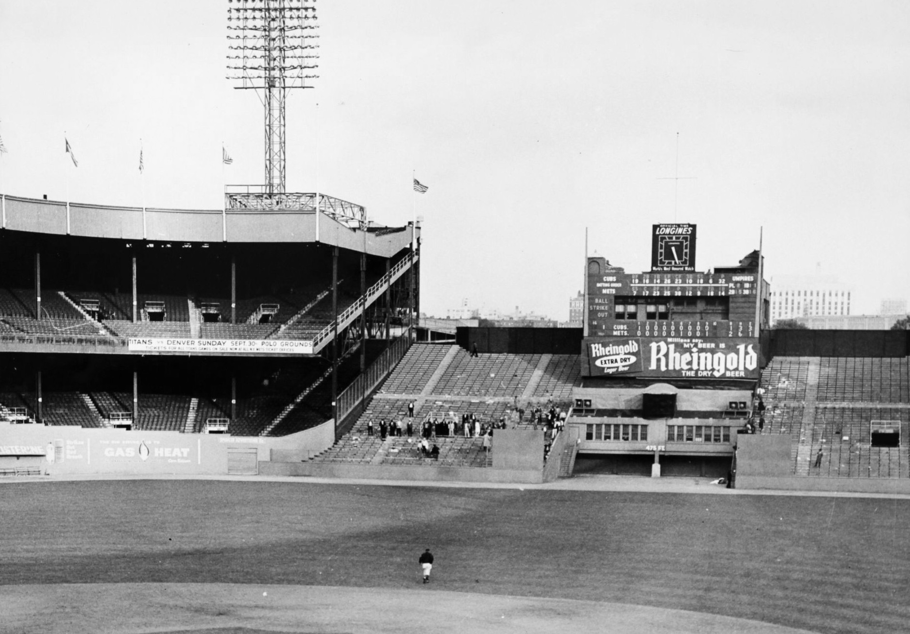
Polo Grounds

Slide 19
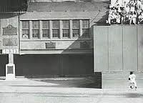
Polo Grounds – 1954 World Series
Notes:
Joe Garagiola looking on when Mays made “The Catch” off of Vic Wertz

Slide 20
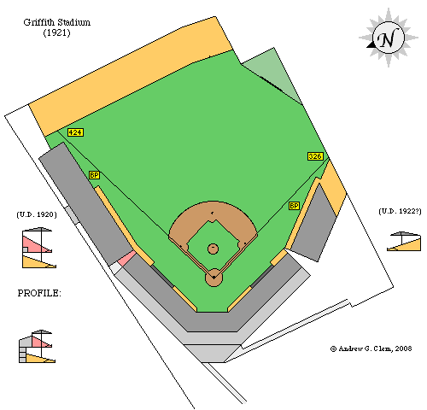
Notes:
Some ballparks had problems with adjoining landowners. Notice unusual shape of centerfield wall.

Slide 21
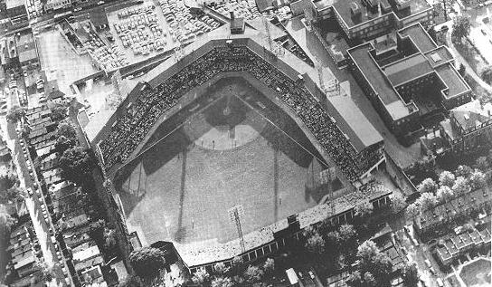
Griffith Stadium
Notes:
Notice the landowners who refused to sell their property (in centerfield area).

Slide 22
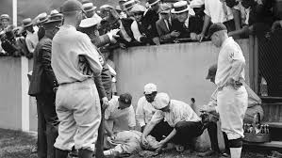
Griffith Stadium
Notes:
Babe Ruth knocked himself out running into right field wall a few days before retiring from baseball

Slide 23
Guess the Ballpark
Notes:
Guess these ballparks by their unique features or events

Slide 24
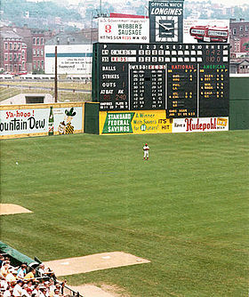
The Terrace
Notes:
Crosley Field, Cincinnati OH

Slide 25
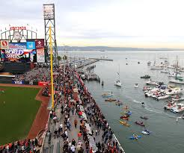
McCovey Cove

Slide 26
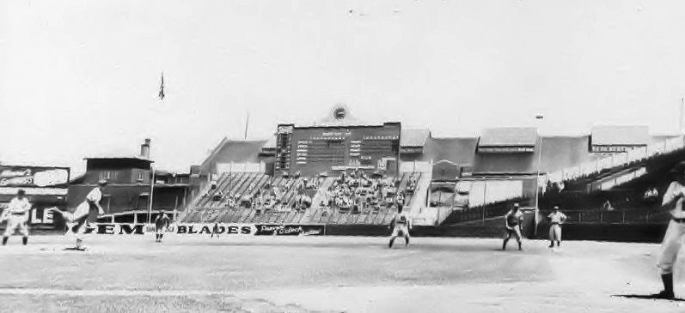
The Jury Box
Notes:
Braves Field, Boston MA

Slide 27
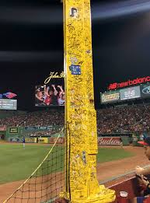
The Pesky Pole
Notes:
Fenway Park

Slide 28
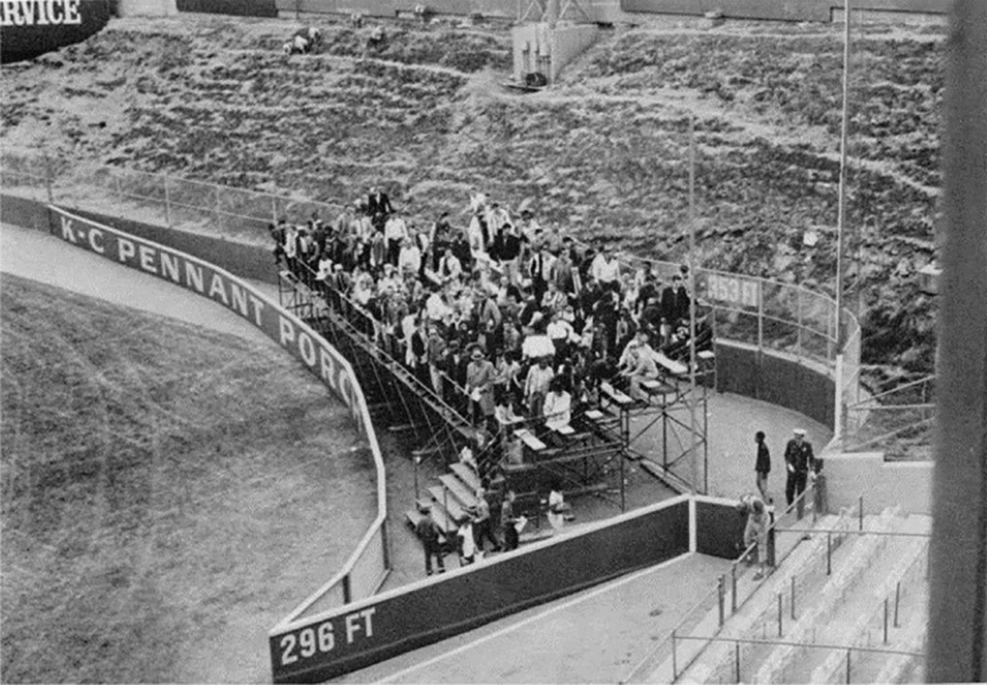
Pennant Porch
Notes:
Kansas City Memorial Stadium – Charles Finley mad at Yankees (1964)

Slide 29
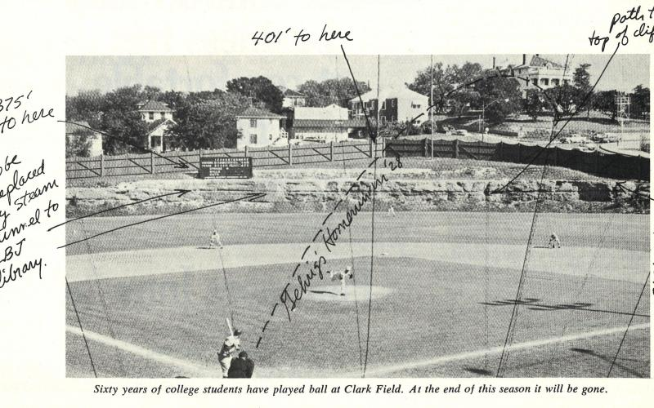
Billy Goat Hill
Notes:
Clark Field – University of Texas (from article Paul wrote for Texas Monthly

Slide 30
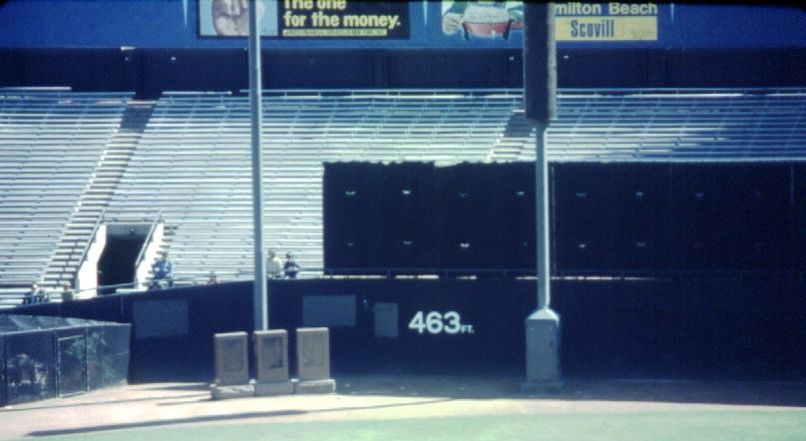
Notes:
Monuments in the outfield (in play). Old Yankee Stadium

Slide 31
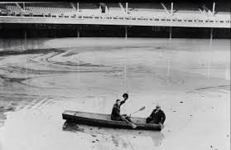
Notes:
Crosley Field Flood January 1937

Slide 32
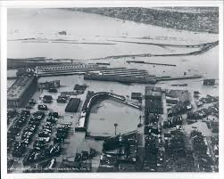
Notes:
Crosley Field Flood January 1937

Slide 33
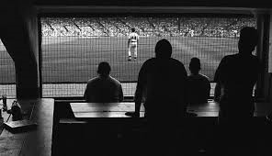
Notes:
Comiskey Park picnic area in left field - 1982

Slide 34
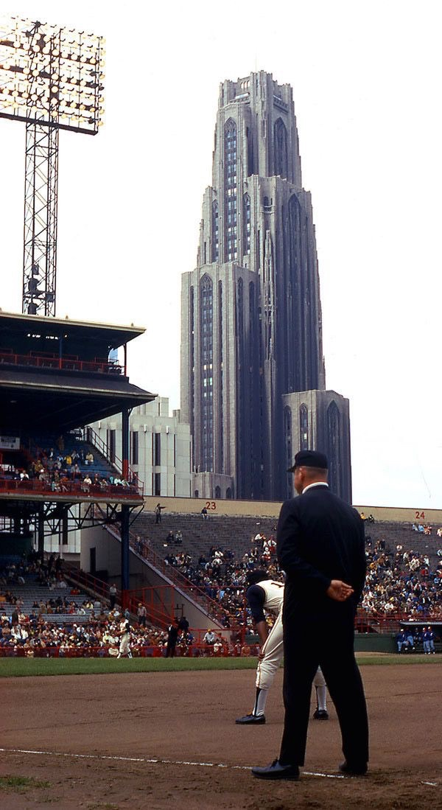
Notes:
Cathedral of Learning in background

Slide 35
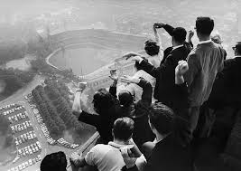

Slide 36
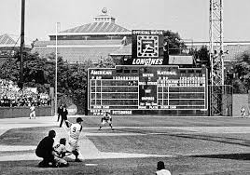
Notes:
Forbes Field, 1960 World Series – Pittsburgh PA

Slide 37
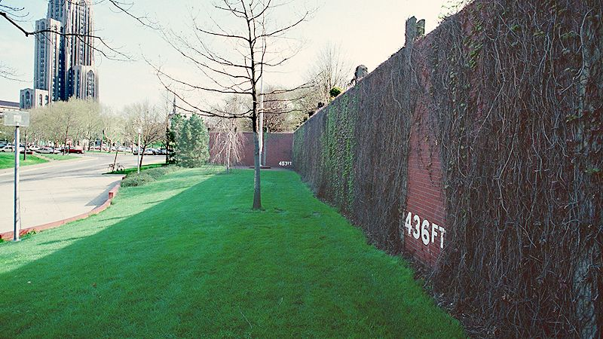
Notes:
Forbes Field today – Pittsburgh PA (preserved center and right field wall)

Slide 38
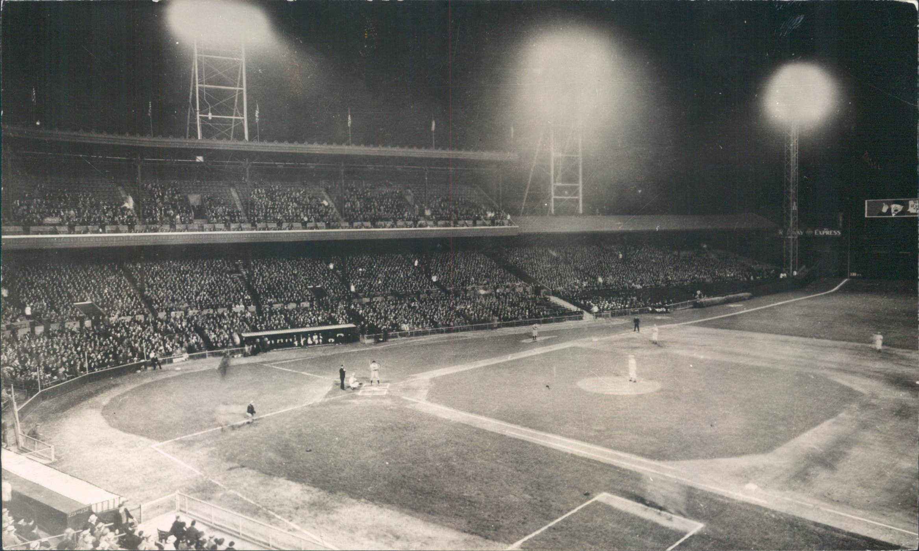
First Night Baseball Game
Notes:
Crosley Field 1935

Slide 39
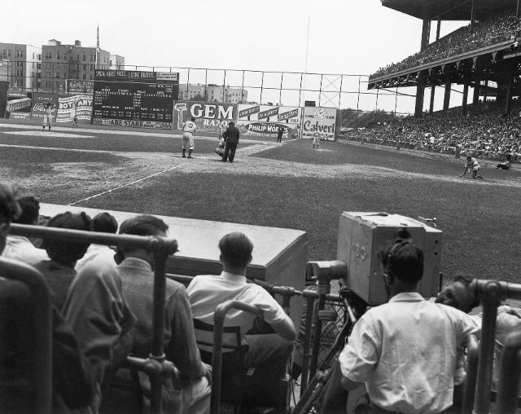
First Televised Baseball Game
Notes:
Ebbets Field 1939

Slide 40
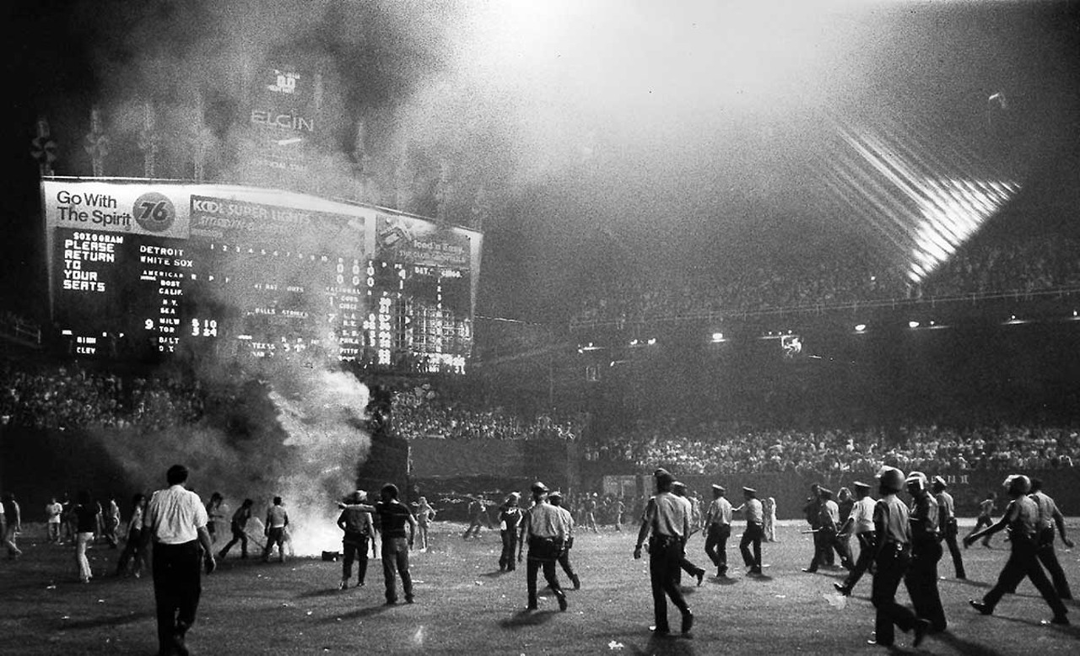
Disco Demolition Night
Notes:
Comiskey Park 1979

