Slide 1
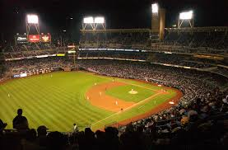
First Basemen

Slide 2
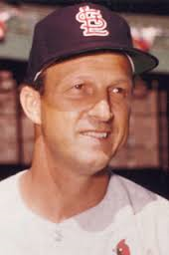
“When my son’s best friend is my teammate, I figure it’s time to retire.”
- Stan Musial (age 43 in 1963)
*The Cardinals’ Mike Shannon played high school baseball with Stan’s son
Stan Musial, HOF First Baseman

Slide 3
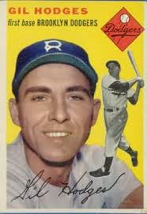
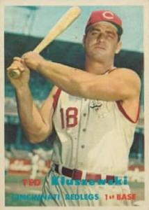
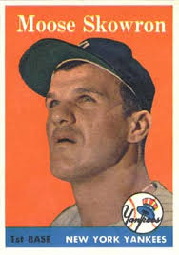
Who was your Favorite First Baseman?
Gil Hodges
Brooklyn Dodgers
Ted Kluszweski
Cincinnati Redlegs
Bill Skowron
New York Yankees

Slide 4
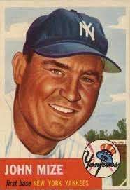
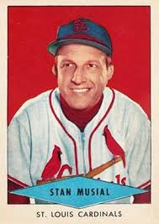
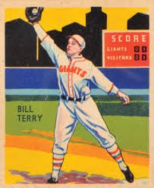
Which First Baseman had the highest career Batting Average?
Johnny Mize
New York Yankees
Stan Musial
St. Louis Cardinals
Bill Terry
New York Giants

Slide 5
Which First Baseman had the highest career Batting Average?
Bill Terry
New York Giants

Slide 6
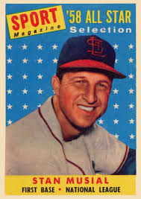
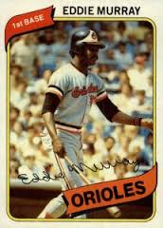
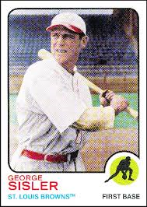
Which First Baseman had the most career Hits?
Stan Musial
St. Louis Cardinals
Eddie Murray
Baltimore Orioles
George Sisler
St. Louis Browns

Slide 7
Which First Baseman had the most career Hits?
Stan Musial
St. Louis Cardinals

Slide 8
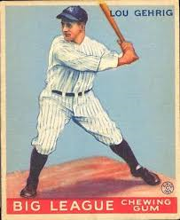
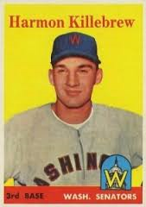
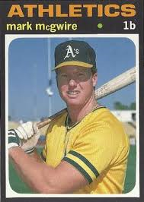
Which First Baseman hit the most Home Runs?
Lou Gehrig
New York Yankees
Harmon Killebrew
Minnesota Twins
Mark McGwire
St. Louis Cardinals

Slide 9
Which First Baseman hit the most Home Runs?
Mark McGwire
St. Louis Cardinals

Slide 10
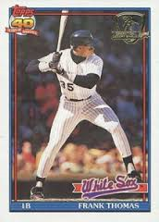
What was Frank Thomas’ Nickname?

Slide 11
What was Frank Thomas’ Nickname?
The Big Hurt
Notes:
Three Hall of Fame catchers. Ernie “Schnozz” Lombardi was still playing when Bill started following baseball

Slide 12
What was Lou Gehrig’s Nickname?

Slide 13
What was Lou Gehrig’s Nickname?
The Iron Horse
Notes:
Because of durability and consistency – like a legendary locomotive (The Iron Horse) of the day. Also nicknamed “Biscuit Pants” by the players because of baggy pants over thick legs and a “broad back porch”

Slide 14
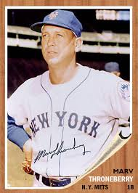
What was Marv Throneberry’s Nickname?

Slide 15
What was Marv Throneberry’s Nickname?
Marvelous Marv
Notes:
Symbol of futility for one of worst teams in ML history – 1962 Mets. Once hit what looked like game winning triple. Umpire called him out when he missed first base. Umpire later told Casey Stengel that he also missed second base!

Slide 16
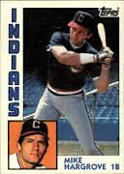
What was Mike Hargrove’s Nickname?
Notes:
Three Hall of Fame catchers. Ernie “Schnozz” Lombardi was still playing when Bill started following baseball

Slide 17
What was Mike Hargrove’s Nickname?
The Human Rain Delay
Notes:
Three Hall of Fame catchers. Ernie “Schnozz” Lombardi was still playing when Bill started following baseball

Slide 18
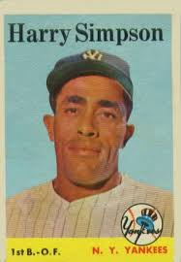
What was Harry Simpson’s Nickname?

Slide 19
What was Harry Simpson’s Nickname?
Suitcase
Notes:
Not because of numerous trades (8 times in 4 years 1955-1959). Nicknamed before this time because of size 13 shoes – as big as suitcases. From newspaper comics character in comic strip “Toonerville Folks” – Suitcase Simpson.

Slide 20
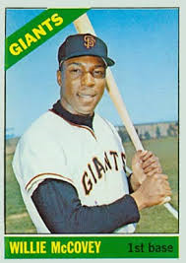
What was Willie McCovey’s Nickname?

Slide 21
What was Willie McCovey’s Nickname?
Stretch
Notes:
6’4” tall

Slide 22
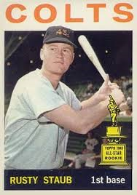
What was Rusty Staub’s Nickname?

Slide 23
What was Rusty Staub’s Nickname?
Le Grande Orange
Notes:
Red hair after trade to Montreal Expos

Slide 24
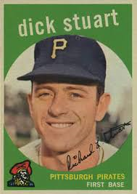
What was Dick Stuart’s Nickname?

Slide 25
What was Dick Stuart’s Nickname?
Dr. Strangeglove
Notes:
Led his league’s 1B in errors seven straight seasons. Radatz suggested his license plate be “E3”. Once received a standing ovation for picking up a hot dog wrapper.

