Slide 1
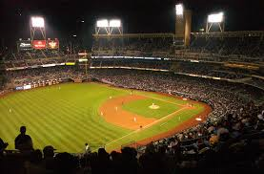
Hall of Famers as Kids

Slide 2
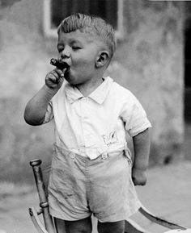
Future Hall of Famer

Slide 3
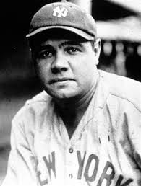
Babe Ruth

Slide 4
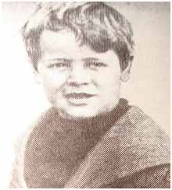
Future Hall of Famer

Slide 5
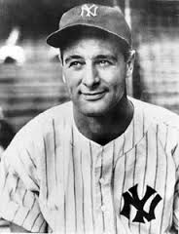
Lou Gehrig

Slide 6
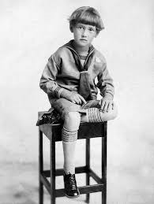
Future Hall of Famer

Slide 7
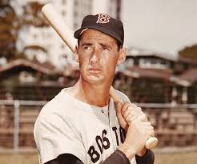
Ted Williams

Slide 8
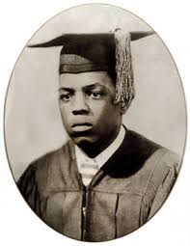
Future Hall of Famer

Slide 9
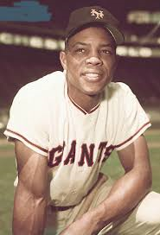
Willie Mays

Slide 10
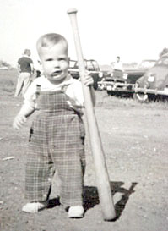
Future Hall of Famer

Slide 11
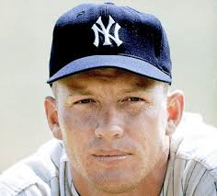
Mickey Mantle

Slide 12
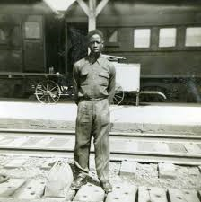
Future Hall of Famer

Slide 13
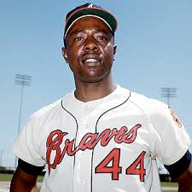
Hank Aaron

Slide 14
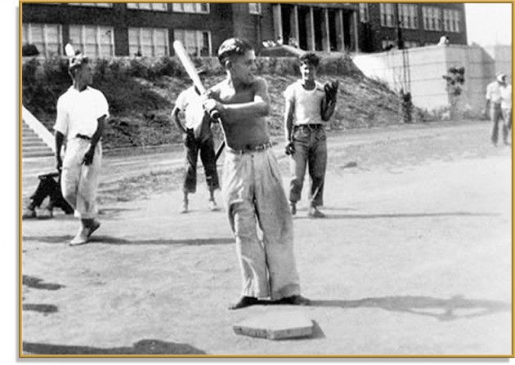
Future Hall of Famer

Slide 15
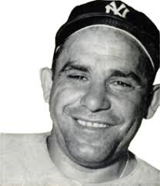
Yogi Berra

Slide 16
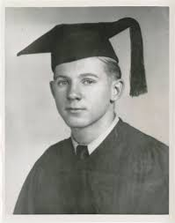
Future Hall of Famer

Slide 17
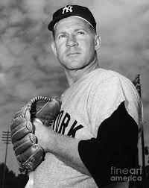
Whitey Ford

Slide 18
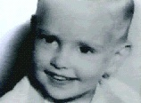
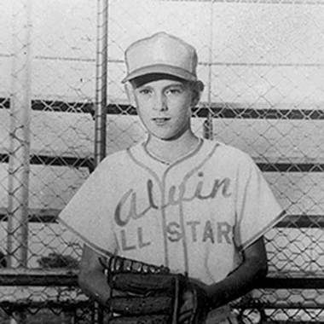
Future Hall of Famer

Slide 19
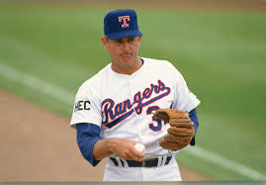
Nolan Ryan

Slide 20
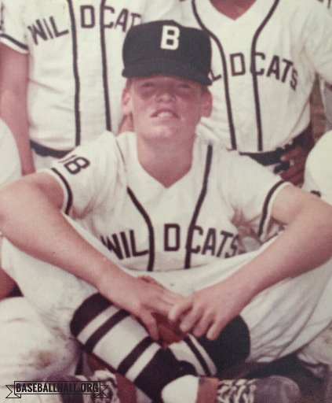
Future Hall of Famer

Slide 21
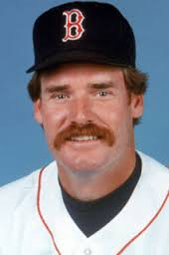
Wade Boggs

Slide 22
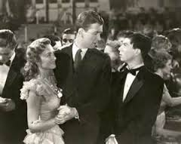
In Reverse Order (not Baseball)
Notes:
It’s A Wonderful Life

Slide 23
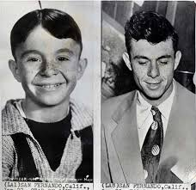
Carl Switzer (aka Alfalfa)
Notes:
It’s A Wonderful Life

Slide 24
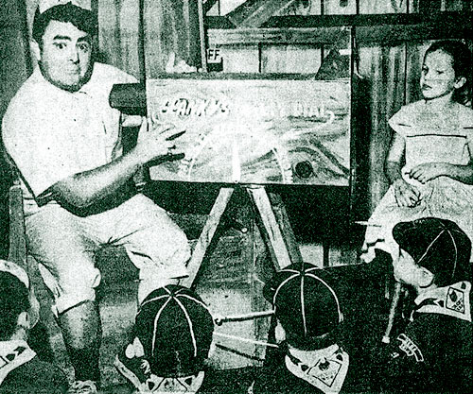
In Reverse Order (not Baseball)
Notes:
It’s A Wonderful Life

Slide 25
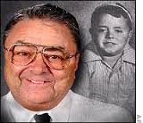
Spanky McFarland
Notes:
It’s A Wonderful Life

