Slide 1
Houston Ballparks
1928-1999

Slide 2
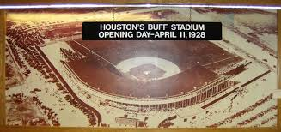

Slide 3
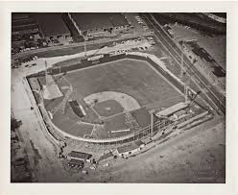

Slide 4
Buffs Stadium – Home of the Houston Buffaloes

Slide 5
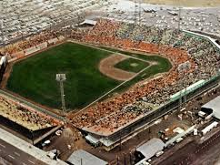
COLT STADIUM

Slide 6
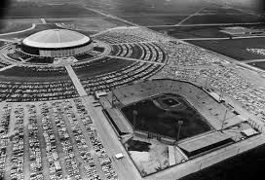
COLT STADIUM and ASTRODOME

Slide 7
