Slide 1

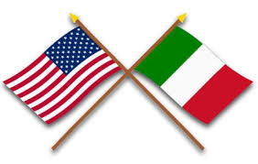
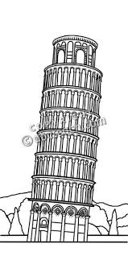
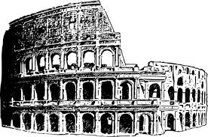
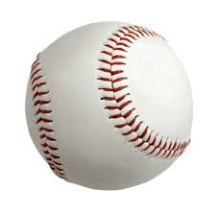
Italian-Americans in
Baseball

Slide 2
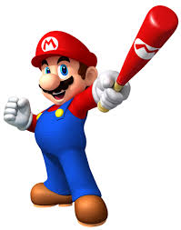
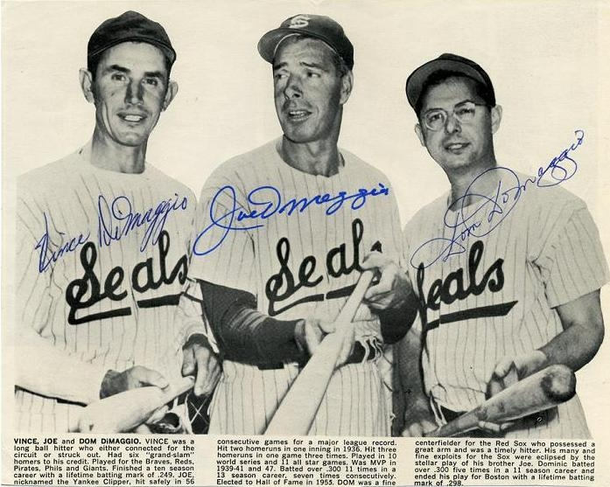
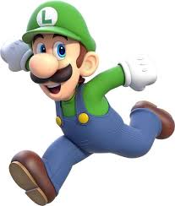
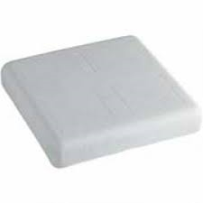
Italian-Americans in Baseball
Two fictional Italian-American
brothers playing baseball
Three real-life Italian-American
baseball brothers
Three real-life Italian-American baseball brothers

Slide 3
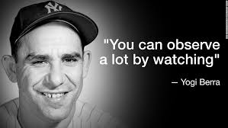
Yogi’s All-Time Italian-American
All-Star Team
For a 2003 book
Yogi agreed to name
his All-Time team of fellow Italian-American
players.
Here are some of
his picks….

Slide 4
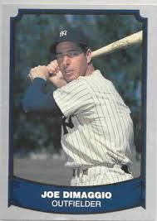
Yogi’s All-Time Italian-American
Center Fielder
First Italian-American elected to the Baseball Hall-of-Fame
1939, 1941, 1947 AL MVP
Holds the all-time record for consecutive games hitting safely

Slide 5
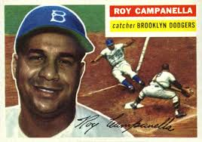
Yogi’s All-Time Italian-American
Catcher
Yogi would not vote for himself … but he said his candidate was “Great, and he’s only half Italian.”
Won three NL MVP awards
Led Brooklyn Dodgers to their only World Series title in 1955

Slide 6
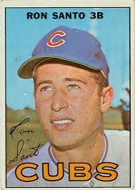
Yogi’s All-Time Italian-American
3rd Baseman
Only MLB third baseman to record 8 consecutive seasons of 90+ RBI
Was a diabetic
Went on to a long broadcasting career as “the world’s single biggest Cubs fan”.

Slide 7
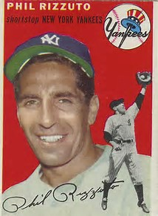
Yogi’s All-Time Italian-American
Shortstop
Yogi’s teammate – he was known as “Scooter”
1950 AL MVP
Went on to a long broadcasting career. Was know for scoring a play as “WW” on his scorecard – indicating he “Wasn’t Watching”

Slide 8
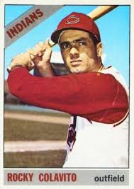
Yogi’s All-Time Italian-American
Right Fielder
Known for his great throwing arm and home run power.
Led the AL in 1965 with 108 RBI
His given names are Rocco Domenico, but we know him as …

Slide 9
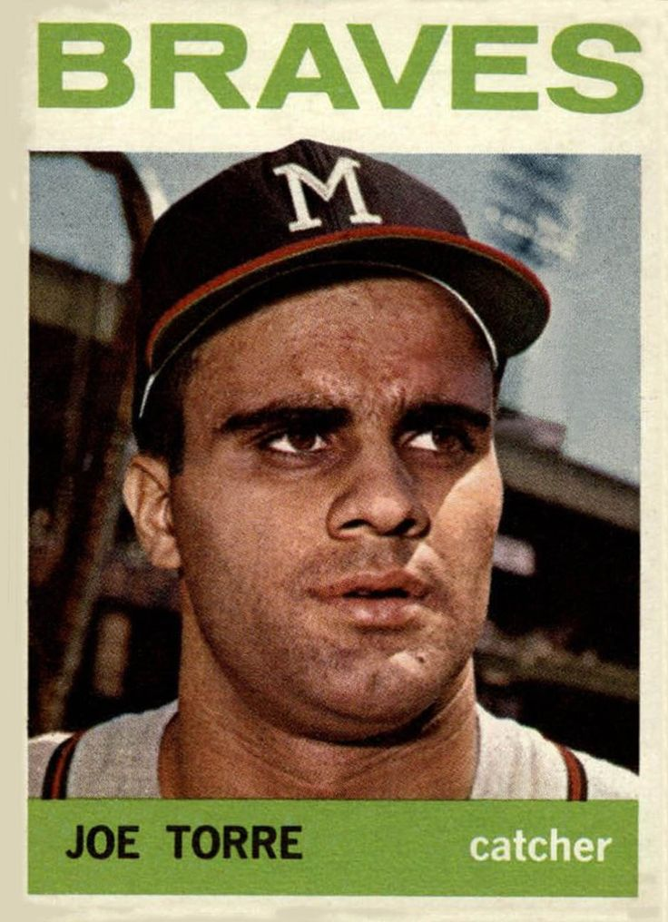
Yogi’s All-Time Italian-American
Manager
Was a power-hitting catcher and 1B/3B during his playing career
His brother Franco played first base for the 1957 World Series champs
Was the 1971 NL MVP

Slide 10
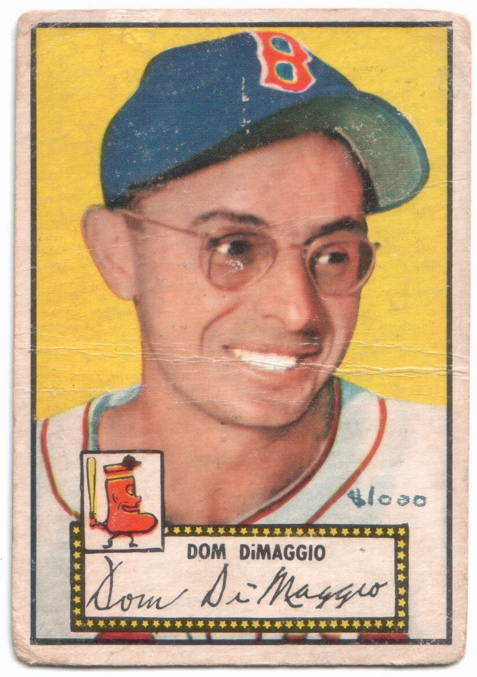
Yogi’s Favorite Red Sox
Center Fielder
Was an excellent fielder, some say better than his brother
Could hit anywhere in the lineup
Because he wore glasses, his nickname was “The Little Professor”

Slide 11
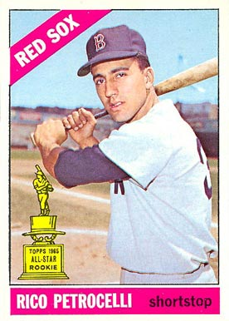
Yogi’s Favorite Red Sox
Short Stop
Was an AL all-star for the 1967 “Impossible Dream” team
His best year at the plate was 1969 when he hit 40 homers with 97 RBI
He moved to 3B when the team acquired Luis Aparicio.

Slide 12
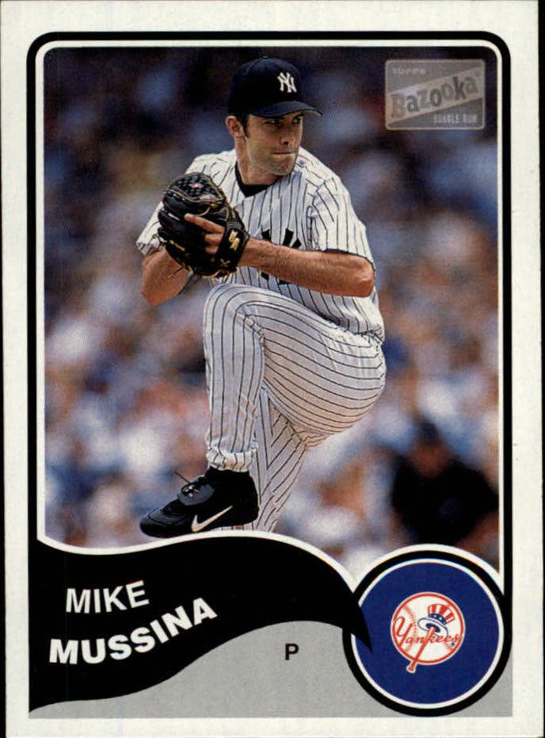
All-Time Leaders
Pitching
He is the all-time Italian-American leader in MLB pitching wins -- 270
He is also the all-time leader in WAR -- 83
His friends call him “Moose”

Slide 13
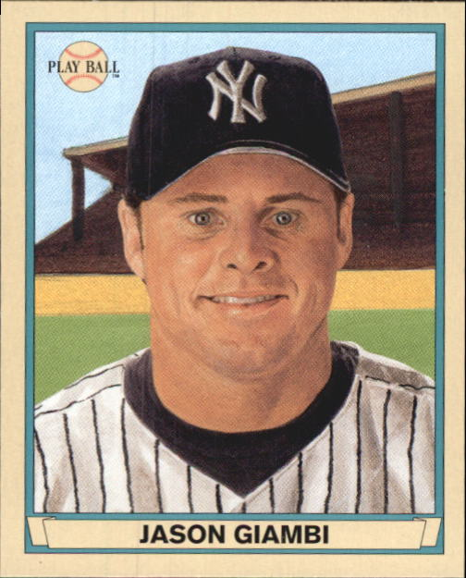
All-Time Leaders
Home Runs
He is the all-time Italian-American leader in round-trippers with 440
Was the 2000 AL MVP
Played 20 years in the majors, finishing his career in 2014

Slide 14
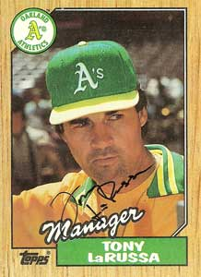
All-Time Leaders
Wins by a Manager
Started his managerial career with the White Sox
Won three World Series and was only the second manager to win one in both leagues
Won 2728 games in the majors, third all-time behind Connie Mack and John McGraw

Slide 15
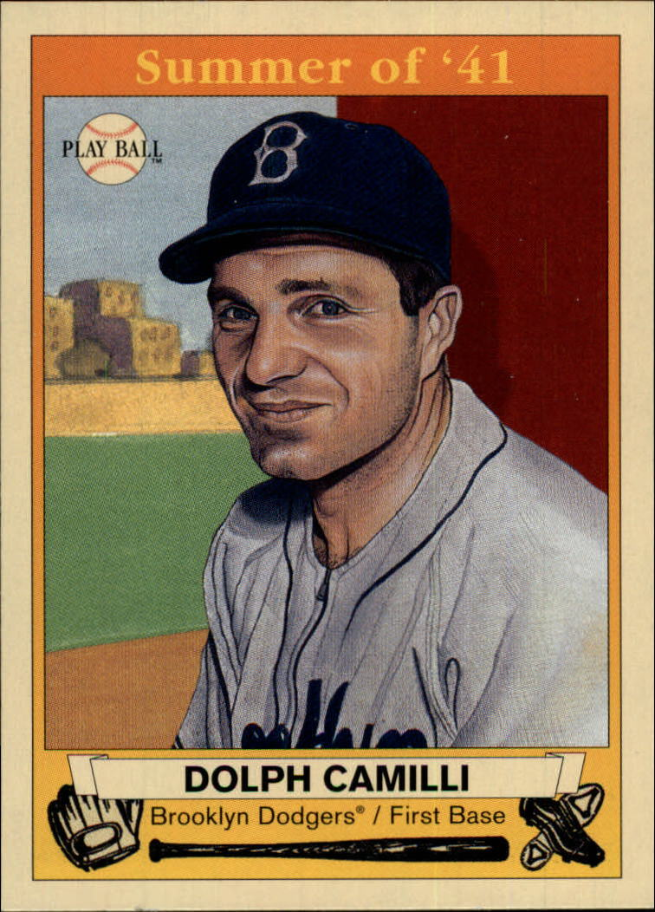
Italian-Americans Sweep 1941 MVPs
The Yankee Clipper won the AL MVP
DiMaggio had his famous 56-game hitting streak, plus led the league with 125 RBI
In the National League, this hard-hitting 1B led the league with 120 RBI & 34 HR
His given first name was Adolph

Slide 16
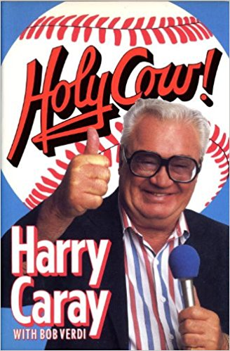
All-Time Broadcaster
His name was Harold Christopher Carabina
He was a major league radio and TV broadcaster for 53 years
He received the HOF Ford Frick Award in 1989
We know him as …

Slide 17
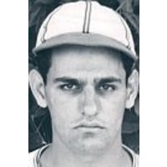
Italian-American
Baseball Nicknames
His real name was Frank Angelo Joseph Crespi
He was a utility infielder for the Cardinals 1938-42
He had a sinister look about him, so he got the nickname …
Creepy Crespi

Slide 18
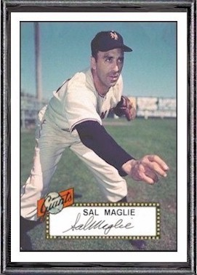
Italian-American
Baseball Nicknames
His real name was Salvatore Anthony Maglie
He jumped to the Mexican League in 1946
Cuban pitching great & manager Adolfo Luque stressed that he needed to pitch inside … so he got the nickname
Sal the Barber

Slide 19
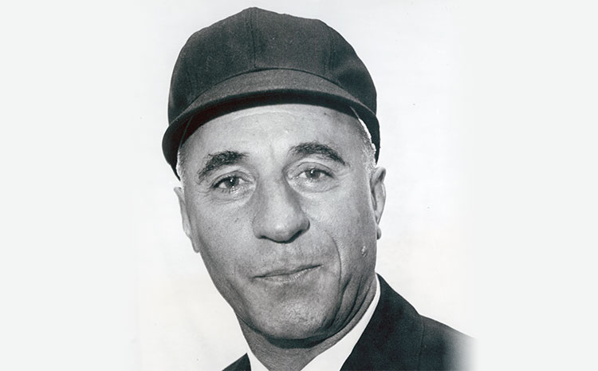
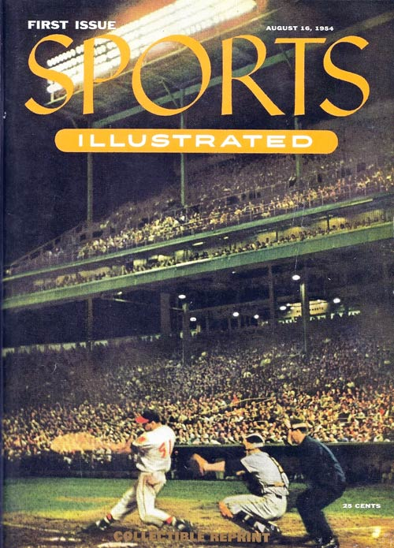
Italian-American Baseball Nicknames
His real given names were August Joseph … his friends called him “Gus”
Was one of the first Italian-American MLB umpires. Went to umpire school on the GI Bill.
He appeared on the cover of the very first issue of Sports Illustrated in 1954.
Everyone else called him …
Augie Donatelli

Slide 20
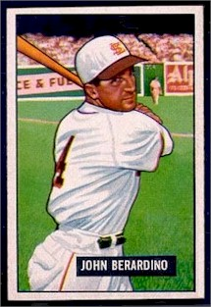
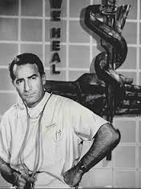
Italian-American Ball Player & Actor
Played for the Browns, Indians, and Pirates in 11-year career
Was a utility infielder on 1948 Indians World Series champs
Better known as …
Dr. Steve Hardy on General Hospital
He is the ONLY player to have a World Series ring AND his star on the Hollywood Walk of Fame

Slide 21
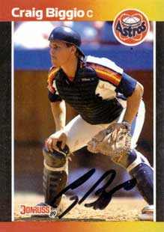
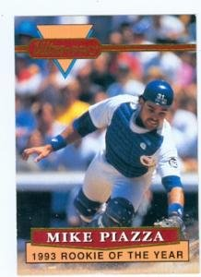
Two Recent Inductees to the Hall of Fame
Started as a catcher, moved to CF and then to 2B
Played his entire career with the Astros, collecting 3060 hits
Was drafted in the 62nd round of the 1988 draft as a favor to his father from Dodgers manager Tom Lasorda
Hit 427 HR with a lifetime BA of .308

Slide 22
But … you don’t have to go all the way to
professional baseball to find
Italian-Americans playing the sport …
in fact, we have a few close at hand …

Slide 23
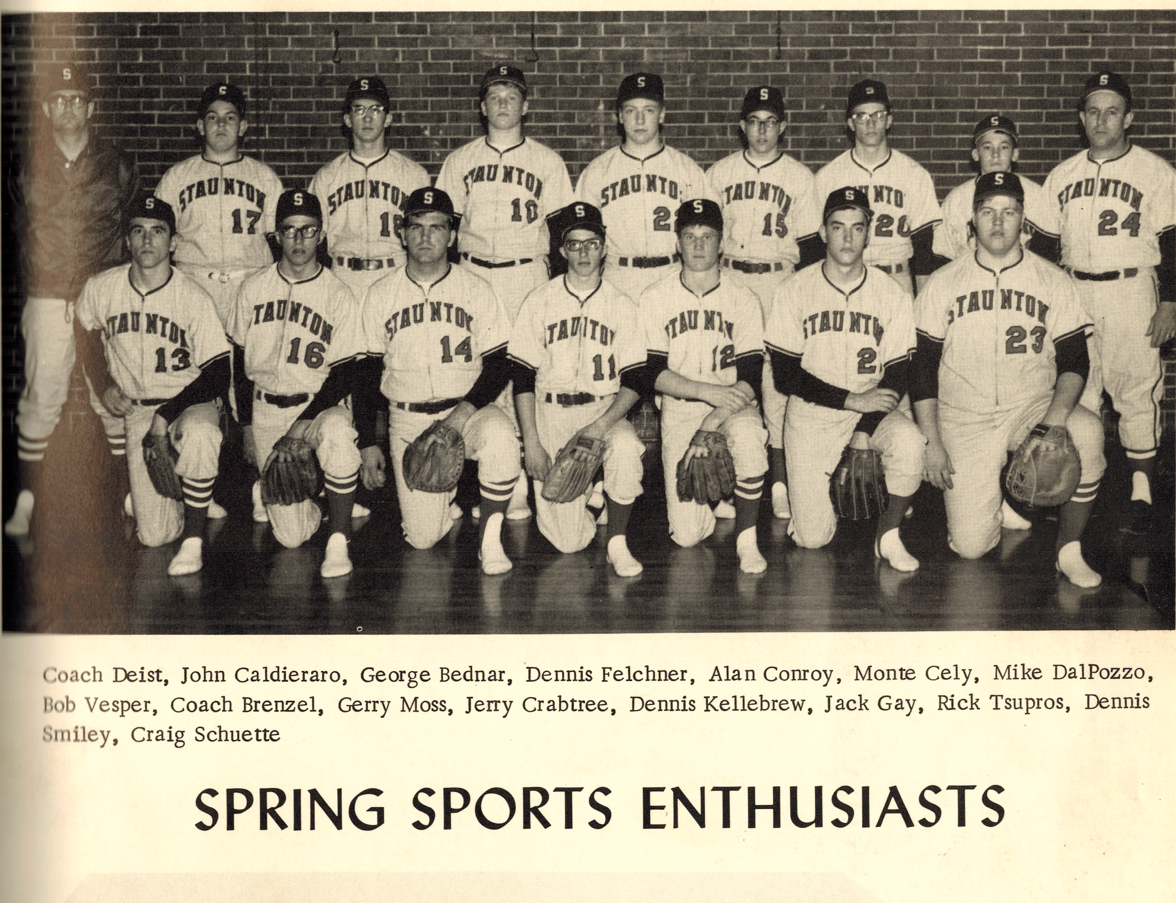
T
There were a lot of Italian-Americans on the
1970 Staunton Bulldogs

Slide 24
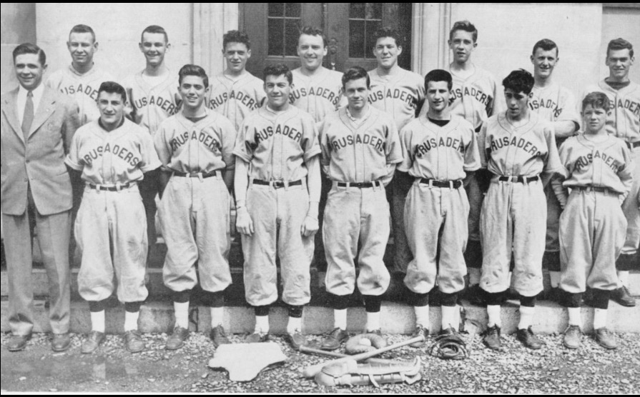
but only one slugging Italian-American outfielder in this picture of the
1947 John Bapst Crusaders

Slide 25
Ciao !

