Slide 1
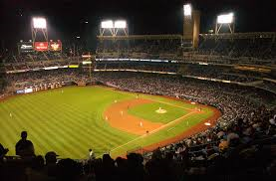
Jackie Robinson

Slide 2
Born in Cairo, Georgia on January 31, 1919
Notes:
His mother moved the family to California when Jackie was 14 months old. If not, Jackie might have played for the Syrupmakers

Slide 3
The Syrupmakers
Notes:
His mother moved the family to California when Jackie was 14 months old. If not, Jackie might have played for the Syrupmakers

Slide 4
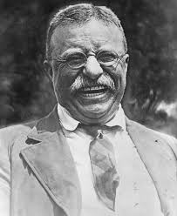
Jackie Roosevelt Robinson
Notes:
Middle name in honor of President Theodore Roosevelt who died 21 days before Jackie was born.

Slide 5
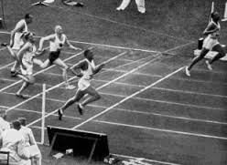
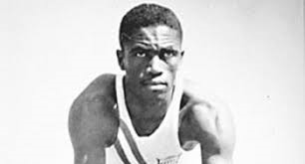
His brother, Mack, won a Silver Medal in 1936 Olympics
Notes:
Finished second to Jesse Owens. He, like Owens, was snubbed by Adolph Hitler on the awards stand.

Slide 6
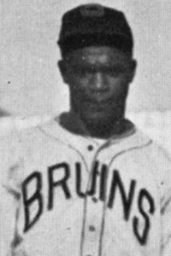
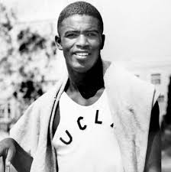
First Four Sport Letterman in UCLA History
Notes:
Baseball was his worst sport – hit .097 in his only season at UCLA

Slide 7
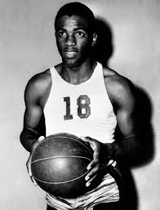
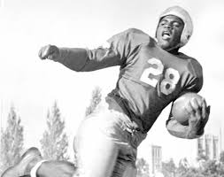
First Four Sport Letterman in UCLA History
Notes:
All Conference in Football and Basketball. Shared Running Back duties with Kenny Washington – who broke modern day color barrier in pro football.

Slide 8
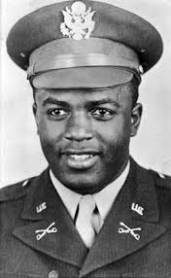
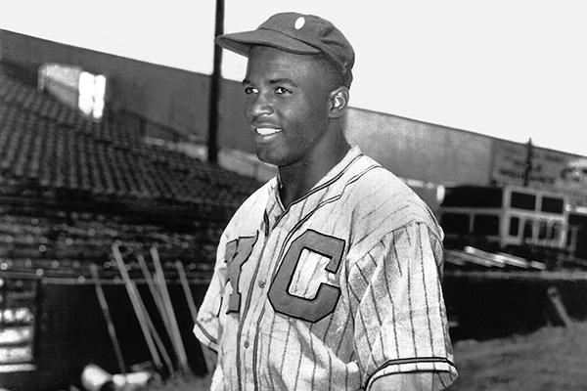
Did not play Organized Baseball from 1941 - 1945
Notes:
In military during WWII. He and Joe Louis became friends – Louis helping Robinson get in Officer’s Candidate school. Played with KC Monarchs in 1945.

Slide 9
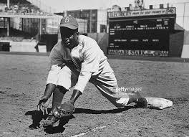
Played First Base in his first ML Game
Notes:
Went 0-3 against Johnny Sain in first major league game. Eddie Stanky traded at end of 1947 allowing Robinson to move to 2B

Slide 10
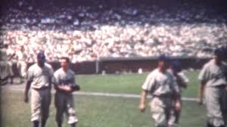
His debut at Wrigley Field was largest paid crowd EVER
Notes:
May 18, 1947 – 46,572 paid. 51,556 in 1930 but Ladies’ Day (only 19,748 paid). Bruce Springsteen 9/13/12 – 84,000+ paid.

Slide 11
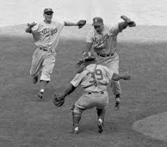
Played in Six World Series – Only game he missed Game 7 1955
Notes:
Don Hoak played 3B for him in the game where Dodgers won only World Series in Brookly.

Slide 12
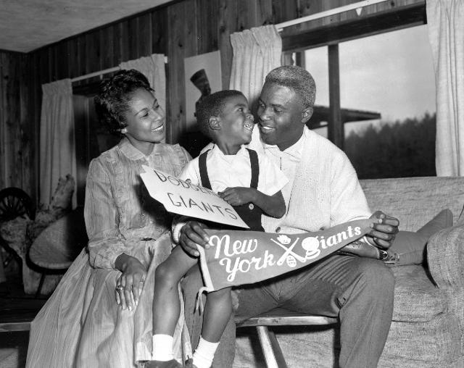
Traded to NY Giants on December 13, 1956
Notes:
Trade announced

Slide 13
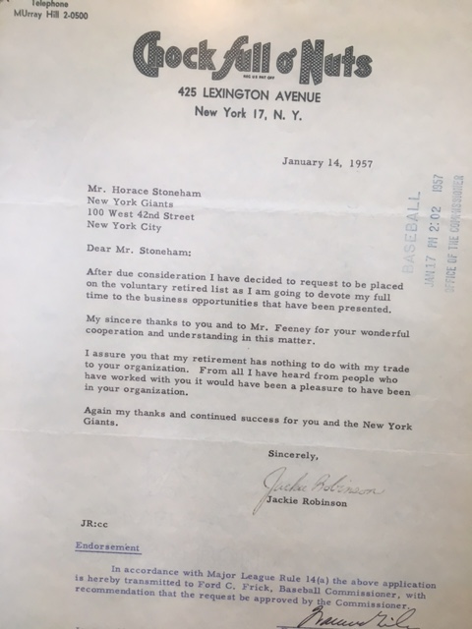
Notes:
Traded to Giants

Slide 14
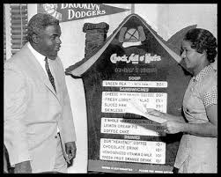
First Black Vice President of major U.S. Corporation
Notes:
VP of Chock Full o’ Nuts from 1957 - 1964

Slide 15
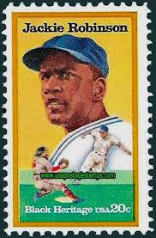
First Baseball Player to be on U.S. Postage Stamp
Notes:
First baseball player of any color (1982)

Slide 16
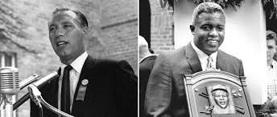
Inducted into Hall of Fame in 1962 with Bob Feller
Notes:
Earlier in his career, Feller had said his “football shoulders” would prevent him from hitting ML pitching
“.

Slide 17
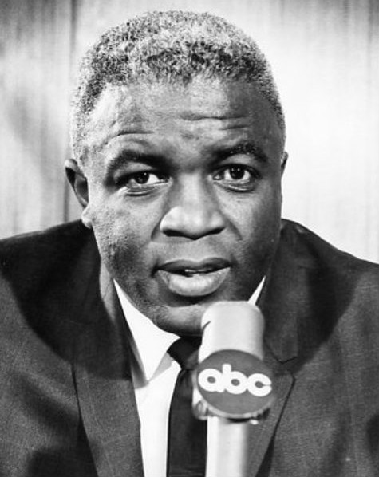
First Black Baseball Analyst on Network TV
Notes:
ABC Game of the Week in 1965. Later did broadcasts for Montreal Expos

Slide 18
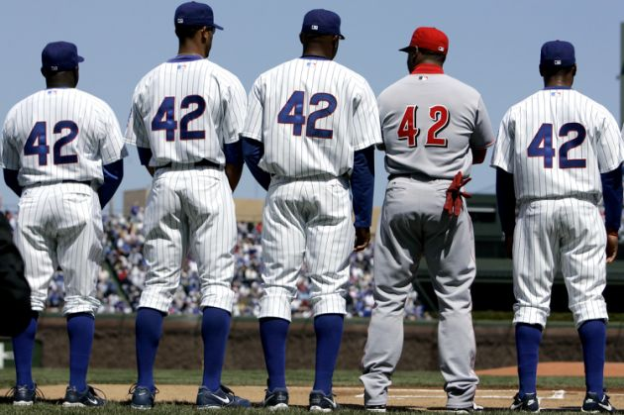
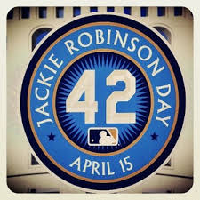
Jackie Robinson Day – April 15
Notes:
His number 42 permanently retired for ALL Teams

