Slide 1
Major League Players from the University of Texas

Slide 2
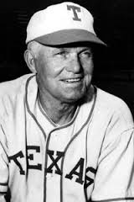
Bibb Falk OF 1920 – 1931
- Chicago White Sox
- Cleveland Indians
Replaced Shoeless Joe Jackson as LF for the White Sox in 1921 after Black Sox scandal
Head baseball coach at UT from 1940 – 1967
UT baseball stadium named for Coach Falk and Coach Billy Disch

Slide 3
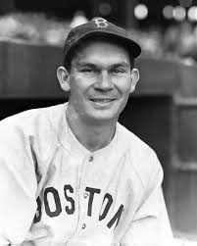
Pinky Higgins 3B 1930 - 1946
- Philadelphia Athletics
- Boston Red Sox
- Detroit Tigers
Set major league record by getting 12 hits in a row
AL Manager of the Year (1958) in his first year as manager of the Red Sox

Slide 4
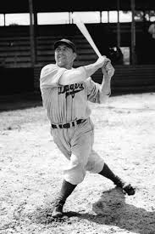
Ernie Koy Sr. OF 1938 - 1942
- Brooklyn Dodgers
- St. Louis Cardinals
- Cincinnati and Philadelphia Phillies
Hit a home run in his first major league at bat for Brooklyn
Traded to Cardinals in 1940 for “Coonskin” Davis and “Ducky” Medwick
Two sons played in NFL and for NCAA Football Champions at Texas (‘63 and ‘67)
Notes:
Ernie Jr on 1963 team and Ted on 1969 team

Slide 5
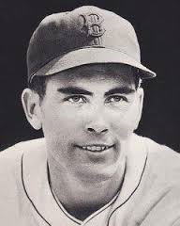
Tex Hughson P 1941 - 1949
- Boston Red Sox
In 1942, he led AL in wins, strikeouts, complete games and innings pitched
AL All Star 1942 – 1944
From Kyle, Texas

Slide 6
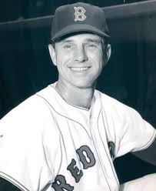
Grady Hatton INF 1946 - 1960
- Cincinnati
- Chicago White Sox
- Red Sox, Cardinals, Orioles, Cubs
First Director of Player Personnel for the Houston Colt 45s
Managed Houston Astros 1966 - 1968

Slide 7
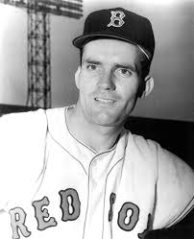
Murray Wall P 1950 - 1959
- Boston Braves
- Boston Red Sox
- Washington Senators
Pitched for University of Texas National Championship teams in 1949 and 1950

Slide 8
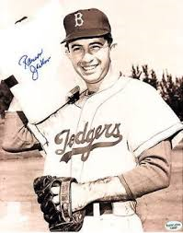
Ransom “Randy” Jackson INF 1950 - 1960
- Brooklyn Dodgers
- Boston Red Sox
- Washington Senators
Hit the last home run ever hit by a Brooklyn Dodger
Played in consecutive Cotton Bowls for TCU and UT (also played at Arkansas)
Nicknamed “Handsome Ransom”

Slide 9
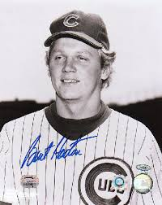
Burt Hooton P 1971 - 1985
- Chicago Cubs
- Los Angeles Dodgers
- Texas Rangers
Nicknamed “Happy”
Threw a no-hitter in his 4th major league game
Three time All American at UT; in College Baseball Hall of Fame
Had lowest career ERA in UT history – 1.14

Slide 10
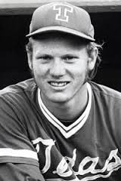
Keith Moreland OF-C-3B 1978 - 1989
- Philadelphia Phillies
- Chicago Cubs
- Padres, Tigers and Orioles
Hit .410 for 1975 National Champion Texas Longhorns
Drafted as a catcher, played 3B and 1B before moving to OF
Played for 1980 World Champion Philadelphia Phillies

Slide 11
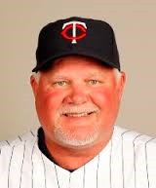
Ron Gardenhire INF 1981 - 1985
- New York Mets
Managed Minnesota Twins from 2002 – 2014
AL Manager of the Year in 2010 (was runner-up five times)

Slide 12
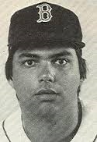
Calvin Schiraldi P 1984 - 1991
- New York Mets
- Boston Red Sox
- Cubs, Padres and Rangers
Most Outstanding Player in 1983 College World Series (Clemens was also on team)
Started inning in 1986 World Series when Mookie Wilson hit grounder that was booted by Bill Buckner
Coach at St. Michael’s Academy in Austin
Son, Lukas, in Seattle Mariners farm system
Notes:
Ernie Jr on 1963 team and Ted on 1969 team

Slide 13
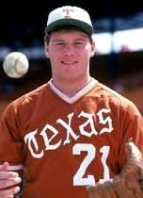
Roger Clemens P 1984 - 2007
- Boston Red Sox
- Toronto Bluejays
- Yankees and Astros
Nicknamed “The Rocket”
Won seven Cy Young Awards
In 1986 – won Cy Young, AL MVP, All Star MVP and set major league record by striking out 20 batters in one game
Ranks 3rd in major league most strikeouts (4,672)
Notes:
Ernie Jr on 1963 team and Ted on 1969 team

Slide 14

Others of Note:
- Spike Owen
- Greg Swindell
- ?????
Trivia: What famous UT players (who did NOT play in the major leagues) both pitched no-hitters for UT baseball team and also quarterbacked the Longhorns to Cotton Bowl victories?

Slide 15
Major League Players from
Texas A&M

Slide 16
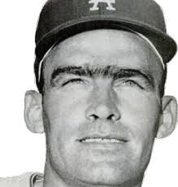
Wally Moon OF 1954 - 1965
- St. Louis Cardinals
- Los Angeles Dodgers
1954 NL Rookie of the Year (beat out Hank Aaron and Ernie Banks)
Replaced Enos Slaughter in the Cardinals’ outfield
Hit home run in first major league at bat
Famous for his “Moon Shots” in LA Coliseum (1959 Champion Dodgers)

Slide 17
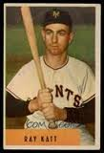
Ray Katt C 1952 - 1959
- New York Giants
- St. Louis Cardinals
Catcher on 1954 World Champion NY Giants
Set major league record with 4 passed balls in one inning (Hoyt Wilhelm)
  Gino Petralli tied record (Charlie Hough)
  Ryan Lavernway also tied (Steven Wright)
Coached Texas Lutheran (Seguin) from 1971 - 1992

Slide 18
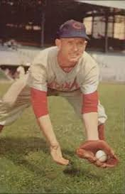
Roy McMillan SS 1951 - 1966
- Cincinnati Redlegs
- Milwaukee Braves
- New York Mets
Won the first three Gold Glove awards given to SS (1957 – 1959)
One of six Redlegs to be voted on the 1957 NL All Star team (ballot stuffing – he remained a starter after two teammates were replaced)
Notes:
Cincinnati changed name to Redlegs in 1953 during McCarthy hearings (instead of Reds)

Slide 19
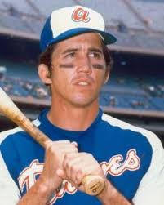
Davey Johnson 2B 1965 - 1978
- Baltimore Orioles
- Atlanta Braves
- Phillies and Cubs
Starting 2B on World Champion Baltimore Orioles in 1966 and 1970
Tied Rogers Hornsby’s all time record for most home runs in a season by 2B (42 in 1973)
Atlanta Braves were first team in history to have 3 players hit 40 or more HRs in same season (Aaron, Evans and Johnson)
Notes:
First even to hit to pinch hit grand slams in same season. AL Mgr. of Year in 1997; NL Mgr. of Year in 2012. Last person to get hit off of Sandy Koufax

Slide 20
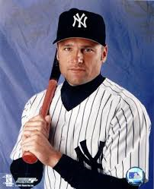
Chuck Knoblauch 2B 1991 - 2002
- Minnesota Twins
- New York Yankees
- Kansas City Royals
AL Rookie of the Year in 1991
Played on the 1991 World Champion Minnesota Twins
By 2000, he developed “Steve Sax Disease” and spent the rest of his career primarily as DH and OF

