Slide 1
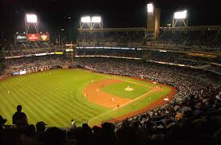
Baseball Memorabilia
What might be in your attic!

Slide 2
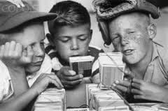
Baseball Cards and other Hidden Treasures
Baseball cards used to cost $0.05 a pack. Today?

Slide 3
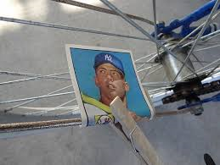
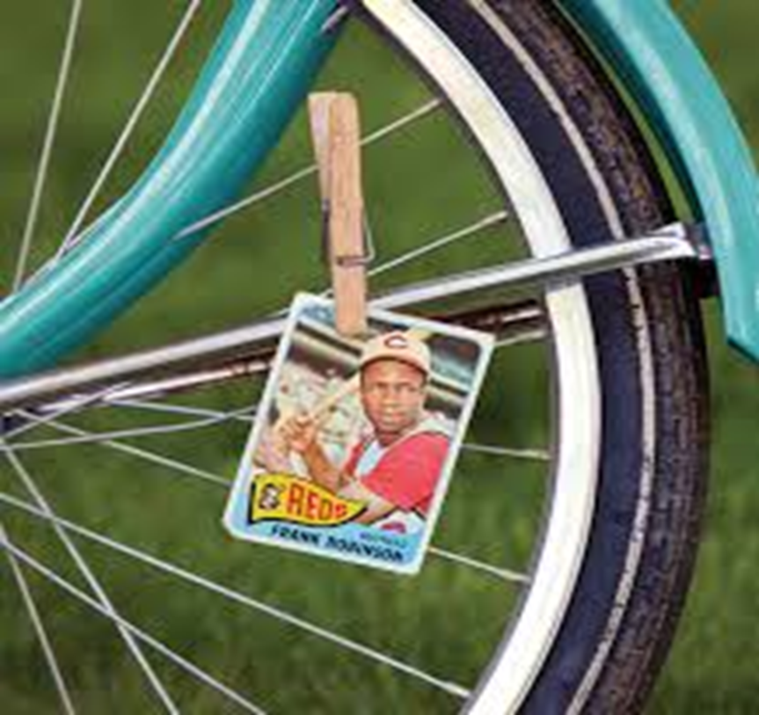
They could be worth $100’s or $1000’s unless…….
We will find out later what a Mantle rookie card (above) is worth!

Slide 4
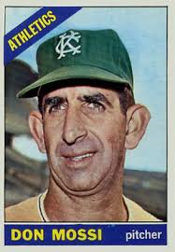
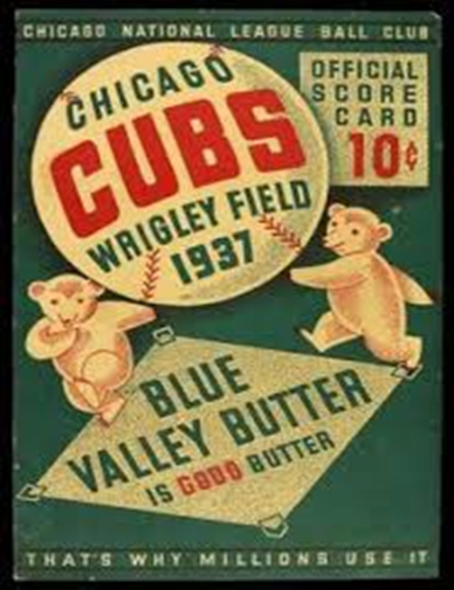
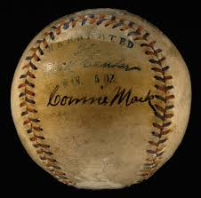
Baseball Memorabilia Market
There is a huge demand for old cards, programs, autographs, etc.

Slide 5
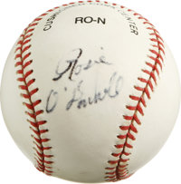
First up for bid – a Rosie O’Donnell Signed Baseball

Slide 6
Rosie O’Donnell Signed Baseball
Sold for $11.95 in 2007

Slide 7
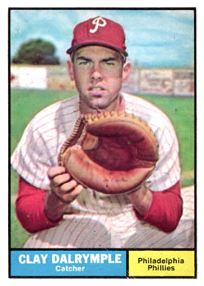
Clay Dalrymple 1961 Card - Mint

Slide 8
Clay Dalrymple 1961 Card - Mint
Sold for $64.53 in 2005

Slide 9
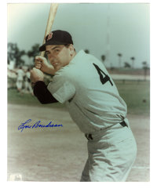
Lou Boudreau (HOF) Autographed Picture

Slide 10
Lou Boudreau (HOF) Autographed Picture
Sold for $21.00 in 2005

Slide 11
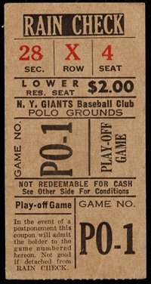
Ticket Stub from Dodgers – Giants Playoff Game 1951

Slide 12
Ticket Stub from Dodgers – Giants Playoff Game 1951
Sold for $358.51 in 2015

Slide 13
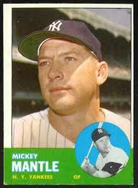
1963 Topps Mickey Mantle - Mint

Slide 14
1963 Topps Mickey Mantle - Mint
Sold for $5,975.00 in 2014

Slide 15
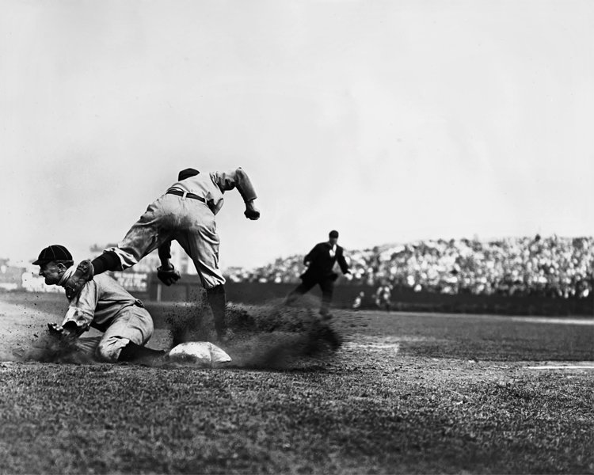
Charles Conlon Archives – 7,462 Original Negatives
Conlon was baseball’s most famous photographer 1904 - 1942

Slide 16
Charles Conlon Archives – 7,462 Original Negatives
Sold for $1,792,000.00 in 2016

Slide 17
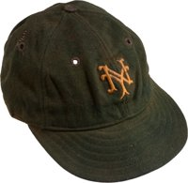
Carl Hubbell (HOF) Game Worn Cap 1933

Slide 18
Carl Hubbell (HOF) Game Worn Cap 1933
Sold for $40,331.25 in 2014

Slide 19
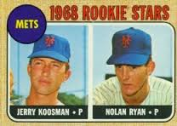
1968 Topps Nolan Ryan Rookie Card - Mint

Slide 20
1968 Topps Nolan Ryan Rookie Card - Mint
Sold for $612,359.03 in 2016

Slide 21
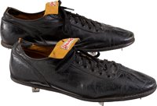
Stan Musial Game Worn Shoes (early 1960’s)

Slide 22
Stan Musial Game Worn Shoes (early 1960’s)
Sold for $6,274.95 in 2013

Slide 23
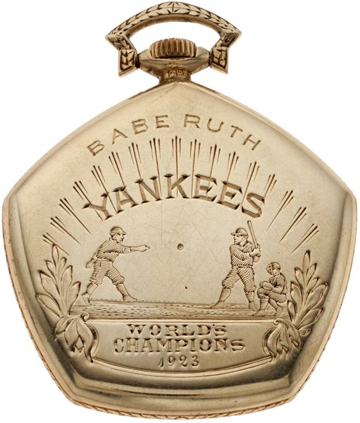
Babe Ruth 1923 World Championship Watch

Slide 24
Babe Ruth 1923 World Championship Watch
Sold for $717,000.00 in 2014

Slide 25
“Shoeless” Joe Jackson Game Used Bat – Rookie Year (1911)

Slide 26
“Shoeless” Joe Jackson Game Used Bat – Rookie Year (1911)
Sold for $956,000.00 in 2014

Slide 27
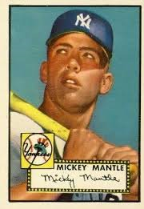
Mickey Mantle 1952 Topps (Rookie) – Near Mint/Mint

Slide 28
Mickey Mantle 1952 Topps (Rookie) – Near Mint/Mint
Sold for $525,800.00 in 2015

Slide 29
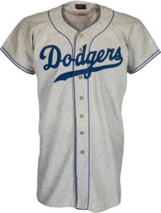
Sandy Koufax Game Worn Jersey 1955 (Rookie)
Sold for $573,000.00 in 2015

Slide 30
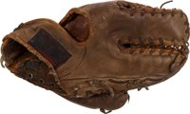
Roger Maris Glove (1960’s)
Sold for $16,730.00 in 2014

Slide 31
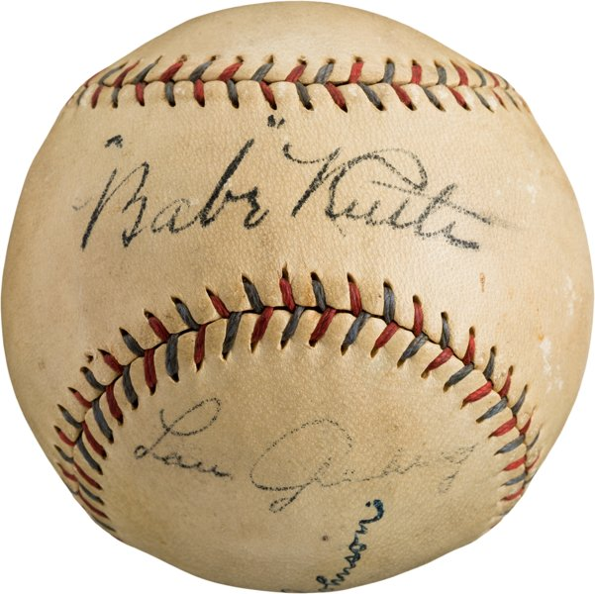
Babe Ruth – Lou Gehrig Autographed Baseball
Sold for $38,837.00 in 2014

Slide 32
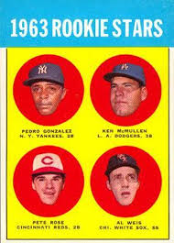
Pete Rose Topps 1963 (Rookie) - Mint
Sold for $717,000.00 in 2016

