Slide 1
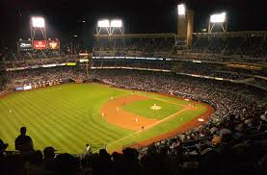
Baseball Scenes that you’ll probably never see this again!

Slide 2
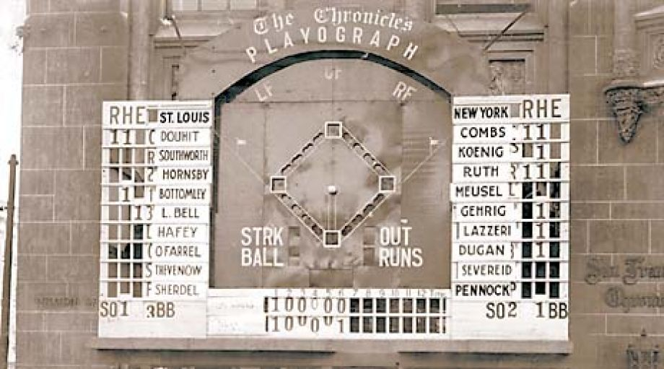
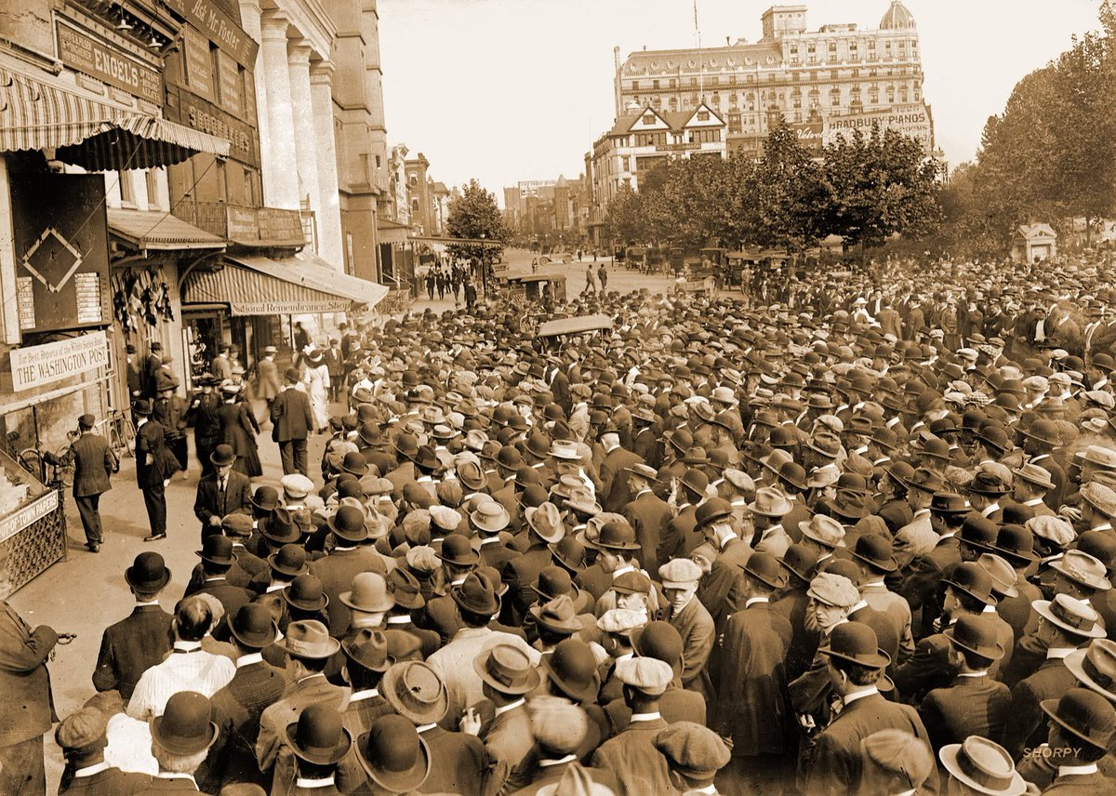
Outdoor scoreboards in Downtown
Before radio and TV, Western Union telegraphs provided play-by-play information

Slide 3
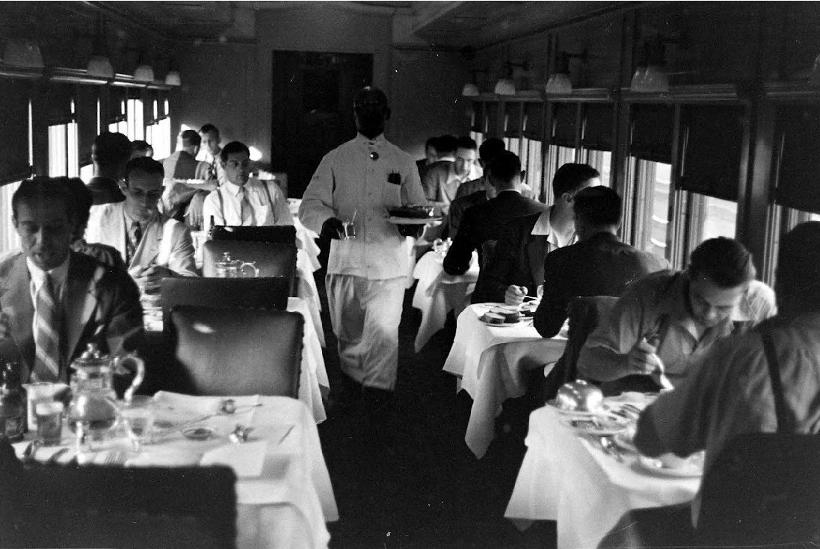
Private Dining Cars
Cleveland Indians in 1938

Slide 4
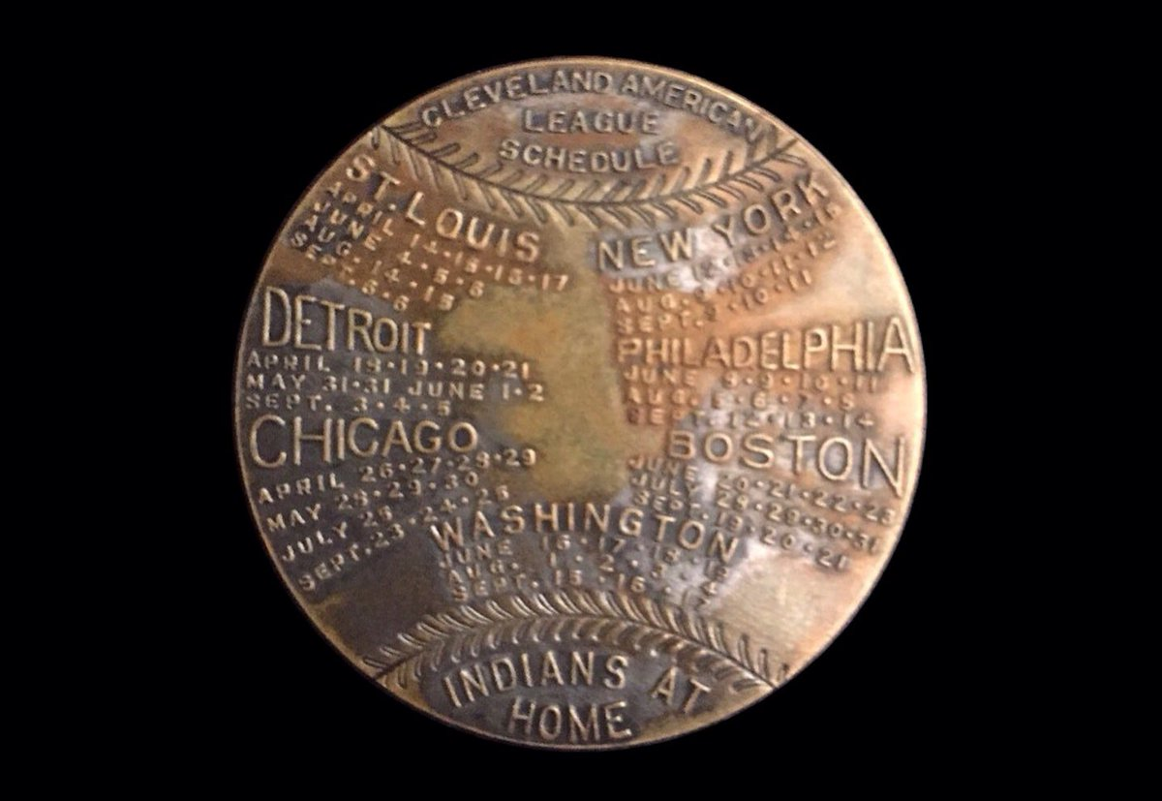
Metal Token – Indians 1920 Schedule

Slide 5
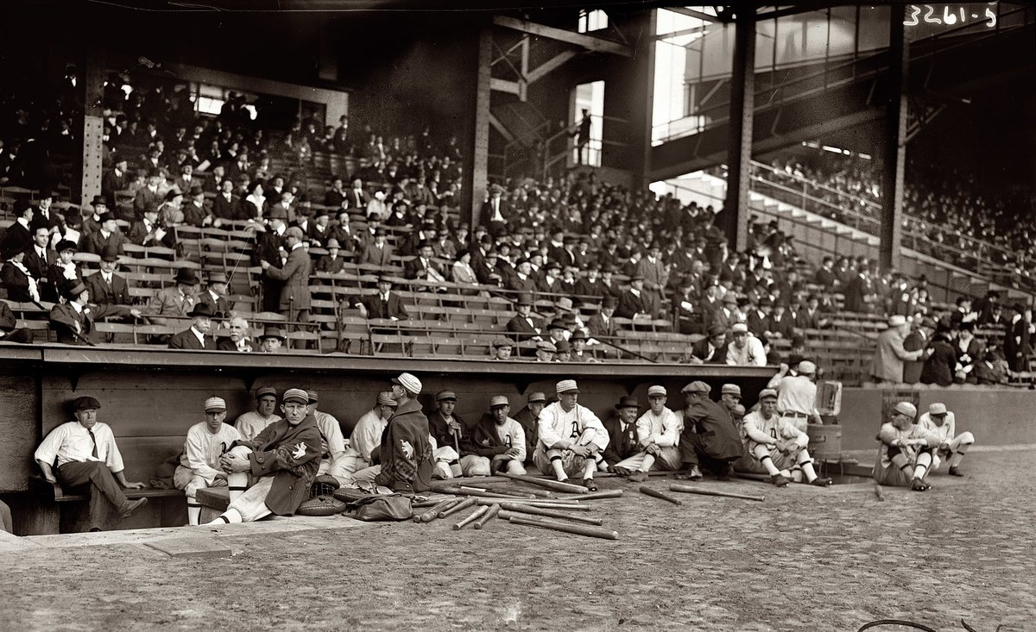
Bats on Field During Game
1914 World Series at Shibe Park

Slide 6
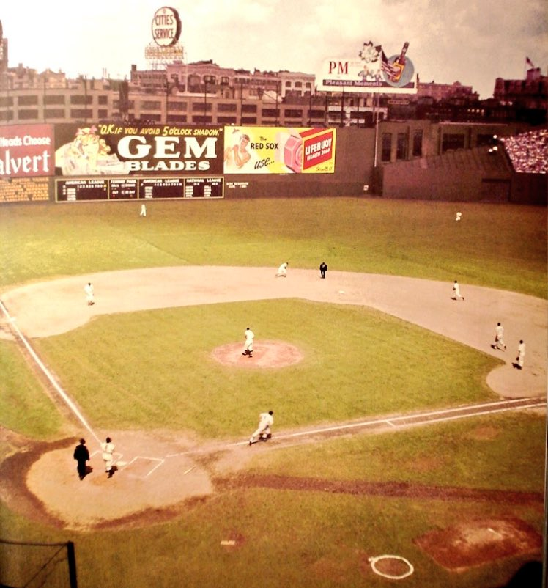
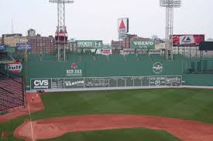
Ads covering the Green Monster

Slide 7
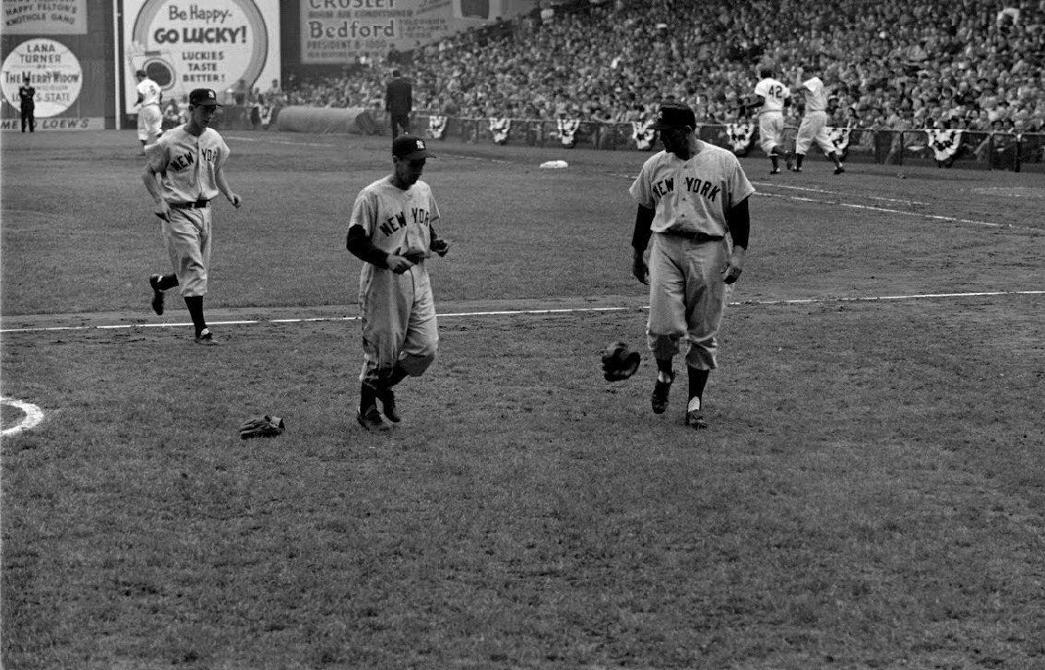
Gloves on the Field

Slide 8
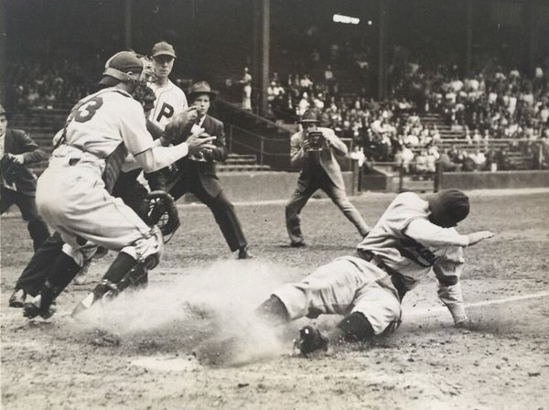
Photographers on the Field

Slide 9
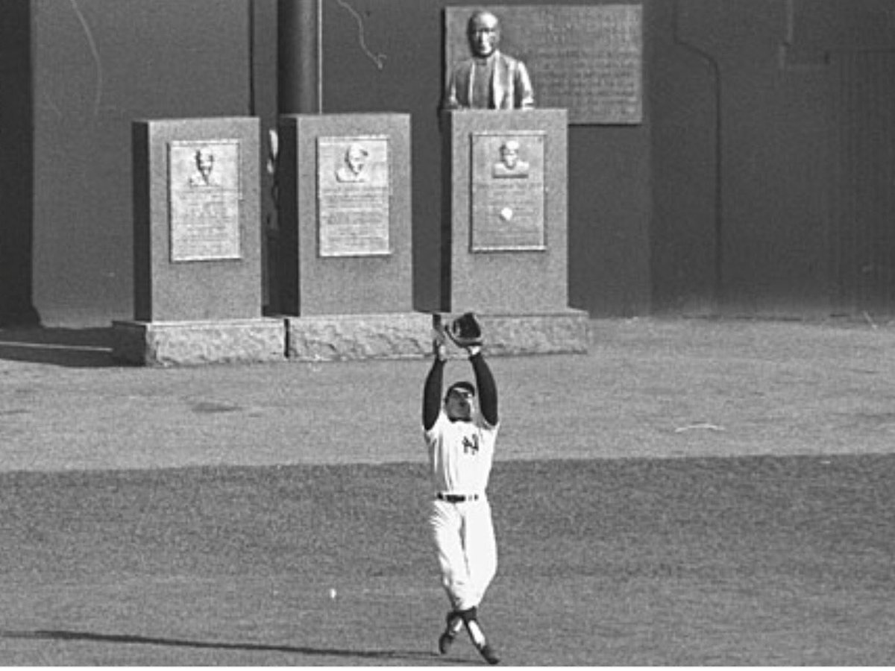
Monuments on the Field

Slide 10
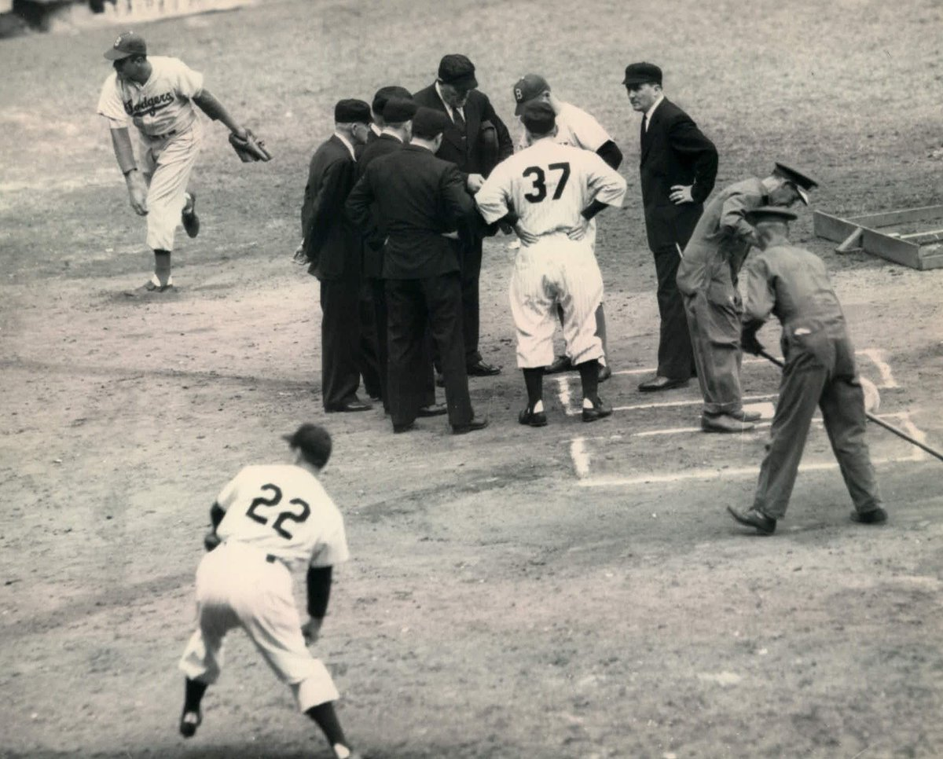
Pitchers Warming up on the Field

Slide 11
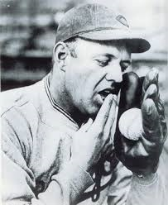
Spitball Pitchers

Slide 12
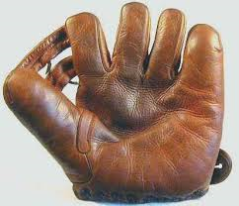
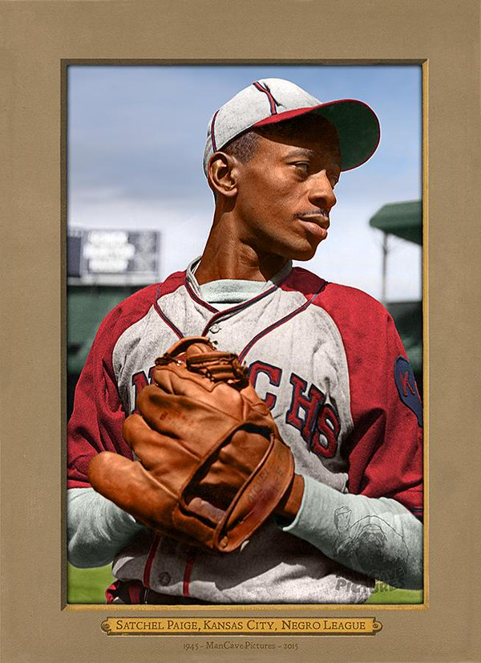
Gloves without Laces

Slide 13
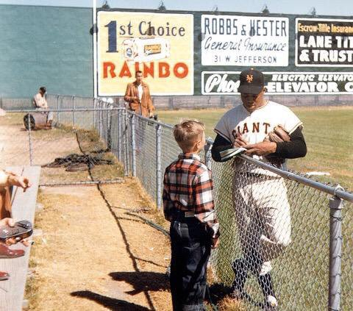
Superstars Signing Autographs
The great Willie Mays

Slide 14
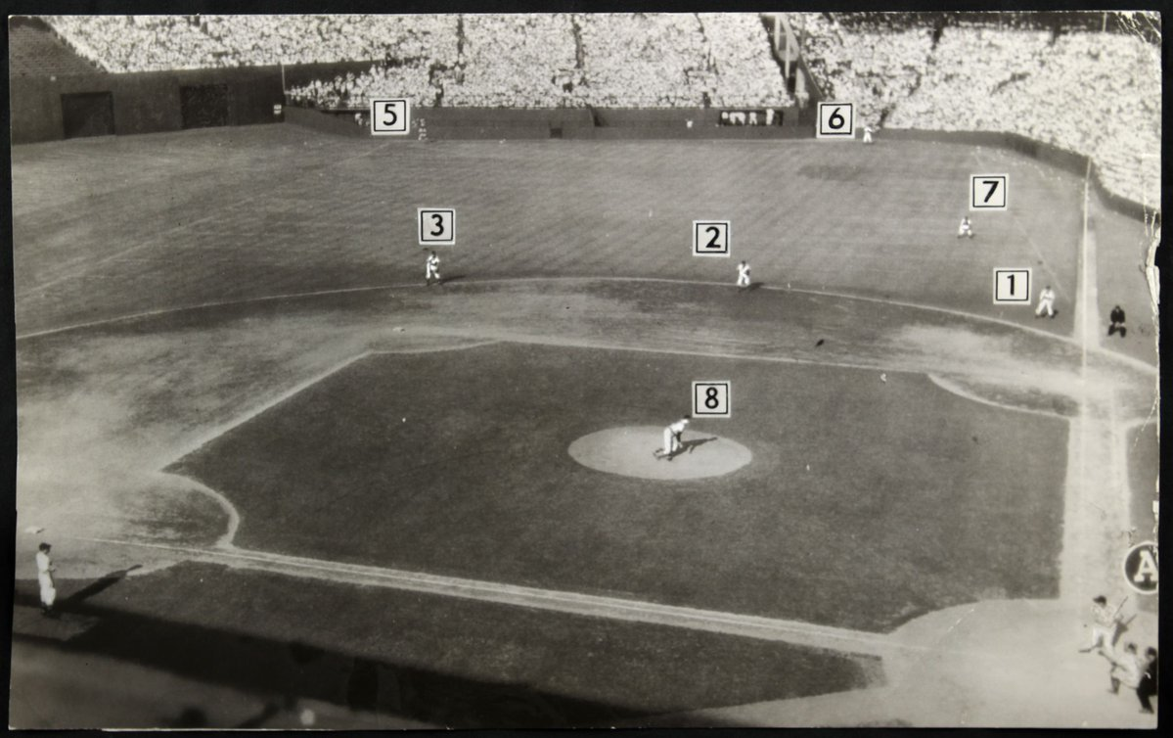
A .400 Hitter
Ted Williams hit .406 in 1941 – the last batter to hit over .400. In 1946, Indians manager Lou Boudreau was the first manager to use the “Ted Williams’ Shift”

Slide 15
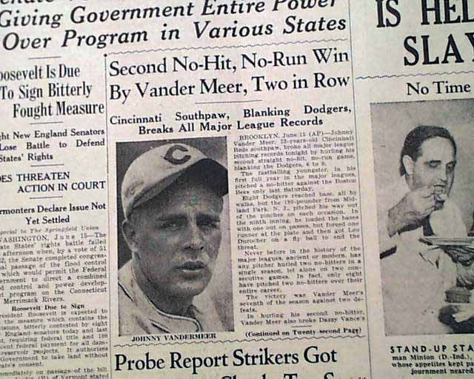
Two Consecutive No-Hitters
Johnny Vander Meer, of the Cincinnati Reds, pitched no-hitters in two consecutive games. The second was during the first night game in the history of Ebbet’s Field (1938).

Slide 16
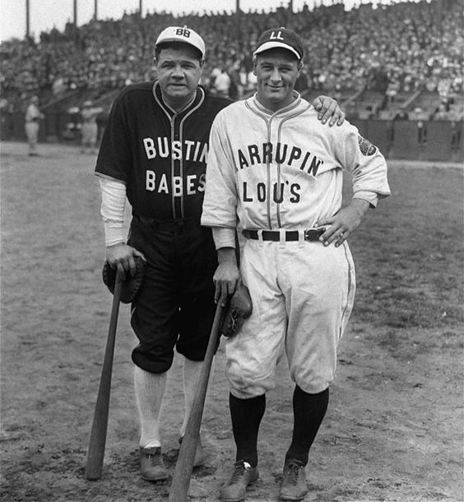
Barnstorming Tours

Slide 17
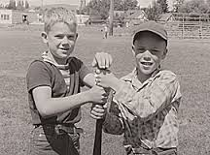
Sandlot Baseball

Slide 18
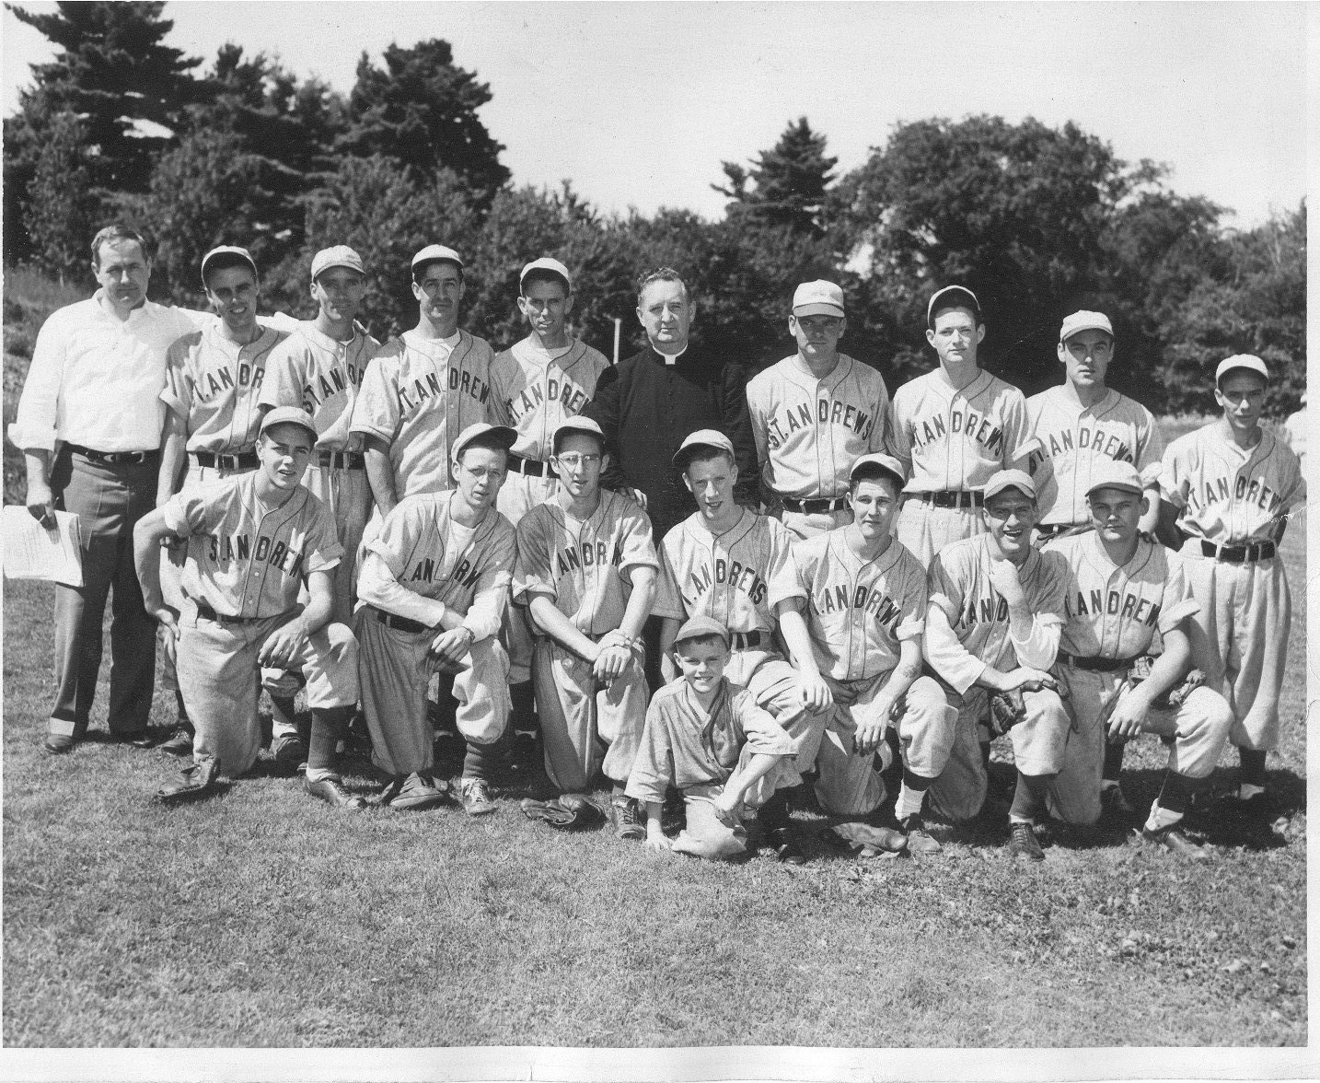
Town Baseball

Slide 19
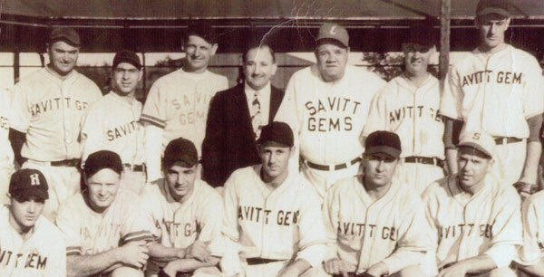
Semi-Pro Baseball
Hartford CT September 30, 1945

