Slide 1
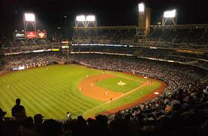
NO-HITTERS
PERFECT GAMES
And One Very Close Call

Slide 2
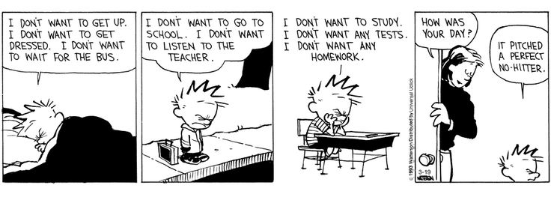
Calvin and Hobbes by Bill Watterson

Slide 3
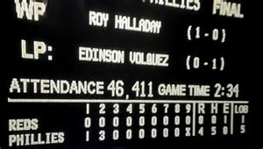
In about 140 years, there have been 296 no-hitters, 252 of them in the modern era (starting in 1901).
As of 1991, a no-hitter has to be a compete game of at least 9 innings.

Slide 4
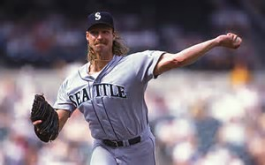
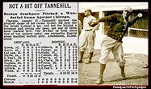
No-hitters come in all shapes and sizes.
TALLEST
shortest
Jesse Tannehill - 5 feet, 8 inches
Randy Johnson - 6 feet, 9 inches

Slide 5
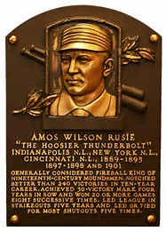
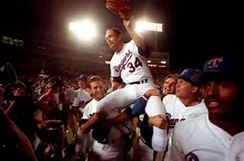
All ages
Nolan Ryan - 44 years, 3 months
Amos Rusie - 20 years, 2 months

Slide 6
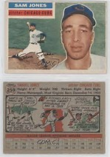
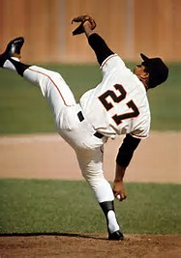
Nationalities
Sam Jones, 1st African-American
Juan Marichal, 1st Latino

Slide 7
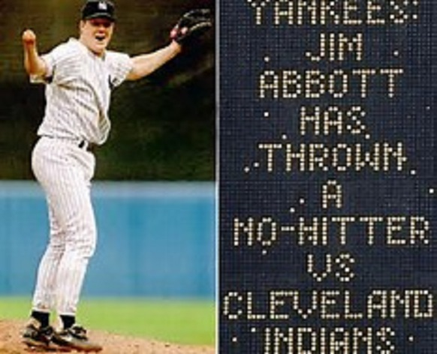
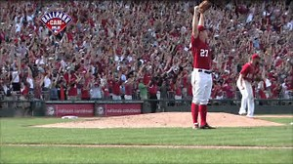
And from A to Z
Jordan Zimmerman
Jim Abbott

Slide 8
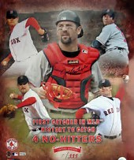
Can’t forget the catchers!
Jason Varitek has caught 4 no-hitters:
Hideki Nomo
Derek Lowe
Clay Buccholz
Jon Lester

Slide 9
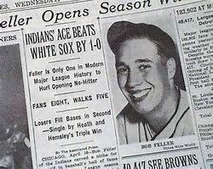
Opening Day
Bob Feller pitched a 1-0 no-hitter on Opening Day in 1949.
This is the only time an opposing team’s batting average didn’t change after a no-hitter.

Slide 10
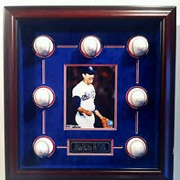
King Of The No-Hitters with 7?
Who else?
1st in 1973
7th in 1991
Notes:
Nolan Ryan also had 11 one-hitters, and 24 no-hitters broken up in the 7th inning or later.

Slide 11
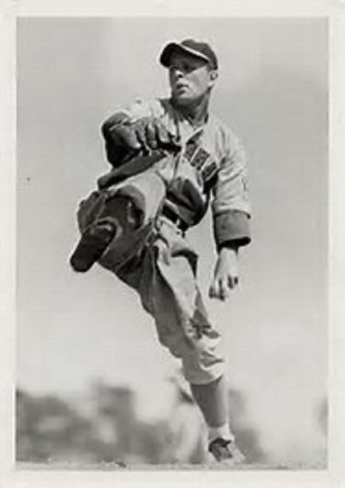
Two in a row!
June 11, 1938. Beat Boston Bees 3-0.
Johnny Vander Meer
June 15, 1938. Beat Dodgers 6-0.

Slide 12
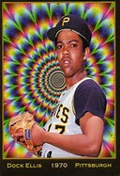
No-hitters can be a trip, man!
Dock Ellis no-hit the Padres, 2-0. He struck out 6 and walked 8.
And, according to Ellis, he was on LSD for the whole game and couldn't feel the ball or see the batter clearly.

Slide 13
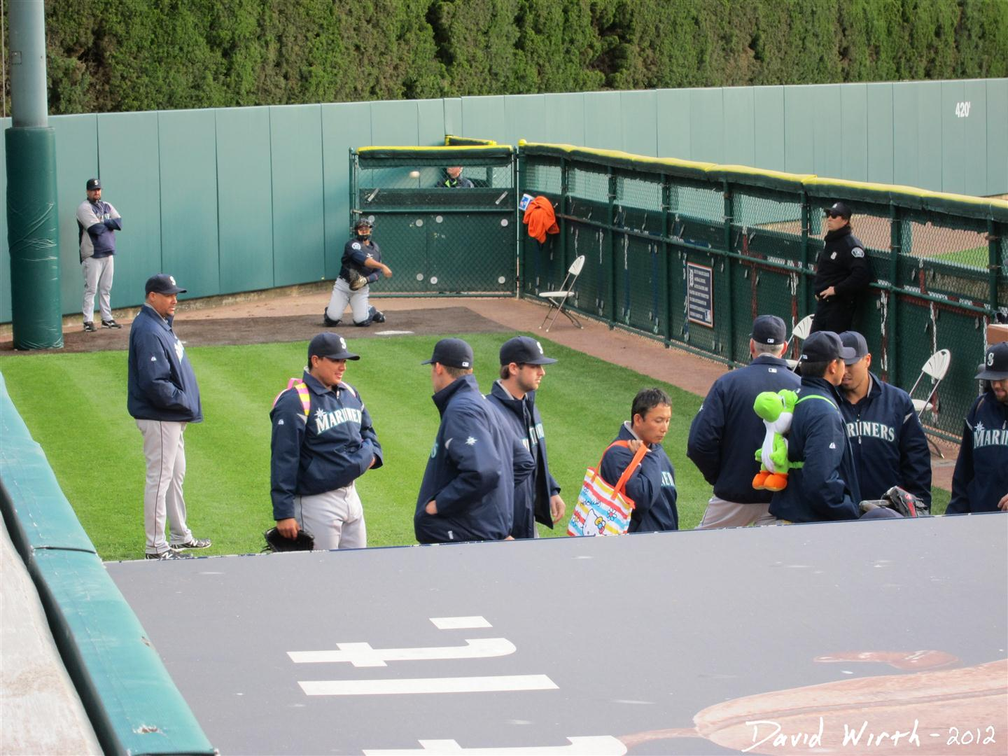
Combined no-hitters
On June 11, 2003, six Astros combined to beat the Yankees, 6-0:
Roy Oswalt (1 IP), Pete Munro ( 2 2⁄3 IP), Kirk Saarloos ( 1 1⁄3 IP), Brad Lidge (2 IP), Octavio Dotel (1 IP), Billy Wagner (1 IP)
On June 8, 2012, six Mariners combined to beat the Dodgers, 1-0:
Kevin Millwood (6 IP), Charlie Furbush ( 2⁄3 IP), Stephen Pryor ( 1⁄3 IP), Lucas Luetge ( 1⁄3 IP), Brandon League ( 2⁄3 IP), Tom Wilhelmsen (1 IP)

Slide 14
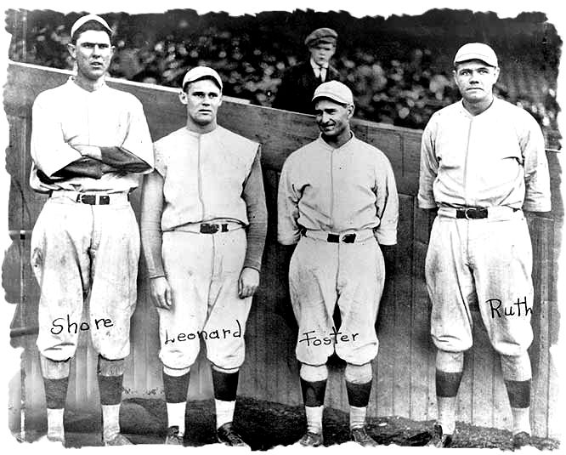
Ernie Shore and someone else
On June 23, 2017, Boston’s starting pitcher walked the 1st batter, punched the umpire in the mouth, and got thrown out of the game. Ernie Shore came in to relieve him. The runner was immediately thrown out stealing, and Shore retired the next 26 batters. (Before 1991, this was considered a perfect game for Shore.)
The starting pitcher who was thrown out was Babe Ruth.

Slide 15
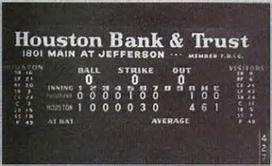
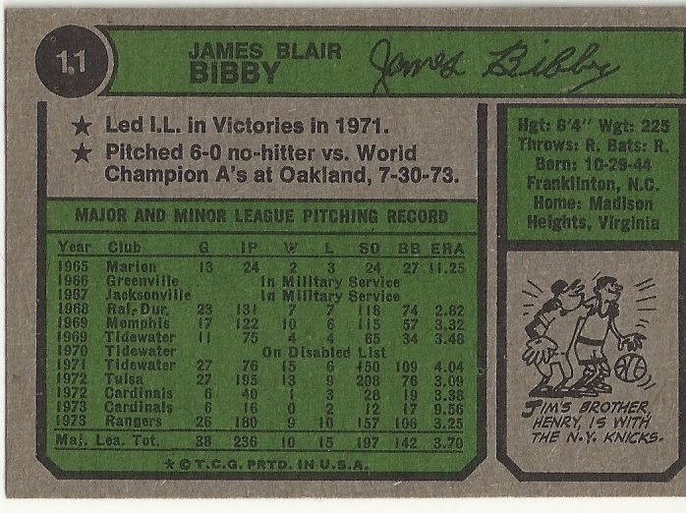
Texas firsts
Don Nottebart threw the first no-hitter in franchise history as a member of the Houston Colt .45s, beating the Phillies 4-1 in front of 8,223 on May 17, 1963, at Colt Stadium.
The Texas Rangers’ first no-hitter was thrown by Jim Bibby on July 30, 1973, beating the A’s, 6-0. (In 1981, he missed out on a perfect game when he allowed a leadoff single, then retired the next 27 batters.)

Slide 16
Which team has thrown the most no-hitters?

Slide 17
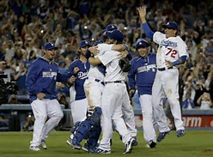
The Dodgers with 25
Top 5
Dodgers = 25
Red Sox = 18
White Sox = 18
Giants = 17
Reds = 16
Only the San Diego Padres have never thrown a no-hitter.

Slide 18
Which team has had the most thrown against them?

Slide 19
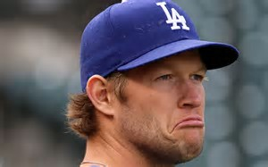
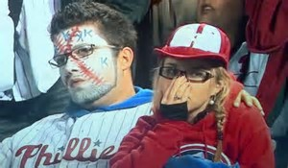
The Dodgers and Phillies with 19

Slide 20
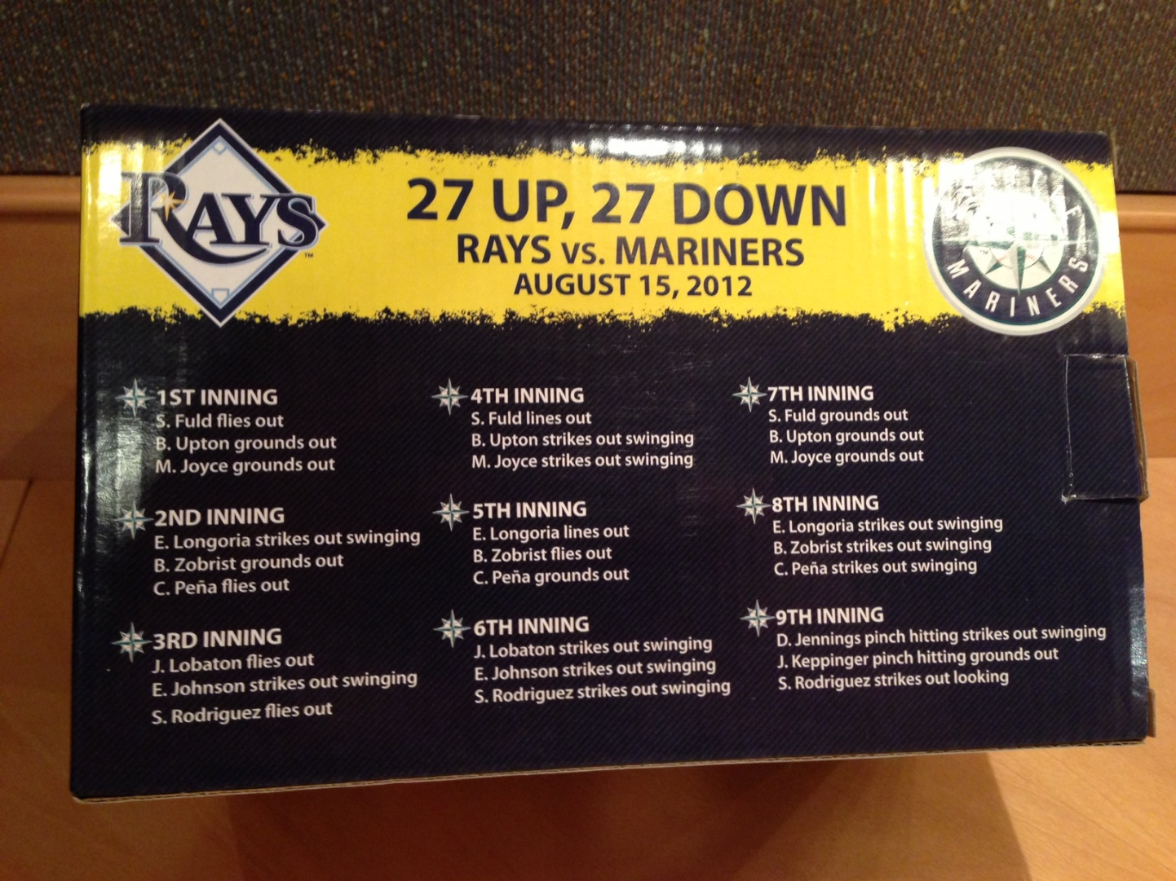
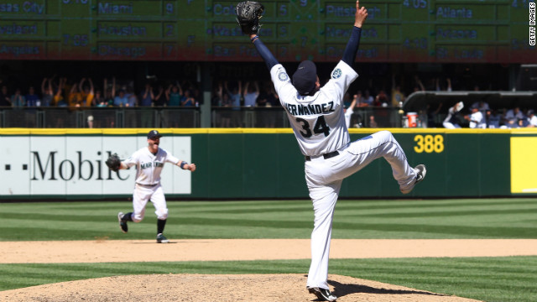
Perfect games
There have been just 23 perfect games in history (21 in the modern era). The most recent one was by Felix Hernandez of the Seattle Mariners on August 15, 2012.
Notes:
215 games – note Koufax record of 97

Slide 21
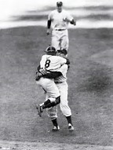
Don Larsen
In game 2 of the 1956 World Series, Don Larsen was given a 6–0 lead. But he lasted only 1.2 innings in a 13–8 loss.
On October 8, 1956, he came back to pitch the only perfect game in World Series history, beating the Dodgers 2-0.
out
https://www.bing.com/videos/search?q=don+larsen&&view=detail&mid=03538F18FCA65BA4F4A203538F18FCA65BA4F4A2&FORM=VRDGAR
Notes:
https://www.bing.com/videos/search?q=don+larsen&&view=detail&mid=03538F18FCA65BA4F4A203538F18FCA65BA4F4A2&FORM=VRDGAR

Slide 22
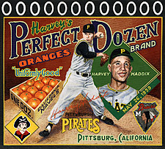
Near perfection
On May 26, 1959, Pittsburgh Pirates pitcher Harvey Haddix had pitched 12 perfect innings against the Milwaukee Braves, the most ever thrown. In the 13th, the leadoff hitter reached on an error, ruining Haddix’s perfect game (but Haddix still had a no-hitter). The next batter sacrifice bunted him to 2nd (still a no-hitter). Then an intentional walk (still a no-hitter). The next batter hit a home run to lose the game (and no-hitter) for Haddix.

Slide 23
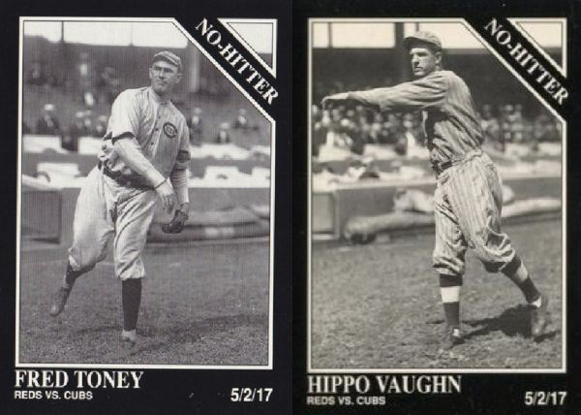
Two in one game?
On May 2, 1917, Fred Toney of the Reds and Hippo Vaughn of the Cubs both completed nine innings of a game without either giving up a hit or a run. Vaughn gave up two hits and a run in the 10th inning, losing the game to Toney, who completed the extra-inning no-hitter. (In 1991, Vaughn’s no-hitter was removed from the record books.)
While it has never happened, even with the 1991 rules changes, it’s possible for opposing pitchers to throw no-hitters in the same game.

Slide 24
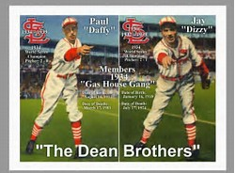
"If I knew he was gonna pitch a no-hitter, I'd a thrown one too.”
- Dizzy Dean, about his brother Daffy

