Slide 1
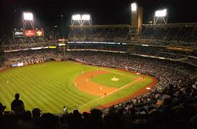
Major League Players
Off-Season Jobs

Slide 2
1958 Major League Salaries
Minimum Pay - $ 7,000/year
Average Pay - $16,353/year
Highest Pay - $75,000 (NL – Mays, Musial)
Many players worked in the off-season to supplement their pay. This was a common occurrence until major league pay exploded in the 1970’s.

Slide 3
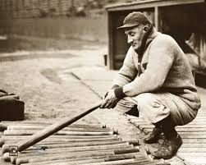
Honus Wagner, HOF
Ran a Garage and was part owner of a Circus

Slide 4
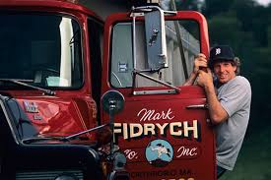
Mark “The Bird” Fidrych
Ran a Garage

Slide 5
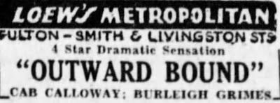
Burleigh Grimes, HOF
Vaudeville Actor
Notes:
HOF Mgr John McGraw, Christy Mathewson and Cap Anson were also in vaudeville

Slide 6
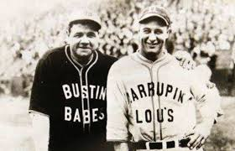
Babe Ruth and Lou Gehrig, HOF
Ran Barnstorming Teams

Slide 7
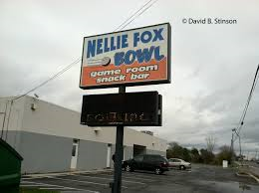
Nellie Fox, HOF
Owned a Bowling Alley

Slide 8
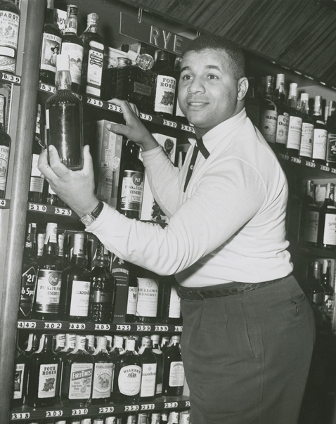
Roy Campanella, HOF
Owned a Liquor Store

Slide 9
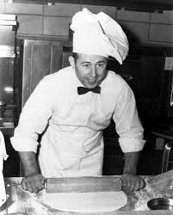
Ron Santo, HOF
Owned a Pizza Restaurant

Slide 10
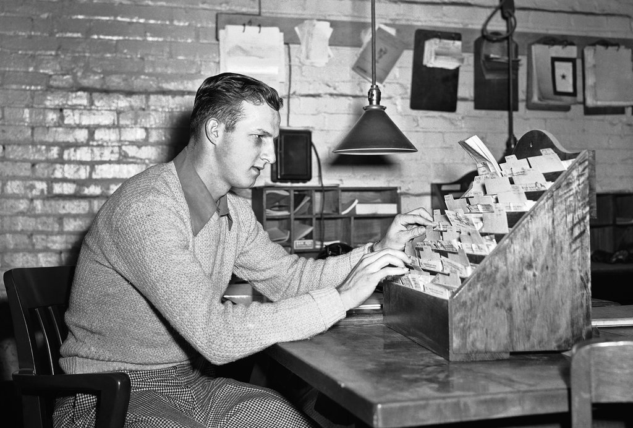
Stan Musial, HOF
Worked as a Shipping Clerk

Slide 11
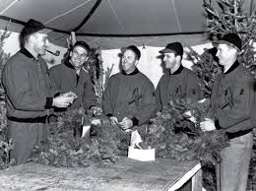
Stan Musial, HOF
Ran a Christmas Tree lot and owned a Restaurant

Slide 12
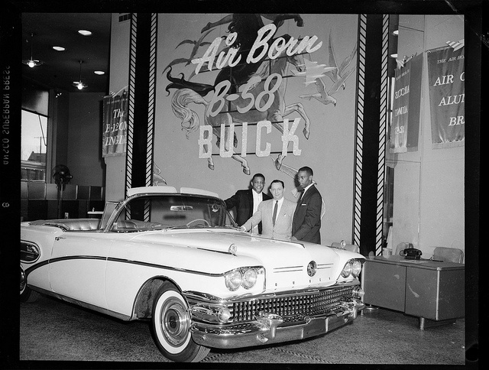
Willie Mays, HOF
Sold Cars

Slide 13
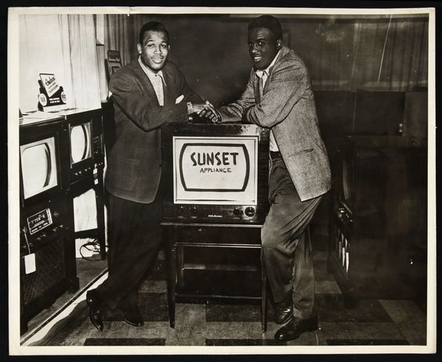
Jackie Robinson, HOF
Sold Appliances

Slide 14
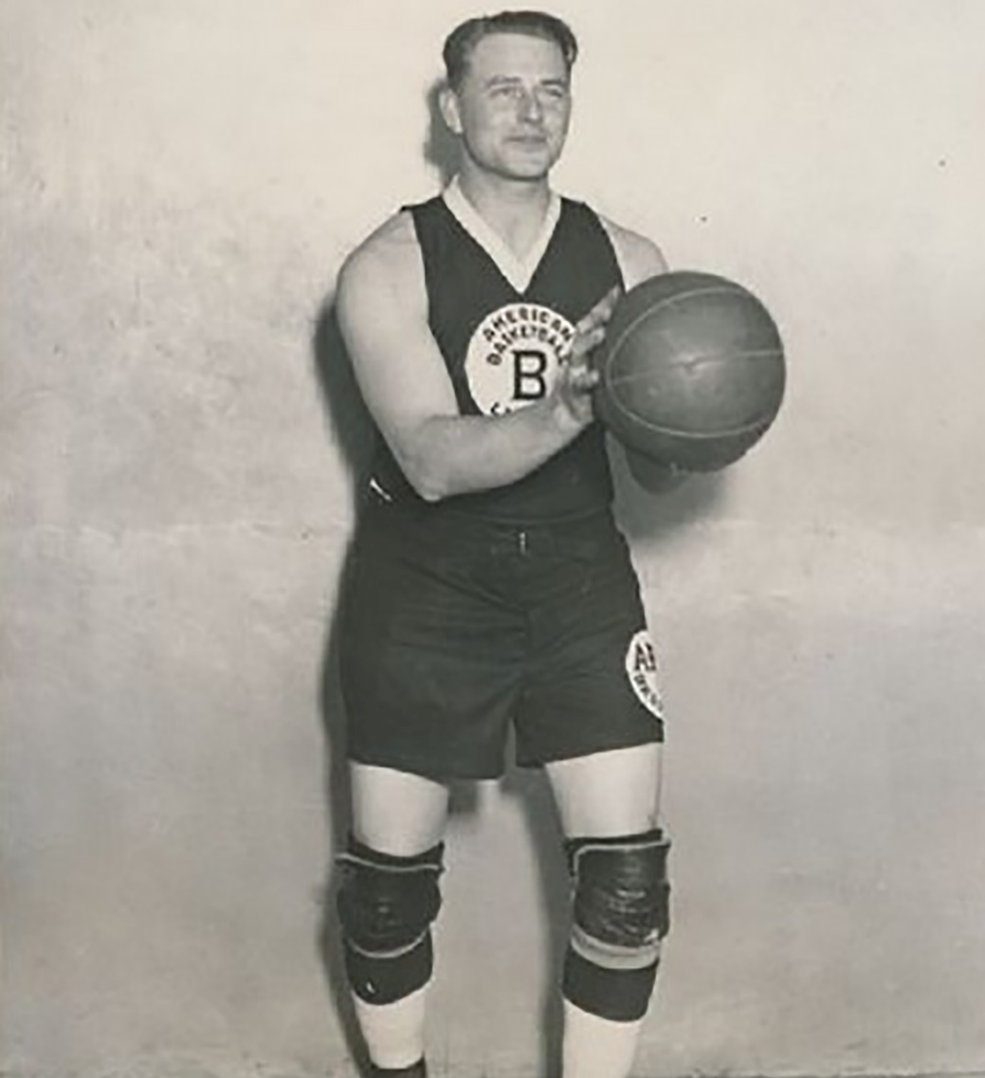
Waite Hoyt, HOF
Played semi-pro basketball

Slide 15
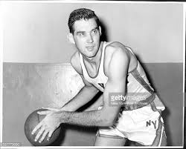
Gene Conley
Played for Boston Celtics in the NBA

Slide 16
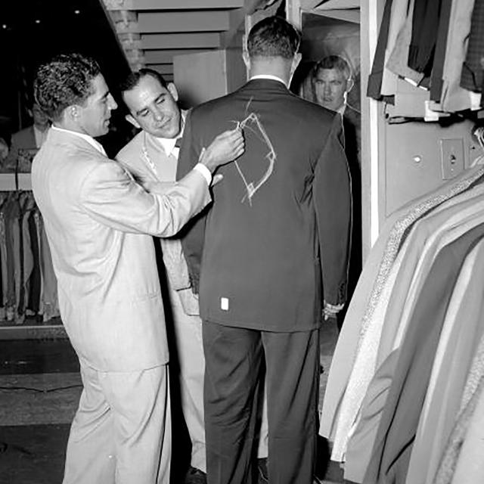
Phil Rizzuto and Yogi Berra, HOF
Men's’ Clothes Store

Slide 17
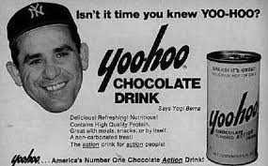
Yogi Berra, HOF
Spokesman for YooHoo

Slide 18
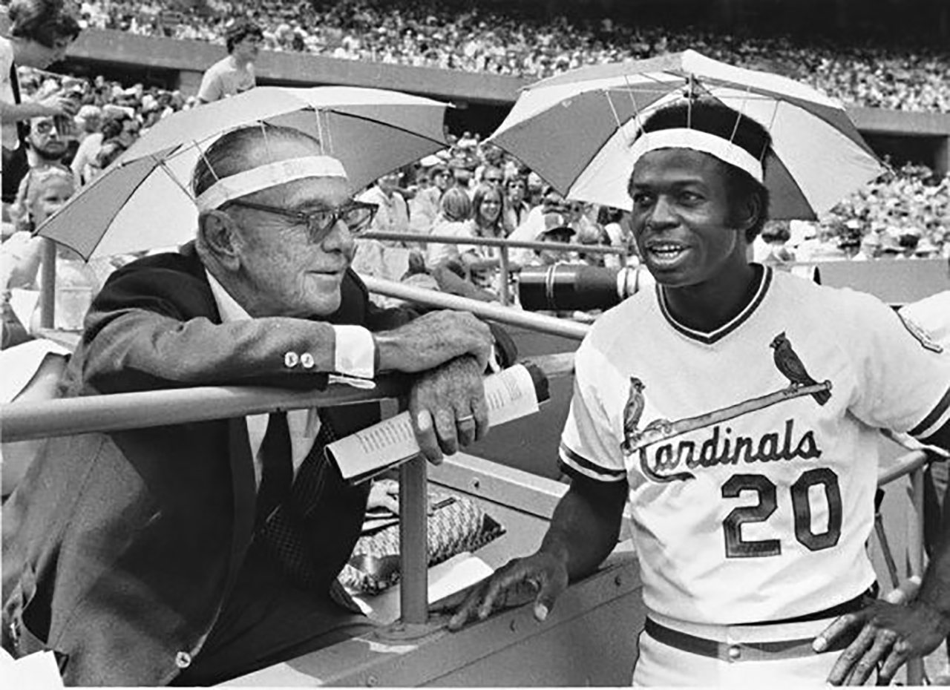
Lou Brock, HOF
Owned Florist shop, invented the “Brockabella”

Slide 19
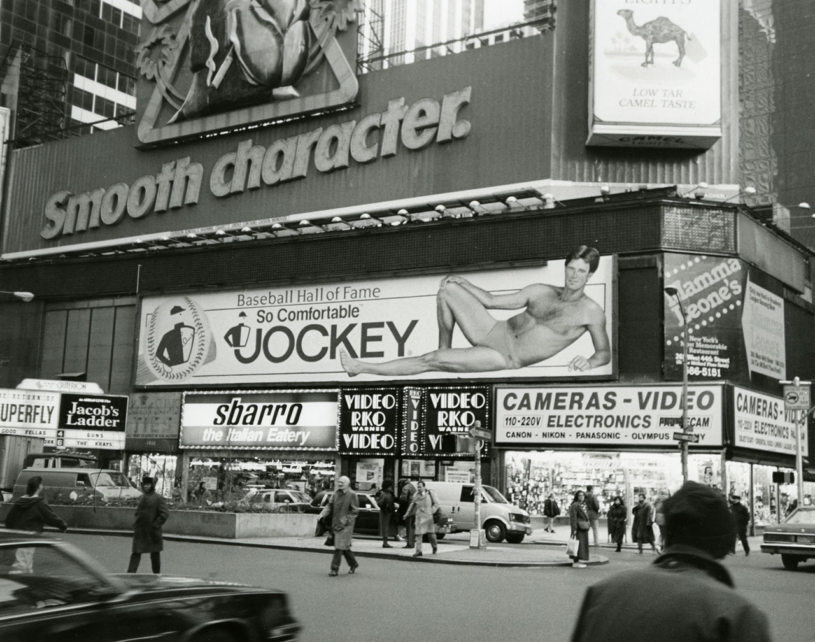
Jim “Cakes” Palmer, HOF
Underwear Model

Slide 20
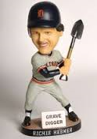
Richie Hebner
Gravedigger

Slide 21
Some more 1958 Off-Season Jobs
Warren Spahn – cattle rancher in Oklahoma
Joe Koppe – painted houses in Detroit
Joey Jay – ran a chicken farm in Florida
Vic Wertz – beer distributor in Michigan
Smokey Burgess – ran a gas station in North Carolina
Gerry Staley – worked at lumber mill in Washington
Alex Kellner – roped mountain lions to sell to zoos
Don Rudolph – “Clothes Catcher”

Slide 22
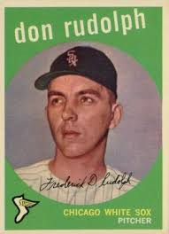
Don Rudolph, Pitcher
1959 Topps Baseball Card

Slide 23
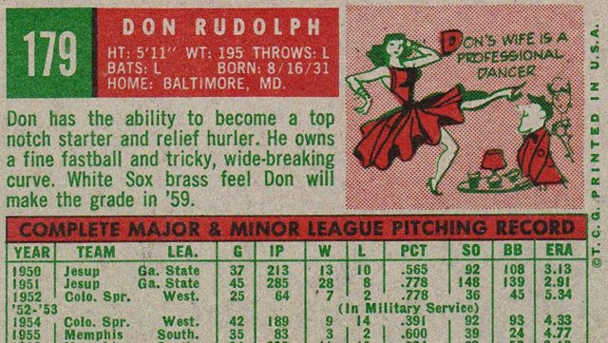
Don Rudolph, Pitcher
1959 Topps Baseball Card

Slide 24
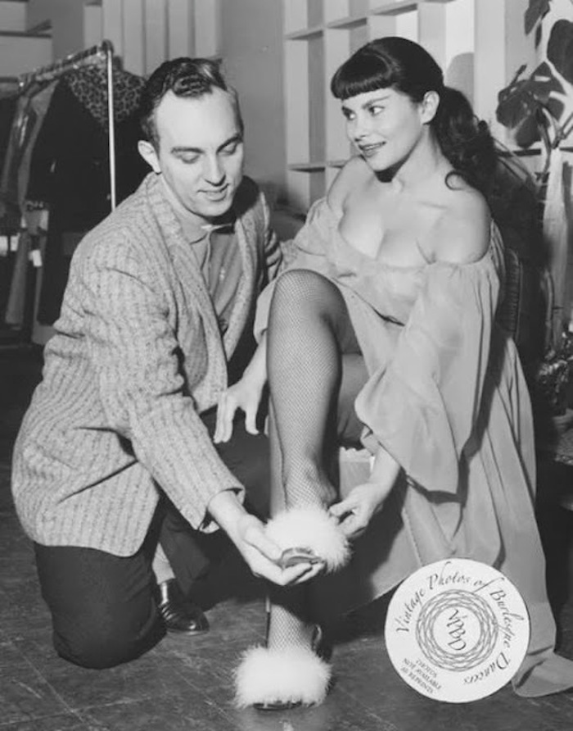
Don Rudolph, “Clothes Catcher”
Rudolph’s wife performed as “Patti Waggin”

