Slide 1
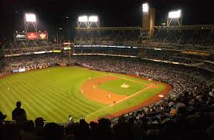
Opening Day

Slide 2
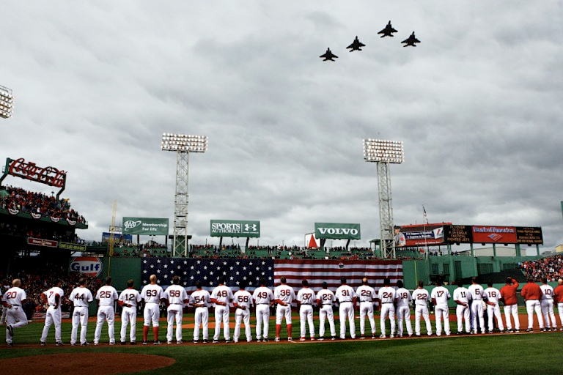
Fenway Park 2012

Slide 3
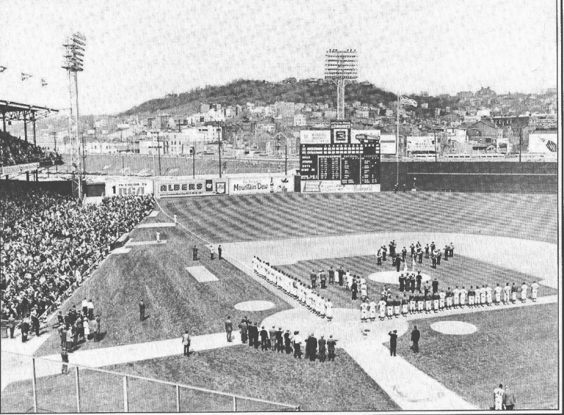
Crosley Field 1968

Slide 4
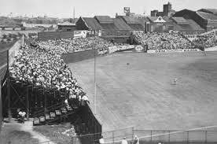
Boston Braves Field 1946
Notes:
Painted outfield bleachers day before game. Wet weather prevented from drying.

Slide 5
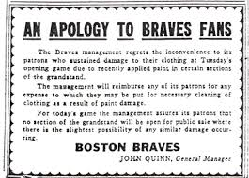
Boston Braves Field 1946
Notes:
Claims came in from all over the country!

Slide 6
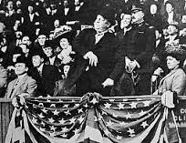
President William Howard Taft 1910
Notes:
First President to throw out opening day pitch

Slide 7
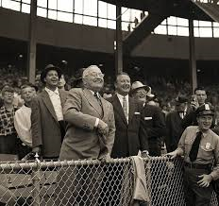
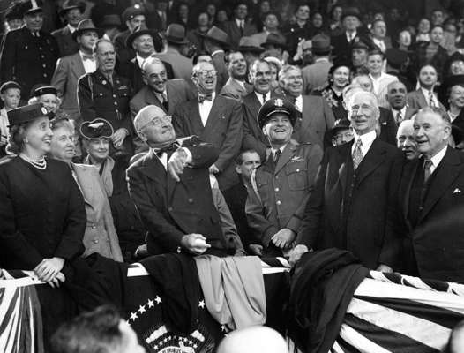
President Harry Truman
Notes:
Truman was ambidextrous. Only recent President to not throw out on Opening Day – Jimmy Carter

Slide 8
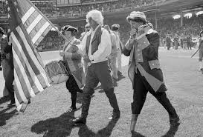
Comiskey Park 1976
Notes:
Owner Bill Veeck – with “peg leg” – played the fifer. GM Paul Richards in white wig.

Slide 9
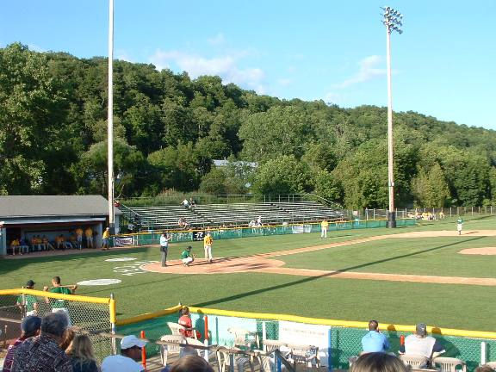
Little Falls NY Mets 1982
Notes:
Parachutists – delivering ball for opening pitch – mistakenly dropped over softball field 10 miles away

Slide 10
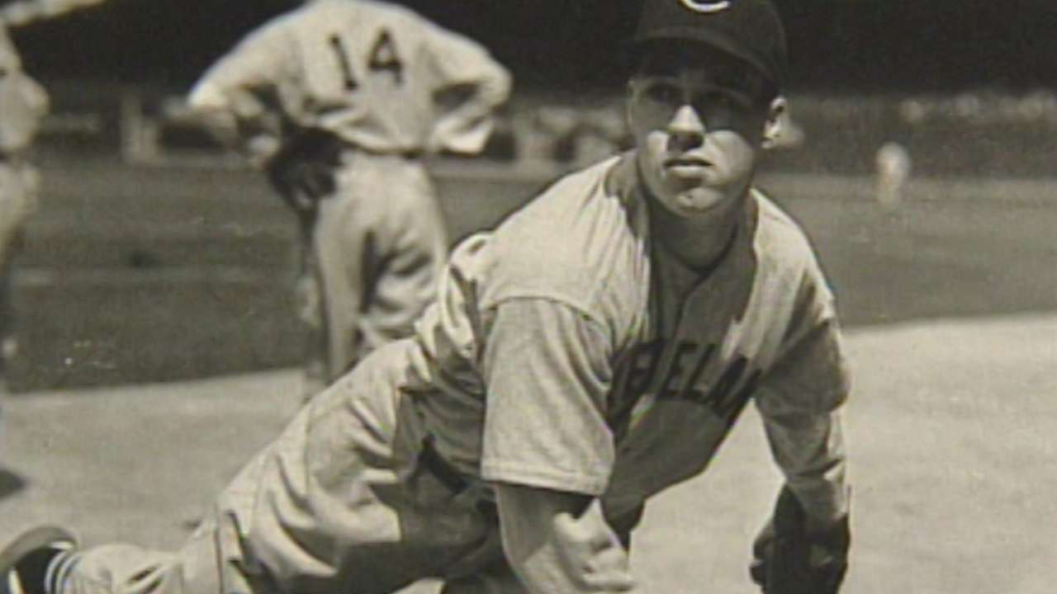
Bob Feller 1940

Slide 11
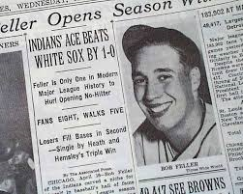
Bob Feller 1940
Notes:
Only Opening Day no-hitter; Luke Appling fouled off 15 pitches in one at bat before being retired

Slide 12
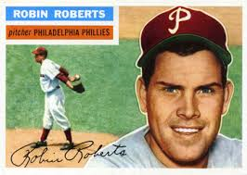
Robin Roberts 1955
Notes:
Pitched 8.1 innings of no-hit ball before Alvin Dark. Set record pitching 12 straight opening days for same team (Phillies) 1950 - 1961

Slide 13
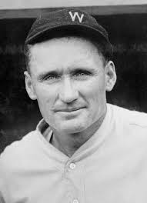
Walter Johnson 1910
Notes:
Pitched 7 Opening Day shutouts in his career

Slide 14
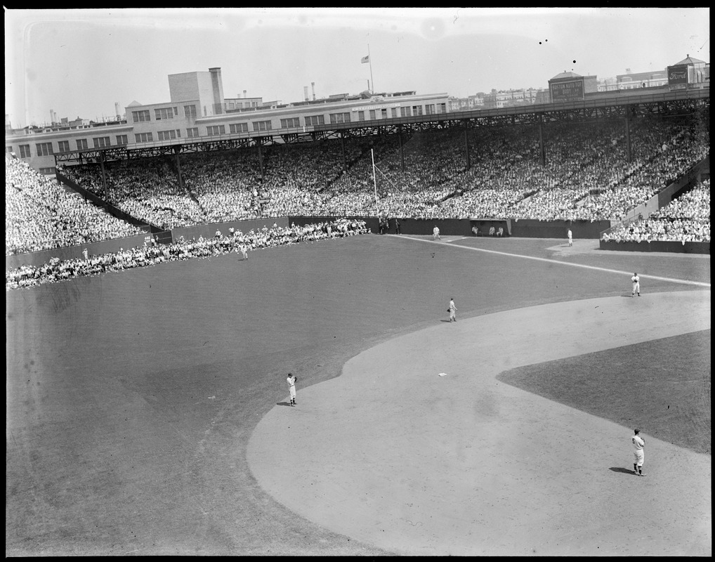
Walter Johnson 1910
Notes:
Only hit gave up in 1910 was when outfielder tripped over a child in the outfield and gave up ground rule double (Fenway Park pictured – incorrect)

Slide 15
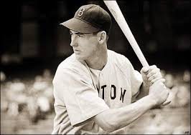
Ted Williams
Notes:
Hit .449 on Opening Day. Had a hit in every Opening Day he played. 3 HRs, 14 RBIs in 14 Opening Days

Slide 16
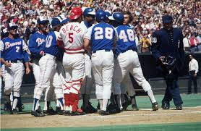
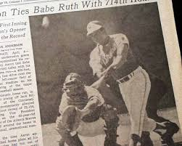
Hank Aaron 1974
Notes:
Aaron tied Babe Ruth’s career home run record on Opening Day 1974

Slide 17
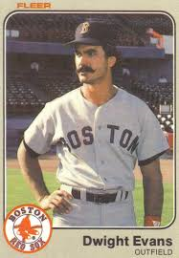
Dwight Evans 1986
Notes:
Evans hit a home run on Jack Morris’ very first pitch of the season

Slide 18
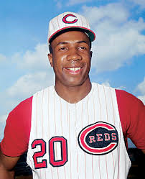
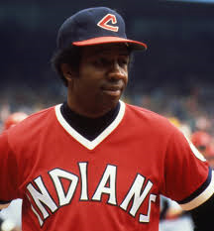
Frank Robinson
Notes:
Most Opening Day home runs (8). Last one on 4/8/1975 – as player/manager (FIRST BLACK MANAGER in baseball history)

