Slide 1
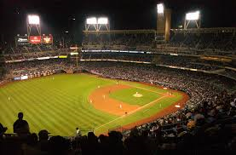
Outfielders

Slide 2
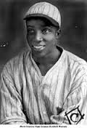
“Cool Papa might have been the fastest player ever”
Cool Papa Bell, Outfielder
*There are 69 outfielders in the Hall of Fame

Slide 3
“One Time he hit a line drive right past my ear. I turned around and saw the ball hit him sliding into second.”
- Satchel Paige, Pitcher
Cool Papa Bell, CF
Pittsburgh Crawfords
*There are 69 outfielders in the Hall of Fame

Slide 4
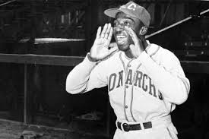
“He was so fast that he could turn off the light switch and be under the covers before the room got dark.”
- Josh Gibson, Catcher
Cool Papa Bell, CF
Kansas City Monarchs
*Cool Papa Bell was inducted into the Baseball Hall of Fame in 1974

Slide 5
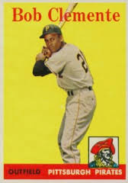
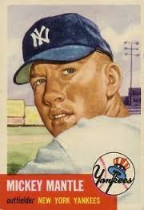
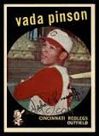
Who was your favorite Outfielder?
Roberto Clemente
Pittsburgh Pirates
Mickey Mantle
New York Yankees
Vada Pinson
Cincinnati Reds
Notes:
Three Hall of Fame catchers. Ernie “Schnozz” Lombardi was still playing when Bill started following baseball

Slide 6
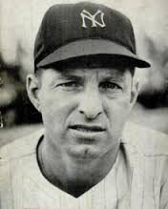
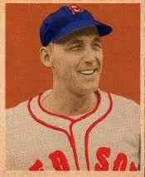
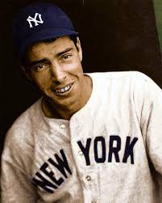
Tom’s favorite Outfielders
Tommy Henrich
New York Yankees
Stan Spence
Boston Red Sox
Joe DiMaggio
New York Yankees
Notes:
Three Hall of Fame catchers. Ernie “Schnozz” Lombardi was still playing when Bill started following baseball

Slide 7
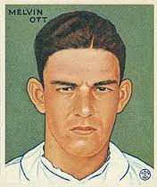
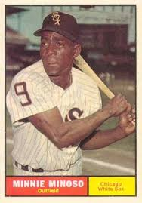
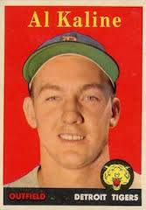
Bill’s favorite Outfielders
Mel Ott
New York Giants
Minnie Minoso
Chicago White Sox
Al Kaline
Detroit Tigers
Notes:
Three Hall of Fame catchers. Ernie “Schnozz” Lombardi was still playing when Bill started following baseball

Slide 8
Outfielders Have Hit Some of the Most Famous Home Runs in Baseball History*
Can You Guess Some of Them?
* Thanks to Dave for providing the list of the Top 100 Home Runs in major league history

Slide 9
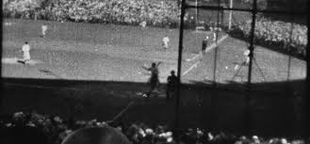
Babe Ruth’s Called Shot – 1932 World Series

Slide 10
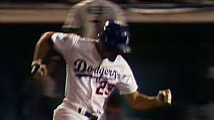
Kirk Gibson’s Home Run – 1988 World Series

Slide 11
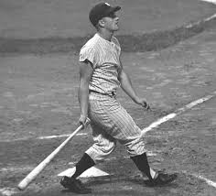
Roger Maris Hits #61 in 1961

Slide 12
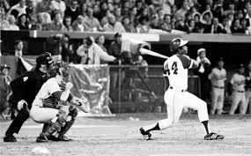
Hank Aaron Hits #715

Slide 13
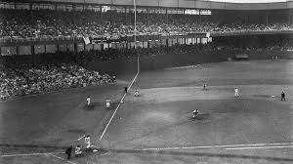
Bobby Thomson – Shot Heard ‘Round The World

Slide 14
Famous Home Runs in Baseball History
Non-Outfielders

Slide 15
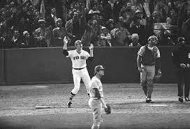
Carlton Fisk – 1975 World Series

Slide 16
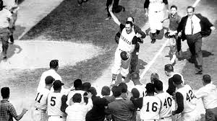
Bill Mazeroski – 1960 World Series

