Slide 1
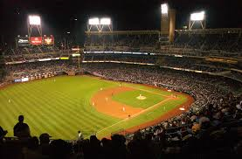
Baseball Players Celebrate Christmas

Slide 2
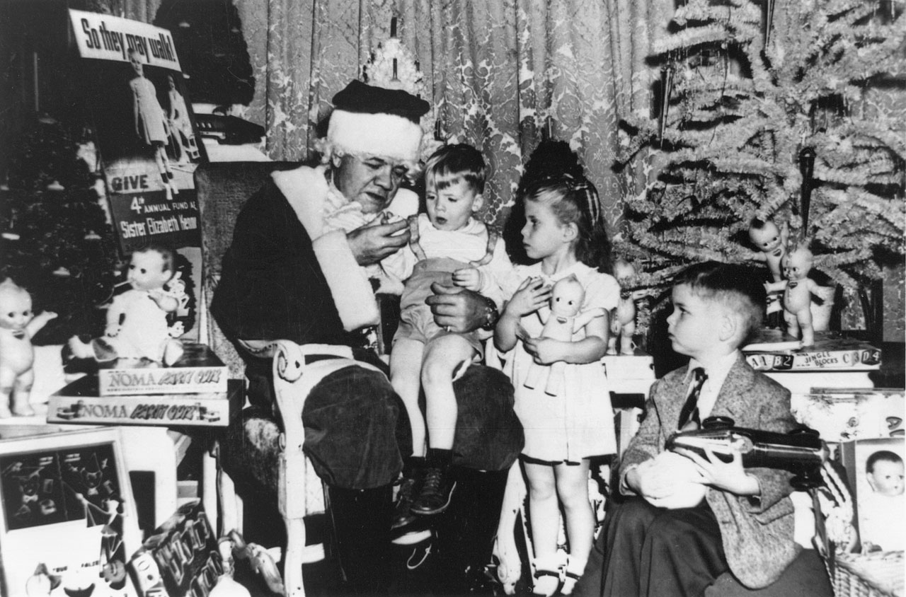

Slide 3
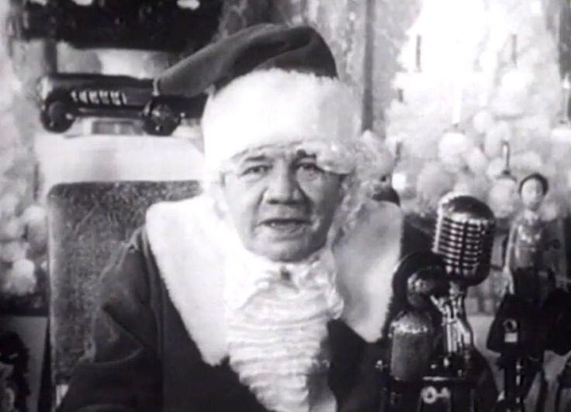

Slide 4
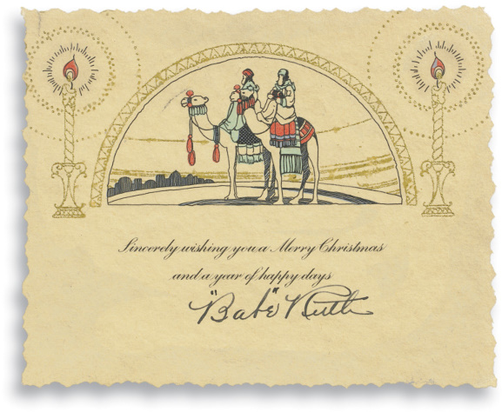

Slide 5
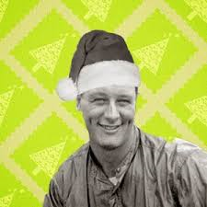

Slide 6
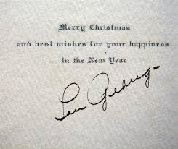

Slide 7
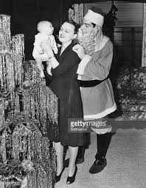
Notes:
Joe DiMaggio

Slide 8
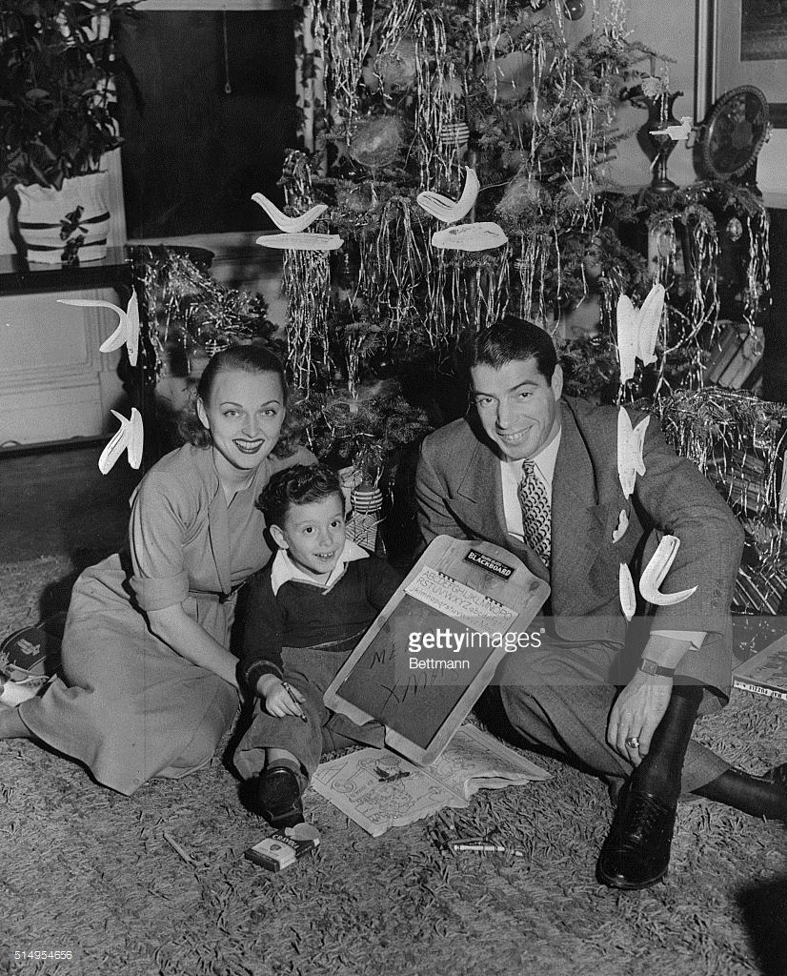
Notes:
Joe DiMaggio

Slide 9
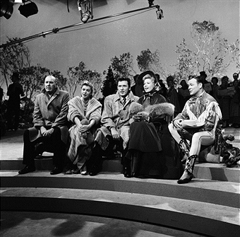
Notes:
Dinah Shore Christmas Special 12/22/57 – Dizzy Dean, Esther Williams, Actor John Raitt, Dinah Shore, Roy Rogers

Slide 10
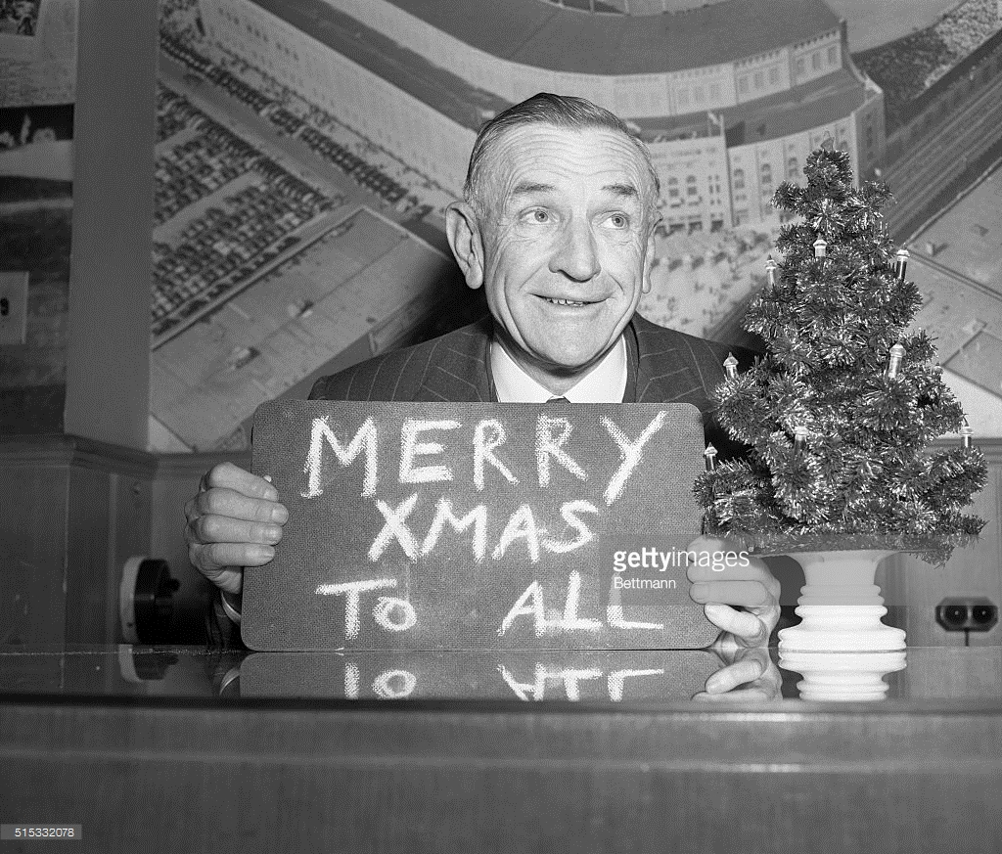
Notes:
Casey Stengel

Slide 11
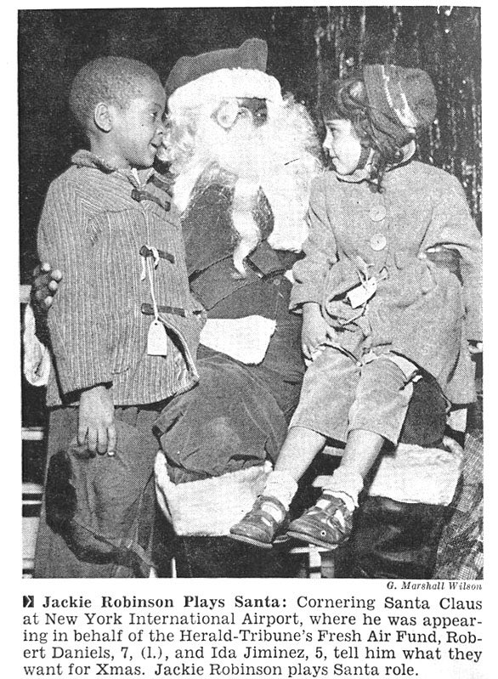
Notes:
Jackie Robinson 1959

Slide 12
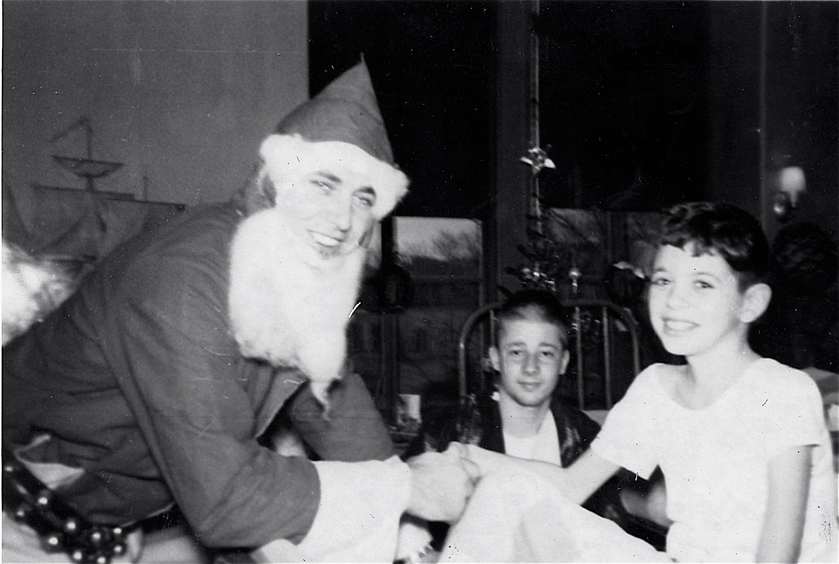
Notes:
Gil Hodges at Children’s Hospital Brooklyn

Slide 13
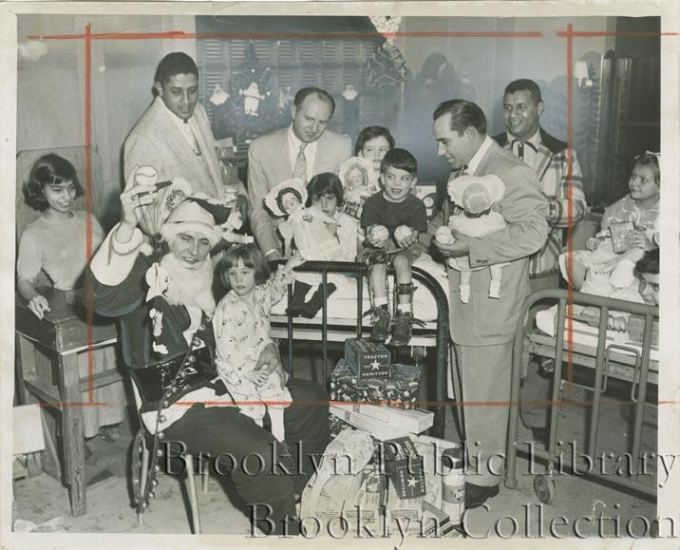
Notes:
Gil Hodges at Children’s Hospital Brooklyn with Don Newcombe, Yogi Berra and Roy Campanella

Slide 14
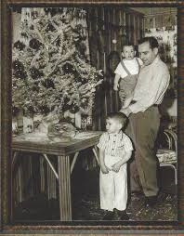
Notes:
Yogi Berra

Slide 15
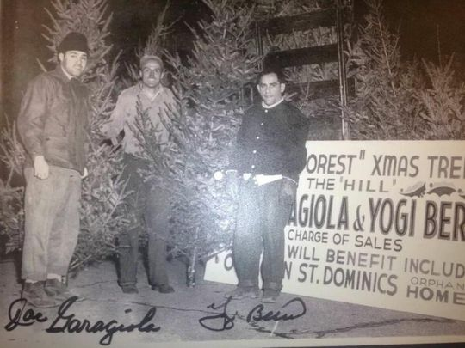
Notes:
Yogi Berra and Joe Garagiola

Slide 16
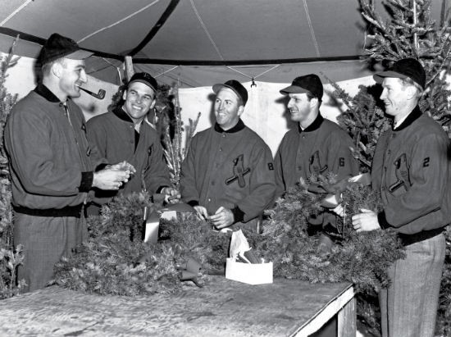
Notes:
Stan Musial – Red Schoendenist

Slide 17
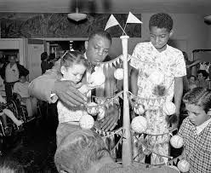
Notes:
Willie Mays

Slide 18
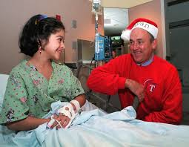
Notes:
Nolan Ryan

Slide 19
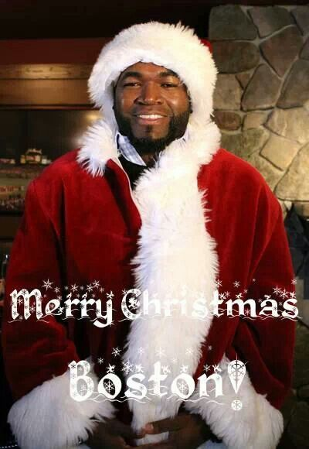
Notes:
David Ortiz – Big Papi

Slide 20
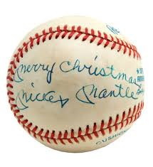
Notes:
Mickey Mantle

Slide 21
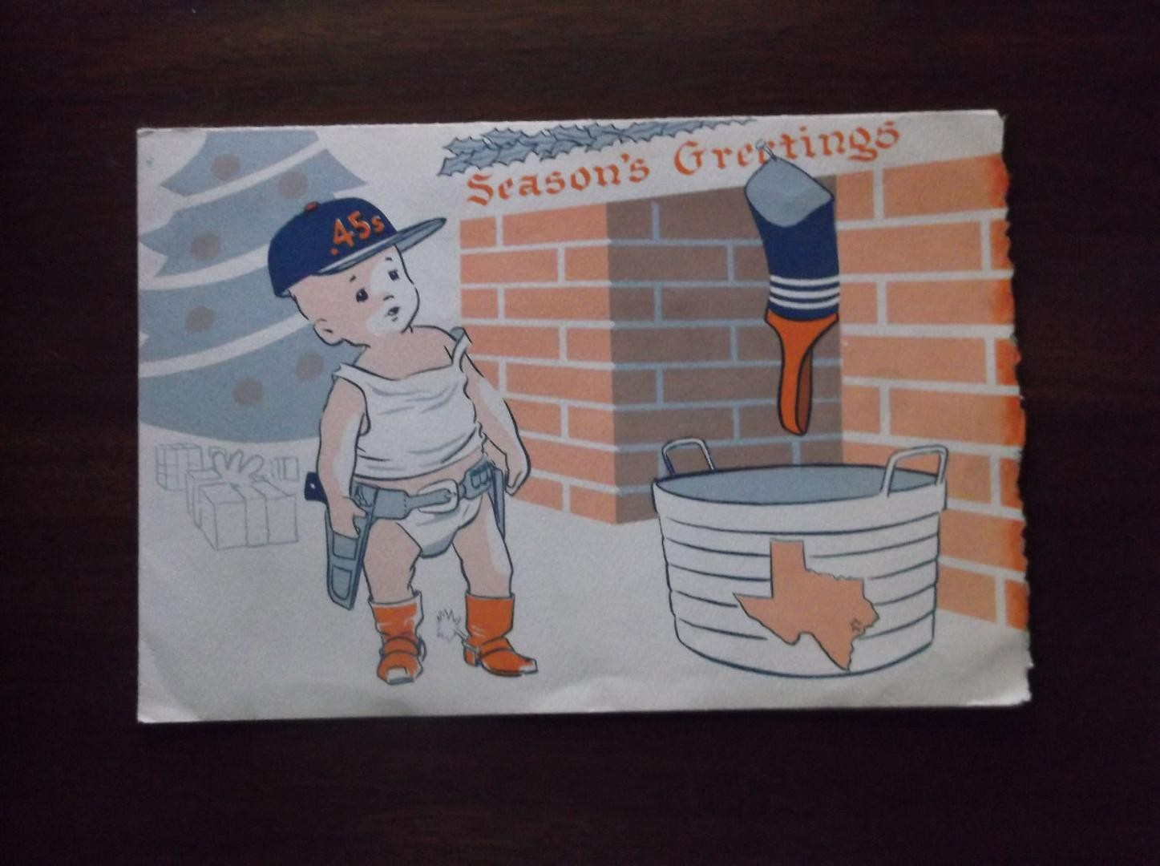
Notes:
Colt 45s Christmas Card 1962

Slide 22
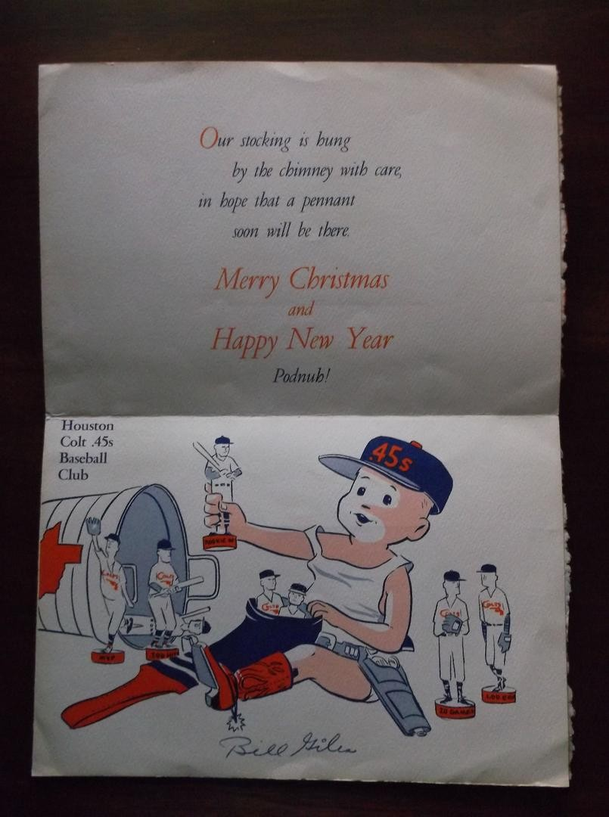
Notes:
Colt 45s Christmas Card 1962

Slide 23
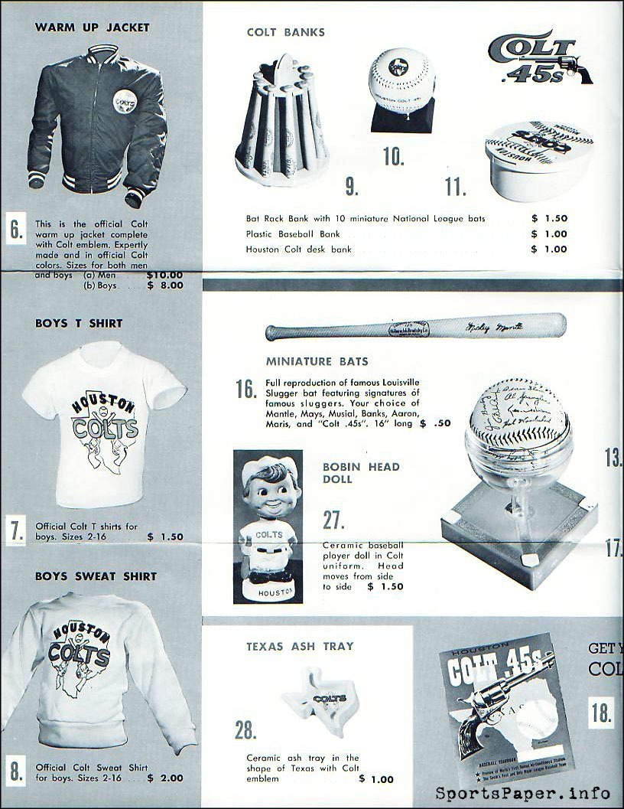
Notes:
Colt 45s Christmas Gift Ideas - 1962

