Slide 1
Sandy Koufax
“The Left Arm of God”

Slide 2
Birth and Childhood
Born: December 30, 1935, Brooklyn, NY
Q. What was unusual about Sandy Koufax’s birth?
A. He was born Sanford Braun, and did not receive the name Koufax until age 9, when his mother married a lawyer, Irving Koufax.

Slide 3
He attended Lafayette High School in Brooklyn.
Q. What former major league owner was a high school classmate and teammate of Sandy’s?
A. Fred Wilpon (former owner of New York Mets).
Other notable Lafayette alumni: Bob and Ken Aspromonte, Al Ferrara, Larry King (two years older than Sandy), Vic Damone, John Franco, Peter Max, Rhea Perlman

Slide 4
In high school, he originally played catcher (left-handed) and first base.
Q. Where did Sandy attend college, and what was his primary sport?
A. University of Cincinnati (as a walk on), and later earned a partial basketball scholarship. Fun fact: his coach was Ed Jucker, who later coached Oscar Robertson and won a national championship.
Fun fact II: Sandy originally wanted to be an architect.

Slide 5
The “Bonus Baby”
Sandy signed as a “bonus baby” with the Brooklyn Dodgers in 1955.
Because he received a bonus of $14,000, larger than the threshold of $4,000, the Dodgers were required to keep him on the major league roster for at least two years. As a result, Sandy never played a day of minor league baseball.
Q. Who was the Dodger scout who signed Koufax?
A. Al Campanis, who remarked “There are two times in my life the hair on my arms has stood up: The first time I saw the ceiling of the Sistine Chapel and the second time, I saw Sandy Koufax throw a fastball."

Slide 6
Early Career
Sandy was an early disappointment during the first six years of his twelve year career. Between 1955 and 1960, he went 36-40. He did, however, average approximately a strikeout per inning (197 Ks in 175 innings in 1960). He also started and pitched well in one of the games in the 1959 World Series.
Q. What Hall of Famer scored the only run in Sandy’s 1-0 loss to the White Sox in the 1959 World Series?
A. Nellie Fox (on a double play).

Slide 7
Sandy “Gets It”
According to the story, Sandy was to start a spring training game against the Twins. After walking the bases full in the first inning, his catcher suggested he ease up and not try to strike everyone out. According to Sandy, that’s what helped his control and made all the difference. In 1961, he went 18-13 and broke Christy Mathewson’s NL record with 269 strikeouts.
Q. Who was the catcher who make the career-changing suggestion to Sandy?
A. Norm Sherry (brother of Larry Sherry, 1959 World Series MVP).

Slide 8
Domination 1962-1966
Four no hitters; one each year (3 at Dodger Stadium, one in Philadelphia), the last one a perfect game.
Three Cy Young awards in four years 1963-66 (when there was only one for both leagues). All by unanimous vote.
MVP and 25 wins in 1963
Two wins in four game WS sweep vs. Yankees; set new WS strikeout record with 15 in Game 1
New MLB record for strikeouts (382 in 1965)
Led MLB in ERA for five straight years; only pitcher to do so.
Q. Who won the Cy Young Award in 1964, the only year that Sandy didn’t? (Hint: he pitched in the same home ballpark).
A. Dean Chance, Los Angeles Angels

Slide 9
The Perfect Game, September 9, 1965
Came during pennant race after Sandy had not won a game in three weeks (since Marichal/Roseboro incident).
Fourth no-hitter; first MLB pitcher to reach that mark (since passed by Nolan Ryan, but not equaled since).
Only game in MLB history with only one hit (Cubs pitcher Bob Hendley pitched a one hitter).
The one hit did not figure in the scoring. (Walk, bunt, stolen base, throwing error on catcher).
Classic Vin Scully call

Slide 10
Harvey Kuenn made last out in two Koufax no-hitters (also vs. Giants in 1963).
Most strikeouts in a perfect game (14); tied with Matt Cain. Only pitcher to strike out at least one batter in each inning in a perfect game). Struck out last six batters.
Three Hall of Famers in Cubs lineup (Banks, Santo, B. Williams).
Selected in 1995 by SABR as the greatest game ever pitched.
Hendley defeated Koufax five days later in a rematch, 2-1.
Cubs then went 7,920 games before being no-hit (Cole Hamels) – longest streak in MLB.

Slide 11
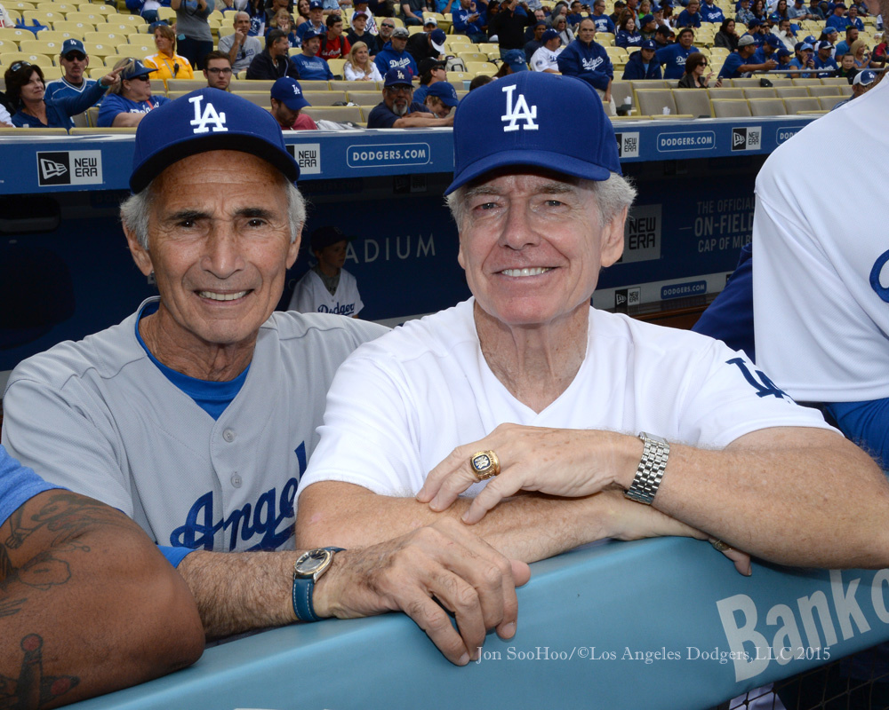
(Extra credit: What future Hall of Famer was born on October 3, 1951, the day Bobby Thomson hit his pennant-winning HR?)
Q. Who was the catcher for Koufax’s perfect game, and the only person to catch no-hitters for both Koufax and Nolan Ryan?
A. Jeff Torborg.

Slide 12
A Man of Principle: The 1965 World Series
Declined to pitch Game 1 because of Yom Kippur.
Drysdale started and lost. When Alston came to relieve him, Drysdale told him “I bet you wish I was Jewish too).
Koufax also lost Game 2 5-1, putting Dodgers down 2-0, but they won three in a row at home, then lost Game 6 in Minnesota, setting the stage for Game 7.
Started on two days rest; lost use of curveball early in game and relied only on fastball.
Pitched three hit shutout against team with Killebrew, Oliva, Allison, Hall, etc.
Q. Who was the losing pitcher in Game 7 of the 1965 World Series?
A. Jim Kaat.

Slide 13
Injuries take their toll
In July 1962, Sandy was 14-4 with 209 Ks. He missed the rest of the season with an ailment in the index finger that was so serious that doctors considered amputation. The Dodgers lost the pennant in a three game playoff. Later, he developed arthritis in his left elbow, and was told he could lose proper function of the arm. The hemorrhaging was so serious that he had to take codeine for the pain, and Butazoldin (usually given to race horses) and “atomic balm” for inflammation. He also had to soak his arm in ice water after each start, during which observers claimed that the arm appeared nearly twice its normal size.

Slide 14
Retirement at age 30
Held out jointly with Don Drysdale prior to 1966 season, ultimately signed for $125,000.
Went 27-9 with 1.73 ERA in final season (highest win total since Dizzy Dean won 30).
Won pennant for Dodgers with 6-0 shutout against Phillies on last day of the season.
Lost Game 2 in last start of career when CF Willie Davis made three errors in same inning (two on same play).
Total WS record: only 4-3, but with a 0.95 ERA.
Retired November 18, 1966, a month short of his 31st birthday. A ten year old boy in Los Angeles cried that day.
Q. Other than Koufax, who is the only pitcher to win 20 games in his final season?
A. Mike Mussina.
Q. What HOF pitcher defeated Koufax in his last start? (Hint: also youngest pitcher to win a WS game)
A. Jim Palmer.

Slide 15
Hall of Fame and beyond
Elected on first ballot in 1972 at age 36 (along with Yogi Berra). Youngest elected HOFer ever.
Has now been a member of the HOF for 45 years, the longest ever.
Became sportscaster immediately upon retirement (ended 10 year contract after 6 years).
Selected in 2017, along with Mays, Aaron, and Bench, as one of the four greatest living players.
Koufax was the final player chosen in the inaugural Israel Baseball League draft in April 2007. Said Manager Art Shamsky, “he’d be working on 41 years rest.”
Named “favorite athlete of the 20th Century” by Sports Illustrated.
ESPN has called him the James Dean of baseball, and likened him to the late author J.D. Salinger.

Slide 16
Sandy and me: my hero for over half a century
(Because, after all, it’s my presentation).
My most prized possession: a signed ticket stub from Sandy’s perfect game.

Slide 17
Me and a replica of Sandy’s HOF plaque (taken at HOF exhibit in Round Rock, TX)

Slide 18
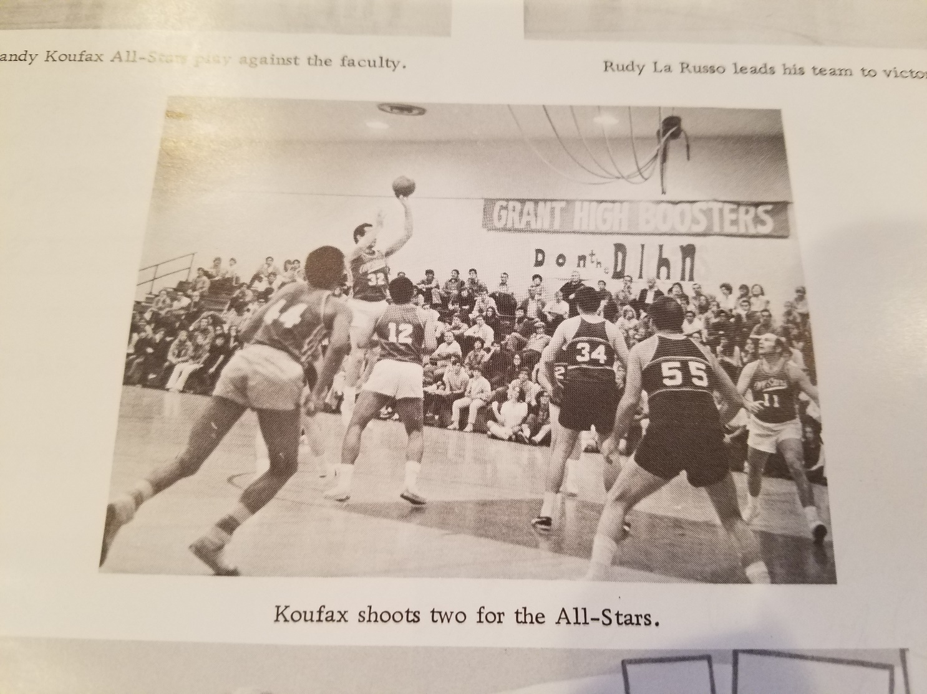
The Sandy Koufax (basketball) All-Stars appear at my high school, circa 1971

Slide 19
Sandy-themed office decor

Slide 21
Forever #32

