Slide 1
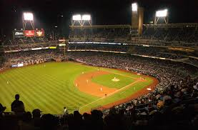
Second Basemen
Or - How Mickey Mantle got Bill Mazeroski in the Hall of Fame

Slide 2
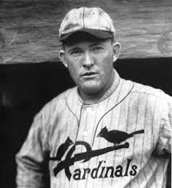
“People ask me what I do all winter when there’s no baseball. I’ll tell you what I do. I stare out the window and wait for Spring”*
- Rogers Hornsby, HOF Second Baseman
* There are only 21 Second Basemen in the Hall of Fame

Slide 3
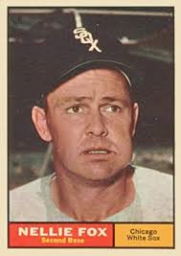
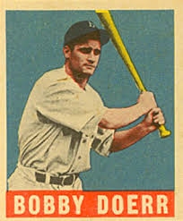
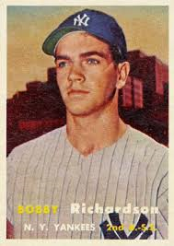
Who was your favorite Second Baseman?
Nellie Fox
Chicago White Sox
Bobby Doerr
Boston Red Sox
Bobby Richardson
New York Yankees

Slide 4
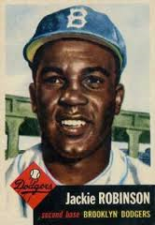
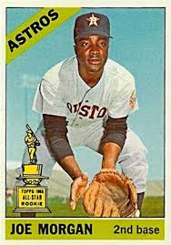
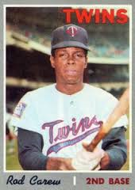
Paul’s favorite Second Basemen
Jackie Robinson
Brooklyn Dodgers
Joe Morgan
Houston Astros
Rod Carew
Minnesota Twins

Slide 5
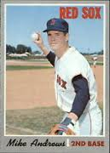
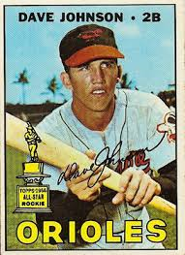
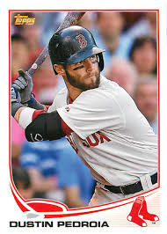
Mike’s favorite Second Basemen
Mike Andrews
Boston Red Sox
Davey Johnson
Atlanta Braves
Dustin Pedroia
Boston Red Sox

Slide 6
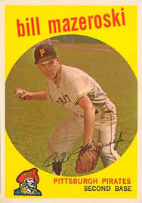
Bill Mazeroski was inducted into the Baseball Hall of Fame in 2011
Years Played | 17 Years
Batting Average | .260
Home Runs | 138
RBIs | 853

Slide 7
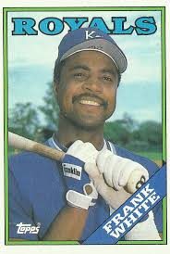
Frank White is not in the Hall of Fame
Years Played | 17 Years | 18 Years
Batting Average | .260 | .255
Home Runs | 138 | 160
RBIs | 853 | 886

Slide 8
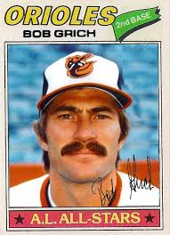
Bobby Grich is not in the Hall of Fame
Years Played | 17 Years | 17 Years
Batting Average | .260 | .266
Home Runs | 138 | 224
RBIs | 853 | 864

Slide 9
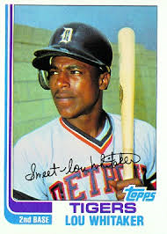
Lou Whitaker is not in the Hall of Fame
Years Played | 17 Years | 19 Years
Batting Average | .260 | .276
Home Runs | 138 | 244
RBIs | 853 | 1064

Slide 10
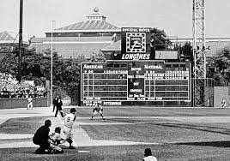
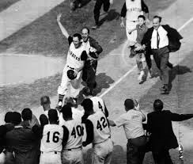
Is Bill Mazeroski in the Hall of Fame because he hit the most famous home run in World Series history?

Slide 11
If so, then Mickey Mantle is the reason Bill Mazeroski is in the
Hall of Fame!*
* If not for one of the smartest plays in baseball history, Bill Mazeroski would never have batted in the 9th inning and never had the chance to hit his famous home run!

Slide 12
The Situation:
Game 7 1960 World Series
Top of the 9th inning
Pirates ahead 9-8
One out
Yankee runners on first (Mickey Mantle) and third base (Gil McDougald)
Yogi Berra batting for the Yankees

Slide 13
Berra hits a hard grounder to 1B Rocky Nelson
Nelson steps on first for the second out
Mantle……………………..
The Rest is History!

