Slide 1
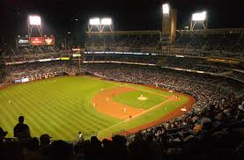
Shortstops

Slide 2
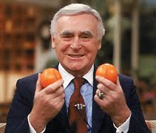
“Good stockbrokers are a dime a dozen, but good shortstops are hard to find”*
- Charlie Finley, Owner of Oakland A’s
* There are only 24 Shortstops in the Hall of Fame

Slide 3
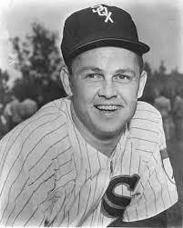
“What is the top requirement for a second baseman? A fine shortstop.”*
- Nellie Fox, Hall of Fame Second Baseman
* Fox played most of his career with Hall of Fame Shortstop, Luis Aparicio

Slide 4
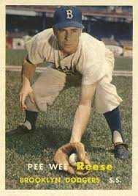
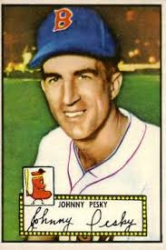
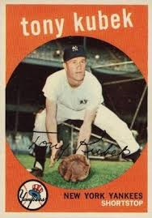
Who was your favorite shortstop?
Peewee Reese
Brooklyn Dodgers
Johnny Pesky
Boston Red Sox
Tony Kubek
New York Yankees

Slide 5
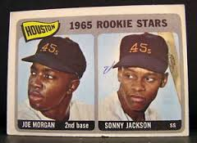
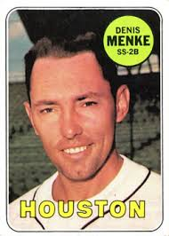
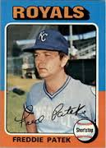
Bobby’s favorite shortstops
Sonny Jackson
Houston Astros
Denis Menke
Houston Astros
Freddie Patek
Kansas City Royals

Slide 6
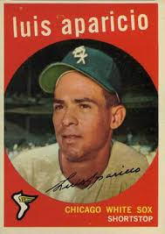
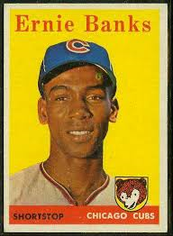
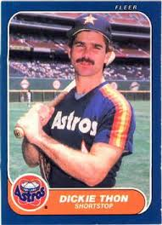
Jim’s favorite shortstops
Luis Aparicio
Chicago White Sox
Ernie Banks
Chicago Cubs
Dickie Thon
Houston Astros

Slide 7

Who hit the most home runs while playing shortstop?

Slide 8
Who hit the most home runs while playing shortstop?
* He hit 345 home runs as a SS; 431 home runs in his career (he played the last 5 years as a 3B)

Slide 9
Who hit the most home runs while playing shortstop?
He hit 345 home runs as a SS; 431 home runs in his career (he played the last 5 years as a 3B)
His dad was once his manager

Slide 10
Who hit the most home runs while playing shortstop?
He hit 345 home runs as a SS; 431 home runs in his career (he played the last 5 years as a 3B
His dad was once his manager
He broke Lou Gehrig’s record by playing in 2,632 consecutive games

Slide 11
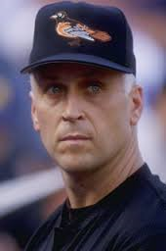
Who hit the most home runs while playing shortstop?
He hit 345 home runs as a SS; 431 home runs in his career (he played the last 5 years as a 3B)
His dad was once his manager
He broke Lou Gehrig’s record by playing in 2,632 consecutive games

Slide 12
Who hit the most home runs while playing shortstop?
Cal Ripken Jr.
Baltimore Orioles
He hit 345 home runs as a SS; 431 home runs in his career (he played the last 5 years as a 3B)
His dad was once his manager
He broke Lou Gehrig’s record by playing in 2,632 consecutive games

Slide 13
Who hit the most home runs while playing shortstop in the National League?

Slide 14
Who hit the most home runs while playing shortstop in the National League?
* He hit 277 home runs as a SS but had 512 home runs in his career (he played the last 11 years as a 1B)

Slide 15
Who hit the most home runs while playing shortstop in the National League?
He hit 277 home runs as a SS but had 512 home runs in his career (he played the last 11 years as a 1B)
“Let’s play two!”

Slide 16
Who hit the most home runs while playing shortstop in the National League?
He hit 277 home runs as a SS but had 512 home runs in his career (he played the last 11 years as a 1B)
“Let’s play two!”
Mr. Cub

Slide 17
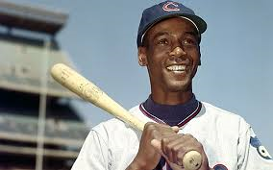
Who hit the most home runs while playing shortstop in the National League?
He hit 277 home runs as a SS but had 512 home runs in his career (he played the last 11 years as a 1B)
“Let’s play two!”
Mr. Cub

Slide 18
Who hit the most home runs while playing shortstop in the National League?
Ernie Banks
Chicago Cubs
He hit 277 home runs as a SS but had 512 home runs in his career (he played the last 11 years as a 1B)
“Let’s play two!”
Mr. Cub

Slide 19
This HOF shortstop had a career batting average of only .262 with 28 HRs (averaged less than 2 per season).

Slide 20
This HOF shortstop had a career batting average of only .262 with 28 HRs (averaged less than 2 per season).
- An excellent defender, he was almost as famous for his backflip

Slide 21
This HOF shortstop had a career batting average of only .262 with 28 HRs (averaged less than 2 per season).
An excellent defender, he was almost as famous for his backflip
Nicknamed “The Wizard of Oz”

Slide 22
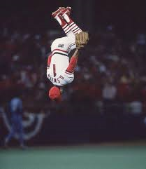
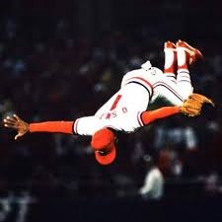
This HOF shortstop had a career batting average of only .262 with 28 HRs (averaged less than 2 per season).
An excellent defender, he was almost as famous for his backflip
Nicknamed “The Wizard of Oz”

Slide 23
This HOF shortstop had a career batting average of only .262 with 28 HRs (averaged less than 2 per season).
Ozzie Smith
St. Louis Cardinals
An excellent defender, he was almost as famous for his backflip
Nicknamed “The Wizard of Oz”

