Slide 1
Baseball Super Fans Fun, Noise and Mayhem at the Ballpark

Slide 2
Definition:
Fan (noun)
An enthusiastic devotee (as of a sport or
performing art), usually as a spectator
An ardent admirer or enthusiast (as of a celebrity
or pursuit)
Probably short for “fanatic”; first known use – 1682.
Derived from the Latin “fanaticus”, meaning “insanely
but divinely inspired”

Slide 3
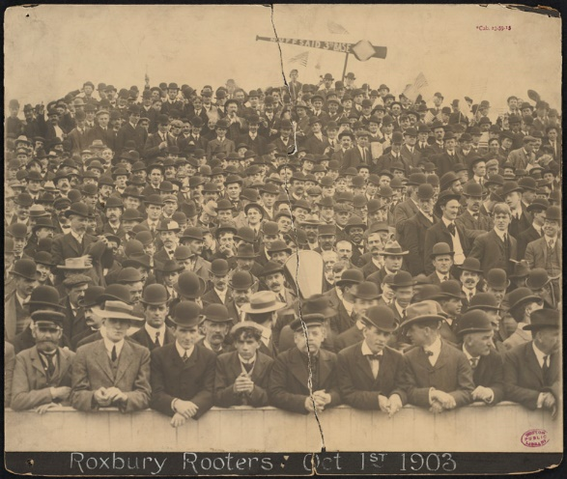
The Boston
Royal Rooters
Original group was organized by
Michael “Nuff Said” McGreevey
at his “Third Base Saloon” and was
active 1894 – 1918.
They were out in force during the
first “modern era” World Series in
1903, traveling to Pittsburgh and in
their reserved section along the third
base line in Boston’s AL park -
Huntington Avenue Grounds.
Their theme song was “Tessie”
JFK’s grandfather, Boston politician and
mayor, John F. Fitzgerald, was an
active member.

Slide 4
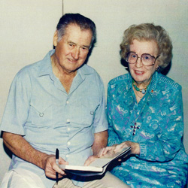
Elizabeth “Lib” Dooley
Bought her first season ticket in 1944 and faithfully attended every BoSox game until poor health caused her to miss some games in 1998 – she attended over 4000 consecutive home games !!
On August 30th of each year, she would call Ted Williams to wish him a happy birthday. She always addressed the Splendid Splinter as “Theodore”.
She often brought cookies and cupcakes for the players.
Williams once said of Lib, “Forever, she’s the greatest Red Sox fan there will ever be … she’s really a big league gal.”
Her father attended every Boston home opener from 1894 to 1970 !
Boston Super Fan

Slide 5
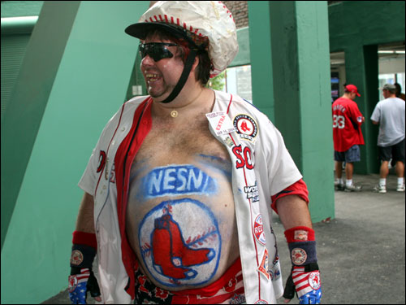
Mike Schuster
from Foxboro, Mass.
Tops most lists as the current Red Sox
Super Fan.
Has appeared in the movie “Fever Pitch”
with Drew Barrymore and Jimmy Fallon,
on David Letterman, and many sports
networks interviews
Current Boston Super Fan https://www.youtube.com/watch?v=tAqGpYA2KCg

Slide 6
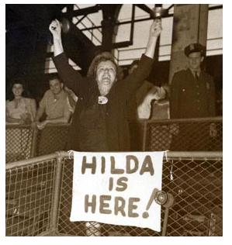
Hilda Chester at Ebbets Field in Brooklyn
Possibly the most famous of all baseball fans
Was a regular at Ebbets Field in Brooklyn from the
1920s until the team moved to Los Angeles. She then
switched allegiance to the Yankees, but she said “it just
isn’t the same anymore.”
After suffering a heart attack in the 1930s, her doctor
ordered her to stop screaming from the stands. The
Dodgers gave her the first of her brass cow bells.
Leo Durocher gave her a season’s pass in the grandstands
but she preferred to sit in the center field bleachers.
Her daughter, Bea Chester, played in the All American
Girls Professional Baseball League in 1943, ‘44, and ‘45.
Her favorite line was “Eat your heart out, ya bum.”
Brooklyn Dodgers

Slide 7
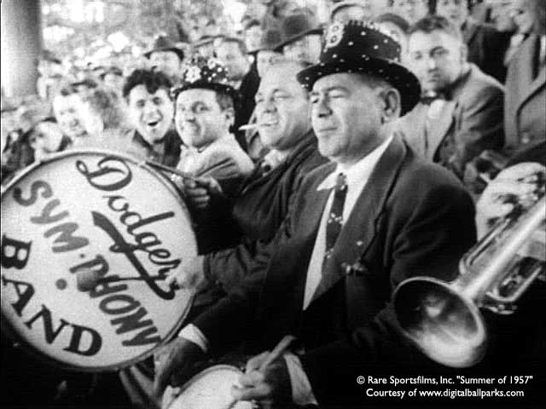
Dodgers’ Sym-Phony Band
Another staple at Ebbets Field from
1941 through the Dodgers’ departure
to LA.
Dodgers’ broadcaster Vin Scully said
the emphasis in their name should be
on the “Phony” … none of them were
accomplished musicians.
They are often credited with being
the first to play the tune
“Three Blind Mice” when
the umpires were introduced.
Brooklyn Dodgers

Slide 8
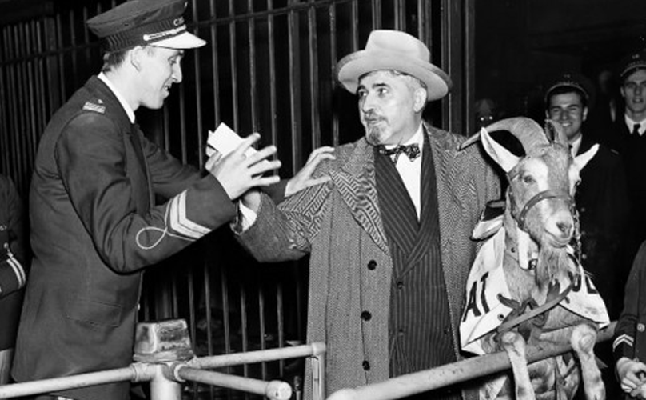
William Sianis
Sianis owned the Billy Goat
Tavern in Chicago. He also
owned a Goat, “Murphy”.
Sianis and his mascot goat
were denied admission to
Game 4 of the 1945 World
Series at Wrigley Field.
The goat had a paid ticket.
Upon being denied entry,
Sianis reportedly told ushers,
“You are never going to win a
World Series again.”
The “Curse of the Billy Goat”
held for 71 years !!
Chicago Cubs

Slide 9
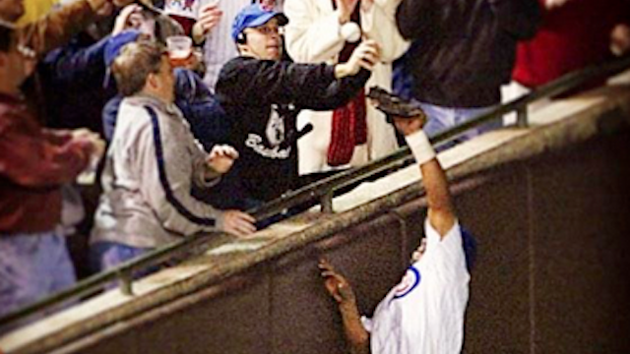
Steve Bartman
On October 14, 2003 the Cubs
were ahead 3-0 in Game Six of the NLCS. The Cubs led the series three games to two over the Florida (now Miami) Marlins.
If the Cubs can close out this game, they will win their first NL Pennant since
“The Billy Goat Curse”.
In the 8th inning, with one out,
Marlin’s second baseman Luis
Castillo hits a foul fly ball down
the left field line.
Here’s what happened next:
Chicago Cubs
https://www.youtube.com/watch?v=vq8G81oOHhY

Slide 10
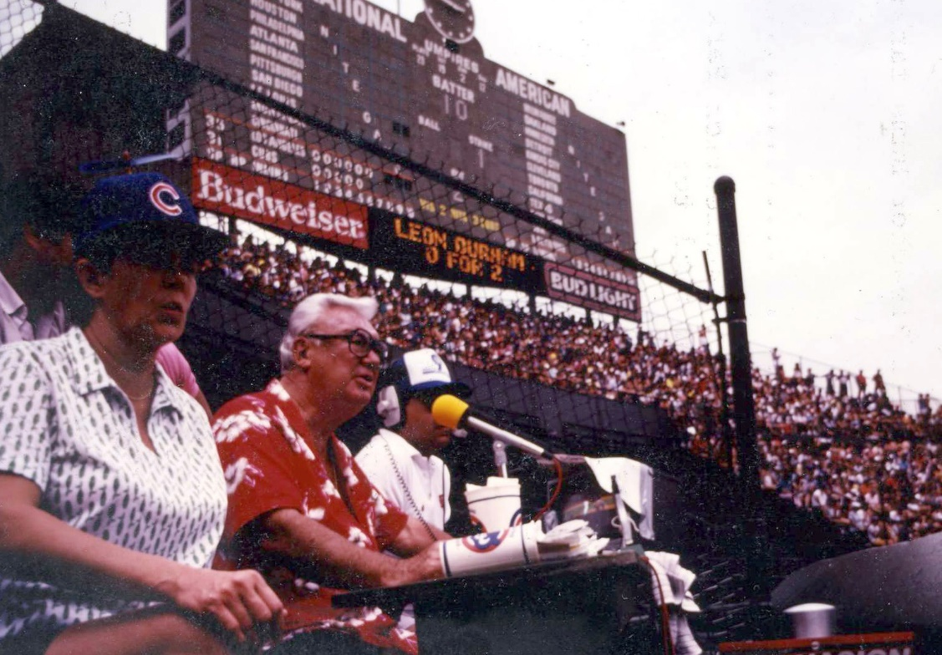
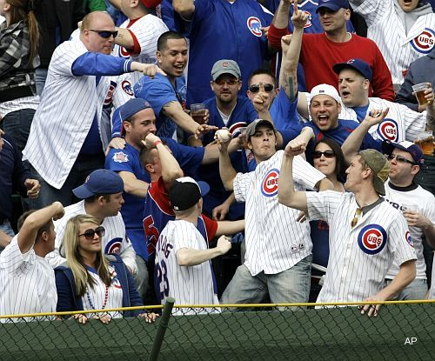
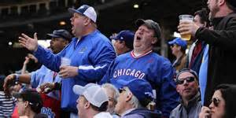
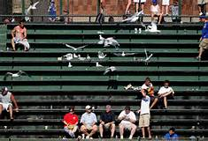
Bleacher Bums
Loyal Cubs fans sitting in the
Wrigley Field bleachers.
Cubs announcer Harry Caray
often announced games sitting among the bleacher residents.
It’s become stylish for Bums to
throw back a home run ball hit by the visiting team.
Back before Wrigley Field had lights, the bleachers were lightly populated during day games. The Cubs weren’t
so good, and often the Bums heckled the home team and manager.
Here’s what Cubs manager Lee
Elia had to say about the
Bleacher Bums in 1983:
Chicago Cubs
https://www.youtube.com/watch?v=diqm0GMFFYI&list=PLxV0KepTnXv37N8yeAUBgEo3xncKvz4SK

Slide 11
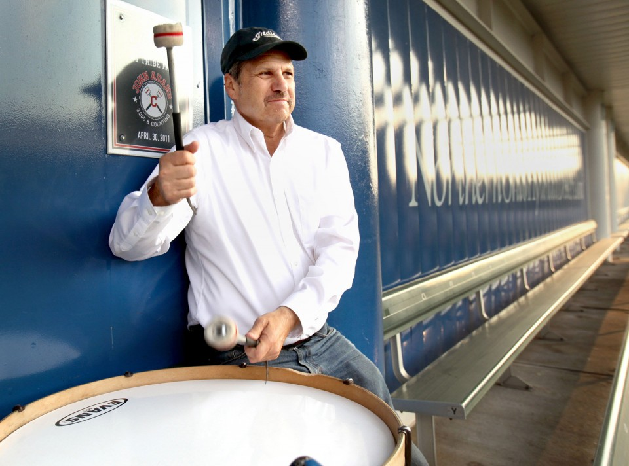
The Drum Guy at Cleveland Indians Games
John Adams has been doing this since 1973
The Indians “comp” John two season’s
tickets – one for him and one for the drum
He’s in the last row of the left field bleachers
He beats his drum when:
The game starts
The Indians have runners on base
The game is “late and close”
Cleveland Indians

Slide 12
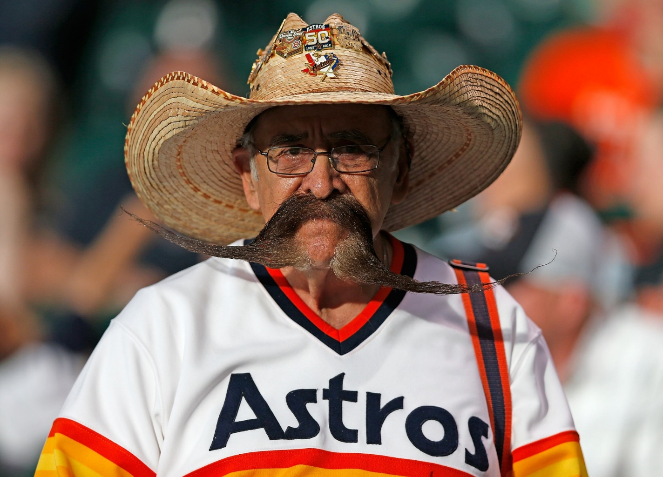
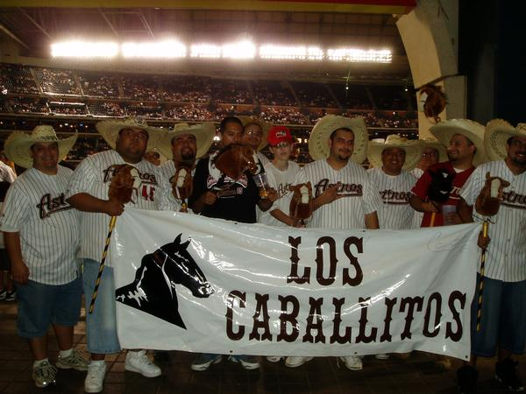
Valentin Jalomo has not missed an Astros game in over 10 years.
He is a retired Houston school teacher.
He enjoys having his picture taken with other Astros fans at MinuteMaid Park.
Houston Astros
Los Caballitos – the personal fan club of “El Caballo”
(The Horse) Carlos Lee when he played for the Astros

Slide 13
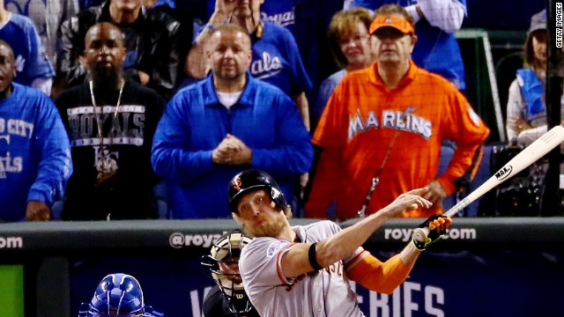
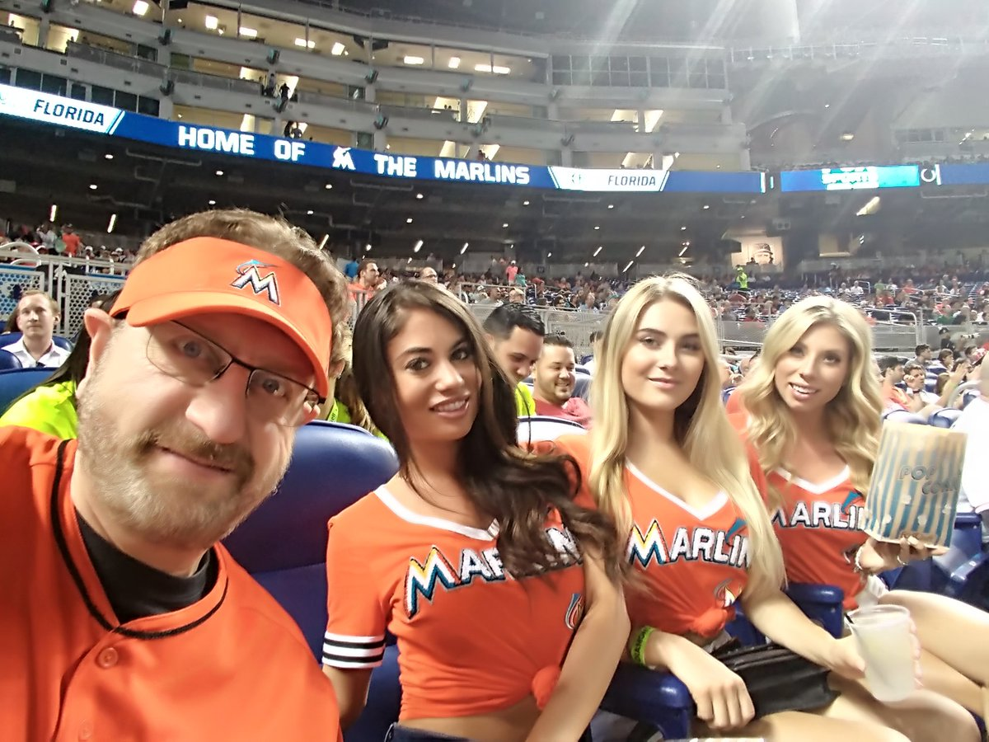
Laurence Leavy is an attorney from North Miami Beach
He gained notoriety when he began showing up at marquee sporting events in 2012, dressed in bright orange Miami Marlins gear.
He estimates he spends 300 days a year
at, or traveling to, sporting events – including the World Series, Super Bowls, NBA finals, and Triple-Crown horse racing events.
Marlins Man
Lately, he has been accompanied by “Marlins Man’s Mermaids”
He claims he wants to “bring sexy back” to baseball …
https://youtu.be/94ljkb2lT1Q

Slide 14
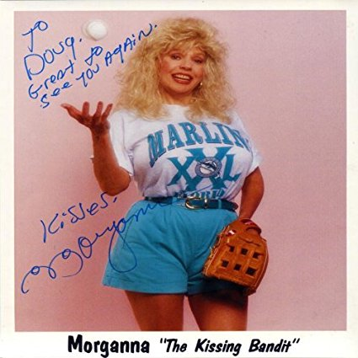
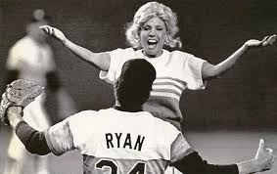
Morganna Roberts is a baseball comedienne and exotic dancer known for rushing the field during play to kiss baseball players.
Her first “victim” was Pete Rose in a 1969 game at Crosley Field in Cincinnati. By 1990 she had kissed 37 MLB players, including Nolan Ryan, George Brett (twice), Steve Garvey and Cal Ripken, Jr.
She retired at the end of the 1999 season.
The Kissing Bandit

Slide 15
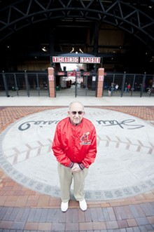
Joe Palermo worked at all three ballparks named “Busch Stadium” – he stopped working full-time in 2015 at age 85. He had 50 years of service as a scorecard/program vendor.
When he started working, a scorecard cost 10 cents. Now they are $2.50.
He is known for having a trivia quiz posted at his vendor stand. He usually awards correct answers with a mini Tootsie-Roll.
One of his last quizzes was, “What Cardinal player holds the single season team record for most stolen bases by a first baseman?”
He grew up near Sportsman’s Park and was a member of the Knot Hole Gang as a kid.
St. Louis Cardinals
Notes:
Answer – Gregg Jeffries had 46 SB in 1993.

Slide 16
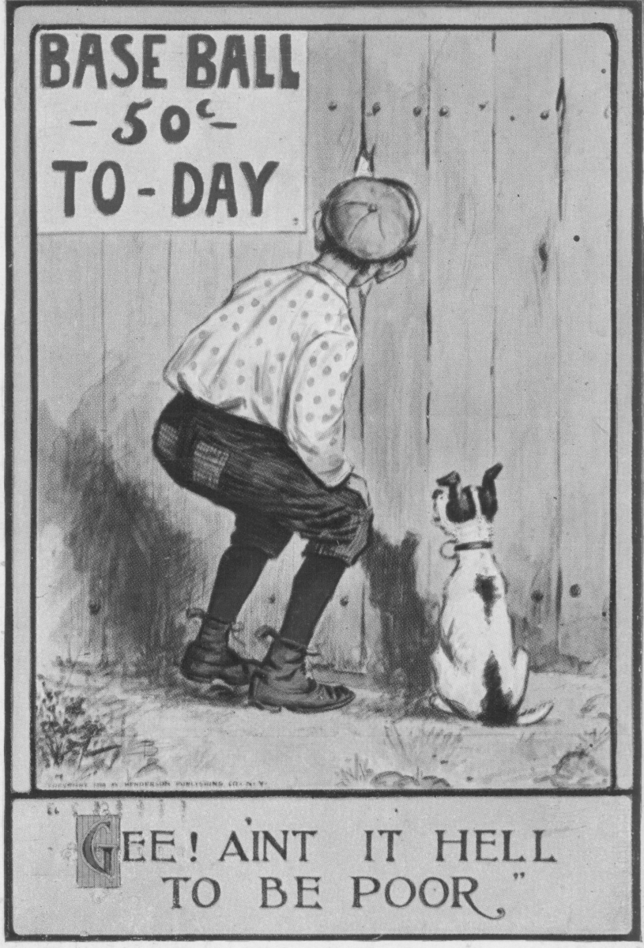
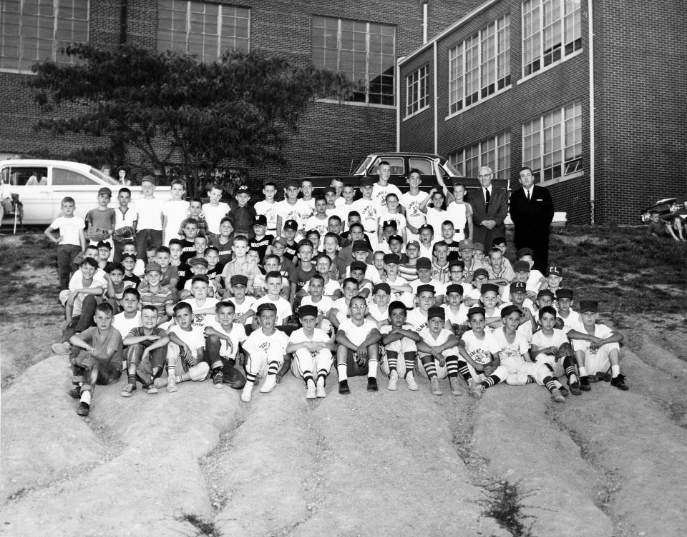
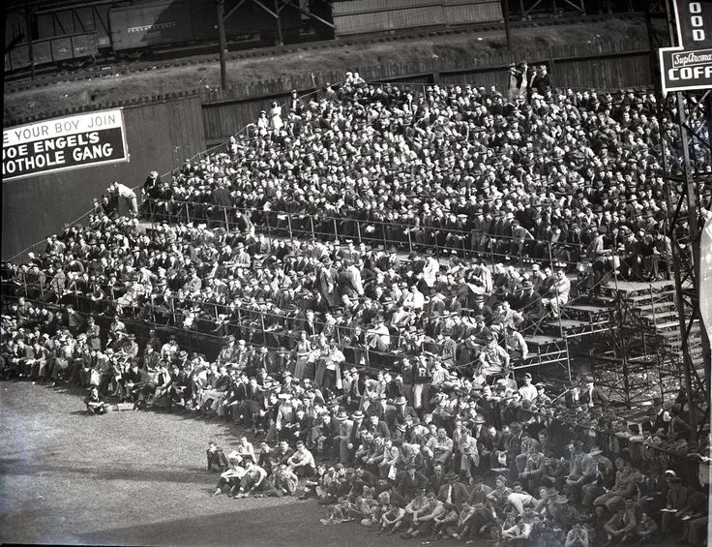
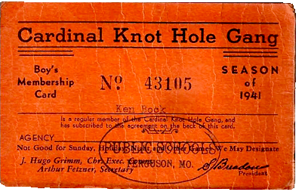
Knot Hole Gang
Fan clubs set up by professional teams to provide free- or reduced-price admittance for kids to attend games during the summer.
First established by St. Louis Cardinals in 1917 as part of public solicitation to buy shares in the club. Program was expanded by Branch Rickey during his years as GM of the Cardinals. The St. Louis Browns had a similar group called the “Boys Brigade”
The Houston Colt .45s’
knot hole gang was called
the “Six Shooter Club”
Still a popular promotion
today, especially among
minor league clubs.

Slide 17
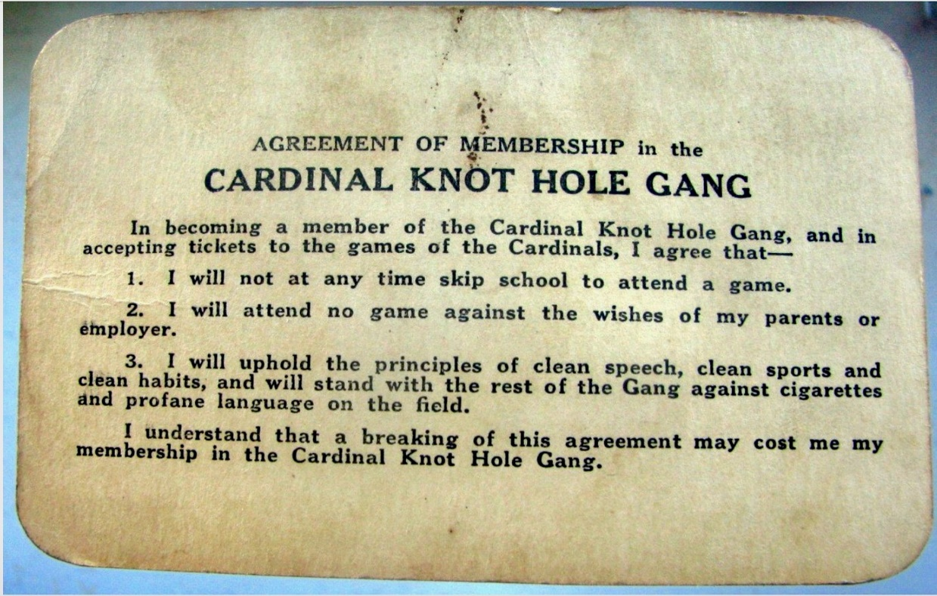
Knot Hole Gang

Slide 18
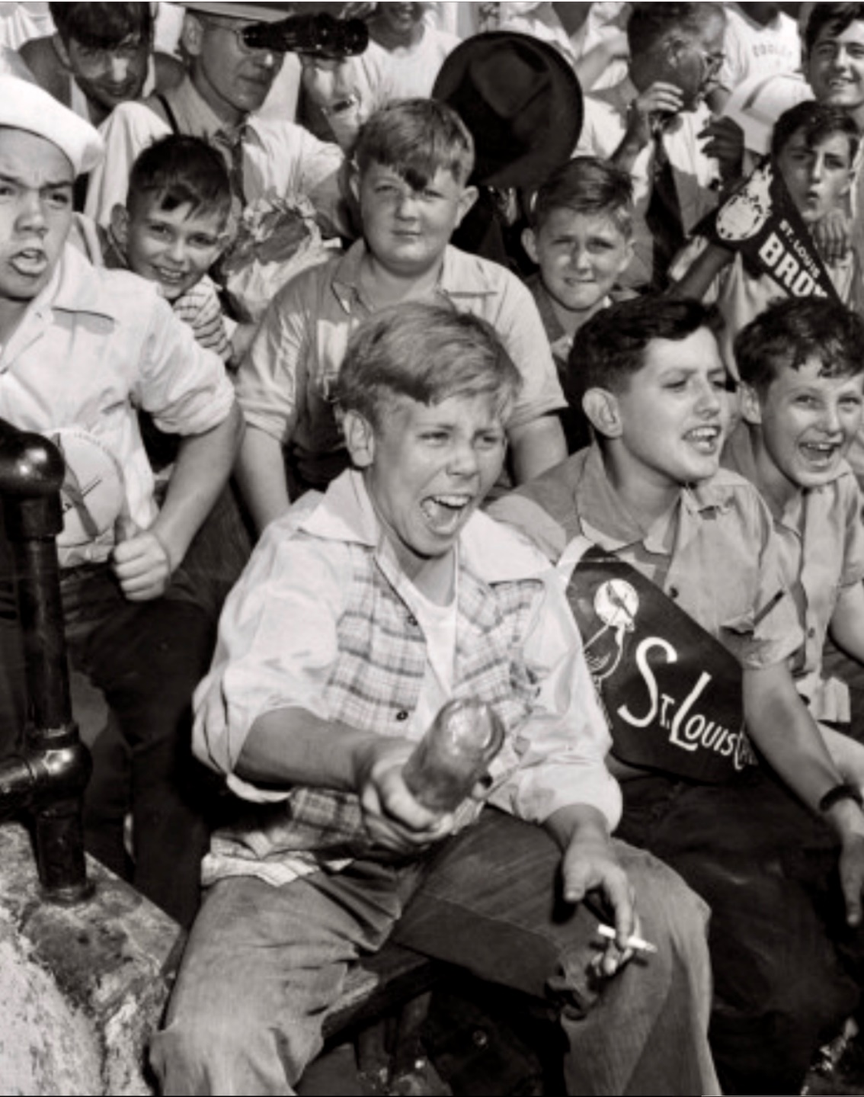
Knot Hole Gang
Not everyone observed all the rules of the
Knothole Gang

Slide 19
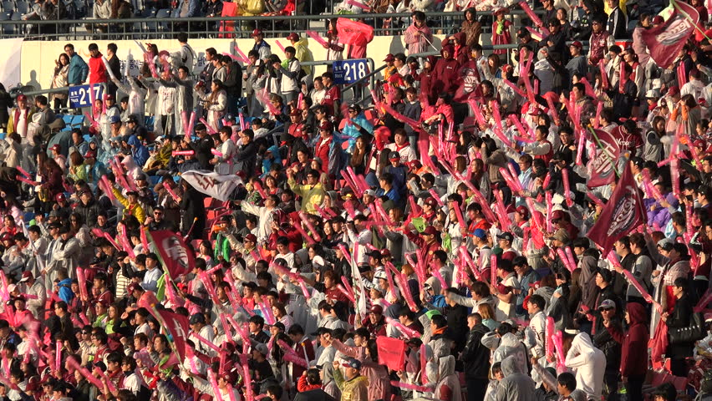
Baseball Fans in Asia
Thundersticks (Korea)
Manufactured in South Korea and first used at baseball games there in 1994.
Popularized in the U.S.A. by Los Angeles fans during the Angels’ 2002 World Series run.
https://www.youtube.com/watch?v=F0O88TQQ--o

Slide 20
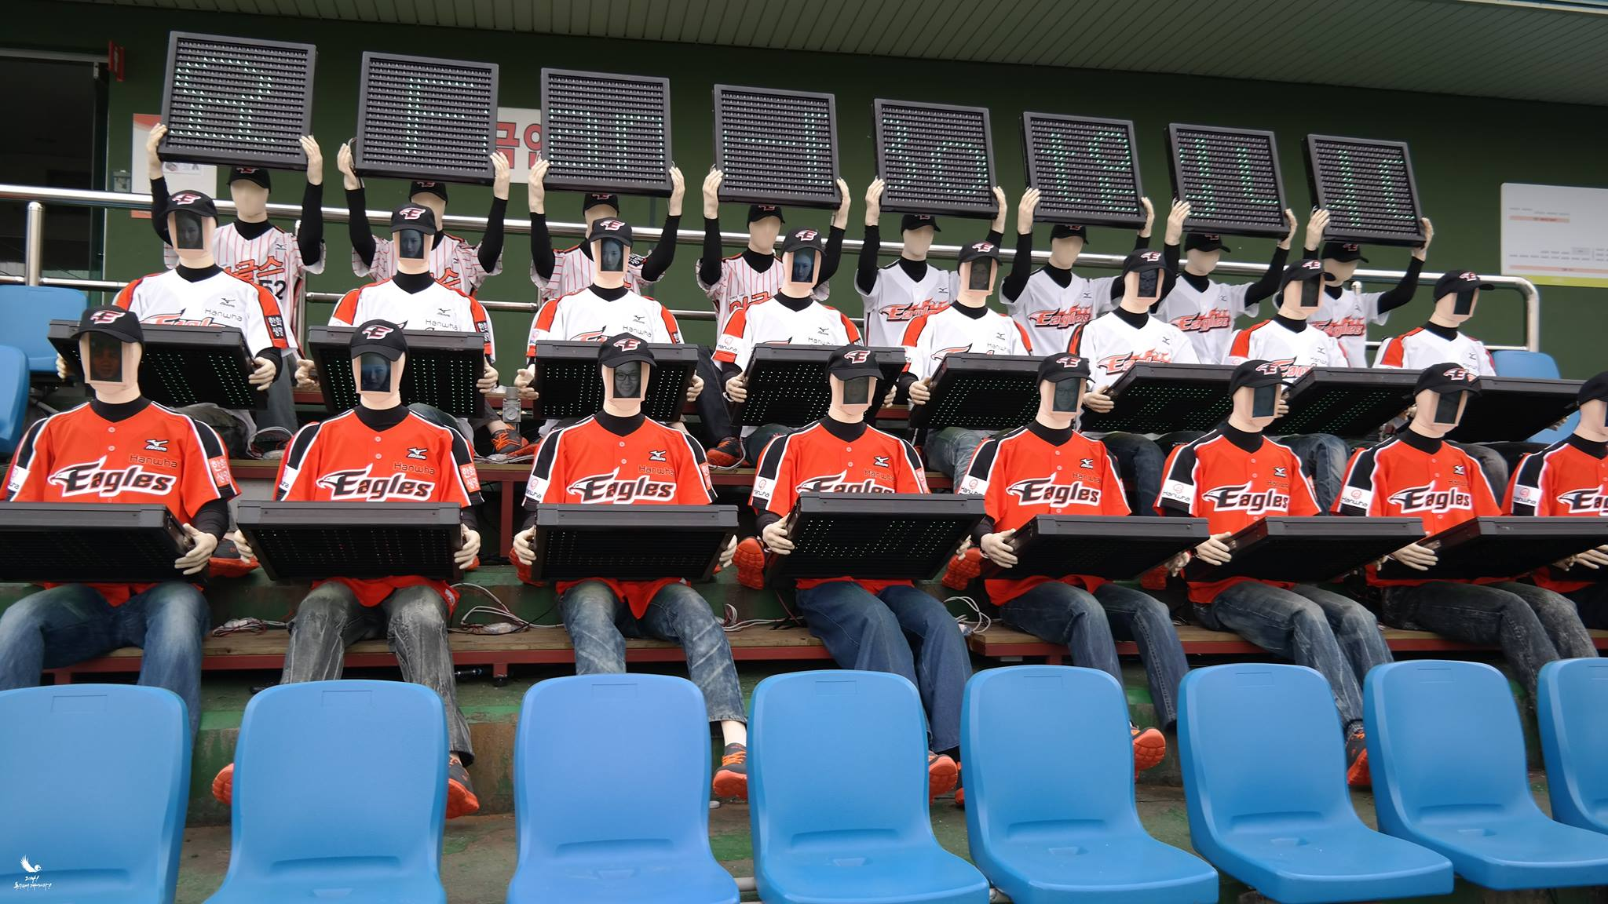
Baseball Fans in Asia
Fan-Bots (Korea)
These fans aren’t even human !!
https://www.youtube.com/watch?v=PHTK63fgl4M

Slide 21
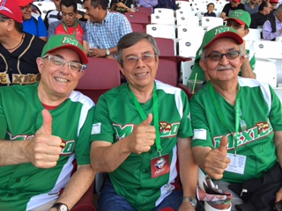
Fanaticos al Estadio
Fans in Mexico
Monte y los dos
Juan Antonios
en
Culiacan, Sinaloa, Mexico

Slide 22
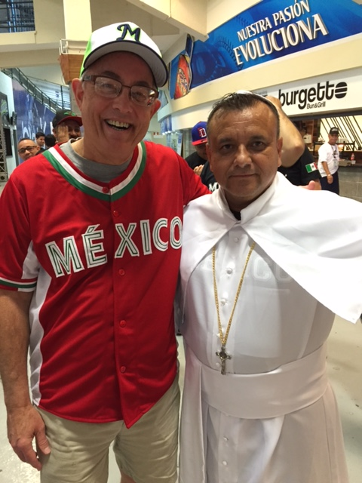
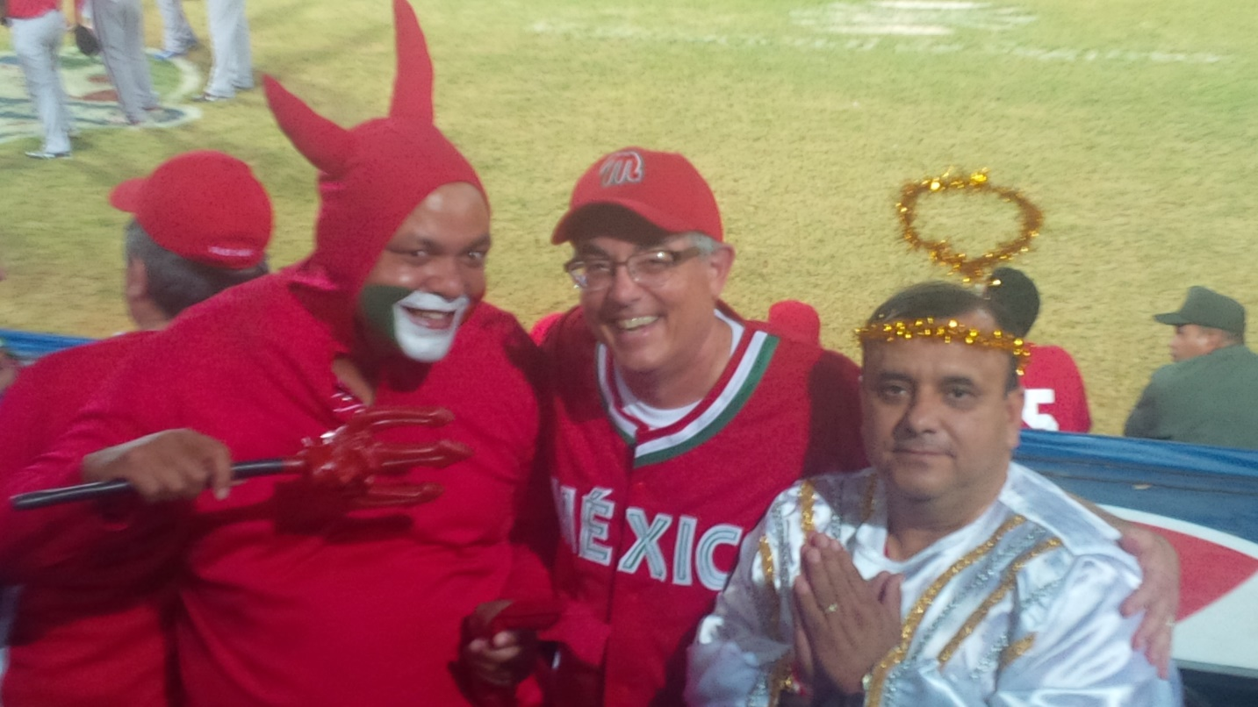
Fanaticos al Estadio
There are great fans South of the Border
With “El Diablo” Jhonny and “El Angel” Martin
in Porlamar, Venezuela
With “El Papa’ Francisco” (Martin) in Santo Domingo

Slide 23
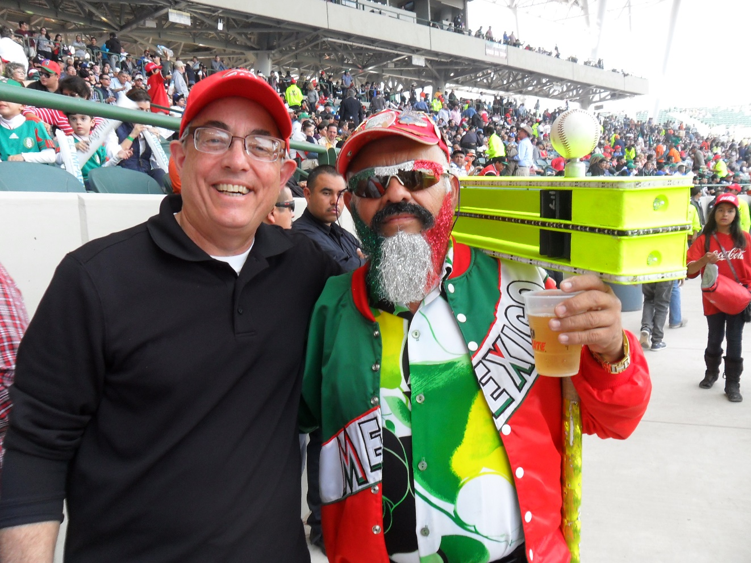
Fanaticos al Estadio
Enrique Estrada, El Rey de los Matraqueros. (Hermosillo, Sonora, Mexico)
https://www.youtube.com/watch?v=zK-waX2OKKY 4:07 , 5:20

Slide 24
We have our own
Super Fan right here in Austin, Texas.

Slide 25
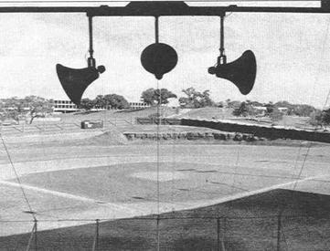
He used to hang out at
Clark Field …

Slide 26
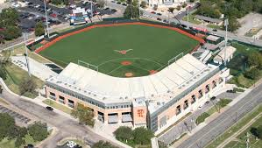
… then he moved to
Disch-Falk

Slide 27
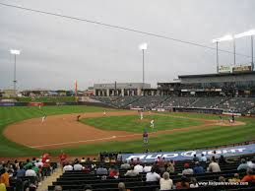
… and sometimes he’s in the
luxury boxes at Dell Diamond

Slide 28
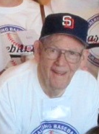
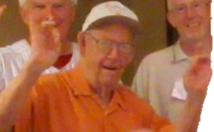
Super Longhorn
Fan
Super John
aka “Singing John”

Slide 29
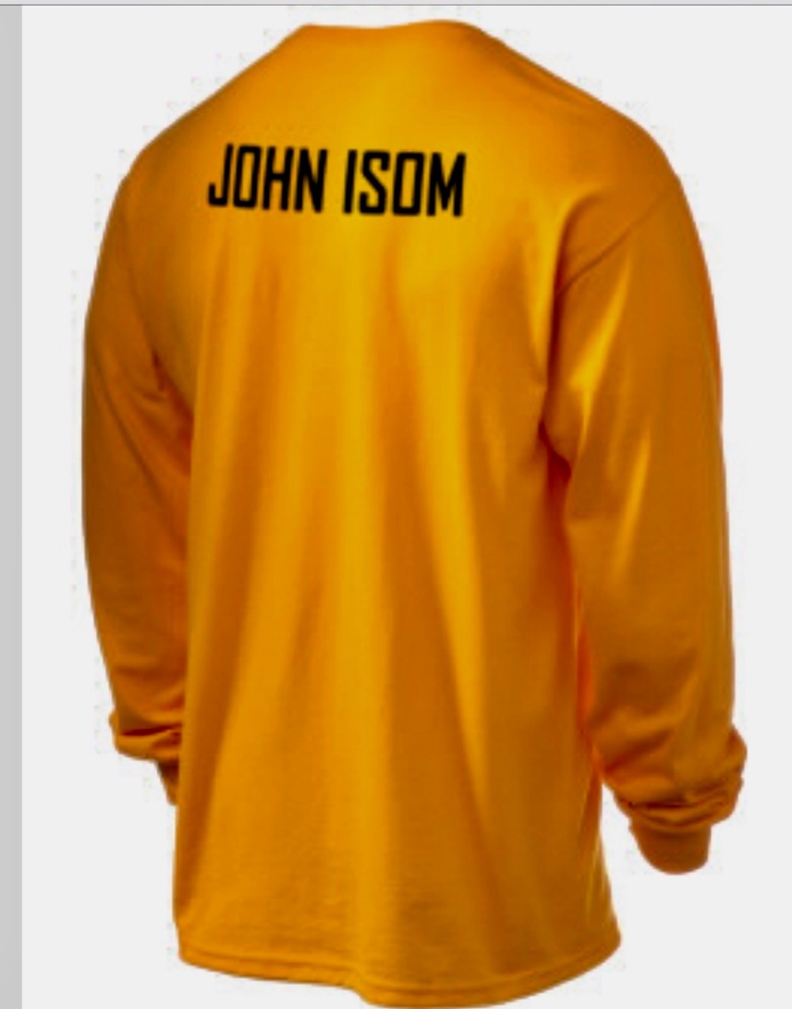
1
We’ve heard you can even buy John-themed sportswear at the Longhorn Shop

