Slide 1
Take Me Out To The Ball Game
The National Anthem of Baseball

Slide 2
The Authors

Slide 3
Music by: Albert Von Tilzer
Born: March 29, 1878
Died: October 1, 1956
Other Songs:
“Put Your Arms Around Me Honey”
“I’ll Be With You In Apple Blossom Time”

Slide 4
Fun Facts:
• Worked as a shoe salesman in Brooklyn before directing a vaudeville company and becoming a composer.
• Never saw a baseball game until twenty years after he wrote the song.
• Died in his sleep after watching Yogi Berra, Sal Maglie, and Hank Aaron sing the song on “The Ed Sullivan Show.”

Slide 5
Lyrics by: Jack Norworth
Born: January 5, 1879
Died: September 1, 1959

Slide 6
Fun facts:
Born John Godfrey Knauff
Worked as a sea trader and began writing and directing songs for sailors.
Collaborated with Von Tilzer on several other hit songs before “TMOTTBG.”
Also wrote “Shine On Harvest Moon,” which debuted in the Ziegfeld Follies of 1908. He once remarked that his songs were sung all year long, TMOTTBG beginning in the spring, and SOHM in the fall.

Slide 7
• Both he and Von Tilzer moved to California and died there.
• Claimed to have never attended a ball game until “Jack Norworth Day” at Ebbets Field in 1940. Was also honored at the 50th anniversary of the song at the L.A. Coliseum in 1958.
• Founded local Little League chapter in Laguna Beach, California. The championship team is awarded the Norworth Trophy, which is the original one given to him at the 50th anniversary celebration in 1958.

Slide 8
• Posthumously donated royalties from the song to support future songwriters through the ASCAP Foundation.
• Buried less than a mile and a half from Angel Stadium in Anaheim.
• Monument near grave was erected by baseball fans in 2010.

Slide 9
Origins of the Song
1908 was the year of the Cubs-Giants pennant race, culminating in the famous “Merkle game” and the Cubs’ last World Championship for more than a century.
According to Jack Norworth, he was riding a subway train in New York. He saw a sign that said “Baseball Today – Polo Grounds,” pulled out a scrap of paper from his pocket, and wrote the lyrics in fifteen minutes.

Slide 10
• The original manuscript of the song is in the Baseball Hall of Fame.
• Contrary to the belief of some, the “Cracker Jack” reference is not an early example of product placement, but had first appeared in ballparks a year earlier.

Slide 11
Popularity
Spent seven weeks “on the charts” at number one in 1908, even though it didn’t reach the charts until the end of the baseball season.
First played at a ballpark in 1934, at a high school game in Los Angeles.
Currently the song played the third most often in public in the United States (behind the National Anthem and Happy Birthday).

Slide 12
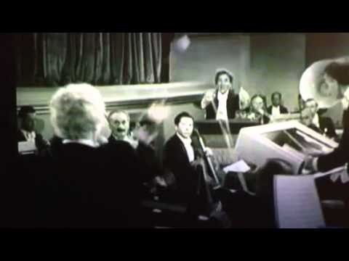
Famous performances
In the Marx Brothers’ 1935 movie A Night At The Opera, the orchestra is supposed to play the overture from ll trovatore, but instead plays “TMOTTBG.”

Slide 13

Harpo Marx on “I Love Lucy” (1955). On the harp, of course.
<

Slide 14
Mickey Mantle, Yogi Berra, Whitey Ford, and Bill “Moose” Skowron (with Jack Norworth) on The Ed Sullivan Show (1958)

Slide 15
Bob Woolf (on his ukelele), Hall of Fame induction ceremony, 1995

Slide 16
Stan Musial (on his harmonica), various Hall of Fame induction ceremonies

Slide 17
Bernie Williams, on guitar, for Derek Jeter’s last game (2014)

Slide 18
Bill Murray (impersonating Daffy Duck) at the World Series at Wrigley Field (2016)

Slide 19
The Theme Song Of The Seventh Inning Stretch
Currently played in every major league ballpark, with some local variations, including the following additional songs:
“Thank God I’m A Country Boy” by John Denver (Baltimore, Atlanta)
“Deep In The Heart Of Texas” (Houston)
“Louie, Louie” (Seattle)
“Beer Barrel Polka” (Milwaukee)

Slide 20
And then there’s Chicago. . . .
While broadcasting for the White Sox, Harry Caray would sing the song in the press box during the seventh inning stretch. He was persuaded to sing it publicly by Bill Veeck, then the Sox owner.
When Harry moved to the Cubs in 1981, he took his seventh inning tradition within him. When Harry became ill, the Cubs engaged a series of “guest singers” to replace him, and have continued to do so since his death in 1998.

Slide 21
People who have led the singing of TMOTTBG at Wrigley Field include:
Sting
Vin Scully

Slide 22
Mr. T.
Mike Ditka (worst rendition ever)

Slide 23
Jeff Gordon (runnerup)
Ozzy and Sharon Osbourne (Dishonorable Mention)

Slide 24
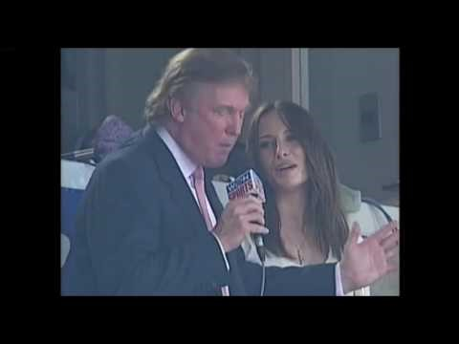
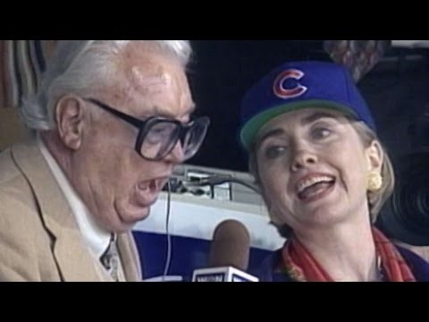
And, to prove it’s a bipartisan tradition. . . .
Donald Trump
Hillary Clinton (Opening Day 1994, when “Tuffy” Rhodes hit three home runs)

Slide 25
The Rest of the Song
Katie Casey was baseball mad
Had the fever and had it bad.
Just to root for the home town crew,
Ev'ry sou* Katie blew.
On a Saturday, her young beau
Called to see if she'd like to go
To see a show but Miss Kate said,
"No, I'll tell you what you can do."
Take me out to the ball game,
Take me out with the crowd
Buy me some peanuts and Cracker Jack,
I don't care if I never get back
Let me root, root, root for the home team,
If they don't win it's a shame
For it's one, two, three strikes, you're out
At the old ball game.

Slide 26
Katie Casey saw all the games,
Knew the players by their first names.
Told the umpire he was wrong,
All along, good and strong.
When the score was just two to two,
Katie Casey knew what to do,
Just to cheer up the boys she knew,
She made the gang sing this song:
(Repeat chorus.)
*A "sou" was slang for a low-denomination coin.
Katie Casey was changed to “Nelly Kelly,” with different lyrics, in a 1927 version of the song.

Slide 27

My favorite version of the song: Carly Simon (1994)
Carly and her family (of the Simon & Schuster publishing company) were friends of Jackie Robinson, who stayed with the Simons while their house in Stamford, CT was being built.
Issued in connection with nine part Ken Burns documentary.
One of the few versions of the song (and the first that I heard) to include all of the verses

Slide 28
A Personal Memoir – my most memorable version of TMOTTBG
In Memoriam
Russel Rosen
1955-2013

