Slide 1
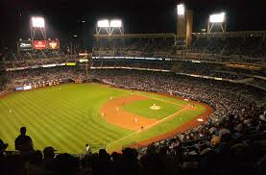
Ted Williams
The Greatest Hitter of All Time?

Slide 2
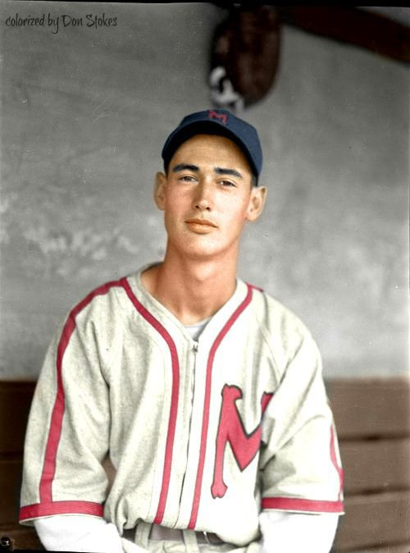
“All I want out of life is that when I walk down the street folks will say “there goes the greatest hitter that ever lived.”
- Ted Williams, age 20
Notes:
Wade Boggs said “Ted Williams is who John Wayne wanted to be when he (John Wayne) was growing up.”

Slide 3
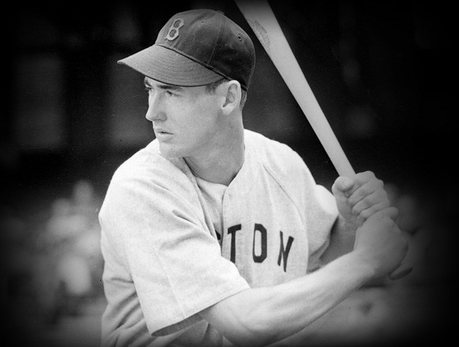
Ted Williams
Won six batting titles
Hit 521 home runs despite missing almost five full seasons due to military service
Was the last batter to hit over .400

Slide 4
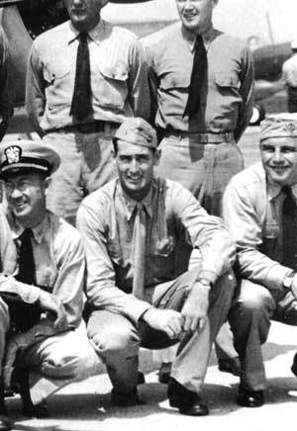
Military Service as Marine Pilot
WWII - missed all of the 1943, 1944 and 1945 seasons
Korean War - missed most of the 1952 and 1953 seasons
His Navy physical revealed that he had 20/10 eyesight
Notes:
Williams credited his hitting success more to focus and discipline than his great eyesight. He flew 39 combat missions in Korea; his wingman for part of that tour was future astronaut John Glenn.

Slide 5
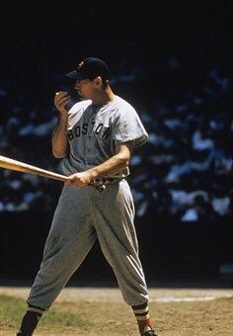
Home Runs
Despite missing five years, Ted finished with 521 HRs
At an average of 37 home runs/season for those five years, he would have hit 706 home runs
At the time, Babe Ruth held the all time home run record with 714 HR
Notes:
Military hero and TOUGH – Broke elbow in first inning of 1950 AS game. Stayed in; went one for four. Surgery next day!

Slide 6
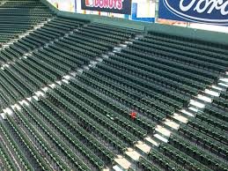
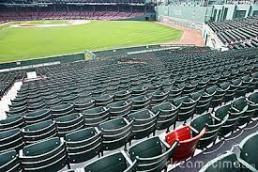
The Red Seat
On June 9, 1946 – Ted Williams hit the longest home run ever at Fenway Park. The homer was estimated at 502 feet.
Notes:
Home run bounced off of the straw hat of 56 year Joe Boucher. Red Sox painted the seat red a few years later in honor of the home run.

Slide 7
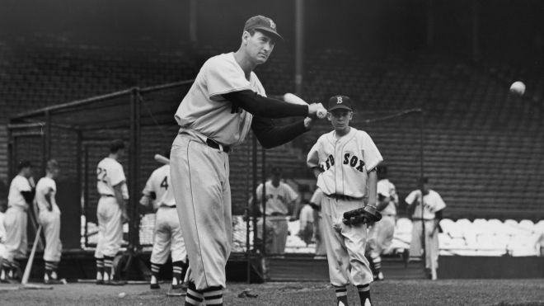
The Last .400 hitter
He went into the last day of the 1941 season – a double header – hitting .39955. Rather than rounding up his average – he played both games.
Notes:
He went 6 for 8 on the last day, raising his average to .406

Slide 8
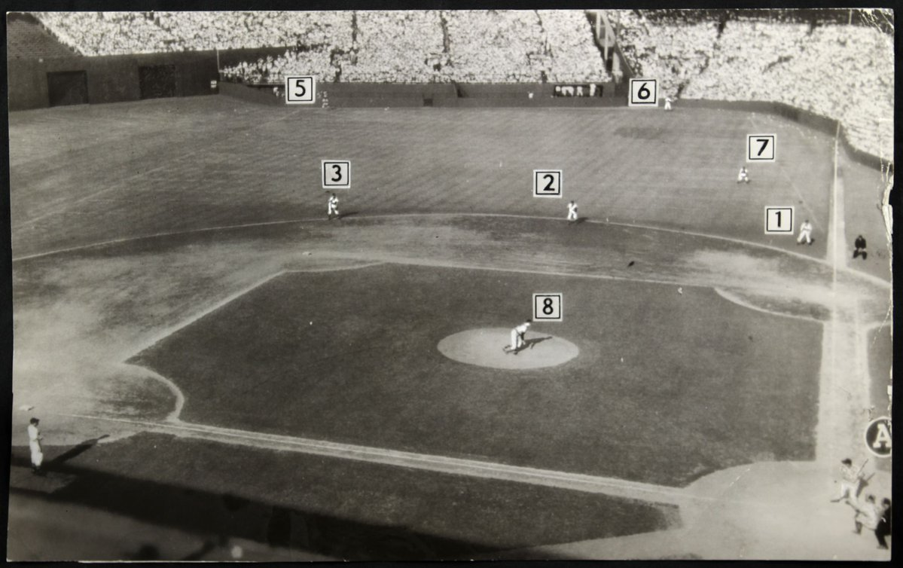
Ted Williams Shift
In 1946, Indians manager Lou Boudreau was the first manager to use the “Ted Williams’ Shift”
Notes:
To combat the shift, Williams did not want to alter his swing. As a result, he experimented with a heavier bat to slow down his swing. He also noticed a mis-aligned home plate at Fenway and a batter’s box that was not level in Kansas City.

Slide 9
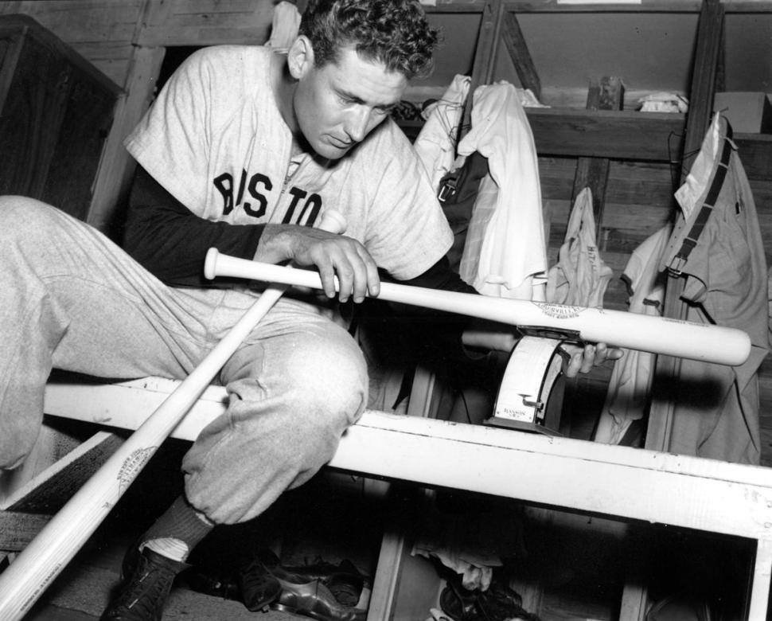
A Perfectionist
Notes:
To combat the shift, Williams did not want to alter his swing. As a result, he experimented with a heavier bat to slow down his swing. He also noticed a mis-aligned home plate at Fenway and a batter’s box that was not level in Kansas City.

Slide 10
Things You Didn’t Know about Ted Williams
Notes:
To combat the shift, Williams did not want to alter his swing. As a result, he experimented with a heavier bat to slow down his swing. He also noticed a mis-aligned home plate at Fenway and a batter’s box that was not level in Kansas City.

Slide 11
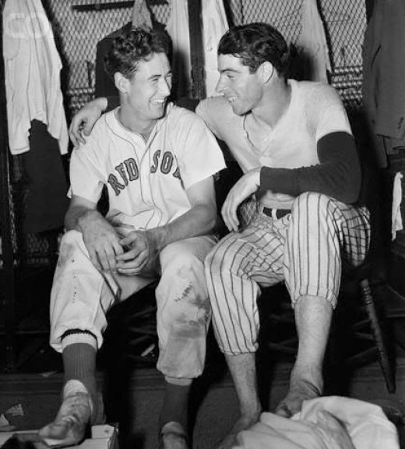
He was almost traded to the NY Yankees
Notes:
After a Yankee home game in 1947, Red Sox owner Tom Yawkey and Yankees owner Dan Topping went drinking at Toots Shor’s bar.

Slide 12
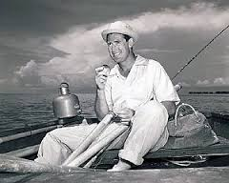
He was almost retired after 1954 season
Notes:
Because of divorce proceedings, Williams did not report to the Red Sox in 1955 until May 28th (game 42). He ended up hitting .356 with 28 HRs and 83 RBIs.

Slide 13
He almost hit .400 twice
Notes:
In 1957, at age 39, he fell five hits short of batting .400 (he hit .388)

Slide 14
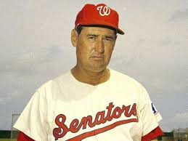
He was AL Manager of the Year in 1969
Notes:
In 1968, the Senators finished in last place. In his first season as manager (1969), Williams led them to a 4th place finish with a 86-76 record – with most of the same players.

Slide 15
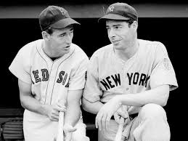
Is a “walk as good as a hit”?
Notes:
DiMaggio has one of most famous records of all time – hitting in 56 consecutive games. In 1949, Williams reached base an incredible 84 consecutive games.

Slide 16
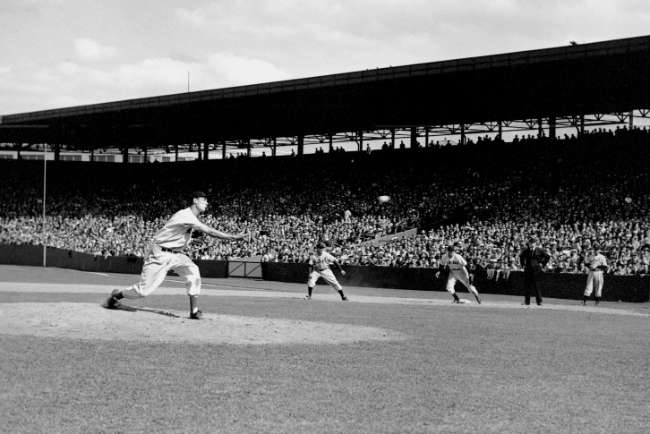
Ted pitched two innings in relief on August 24, 1940
Notes:
Gave up one run in two innings as the Sox lost 12-1 to Detroit. He struck out one batter

Slide 17
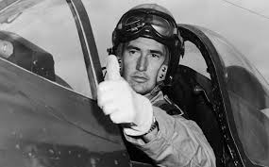
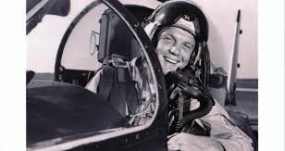
John Glenn saved his life
Notes:
During the Korean War, Williams’ F9F Panther jet was hit by anti-aircraft fire and burst into flames. Glenn flew by and pointed skyward. Flying into thinner air put out the fire.

Slide 18
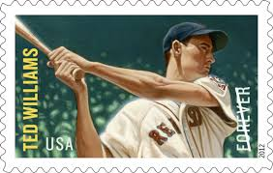
Harvard wanted to give him honorary degree in 1991
Notes:
Curt Gowdy called Williams the “smartest person I ever met” To honor his achievements in hitting, aviation, fishing and photography – Harvard proposed giving him an honorary degree in 1991. Williams declined saying he “didn’t earn it and it’s not the right thing to do.”

Slide 19
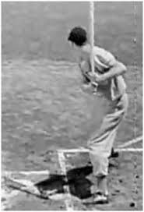
Nicknames
The Splendid Splinter
Thumper
Teddy Ballgame
The Kid

Slide 20
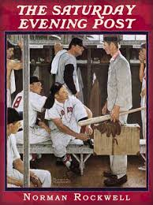
The Rookie
Notes:
Norman Rockwell cover of the Saturday Evening Post on March 2, 1957. Williams was NOT “The Rookie” but is pictured in center of picture. Mickey McDermott, rookie picture, was supposedly “The Kid”

Slide 21
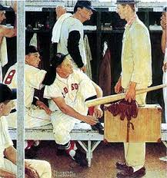
Painting sold for $22,565,000 in 2014
Notes:
Rockwell paid a local high school student $60 to pose for the picture of Mickey McDermott. Frank Sullivan, Sammy White, Jackie Jensen and Billy Goodman also posed. Williams did not – Rockwell used baseball cards and photos to create his image.

Slide 22
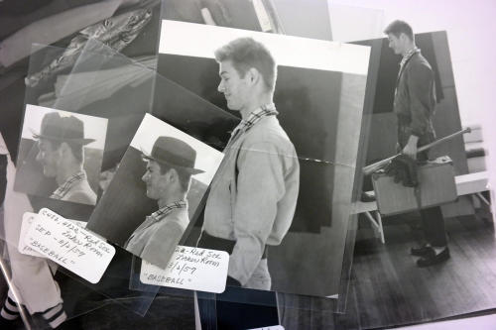
Rockwell paid a local high school student $60 to pose as McDermott
Notes:
Rockwell paid a local high school student $60 to pose for the picture of Mickey McDermott. Frank Sullivan, Sammy White, Jackie Jensen and Billy Goodman also posed. Williams did not – Rockwell used baseball cards and photos to create his image.

Slide 23
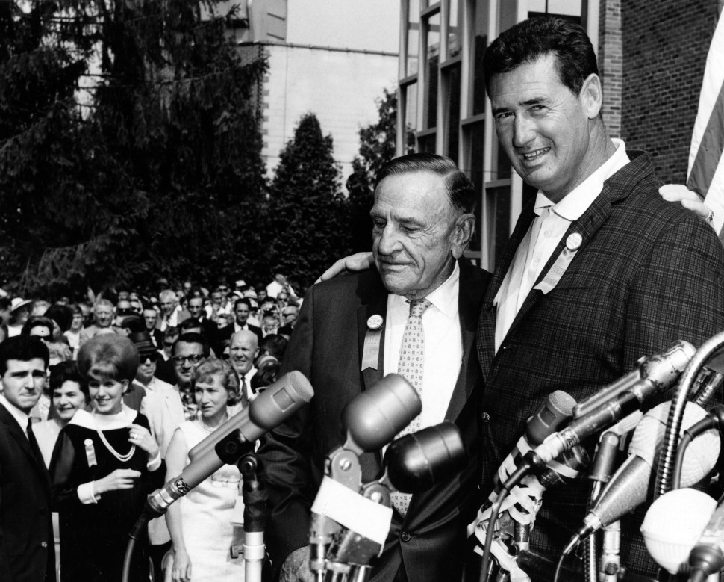
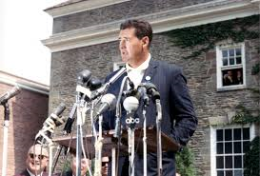
Hall of Fame
Ted Williams and Casey Stengel were inducted into the Hall of Fame in 1966
Notes:
Williams and Casey Stengel were inducted into the baseball HOF in 1966. Williams was only the 8th player elected on the first ballot.

Slide 24
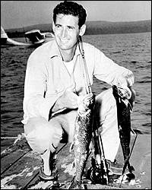
Hall of Fame II
Notes:
Williams and four others were inducted into the International Game Fish Association's Fishing Hall of Fame in Dania Beach, Fla. In February 2000.

Slide 25
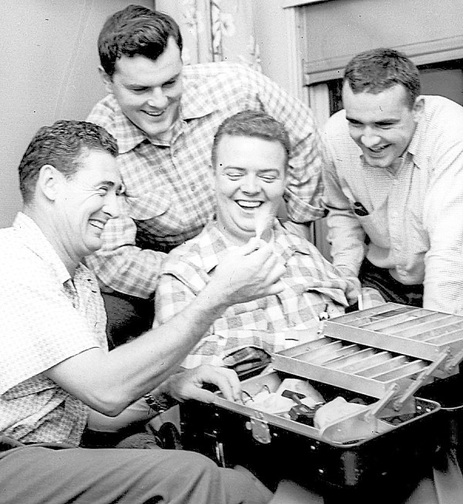
1954 Fishing Trip to Bangor Maine
Notes:
Ted Williams (left) made a Bangor and Aroostook Railroad fishing excursion in September 1954, right after the end of the baseball season.

Slide 26
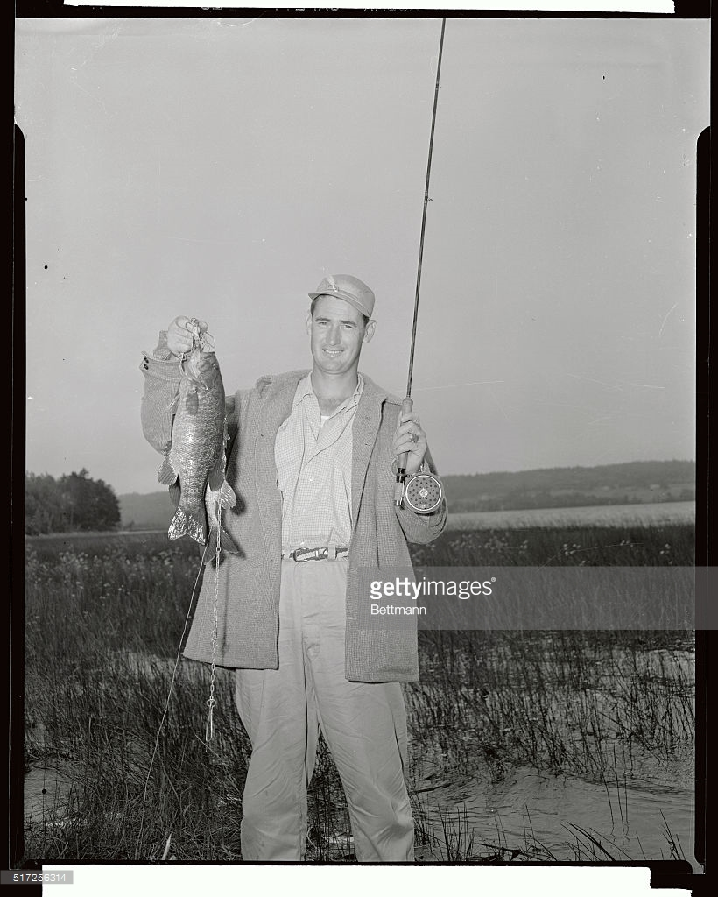
Fishing Trip to Round Pond, Maine 1950

Slide 27
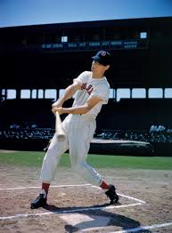
He Really Was the Greatest
Voted to the AL All Star team 19 times
American League MVP two times
Won the Triple Crown twice (and was NOT voted MVP either time!)
Won batting title as 39 year old in 1957 – hitting .388. Won again in 1958 (the oldest player ever to lead league in batting).
Notes:
Joe Gordon won MVP in 1942; Joe DiMaggio in 1947. Only two players have had multiple Triple Crown seasons – Williams and Rogers Hornsby

Slide 28
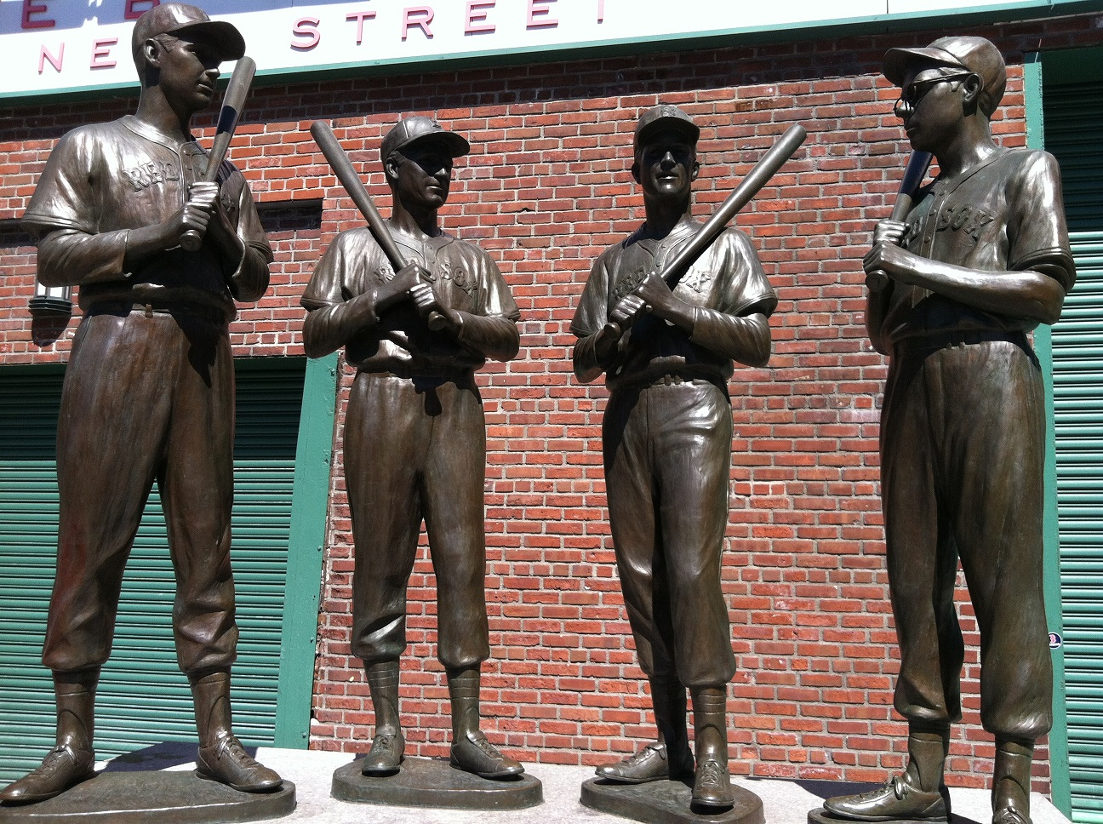
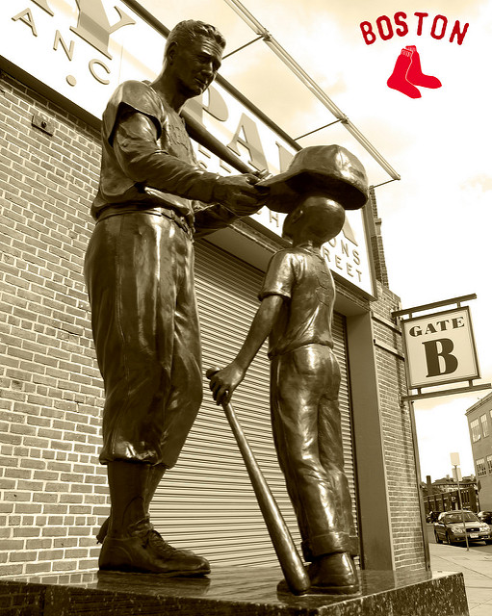
Teammates & Jimmy Fund Statues
Notes:
Since its founding in 1948, the Jimmy Fund has raised more than $750 million to fight cancer in children.

Slide 29
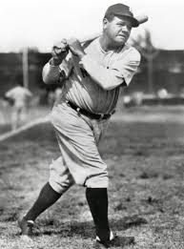
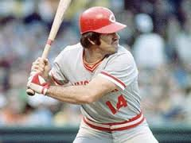
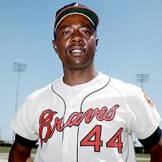
Who Do You Think was the Greatest Hitter?

