Slide 1
The Worst Team in Baseball
1950 - 1959

Slide 2
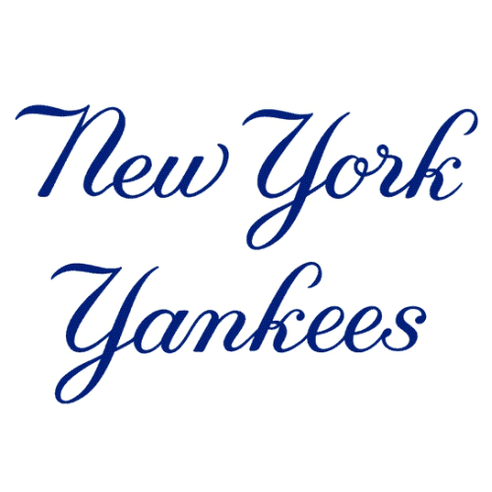

The Golden Age of Baseball
8 AL Championships
6 World Series

Slide 3
From 1950-1959, they had the worst winning percentage in all of baseball - losing 60% of their games.
Six times they finished last in their league, and next to last in two more seasons.
They lost 100 or more games 3 years in a row.
The Worst Team in Baseball
Hint: By the end of the decade they were World Series Champions

Slide 4
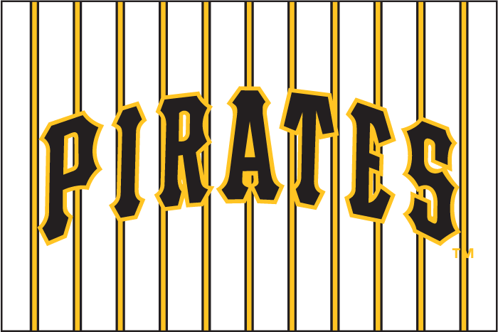
The Pittsburgh Pirates
1950 -1959

Slide 5
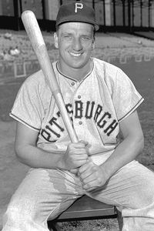
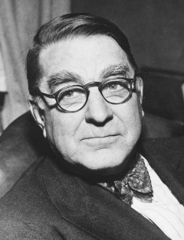
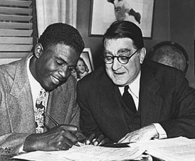
1950 Pirates
Ralph Kiner - 47 HR / 122 RBI
5th consecutive year leading league
Pirates lose 96 games
Last place finish
Minor league prospects:
Frank Thomas
Gus Bell
Bob Friend
Vernon Law

Slide 6
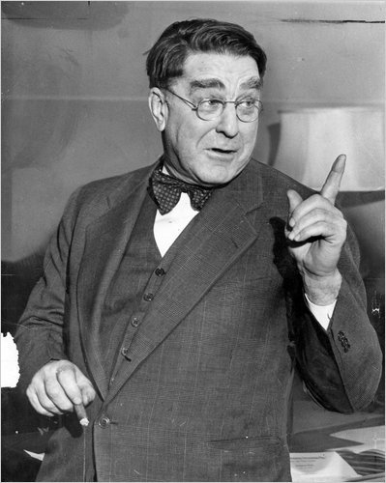
Branch Rickey’s 5 Year Plan
Pirates will produce a champion within 5 years

Slide 7
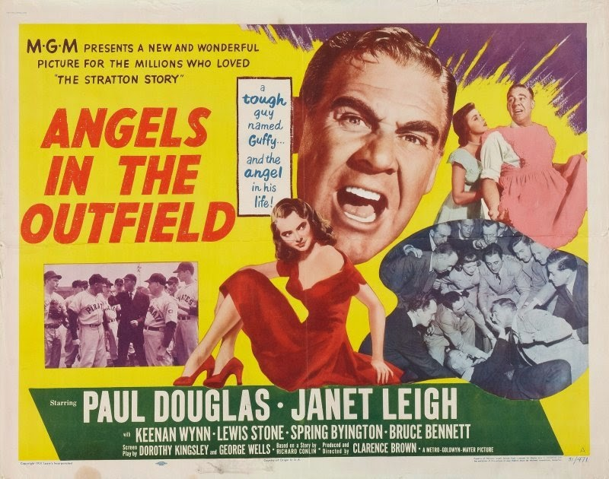
1951 Pirates
Heaven Help the Pirates
Pirates “improve”
by 6 games,
and finish 7th
Korean War impacts player development
Pirates are nearly bankrupt
Player signings:
Dick Stuart
Bob Skinner
Dale Long

Slide 8
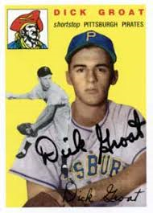
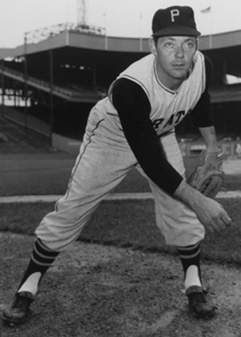
1952 Pirates
The Rickey Dinks
Rickey’s Rinky Dinks lose 112 games
Last in every batting category
Last in every pitching category
Last in fielding
New players signed:
Dick Groat
Roy Face

Slide 9
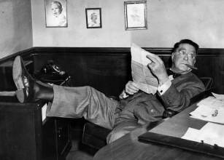
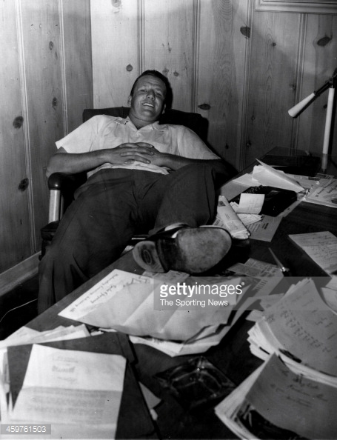
1953 Pirates
“ We can finish in last place without you”
Kiner’s Stats 1946-52:
294 HR / 772 RBI
Led both leagues
Kiner takes pay cut in March
Rickey trades Kiner in
June
Pirates lose 104 games
Finish in last place without Kiner

Slide 10
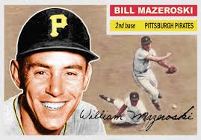
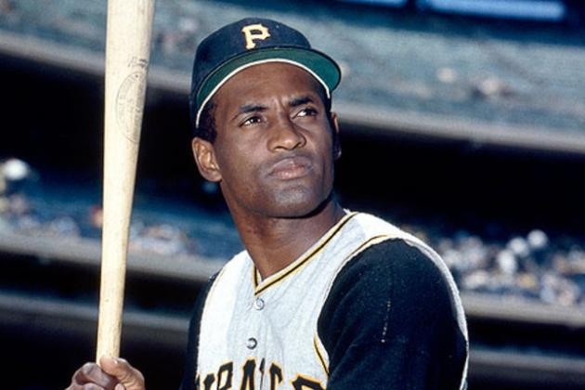
1954 Pirates
Bill Mazeroski and Roberto Clemente
Pirates lose 101 games
Rickey is on the hot seat
Frank Thomas leads team in hitting; Bob Skinner makes debut
Pirates sign 17 yr old Bill Mazeroski
Clemente is drafted from Dodgers

Slide 11
1955 Pirates
End of the 5 Year Plan
Rickey’s Achievements
Stabilized Pirates farm system
Established instructional camp in 1953
Introduced batting helmets
Pirates finish last – lose 99 games
From 1951-1955:
269W – 501L
Lost 65% of games played
One 7th place finish, four times in last place

Slide 12
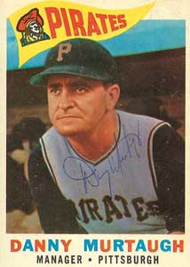
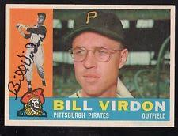
1956 - 1957
Small Steps
Joe Brown replaces Rickey as General Manager
Pirates finish 7th in 1956 and tied for 8th in 1957
New faces on field:
Bill Virdon in CF
Danny Murtaugh is manager

Slide 13
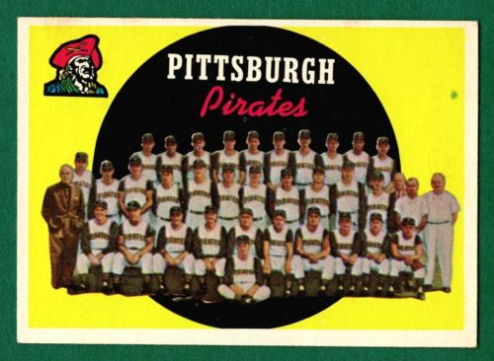
1958 - 1959
Winning Seasons
2nd place 1958!
4th in 1959
Back-to-back winning seasons for first time in 15 years
3rd best pitching staff in National League
New Faces:
Smoky Burgess
Don Hoak
Harvey Haddix

Slide 14
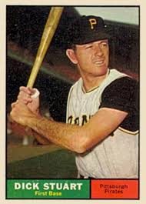
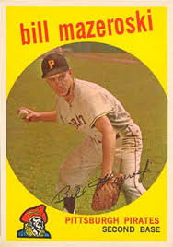
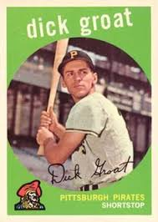
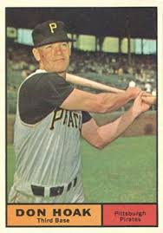
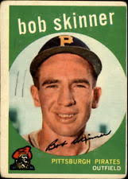
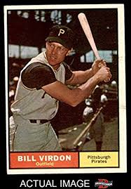
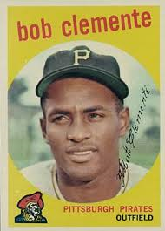
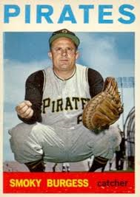
1959 Starting Lineup

Slide 15
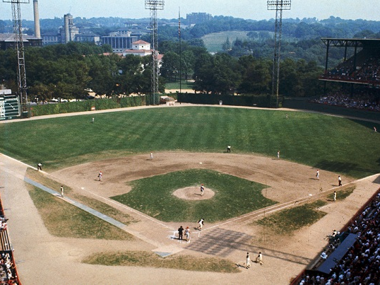
1960 World Series at Forbes Field
https://www.youtube.com/watch?v=65Og0gUKfvc

