Slide 1
The Year in Baseball: 1950
Notes:
We’re going to go a little further back into the Fabulous Fifties – to 1950.

Slide 2
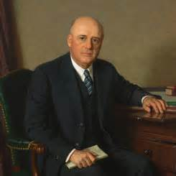
1950 -- Off the Field:
President, Chairman of Joint Chiefs, and House Speaker
Notes:
Our President was Harry Truman from Missouri; the Chairman of the Joint Chiefs was Omar Bradley; and the Speaker of the House of Representatives was from Bonham, Texas – Sam Rayburn.

Slide 3
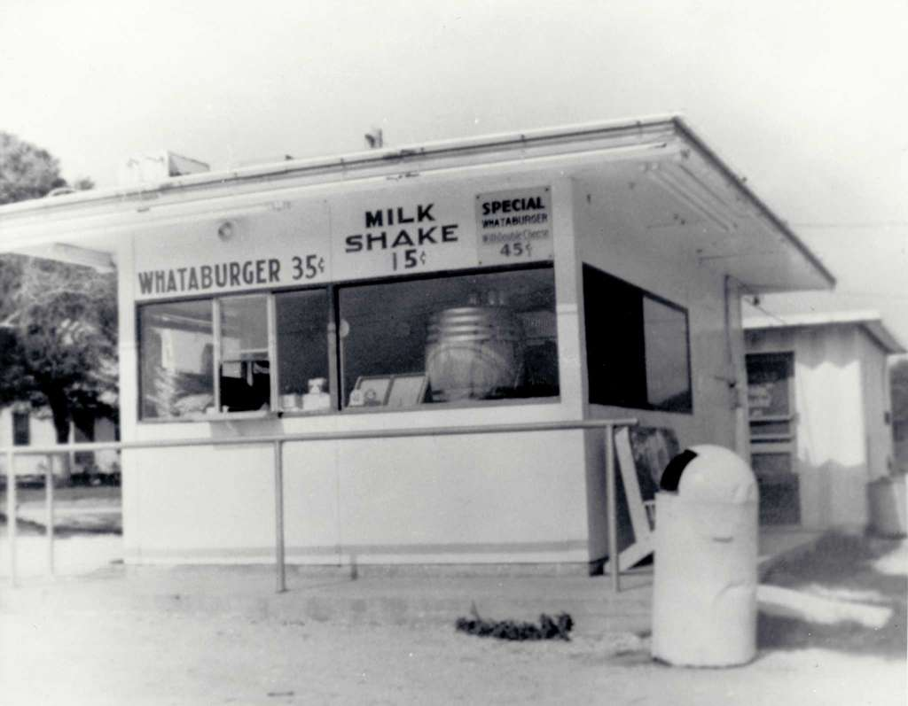
1950 -- Off the Field:
Consumer prices:
“I’ll have a burger and a shake.”

Slide 4
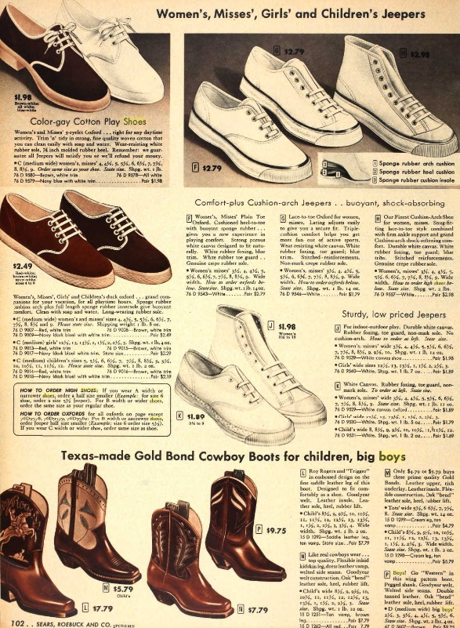
1950 -- Off the Field:
Consumer prices:
“Mom, I need a new pair of sneakers for the summer.”

Slide 5
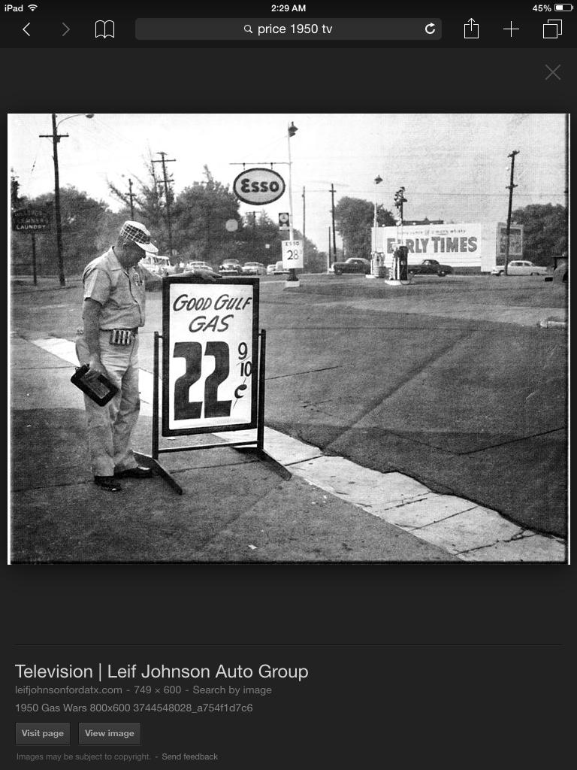
1950 -- Off the Field:
Consumer prices:
Gas War -“Fill ‘er up!”
What is the lowest price you’ve ever paid for gasoline?

Slide 6
1950 -- Off the Field:
Baseball Gear
from
1950s era Sears Catalogs

Slide 7
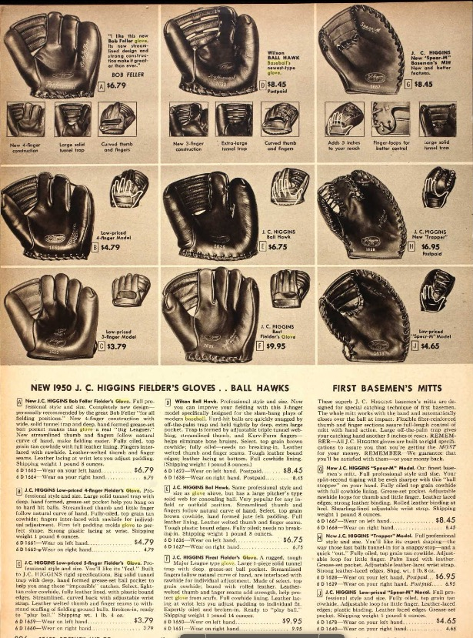
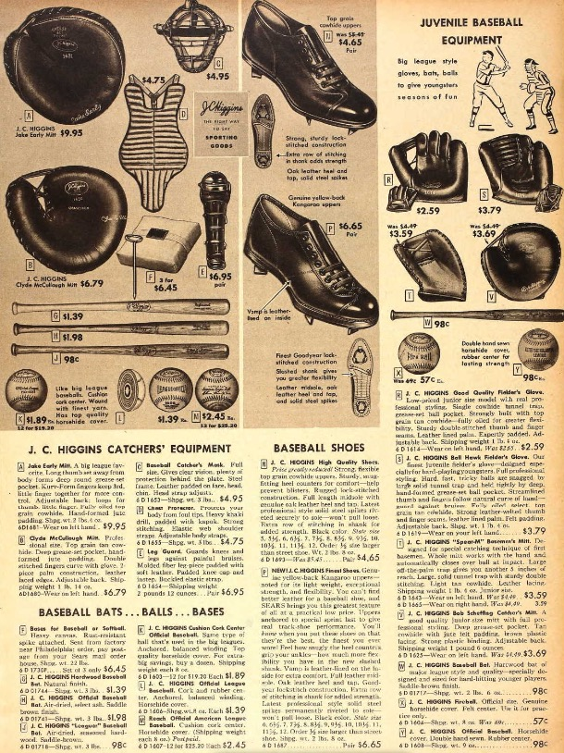

Slide 8
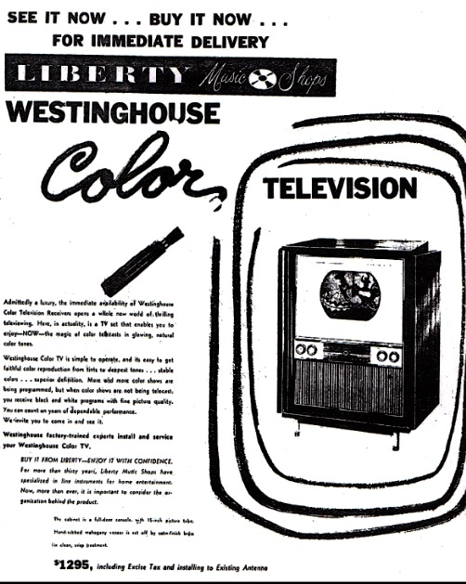
1950 -- Off the Field:
Television – still in its infancy, there were 107 TV stations broadcasting in the U.S. TV sets in use jumped 60% from 5 to 8 million during the year.
Some of the popular shows had transitioned from radio.
Cisco Kid
Life of Riley
Jack Benny Show
Howdy Doody
Ed Sullivan
… and … popular on radio, a hit on TV, and STILL in syndication today …
https://www.youtube.com/watch?v=Td4RHvyAFsM

Slide 9
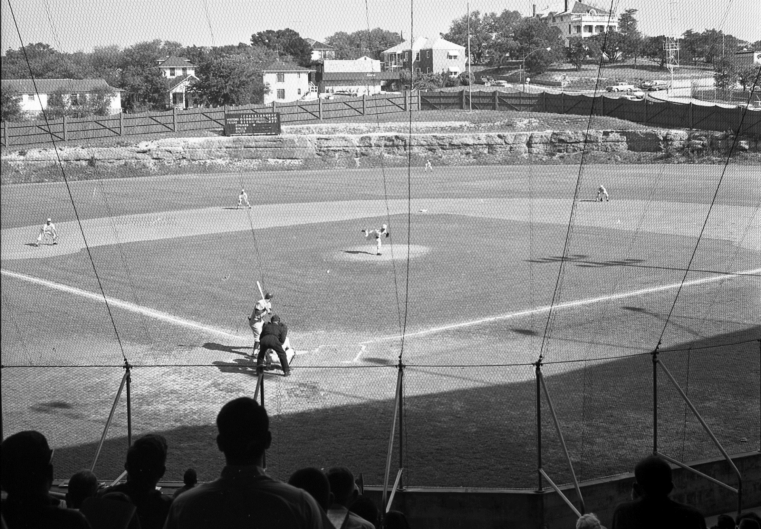
1950 -- On the Field: Spring Baseball
The 1950
University of Texas Longhorns Baseball Team
won the
Southwest Conference and the
College World Series
Clark Field
Notes:
The Longhorns played at Clark Field, at the corner of 23rd and Red River and featured the Billy Goat Hill.

Slide 10
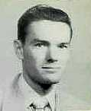
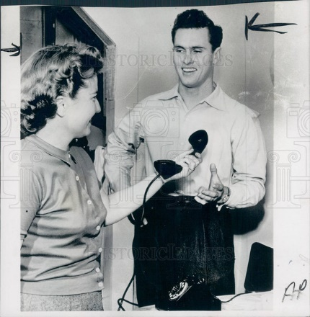
1950 -- On the Field: Spring Baseball
1950 Texas Longhorns All-Americans
Bob Brock OF
Charlie Gorin P
Murray Wall P
First Team all SWC
Kal Segrist IF
Ben Tompkins 3B
Frank Womack OF
Dick Risenhoover OF
Notes:
Charlie Gorin and Murray Wall both pitched for the Braves. Kal Segrist was a utility infielder for the Yankees and Orioles – he was head baseball coach at Texas Tech from ‘68 – ’83. Ben Tompkins was starting QB at UT in 1950, played 8 years of minor league baseball and was an NFL ref for 20 years, in two Super Bowls. Risenhoover broadcast Texas Rangers games in the ‘70s.

Slide 11
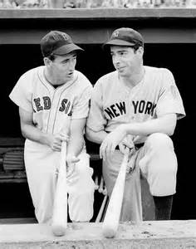
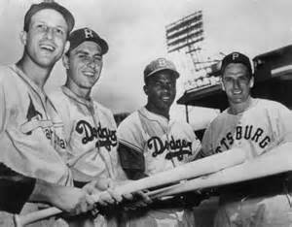
1950 – On the Field
All-Star Game
This was the first All-Star Game to go extra innings
https://www.youtube.com/watch?v=1Q9F728fYUQ
Notes:
NL – Stan Musial, Gil Hodges, Jackie Robinson, Ralph Kiner. AL – Ted Williams and Joe DiMaggio.

Slide 12
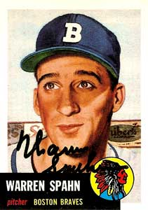
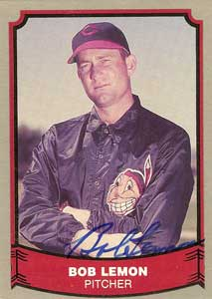
1950 -- On the Field:
League Pitching Leaders:
21-17 3.16 ERA
25 complete games 293 innings pitched
191 strikeouts
23-11 3.84 ERA
22 complete games 288 innings pitched

Slide 13
1950 -- On the Field:
“Spahn and Sain and …..”
“First we’ll use Spahn, then we’ll use Sain, Then an off day, followed by rain. Back will come Spahn, followed by Sain And followed, we hope, by two days of rain.”
Gerry Hern, Boston Post, September 14, 1948
21 - 17
20 - 13
A tough pitching duo

Slide 14
1950 – On the Field:
League Leaders in HR
Ralph Kiner – 47 HR
Al Rosen – 37 HR
Pirates’ GM Branch Rickey to Ralph Kiner, upon Kiner’s request for a substantial raise after leading the league in HR, “Son, we finished in last place with you, and we can finish in last place without you.”
Notes:
Mickey Mantle hit 37 homers to lead the AL. He also led the league in triples, walks, and SLG.

Slide 15
1950 – On the Field:
League Batting Leaders
Billy Goodman .354
Stan Musial .346
Also led league with .596 slugging average
Notes:
Mickey Mantle hit 37 homers to lead the AL. He also led the league in triples, walks, and SLG.

Slide 16
1950 -- On the Field:
League MVPs:
Jim Konstanty p
74 Games, 16 - 7 with 22 Saves, ERA 2.66
First reliever to win MVP
Phil Rizzuto ss
.324 BA, 125 Runs

Slide 17
1950 -- On the Field: Final Regular Season Standings
1950 National League Team Standings
Team | Wins | Losses |  | GB
Philadelphia | 91 | 63 |  | 0
Brooklyn | 89 | 65 |  | 2
New York | 86 | 68 |  | 5
Boston | 83 | 71 |  | 8
St. Louis | 78 | 75 |  | 12 1/2
Cincinnati | 66 | 87 |  | 24 1/2
Chicago | 64 | 89 |  | 26 1/2
Pittsburgh | 57 | 96 |  | 33 1/2
1950 American League Team Standings
Team | Wins | Losses |  | GB
New York | 98 | 56 |  | 0
Detroit | 95 | 59 |  | 3
Boston | 94 | 60 |  | 4
Cleveland | 92 | 62 |  | 6
Washington | 67 | 87 |  | 31
Chicago | 60 | 94 |  | 38
St. Louis | 58 | 96 |  | 40
Philadelphia | 52 | 102 |  | 46

Slide 18
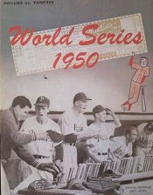
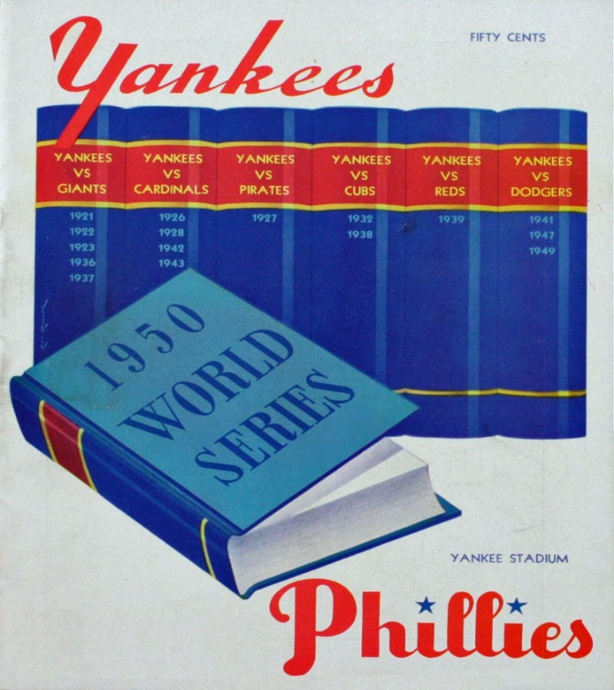
1950 World Series
Series began on
October 4, 1950
at
Shibe Park
Philadelphia

Slide 19
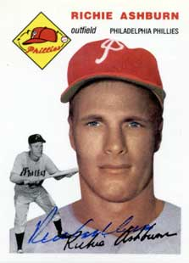
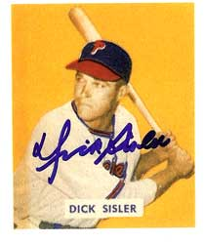
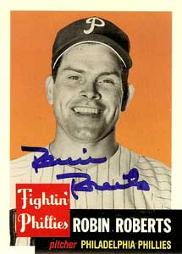
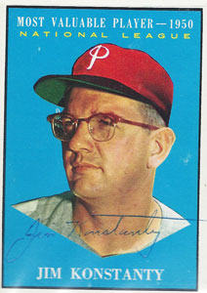
1950 World Series
A few Phillies
“Whiz Kids”
players
Notes:
Key “Whiz Kid” Phillies – CF Richie Ashburn, ace pitcher Robin Roberts, LF Dick Sisler, MVP and key reliever Jim Konstanty, and their 1B – about whom we’ll talk more later.

Slide 20
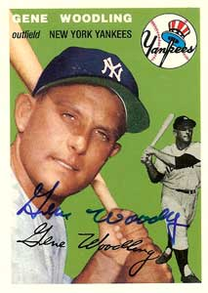
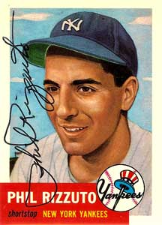
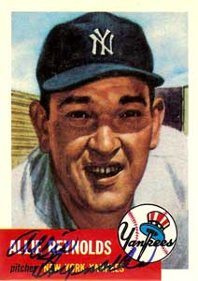
1950 World Series
Key
Yankees
Notes:
top of batting order – Woodling, Rizzuto, DiMaggio, and Berra. Pitchers Vic Raschi, Allie Reynolds, Eddie Lopat and rookie Whitey Ford

Slide 21
1950 World Series
https://www.youtube.com/watch?v=Eem3J4H-gO0

Slide 22
More on the Phillies’ first baseman -- Eddie Waitkus
Notes:
The Whiz Kid Phillies’ first baseman was veteran Eddie Waitkus. Waitkus was shot by a deranged female fan at a Chicago hotel in June, 1949.

Slide 23
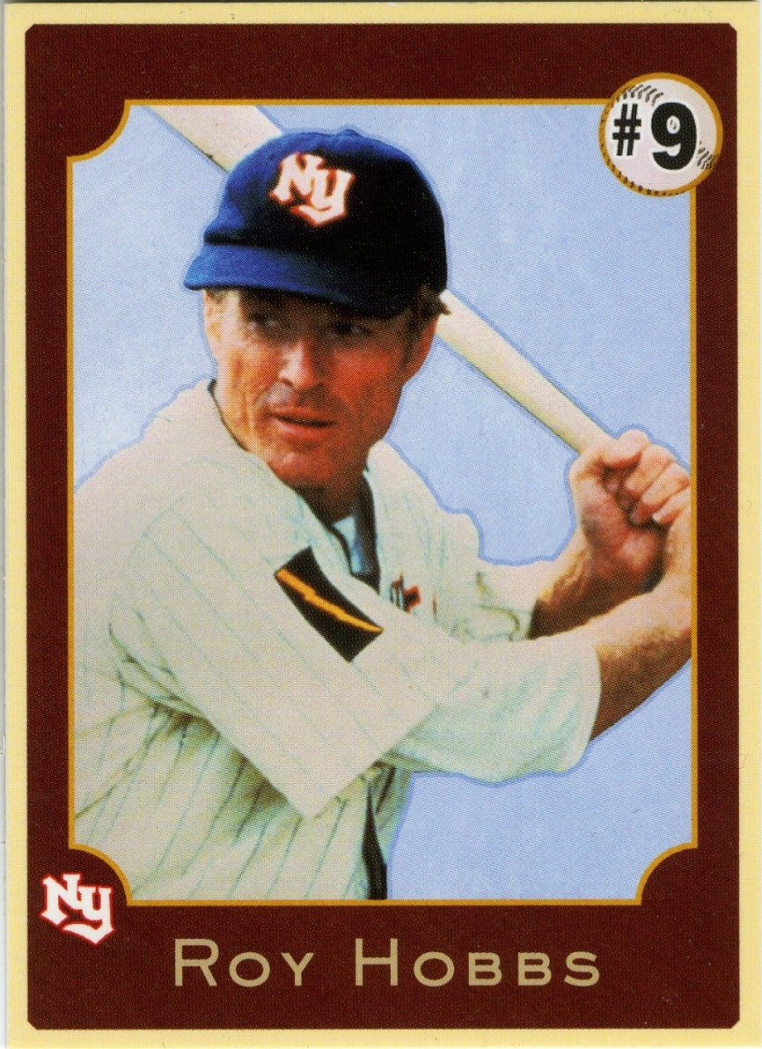
Phillies’ first baseman Eddie Waitkus’
misfortune was an inspiration
for …
the character Roy Hobbs in “The Natural”
Notes:
Waitkus misfortune was part of the inspiration for Bernard Malamud’s 1952 novel “The Natural”. The book was made into a movie in 1984 starring Robert Redford as Roy Hobbs.

