Slide 1
The Year in Baseball:
1955
Notes:
Let’s reminisce about the Fabulous Fifties, and in particular on- and off-the-field in 1955

Slide 2
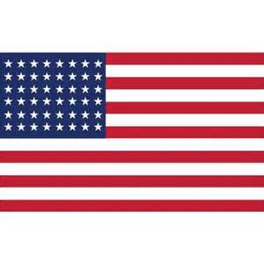
1955 -- Off the Field:
Notes:
Here’s a picture of Old Glory in 1955. How many stars were on that flag? What states were not yet in the union? (Alaska admitted 3 January 1959, and Hawaii 21 August 1959)

Slide 3
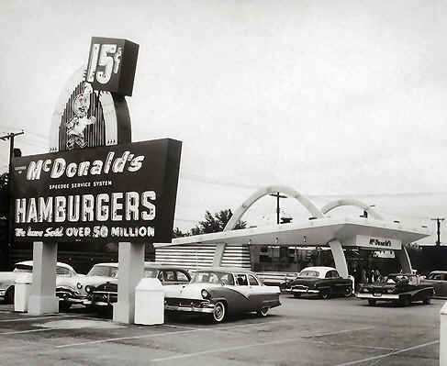
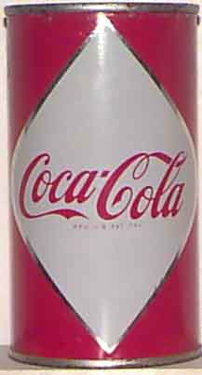
1955 -- Off the Field:
Notes:
In 1955 McDonalds’s was incorporated and the first franchised McDonald’s opened in Des Plains, Illinois. Ray Kroc, who was in charge of expansion eventually bought the company from the McDonald brothers and later also bought the San Diego Padres baseball team. The first cans of Coca Cola were test-marketed and also shipped to U.S. servicemen overseas.

Slide 4
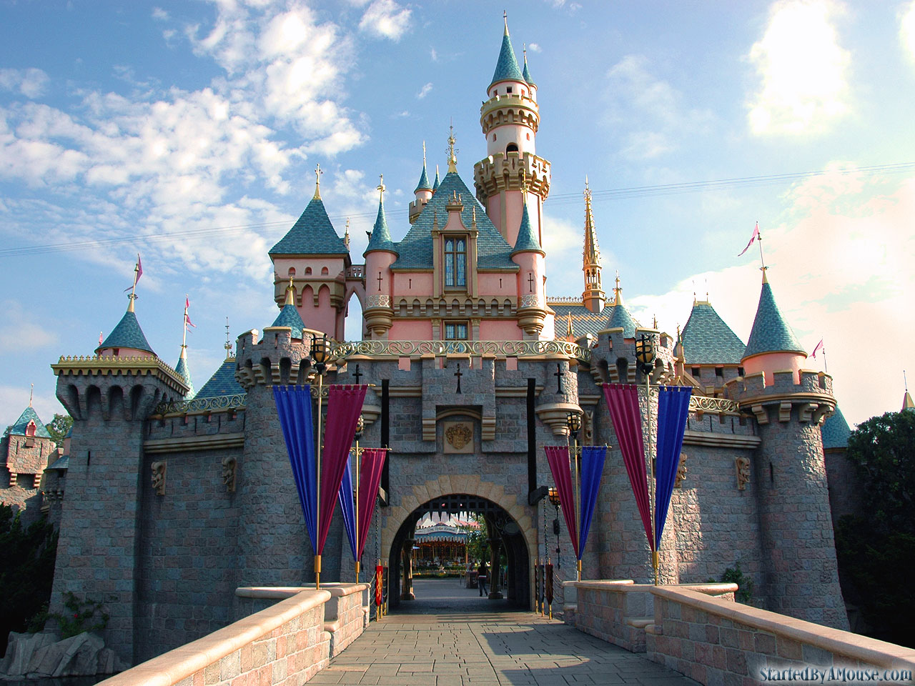
1955 -- Off the Field:
A Magical Kingdom opens in Anaheim, California
Notes:
Disney Land opened in California. Did anyone go there in the ‘50s ??

Slide 5
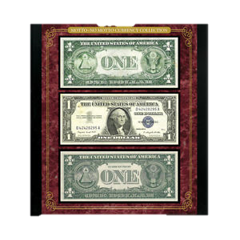
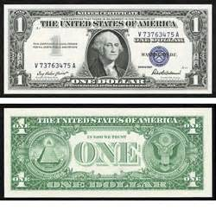
1955 -- Off the Field:
OLD
Legislation was passed to make a change to U.S. paper money.
Can you spot the change?
NEW
Notes:
Pass out some dollar bills for this item. Legislation was passed in 1955 to make a historic change to U.S. paper money. Can you spot the difference on the reverse of the $1 bill ?? Answer: The 1955 legislation added “In God We Trust” to paper currency. Also mention that the bills were “Silver Certificates” – could be redeemed for silver dollars until the mid-1960s.

Slide 6
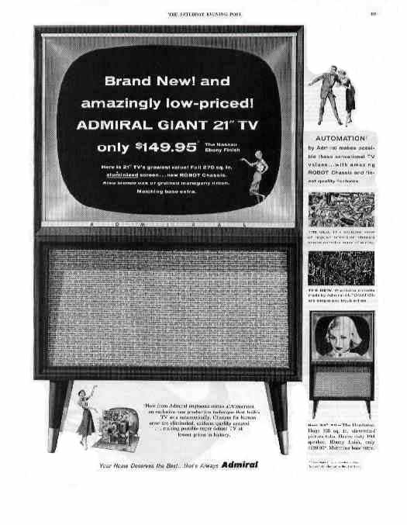
1955 -- Off the Field:
Television:
39 million sets in the U.S.
2 of 3 households had a TV
What were some of your favorite mid-50’s
TV shows?

Slide 7
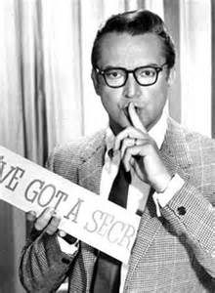
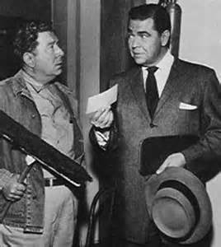
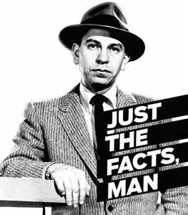
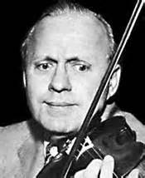
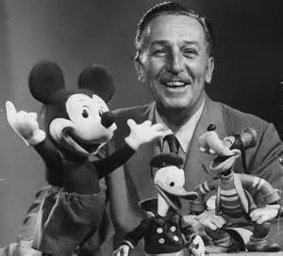
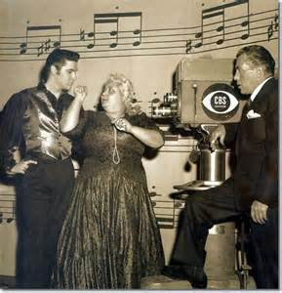
1955 -- Off the Field:
Popular TV shows:
Notes:
10. I’ve Got a Secret; 9. The Millionaire; 8. Dragnet; 5. Jack Benny Show; 4. Walt Disney Show; 3. Ed Sullivan Show (Elvis’ first appearance set a TV record with estimated 60million viewers)

Slide 8
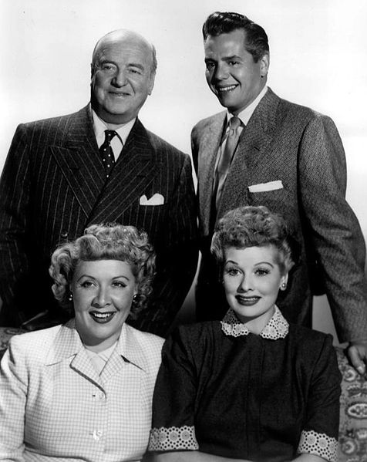
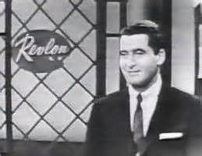
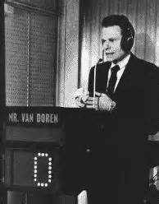
1955 -- Off the Field:
The top two TV shows of 1955
https://www.youtube.com/watch?v=-t4ql-r406Q
Notes:
#2 – I Love Lucy – you can still see if on TV today. #1 – The $64,000 Question. Contestants could answer for 2,4,8, 16, 32, and 64,000 – later got in trouble for giving answers to contestants.

Slide 9
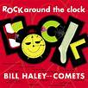
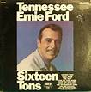
1955 – Off the Field
Two longest-
running songs
on the hit parade
https://m.youtube.com/watch?v=EkRYuMqw-B0
Notes:
Anyone want to sing ?

Slide 10
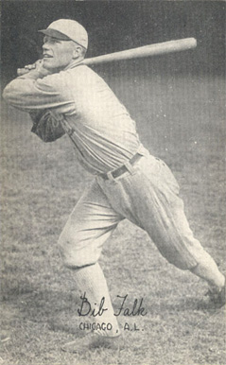

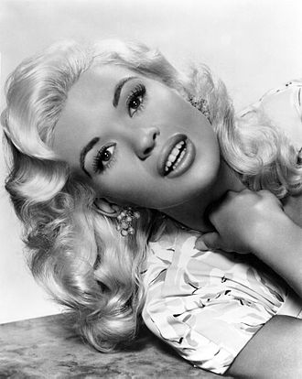
1955 -- On the Field:
Spring Baseball
University of Texas Longhorns Baseball: 10-13-1 overall, 7-8-1 in SWC
Catcher played in the
Majors for the Phillies
February Playmate of Month
UT Head Coach was a
White Sox outfielder
Notes:
1955 was an off-year for baseball at Texas. The team was again coached by Bibb Falk. Mack Burk was the only player who made the majors. Texas-Ex Jayne Mansfield appeared in Playboy.

Slide 11




1955 -- On the Field:
These future Hall-of-Famers made their rookie debut:
Notes:
Sandy Koufax, Harmon Killebrew (with Senators), Roberto Clemente, Brooks Robinson

Slide 12
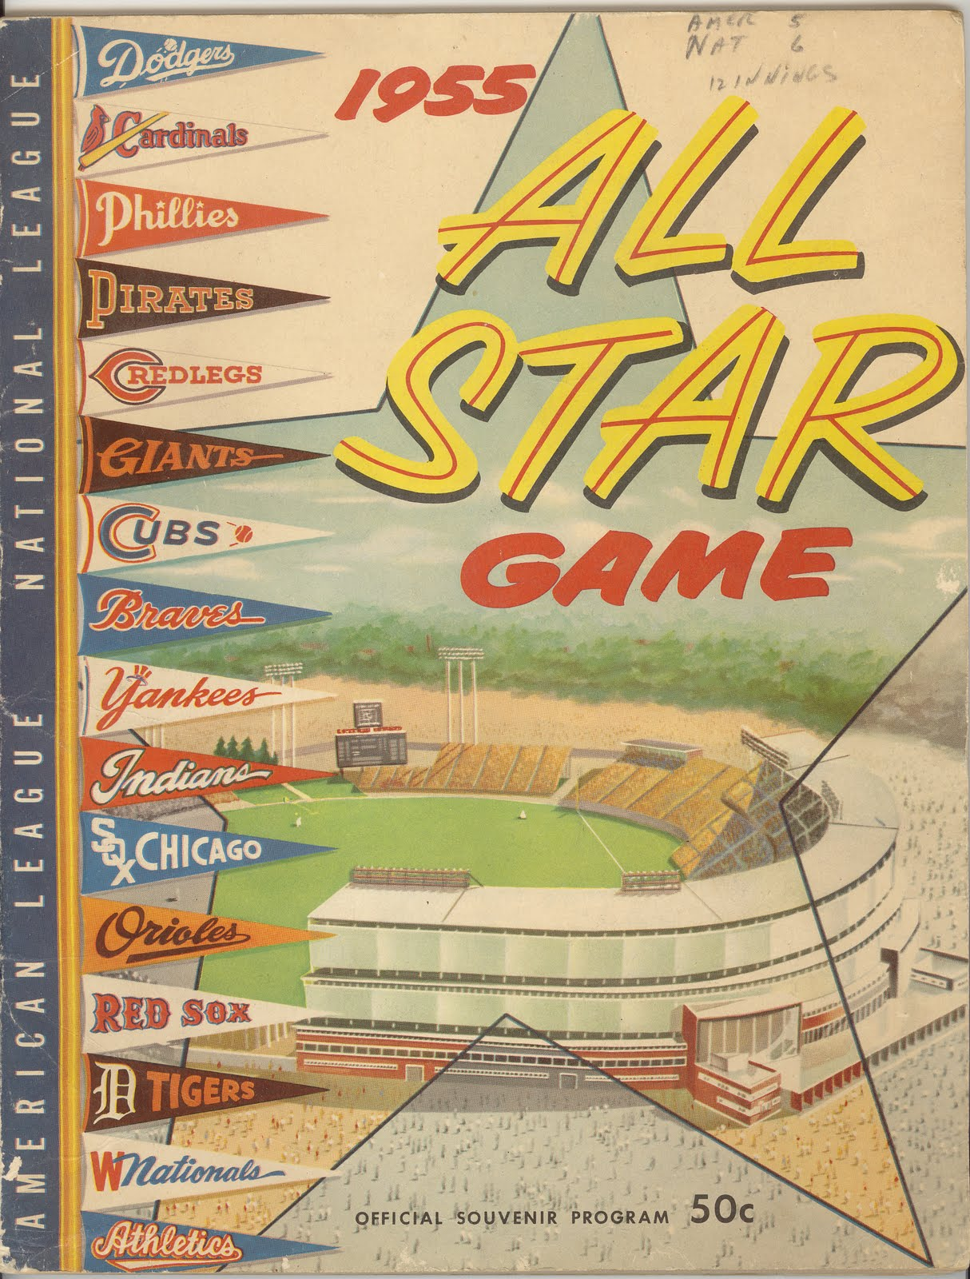




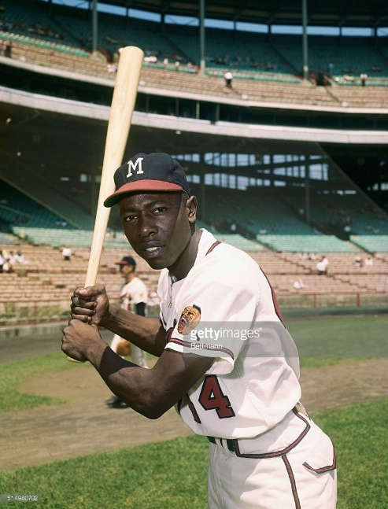

1955 -- On the Field:
http://m.mlb.com/news/article/21753016/
Notes:
The 1955 All-Star game, held at County Stadium in Milwaukee, was one of the greatest All-Star games ever. The American League jumped on Robin Roberts in the first – with Mickey Mantle hitting a three-run homer to drive in himself, Ted Williams, and Nellie Fox. The AL led after the top of the first, 4-0. The NL chipped away, and Henry Aaron tied the game in bottom 8th with an RBI single. Game went to extra innings, and here’s what happened.

Slide 13
1955 -- On the Field:
Final Regular Season Standings
1955 National League Team Standings
Team | Wins | Losses |  | GB
Brooklyn | 98 | 55 |  | 0
Milwaukee | 85 | 69 |  | 13½
New York | 80 | 74 |  | 18½
Philadelphia | 77 | 77 |  | 21½
Cincinnati | 75 | 79 |  | 23½
Chicago | 72 | 81 |  | 26
St. Louis | 68 | 86 |  | 30½
Pittsburgh | 60 | 94 |  | 38½
1955 American League Team Standings
Team | Wins | Losses |  | GB
New York | 96 | 58 |  | 0
Cleveland | 93 | 61 |  | 3
Chicago | 91 | 63 |  | 5
Boston | 84 | 70 |  | 12
Detroit | 79 | 75 |  | 17
Kansas City | 63 | 91 |  | 33
Baltimore | 57 | 97 |  | 39
Washington | 53 | 101 |  | 43
Notes:
Remember there were only 8 teams in each league in 1955. The Boston Braves had moved to Milwaukee in ‘53; the St. Louis Browns had moved to Baltimore in ’54; the Athletics had moved to Kansas City in ‘55. There not yet any teams on the West Coast. Here’s how the regular season ended up …

Slide 14


1955 -- On the Field:
League Most Valuable Players:
Notes:
Dodgers catcher Roy Campanella won his third MVP (also ‘51 and ‘53). He hit .318 with 32 HR and drove in 107 runs batting clean-up in the Dodgers’ lineup.
Yankees catcher Yogi Berra also won his third MVP (plus ‘51 and ‘54). He hit .272, with 27 homers and 108 RBI.

Slide 15
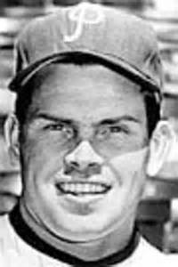

1955 -- On the Field:
League Leaders in Pitching Wins:
Notes:
Robin Roberts of the Phillies won 23 games against 14 losses. He pitched 305 innings !
Whitey Ford was 18-7 with eighteen complete games. Bob Lemon of the Indians and Frank Sullivan of the Red Sox also won 18.

Slide 16
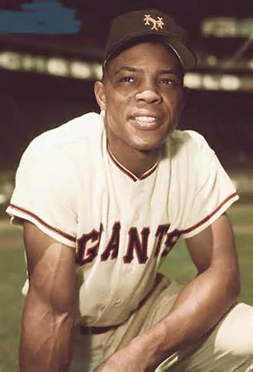
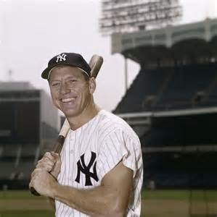
1955 – On the Field:
League Leaders in HR
Notes:
Willie Mays had 51 HRs, to go along with 127 RBI and a .319 batting average. He also led the NL in triples (13) and SLG (.659)
Mickey Mantle hit 37 homers to lead the AL. He also led the league in triples, walks, and SLG.

Slide 17
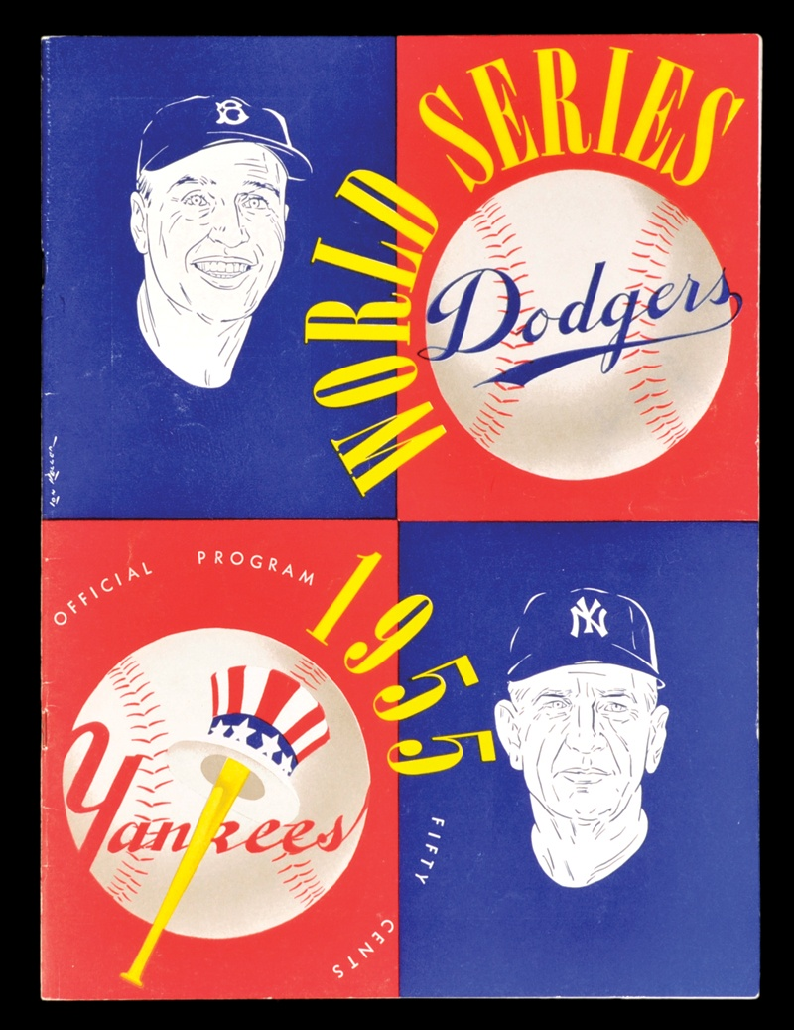
1955 World Series

Slide 18




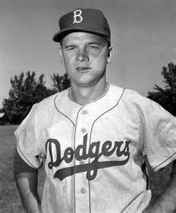



1955 World Series
Dodgers Game 7
Starting Line-up
Jim Gilliam LF
Roy Campanella C
Don Hoak 3B
Pee Wee Reese SS
Carl Furillo RF
Don Zimmer 2B
Duke Snider CF
Gil Hodges 1B
Johnny Podres P

Slide 19








1955 World Series
Yankees Game 7
Starting Line-up
Phil Rizzuto SS
Yogi Berra C
Bob Cerv CF
Elston Howard LF
Billy Martin 2B
Hank Bauer RF
Gil McDougald 3B
Moose Skowron 1B
Tommy Byrne P

Slide 20
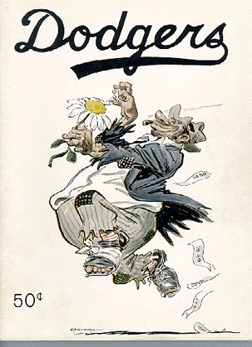
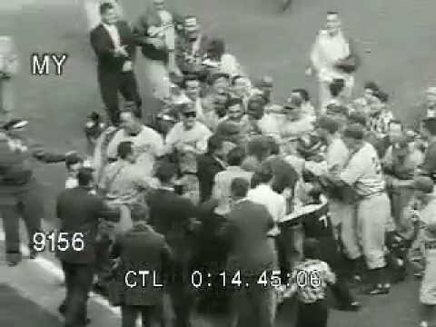

1955 World Series
Game 7 was played Tuesday, October 4 at Yankee Stadium
https://www.youtube.com/watch?v=Lyb6zXboIjY
Notes:
The Brooklyn Dodgers and New York Yankees faced off in the 1955 World Series. The Series came down to game 7 at Yankee Stadium. Here’s what happened …

