Slide 1
The Year in Baseball: 1960

Slide 2
1960 -- Off the Field:
Presidential and VP candidates
Notes:
Kennedy (Mass.) and LBJ (Tex) running for the Democrats – emphasizing “New Leadership” . VP Nixon (California) and Henry Cabot Lodge (Mass.) running for the Republicans, stressing “Experience”. With allegations of dead people voting in Chicago and cattle voting in Texas, JFK won in a very close contest.

Slide 3
1960 -- Off the Field:
Cars !!
77% of all U.S. families owned a car
15% owned two or more cars

Slide 4
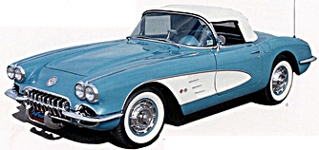
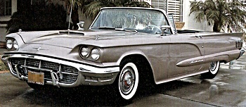
1960 -- Off the Field:
Popular Sports Cars
Chevy Corvette
Ford Thunderbird
Notes:
Base manufacturer’s suggested retail price for the ’60 Corvette was $3,872 !! $102 extra for “deluxe heater” and $147 extra for AM/FM radio.

Slide 5
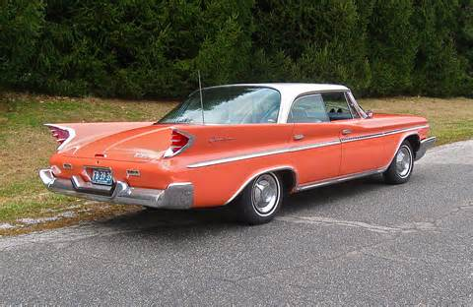
1960 -- Off the Field:
Big cars …
Check out those fins !
Cadillac Coupe de Ville
Chrysler DeSoto

Slide 6
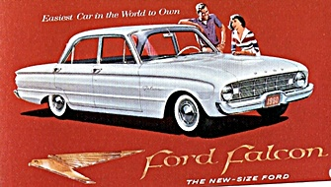
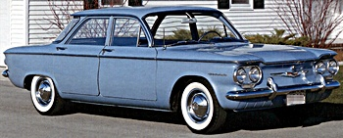
1960 -- Off the Field:
Small cars …
New models that were introduced in ‘60
Chevy Corvair
Ford Falcon
Notes:
The Chevy Corvair had an aluminum block, air-cooled engine. It was generally considered a “lemon”. The Ford Falcon was introduced and it was a top-seller. The Falcon’s chassis was used as the base for the Ford Mustang when it was introduced a few years later.

Slide 7
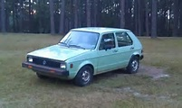
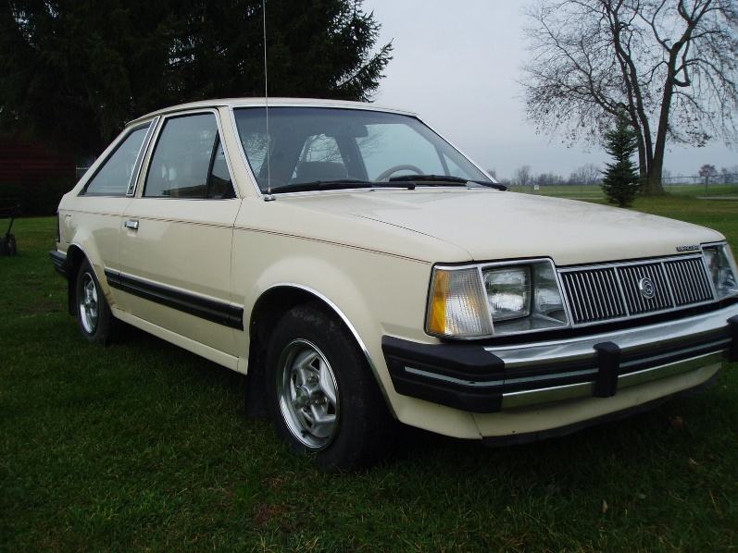
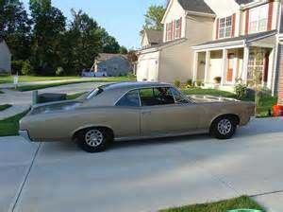
1960 -- Off the Field:
Cars !!
What was your first – or favorite – car ?
Notes:
Ira – 1980 VW Rabbit; Monte – 1966 Pontiac Tempest; Mike McN – 1984 Mercury Lynx

Slide 8
1960 – Off the Field
Rock & Roll
This song topped the charts
and started a new dance
craze …
https://www.youtube.com/watch?v=pHGXwQeUk7M
Notes:
Ernest Evans had the top hit song of 1960 … we know him by his stage name “Chubby Checker”.

Slide 9
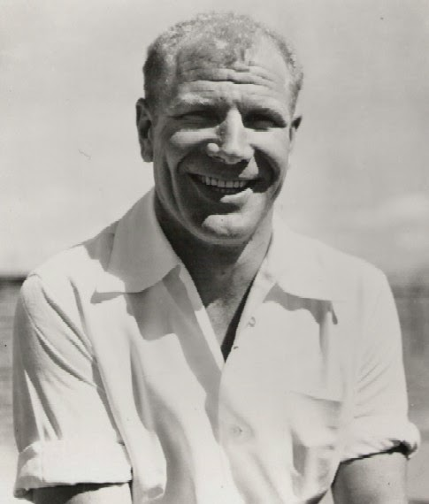
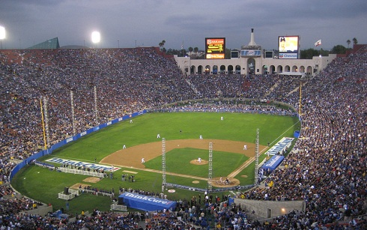
1960 -- On the Field: Some Highlights
Set a new all-time NL attendance record of 2,253,887 here
Put players’ names on White Sox uniforms
Notes:
Maverick owner Bill Veeck put players’ names on the back of uniforms. The Dodgers set an NL attendance record playing in the LA Coliseum.

Slide 10
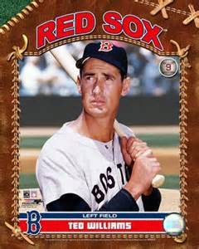
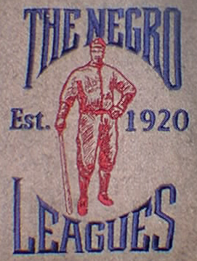
1960 -- On the Field: Some Highlights
The Sporting News “Player of the Decade”
Last organized black pro league folded
Notes:
Ted Williams was named Player of the Decade (the ‘50s) by The Sporting News. The Negro American League folded, although some teams played on as barn-stormers. The Indianapolis Clowns continued playing into the 1980s.

Slide 11
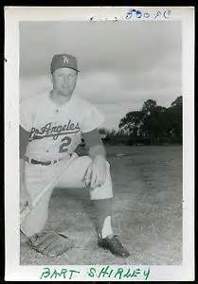
1960 -- On the Field: Spring Baseball
University of Texas Longhorns baseball – 19-3 overall, SWC champs at 13-2
Other All-SWC players: Jay Arnette, OF Tom Belcher, P Bob Callaway, P Wayne McDonald, OF Roy Menge, OF
Bibb Falk – head coach
Bart Shirley - SS
Notes:
Bibb Falk was head coach at UT Baseball from 1940 – 67, missing ‘43-45 war years. Bart Shirley played parts of 4 seasons for Dodgers & Mets. Arnette – 4 seasons in Dodgers minors. Belcher – 3 seasons in Mets minors. McDonald played 4 seasons in Milwaukee minors, the last two for Austin Senators in Texas League. Menge played 2 seasons for Milwaukee in minors.

Slide 12
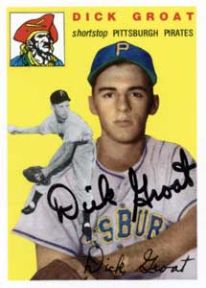
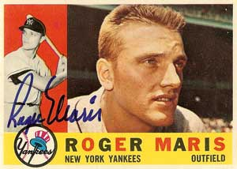
1960 -- On the Field:
League Most Valuable Players:
.283 batting avg, 39 HR, led AL with 112 RBI
led NL with .325 batting avg.

Slide 13
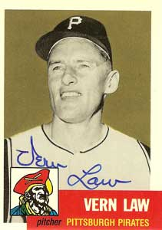
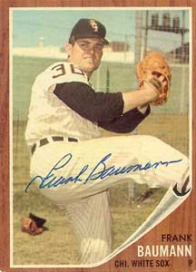
1960 -- On the Field:
League Pitching Leaders:
20-9 with 3.08 ERA in 271 innings
Cy Young Award (only one winner for all MLB)
13-6 with 2.67 ERA in 185 innings

Slide 14
1960 – On the Field:
League Leaders in HR
Ernie Banks – 41 HR
Mickey Mantle – 40 HR
Notes:
Mickey Mantle hit 37 homers to lead the AL. He also led the league in triples, walks, and SLG.

Slide 15
1960 -- On the Field: Final Regular Season Standings
1960 National League Team Standings
Team | Wins | Losses |  | GB
Pittsburgh | 95 | 59 |  | 0
Milwaukee | 88 | 66 |  | 7
St. Louis | 86 | 68 |  | 9
Los Angeles | 82 | 72 |  | 13
San Francisco | 79 | 75 |  | 16
Cincinnati | 67 | 87 |  | 28
Chicago | 60 | 94 |  | 35
Philadelphia | 59 | 95 |  | 36
1960 American League Team Standings
Team | Wins | Losses |  | GB
New York | 97 | 57 |  | 0
Baltimore | 89 | 65 |  | 8
Chicago | 87 | 67 |  | 10
Cleveland | 76 | 78 |  | 21
Washington | 73 | 81 |  | 24
Detroit | 71 | 83 |  | 26
Boston | 64 | 89 |  | 32
Kansas City | 58 | 96 |  | 39

Slide 16
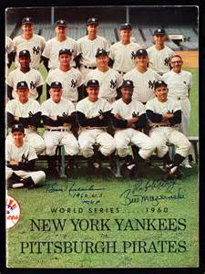
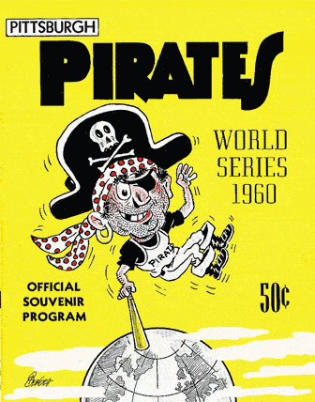
1960 World Series
vs.

Slide 17
1960 World Series
Game 7 starting lineup
New York Yankees
Bobby Richardson 2B
Mickey Mantle CF
Johnny Blanchard C
Tony Kubek SS
Yogi Berra LF
Clete Boyer 3B
Roger Maris RF
Moose Skowron 1B
Bob Turley P

Slide 18
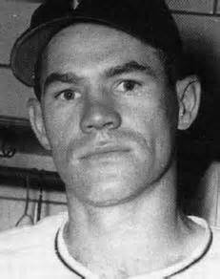
1960 World Series
Game 7 starting lineup
Pittsburgh Pirates
Rocky Nelson 1B
Don Hoak 3B
Bill Virdon CF
Roberto Clemente RF
Dick Groat SS
Bill Mazeroski 2B
Bob Skinner LF
Smoky Burgess C
Vern Law P

Slide 19
1960 World Series
Game 7 was played Thursday October 13 at Forbes Field
https://www.youtube.com/watch?v=65Og0gUKfvc

