Slide 1
The Year in Baseball: 1962

Slide 2
1962 -- Off the Field:
On January 1, 1962 – Decca Records held two auditions at their studios in West Hampstead, England.

Slide 3
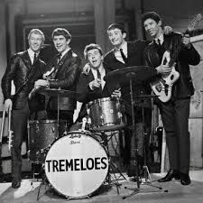
1962 -- Off the Field:
Decca Records opted to sign The Tremeloes to a contract. The other group was rejected because “guitar groups were on the way out”.

Slide 4
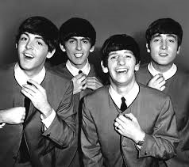
1962 -- Off the Field:
The group they rejected was The Beatles.

Slide 5
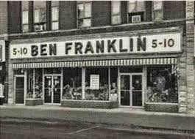
1962 -- Off the Field:
After his new marketing concept was rejected by Ben Franklin Stores, their most successful franchisee in Arkansas, Oklahoma and Missouri opened his own store in 1962.

Slide 6
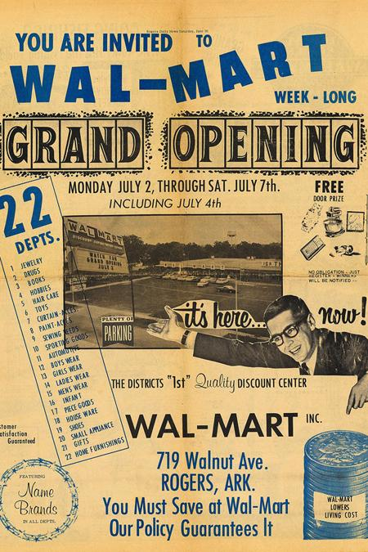
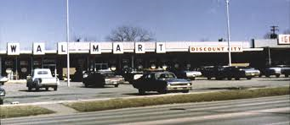
1962 -- Off the Field:
Sam Walton opened his first Wal-Mart on July 2, 1962 in Rogers, Arkansas

Slide 7
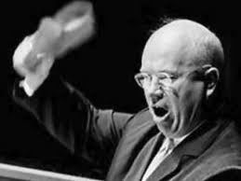
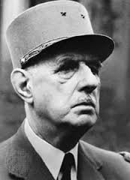
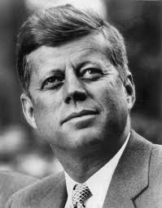
1962 -- Off the Field:
World Leaders

Slide 8
1962 -- Off the Field:
Nikita Krushchev
Soviet Union
Charles De Gaulle
France
John F. Kennedy
USA
World Leaders

Slide 9
1962 – Off the Field
Rock & Roll
This song set a record as the only song to reach number 1 in two different chart runs (1960 and 1962)
https://www.youtube.com/watch?v=pHGXwQeUk7M
Notes:
Ernest Evans had the top hit song of 1960 … we know him by his stage name “Chubby Checker”.

Slide 10
1962 – Off the Field
Rock & Roll
The #1 Song for 1962 was by this guy. Who is it? What was the name of his hit single?

Slide 11
1962 – Off the Field
Rock & Roll
Mr. Acker Bilk
“Stranger on the Shore”
https://www.youtube.com/watch?v=7jzx664u5DA

Slide 12
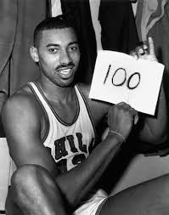
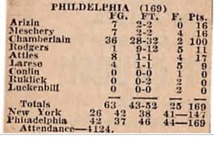
1962 -- Off the Field: Wilt Chamberlain Scores 100 points

Slide 13
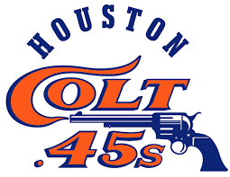
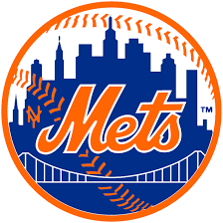
1962 -- On the Field: NL Expansion

Slide 14
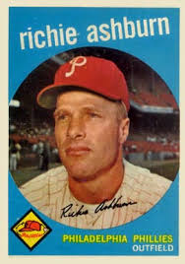
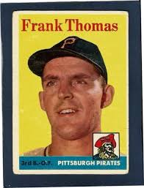
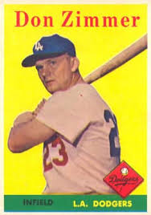
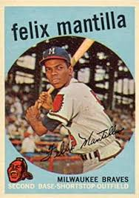
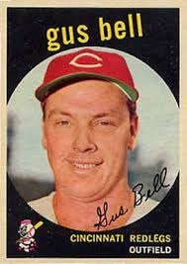
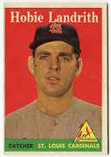
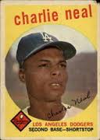
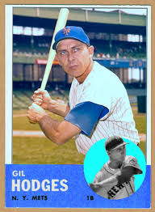
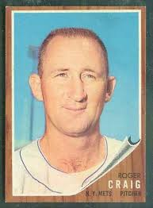
1962 Mets
Richie Ashburn CF
Frank Thomas LF
Don Zimmer 3B
Felix Mantilla SS
Gus Bell RF
Hobie Landrith C
Charlie Neal 2B
Gil Hodges 1B
Roger Craig P

Slide 15
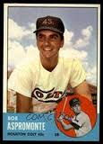
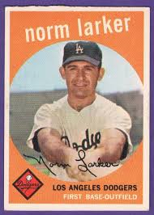
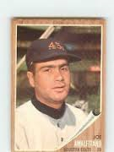
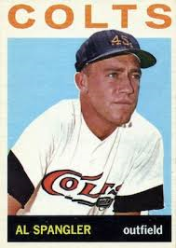
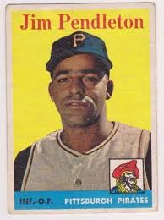
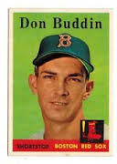
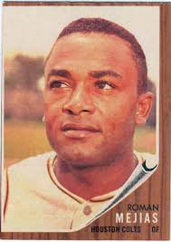
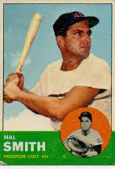
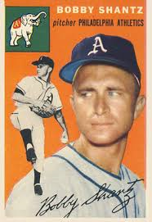
1962 Colt 45s
Bob Aspromonte 3B
Norm Larker 1B
Joe Amalfitano 2B
Al Spangler LF
Jim Pendleton RF
Don Buddin SS
Roman Mejias RF
Hal Smith C
Bobby Shantz P

Slide 16
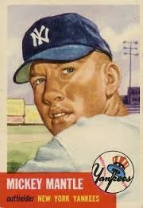
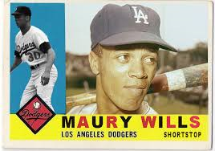
1962 -- On the Field:
League Most Valuable Players:
.299 batting avg., ML record 104 stolen bases
.321 batting avg. with 30 home runs

Slide 17
1962 – On the Field:
League Leaders in HR
Willie Mays– 49 HR
Harmon Killebrew– 48 HR
Notes:
Mickey Mantle hit 37 homers to lead the AL. He also led the league in triples, walks, and SLG.

Slide 18
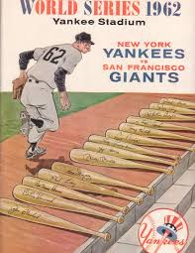
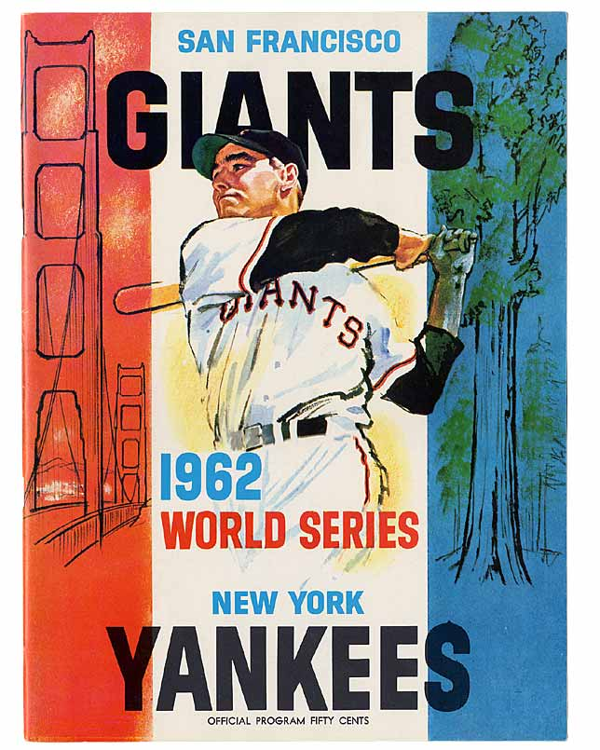
1962 World Series
vs.
Yankees beat the Giants in Game 7 (1-0) with Ralph Terry on the mound

Slide 19
