Slide 1
The Year in Baseball:
1965

Slide 2
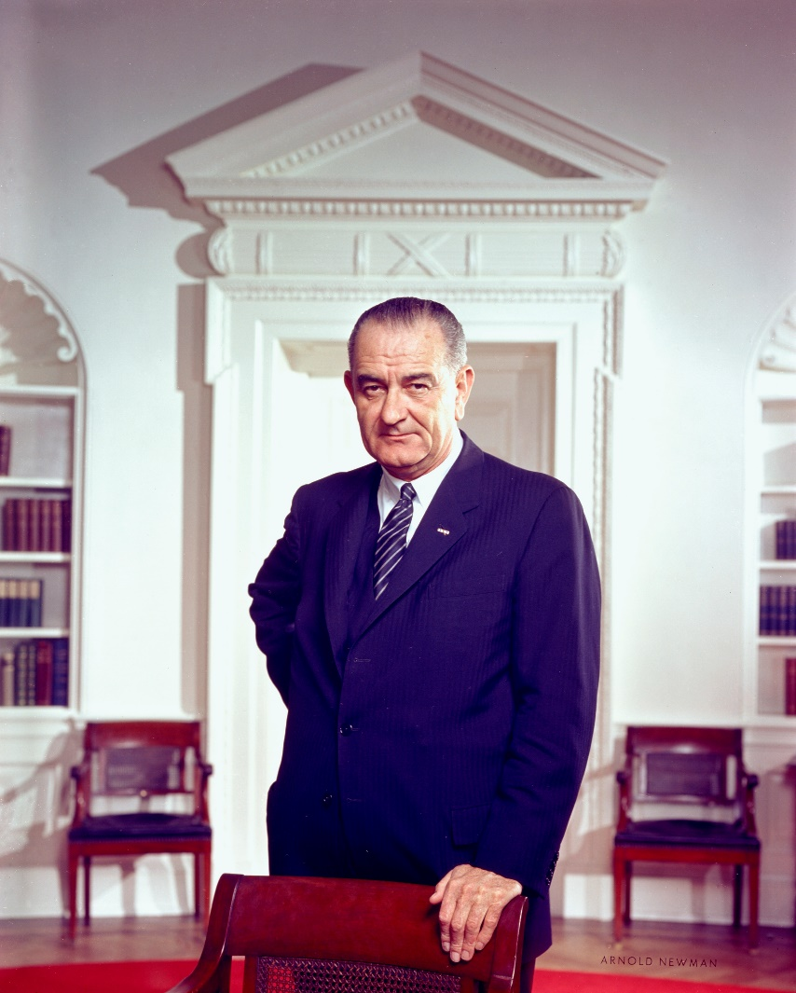
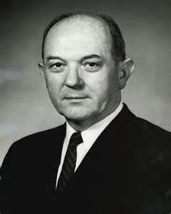
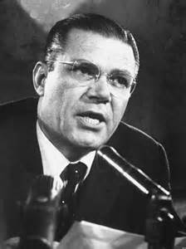
1965 -- Off the Field:
President Secty. of State Secty. of Defense
Notes:
LBJ – had just won a landslide re-election in November, 1964 over Barry Goldwater. Had championed the Civil Rights Act in ‘64 and would push the Voting Rights Bill in ‘65. Dean Rusk was a Kennedy appointee and is one of the longest-serving US Secty of State (behind Cordell Hull). Robert McNamara was president of Ford Motor Co. and was also a Kennedy appointee. He was also one of the longest-serving US Secty of Defense.

Slide 3

1965 -- Off the Field:
Technology … now and then …
Music – Now -- you can take your tunes everywhere.
iPod
Play 40 hours of music on a full charge.

Slide 4
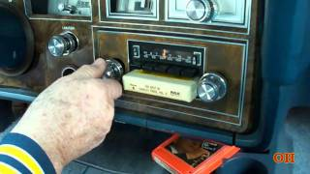
1965 -- Off the Field:
Technology … now and then …
Music – in ‘65, you could take your tunes with you … sort of …
8-track
Played 40 minutes of music
per cartridge … about enough
to store a 33rpm LP album.

Slide 5
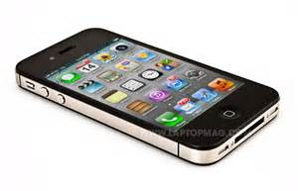
1965 -- Off the Field:
Technology … now and then …
Telephone – Now – you can make a call, access the internet and take pictures & videos from your smart-phone
iPhone

Slide 6
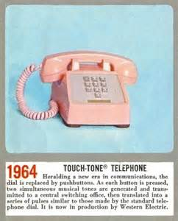
1965 -- Off the Field:
Technology … now and then …
Telephone – in ‘65 – you could make calls by pushbutton.
Western
Electric
Touch-tone

Slide 7

1965 -- Off the Field:
Technology … now and then …
Computing – Now – you can carry your processing power with you and connect via Wi-Fi to the ‘net
iPad

Slide 8
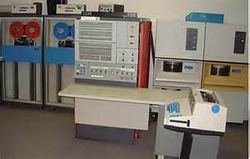
1965 -- Off the Field:
Technology … now and then …
Computing – in ‘65 – the latest and greatest ….
IBM
System/360
Model 30

Slide 9
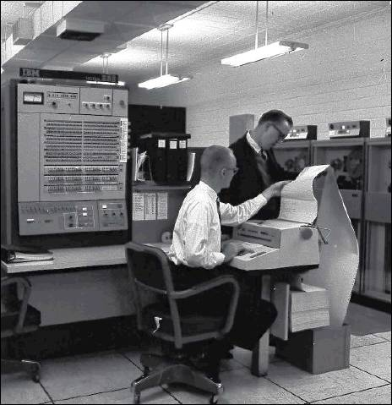
1965
Off the Field:
Technology … now and then …
Computing
IBM plans to open
new facility in Austin

Slide 10
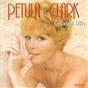
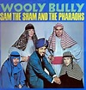
1965 – Off the Field
These recording artists had top selling songs in ‘65:
https://www.youtube.com/watch?v=reSSvOnQEr8
https://www.youtube.com/watch?v=wpjDcmgHCd4

Slide 11
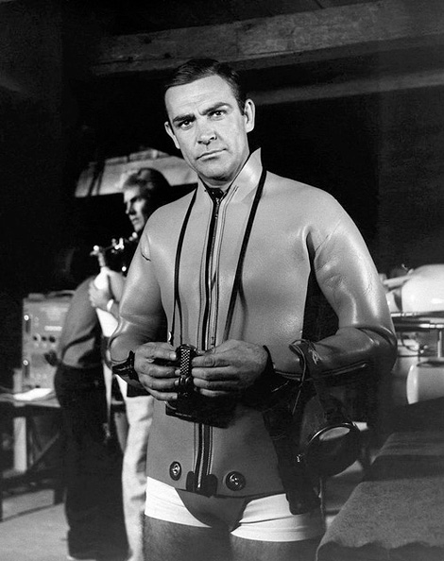
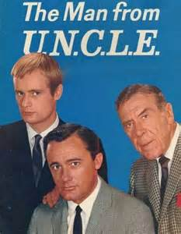
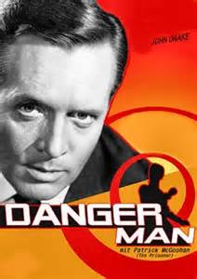

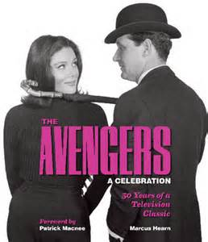
1965 -- Off the Field:
The spies have it at the movies and on TV:
“Thunderball”
was #2 at the box office

Slide 12



1965 -- On the Field:
Some Highlights
Played all nine positions in
a single game
Hit his 400th home run
Hit his 500th home run
And, on April 9th, with President Johnson and Governor Connally in attendance, …
Notes:
Dagoberto “Bert” Campaneris became first player in modern era to play all nine positions in a single game (A’s vs. Angels) – A’s lost 5-3 in 13 innings. Ernie Banks hit his 400th home run in a game at Wrigley Field. Willie Mays hit #500 in a game against Houston; at the time he was only the fifth player to reach 500 career homers (can you name the others? (Ruth, Foxx, Williams, Ott). Today there are 27 players in the 500-HR club. Houston P Don Nottebart gave up #500 to Mays.

Slide 13
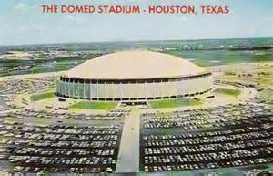
1965 -- On the Field:
the Astrodome opened !

Slide 14


1965 -- On the Field:
League Most Valuable Players:
led NL with 52 HR, 350 TB
led AL with 126 runs, 45 doubles, 12 triples, 308 TB

Slide 15


1965 -- On the Field:
League Pitching Leaders:
Sandy Koufax
26 – 8 2.05 ERA 335 IP 382 K perfect game
Cy Young Award (only one winner for all MLB)
Jim “Mudcat” Grant
21 – 7 6 shutouts

Slide 16


1965 – On the Field:
League Leaders in Batting Average
Roberto Clemente .329
Tony Oliva .321
Notes:
Mickey Mantle hit 37 homers to lead the AL. He also led the league in triples, walks, and SLG.

Slide 17
1965 -- On the Field:
Final Regular Season Standings
1965 National League Team Standings
Team | Wins | Losses |  | GB
Dodgers | 97 | 65 |  | 0
Giants | 95 | 67 |  | 2
Pirates | 90 | 72 |  | 7
Reds | 89 | 73 |  | 8
Braves | 86 | 76 |  | 11
Phillies | 85 | 76 |  | 11 1/2
Cardinals | 80 | 81 |  | 16 1/2
Cubs | 72 | 90 |  | 25
Astros | 65 | 97 |  | 32
Mets | 50 | 112 |  | 47
1965 American League Team Standings
Team | Wins | Losses |  | GB
Twins | 102 | 60 |  | 0
White Sox | 95 | 67 |  | 7
Orioles | 94 | 68 |  | 8
Tigers | 89 | 73 |  | 13
Indians | 87 | 75 |  | 15
Yankees | 77 | 85 |  | 25
Angels | 75 | 87 |  | 27
Senators | 70 | 92 |  | 32
Red Sox | 62 | 100 |  | 40
Athletics | 59 | 103 |  | 43

Slide 18
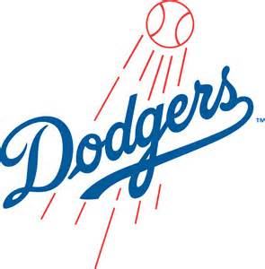
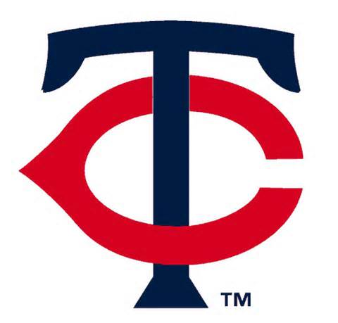
1965 World Series
vs.
Game 1 is played October 6 at
Metropolitan Stadium in Minneapolis, Minn.

Slide 19







1965 World Series – key Dodgers
Maury Wills
Ron Fairly
Wes Parker
Don Drysdale
Sandy Koufax
Claude Osteen
Notes:
Mickey Mantle hit 37 homers to lead the AL. He also led the league in triples, walks, and SLG.

Slide 20


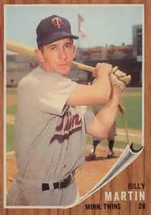


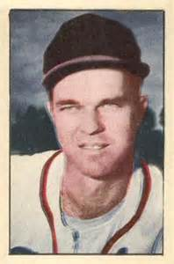
1965 World Series – key Twins
3B Coach
Zoilo Versalles
Tony Oliva
Harmon Killebrew
Pitching
Coach
Jim “Mudcat” Grant
Jim Kaat
Camilo Pasqual
Notes:
Mickey Mantle hit 37 homers to lead the AL. He also led the league in triples, walks, and SLG.

Slide 21
1965 World Series
vs.
https://www.youtube.com/watch?v=vNWwWm7i4bo
Notes:
Why didn’t Sandy Koufax start Game 1 ??

