Slide 1
The Year in Baseball:
1969

Slide 2
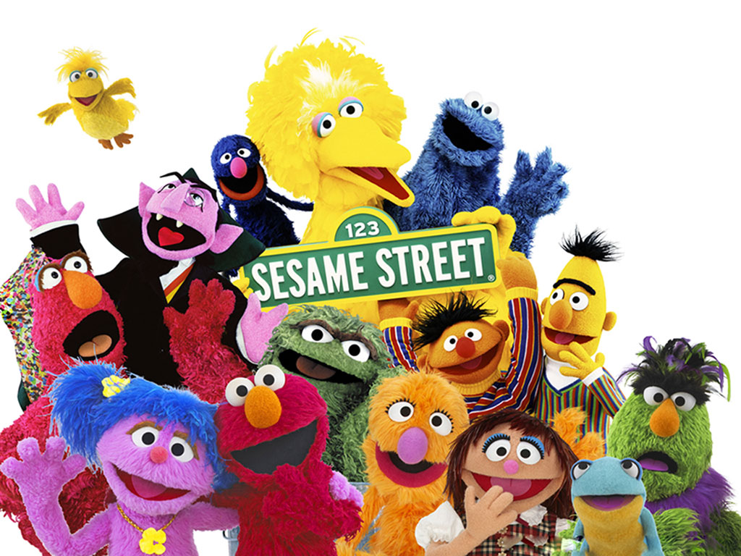
1969 – Sesame Street debuted

Slide 3
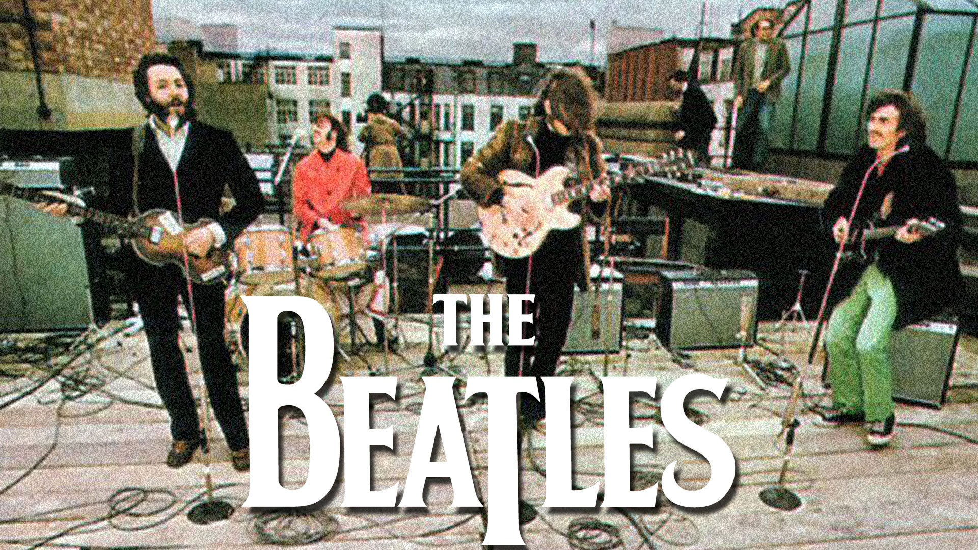
The Beatles’ last performance together:

Slide 4
1969 -- Off the Field:
Popular Music
An Aquarian Exposition ?

Slide 5
1969 -- Off the Field:
Popular Music
An Aquarian Exposition ?
Held in White Lake, New York ?

Slide 6
1969 -- Off the Field:
Popular Music
An Aquarian Exposition ?
Held in White Lake, New York ?
On Max Yasgur’s dairy farm ?

Slide 7
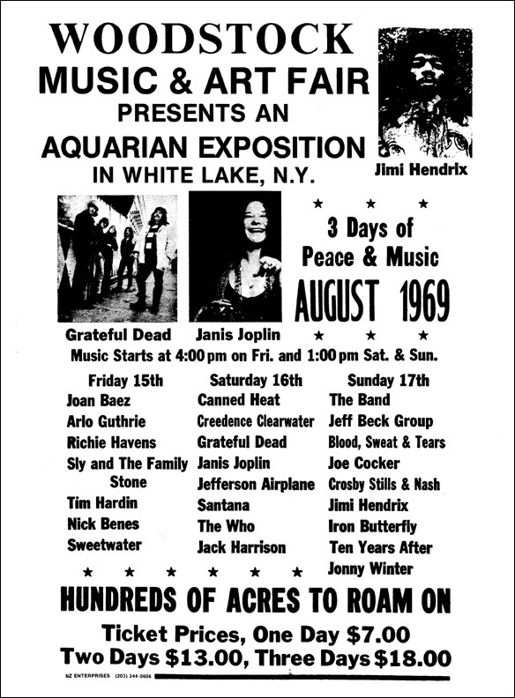
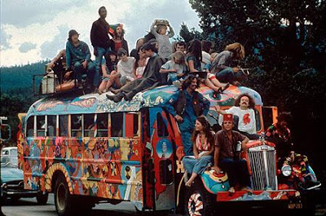
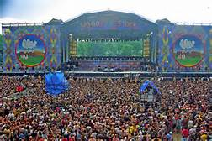
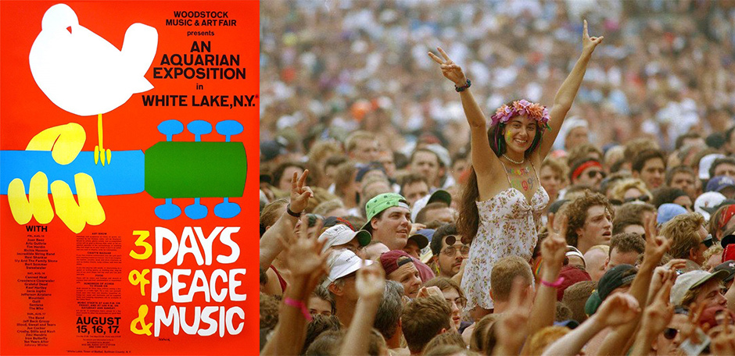
Woodstock

Slide 8
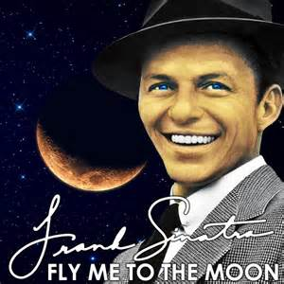
1969 – Popular Music:
https://www.youtube.com/watch?v=5hxibHJOE5E
This song was a hit (again) in ‘69
Notes:
This song was written in 1954 and performed by many artists, but Frank Sinatra’s rendition from 1964 is the best known. It had another big upswing in popularity in 1969…

Slide 9
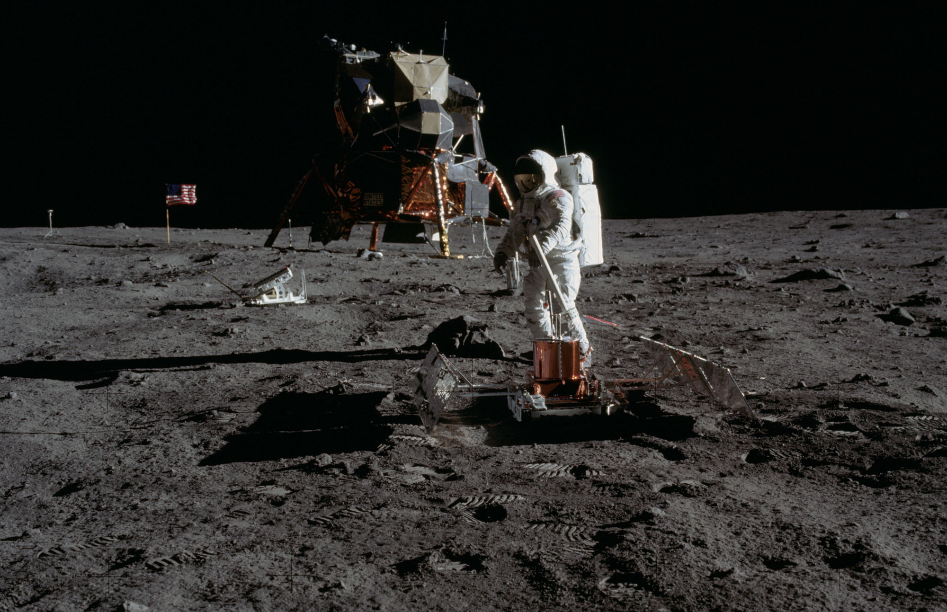
1969 – Way Off the Field:
July 20
Apollo 11
lands on the
Moon
https://www.youtube.com/watch?v=sTBIr65cL_E

Slide 10
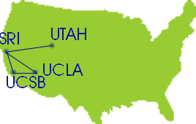
1969 – Technology
What does this represent ?

Slide 11
1969 – Technology
ARPANET – the grand-daddy of the Internet
Notes:
ARPAnet – this is what the “Internet” looked like in 1969 – the first transmissions were made among computers at these universities on October 29, 1969

Slide 12
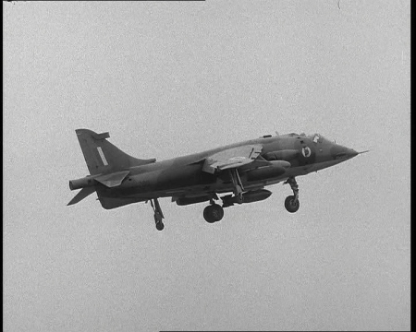
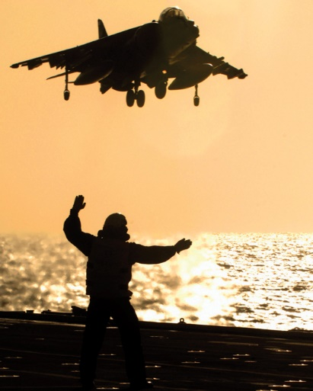
1969 – Technology
The “jump-jet”
(Hawker Harrier)
went into service
with the RAF in
April

Slide 13
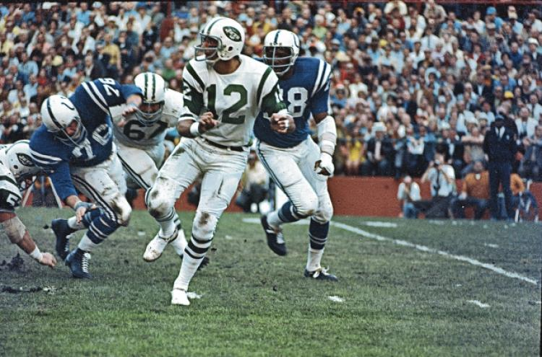
1969 -- On the Field:
NFL-AFL Championship Game III – the Super Bowl
“Broadway Joe” Namath and the AFL champ New York Jets upset the NFL’s Baltimore Colts 16-7
Notes:
This was the first NFL-AFL championship game to be called the “Super Bowl”, and first won by an AFL team – played at the Orange Bowl on January 12th.

Slide 14
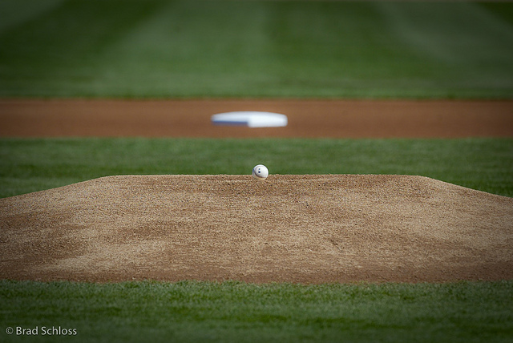
1969 -- On the Field:
Height of Pitcher’s Mound reduced
1968 – 15 inches max.
1969 - 10 inches max.

Slide 15
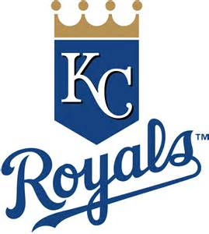
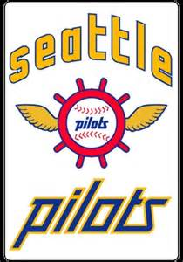
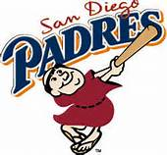
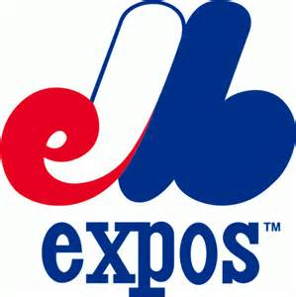
1969 -- On the Field:
Major League baseball added
four new teams and
began the era of
“Division Play”

Slide 16
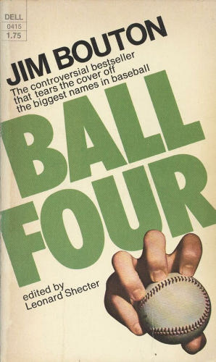
1969 – On and off the Field
“Ball Four” is based on Jim Bouton’s 1969 season with the Seattle Pilots
and Houston Astros.
Some quotes:
“Baseball players are smarter than football players. How often do you see
a baseball team penalized for too many men on the field?”
“It never hurts to apologize, especially when you don’t mean it.”
“I can still remember Pete Rose on the dugout steps screaming at me,
‘F*** you, Shakespeare’ ”
“Never forget Doubleday’s First Law of Baseball – if you throw a fastball
with insufficient speed, someone will smack it out of the park with a
stick.”
“A ballplayer spends a good piece of his life gripping a baseball, and in the
end it turns out it was the other way around all the time.”

Slide 17



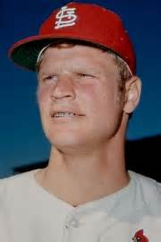
1969 -- On the Field:
Appeared in first Major League game
Announced his retirement
at age 37
“ If it stays fair …
home run!! ”
Designated Hebrew
Bob Gibson said of this pitcher and
Steve Carlton, “With their 500 wins we
might have won a few more pennants …”
Notes:
Micky Mantle, Carlton Fisk, Ron Blomberg, Jerry Reuss

Slide 18


1969 -- On the Field:
League Most Valuable Players:
Willie McCovey
45 HR, 126 RBI
Harmon Killebrew
49 HR, 140 RBI

Slide 19



1969 -- On the Field:
Cy Young Award Winners:
Tom Seaver
25 – 7 2.21 ERA
Mike Cuellar
23 – 11 2.38 ERA
Denny McLain
24 – 9 2.80 ERA
Notes:
Had a tie in Cy Young voting in the AL. First and only time there were three Cy Young winners! Made a change to voting procedures in 1970 to prevent in future.

Slide 20
1969 -- On the Field:
Final Regular Season Standings
1969 National League Team Standings
East | Wins | Losses |  | GB
** Mets ** | 100 | 62 |  | -
Cubs | 92 | 70 |  | 8
Pirates | 88 | 74 |  | 12
Cardinals | 87 | 75 |  | 13
Phillies | 63 | 99 |  | 37
Expos | 52 | 110 |  | 48
West | Wins | Losses |  | GB
** Braves ** | 93 | 69 |  | -
Giants | 90 | 72 |  | 3
Reds | 89 | 73 |  | 4
Dodgers | 85 | 77 |  | 8
Astros | 81 | 81 |  | 12
Giants | 52 | 110 |  | 41
1969 American League Team Standings
East | Wins | Losses |  | GB
** Orioles ** | 109 | 53 |  | -
Tigers | 90 | 72 |  | 19
Red Sox | 87 | 75 |  | 22
Senators | 86 | 76 |  | 23
Yankees | 80 | 81 |  | 28 1/2
Indians | 62 | 99 |  | 46 1/2
West | Wins | Losses |  | GB
** Twins ** | 97 | 65 |  | -
Athletics | 88 | 74 |  | 9
Angels | 71 | 91 |  | 26
Royals | 69 | 93 |  | 28
White Sox | 68 | 94 |  | 29
Pilots | 64 | 98 |  | 33

Slide 21
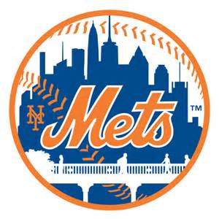
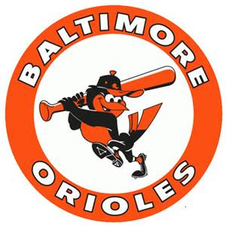
1969 World Series
The Mets and the Orioles both swept their LCS series
and advanced to the World Series.
“The Miracle Mets” vs. “The Lumber Company”

Slide 22
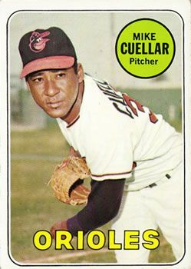
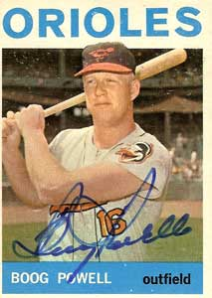
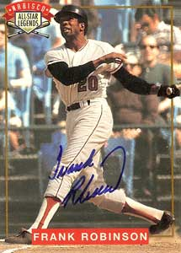


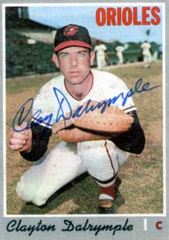

1969 World Series – key Orioles
Maury Wills
Ron Fairly
Wes Parker
Mgr. Earl Weaver
Don Drysdale
Sandy Koufax
Claude Osteen
Notes:
Mickey Mantle hit 37 homers to lead the AL. He also led the league in triples, walks, and SLG.

Slide 23
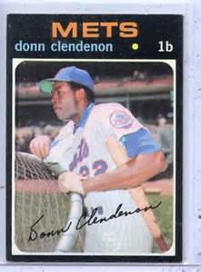

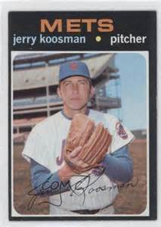
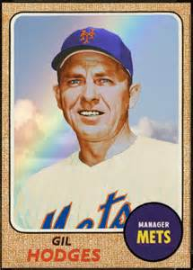
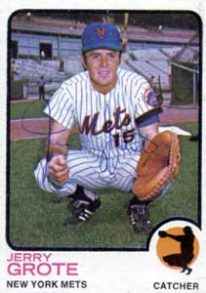
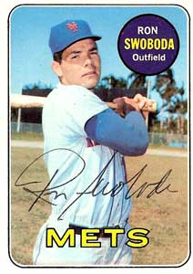
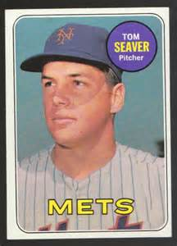
1969 World Series – key Mets
Tony Oliva
Camilo Pasqual
Notes:
Mickey Mantle hit 37 homers to lead the AL. He also led the league in triples, walks, and SLG.

Slide 24
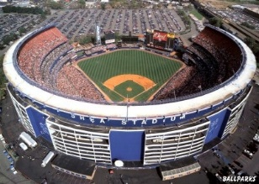
1969 World Series
Games 3,4,5 – Shea Stadium
https://www.youtube.com/watch?v=k2DRdoM7tmU

